Slide 1


Slide 2

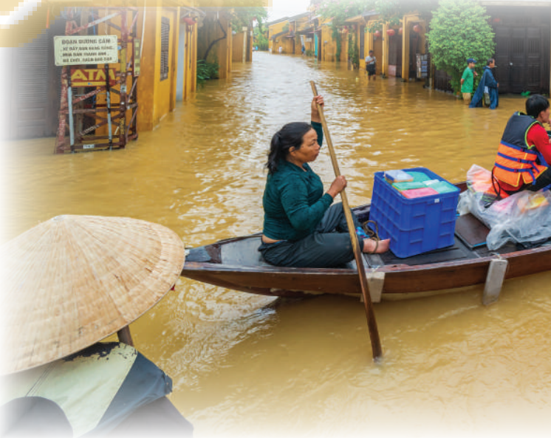
Unit
9
NATURAL DISASTERS
Unit
ETHNIC GROUPS OF VIET NAM
LESSON 1: GETTING STARTED
We are all safe!
Unit

Slide 3

OBJECTIVES
OBJECTIVES
By the end of the lesson, students will be able to:
Gain an overview about the topic Natural disasters.
Gain vocabulary to talk about Natural disasters.

Slide 4
LESSON 1: GETTING STARTED
LESSON 1: GETTING STARTED
Network
WARM-UP
Vocabulary
Listen and read.
PRESENTATION
Task 1: Read the conversation again. Complete each sentence with no more than TWO words from it.
Task 2: Write the natural disasters from the box under the pictures. Then listen, check, and repeat.
Task 3: Choose the correct answer to complete each sentence.
PRACTICE
PRODUCTION
Task 4: Work in groups. Complete the web with all of the words and phrases related to natural disasters you know.
CONSOLIDATION
Wrap-up
Homework

Slide 5
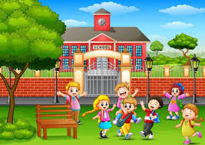
LESSON 1: GETTING STARTED
WARM-UP
Network
Aims of the stage:
to create an active atmosphere in the class before the lesson.
to introduce the topic.

Slide 6

WARM-UP: NETWORK
Flood
Drought
Earthquake
Natural disasters
Tidal wave
Acid rain
Typhoon
Snow storm

Slide 7

LESSON 1: GETTING STARTED
Network
WARM-UP
Vocabulary
Listen and read.
PRESENTATION
Aims of the stage:
to provide students with vocabulary
to help students well-prepared for the listening and reading tasks

Slide 8

PRESENTATION: VOCABULARY
Damage (n,v)
/ˈdæmɪdʒ/
Thiệt hại, gây tổn hại

Slide 9

PRESENTATION: VOCABULARY
Funnel (n)
/ˈfʌnəl/
Cái phễu

Slide 10
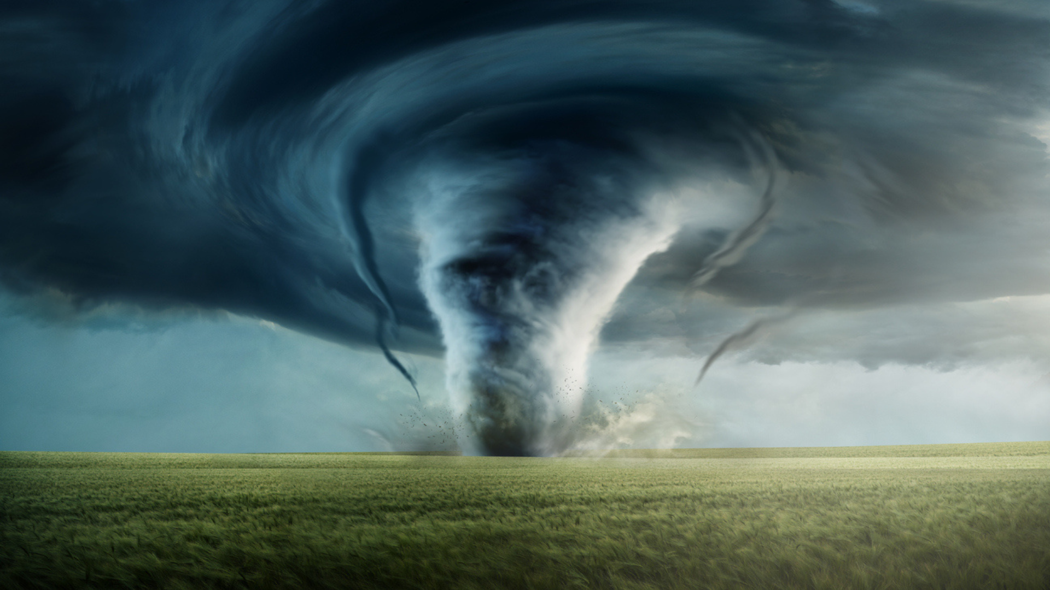
PRESENTATION: VOCABULARY
Tornado (n)
/tɔːˈneɪdəʊ/
Lốc xoáy

Slide 11
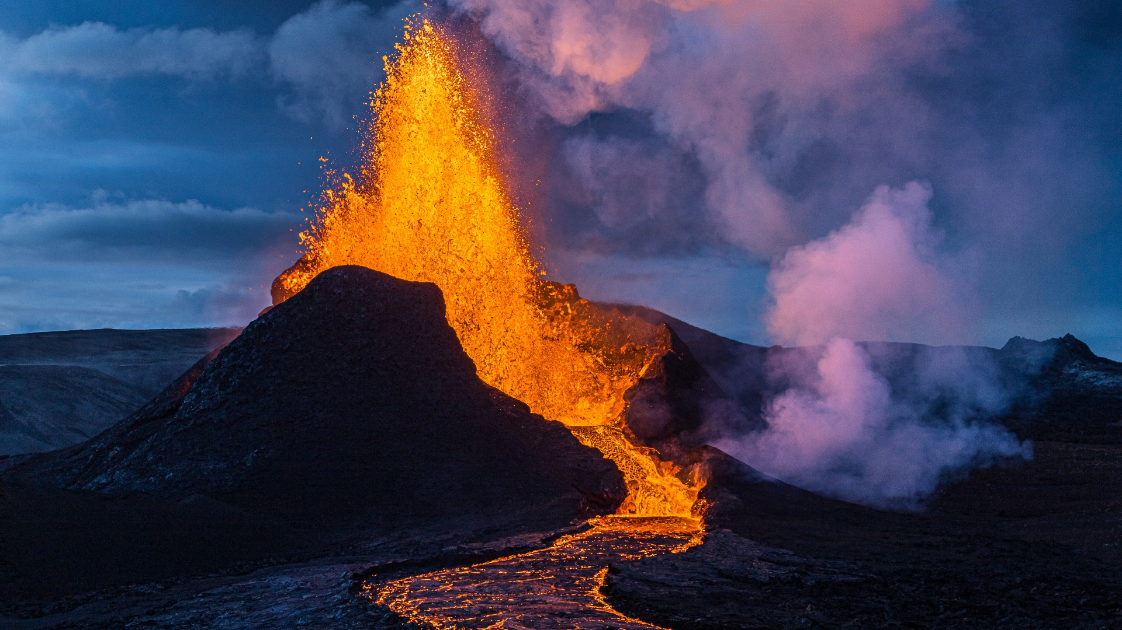
PRESENTATION: VOCABULARY
Eruption (n)
/ɪˈrʌpʃən/
Sự phun trào

Slide 12
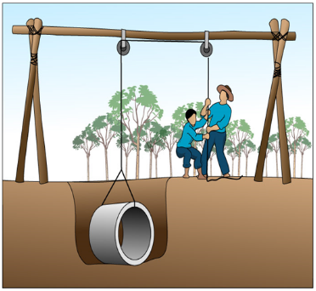
PRESENTATION: VOCABULARY
Pull up
/pʊl ʌp/
Kéo lên, nhổ lên, lôi lên

Slide 13
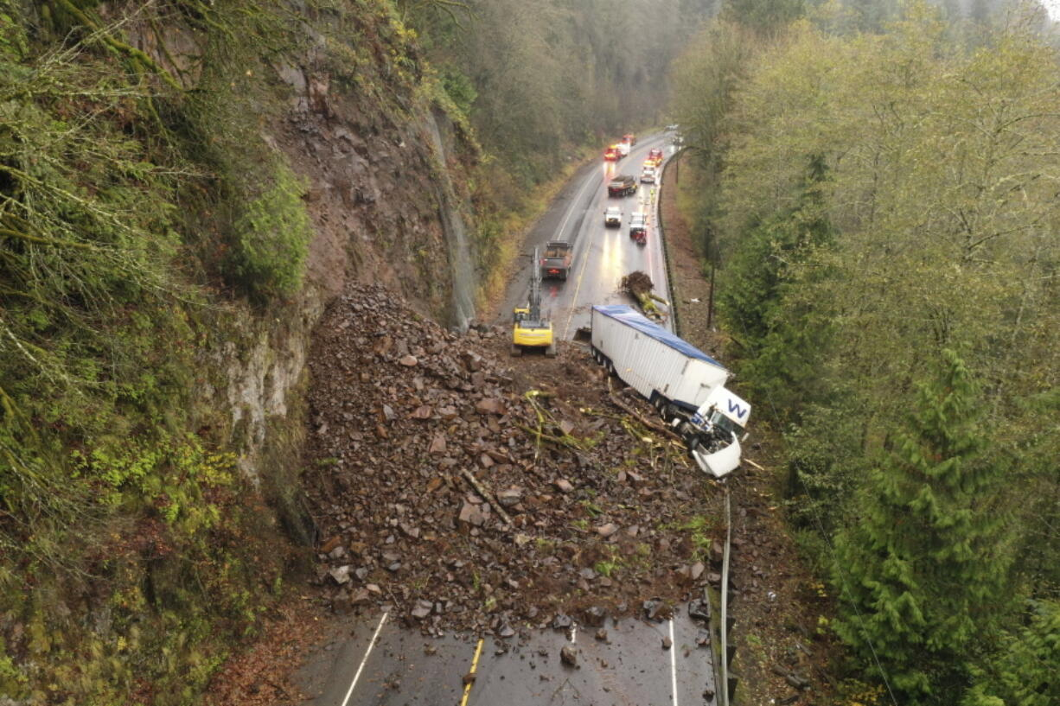
PRESENTATION: VOCABULARY
Landslide(n)
/ˈlændslaɪd/
Vụ sạt lở

Slide 14
PRESENTATION: VOCABULARY
Form | Pronunciation | Vietnamese equivalent
1. Damage (n,v) | /ˈdæmɪdʒ/ | Thiệt hại, gây tổn hại
2. Funnel (n) | /ˈfʌnəl/ | Cái phễu
3. Tornado (n) | /tɔːˈneɪdəʊ/ | Lốc xoáy
4. Eruption (n) | /ɪˈrʌpʃən/ | Sự phun trào
5. Pull up | /pʊl ʌp/ | Kéo lên, nhổ lên, lôi lên
6. Landslide (n) | /ˈlændslaɪd/ | Vụ sạt lở

Slide 15
PRESENTATION: VOCABULARY
Form |  | Vietnamese equivalent
1. Damage (n,v) |  | Lốc xoáy
2. Funnel (n) |  | Sự phun trào
3. Tornado (n) |  | Thiệt hại, gây tổn hại
4. Eruption (n) |  | Cái phễu
5. Pull up |  | Vụ sạt lở
6. Landslide (n) |  | Kéo lên, nhổ lên, lôi lên

Slide 16
PRESENTATION: LISTEN AND READ
Aim of the task:
to have students get to know the topic

Slide 17
PRESENTATION: LISTEN AND READ
- What can you see in the picture?
- What natural disaster is it?

Slide 18

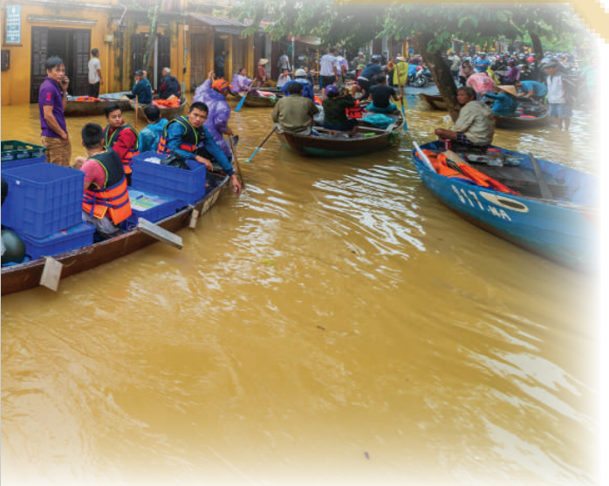
PRESENTATION: LISTEN AND READ.
Tom: You look pretty sad, Mi. What’s the matter?
Mi: My uncle called us this morning. Our home town has been affected by a flood. It’s the second time this year.
Tom: I’m sorry to hear that. How are things there now?
Mi: My uncle, his wife, and his children are all safe. They moved everything to the second floor of their house last night. Are there natural disasters in your home town in the US?
Tom: Yes, we sometimes have tornadoes.
Mi: Tornadoes? Sounds strange. What’s a tornado?
Tom: It’s a violent storm that moves in a circle with very strong winds. I still remember the tornado we had last year.
Mi: What happened?
Tom: One evening my parents and I were having dinner. Suddenly we heard a very loud noise. When we looked out of the window, we saw a big funnel of wind moving towards us.
Mi: Did it cause any damage?
Tom: Yes, a lot. It damaged the roof of our house and pulled up some trees in our yard. Fortunately, no one was hurt.

Slide 19
LESSON 1: GETTING STARTED
LESSON 1: GETTING STARTED
Network
WARM-UP
Vocabulary
Listen and read.
PRESENTATION
Task 1: Read the conversation again. Complete each sentence with no more than TWO words from it.
Task 2: Write the natural disasters from the box under the pictures. Then listen, check, and repeat.
Task 3: Choose the correct answer to complete each sentence.
Task 4: Work in groups. Complete the web with all of the words and phrases related to natural disasters you know.
PRACTICE

Slide 20
PRACTICE
1
Read the conversation again. Complete each sentence with no more than TWO words from it.
There is a _____ in Mi’s home town.
Her uncle’s family had to move everything to the ___________ last night.
A tornado is an example of a _______________.
Tom’s family ___________ dinner when the tornado came.
The tornado damaged their roof and _______ up some trees in their yard.
flood
second floor
natural disaster
were having
pulled

Slide 21
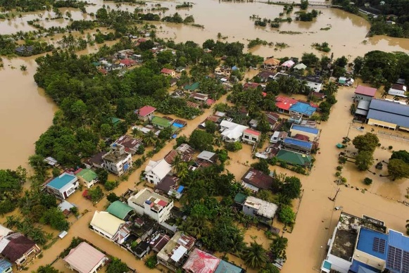
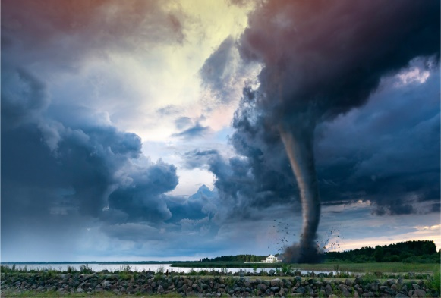
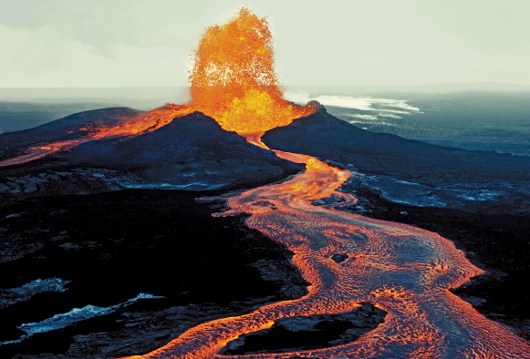
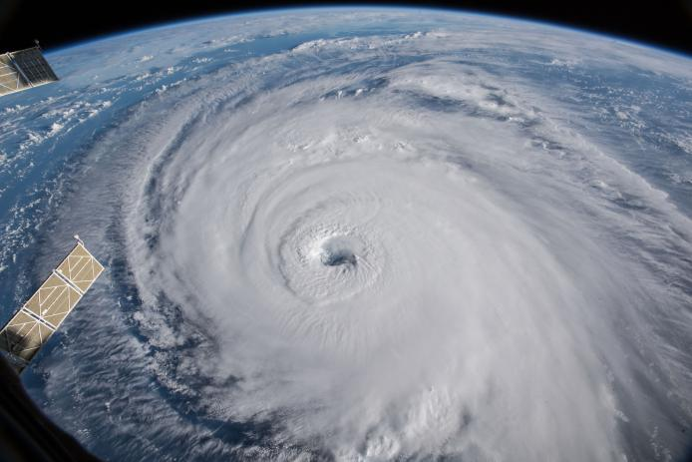
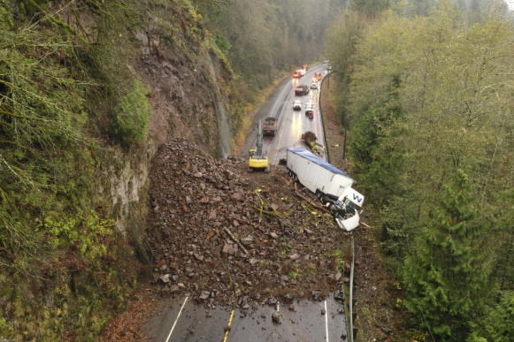
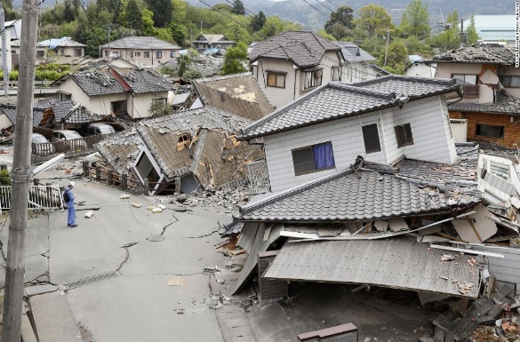
PRACTICE
2
Write the natural disasters from the box under the pictures. Then listen, check, and repeat.
volcanic eruption
earthquake
landslide
storm
tornado
flood
1. ………………………....
2. ………………………....
3. ………………………....
4. ………………………....
5. ………………………....
6. …………………………..

Slide 22
PRACTICE
3
Choose the correct answer to complete each sentence.
1. When there is a(n) earthquake / volcanic eruption, hot gases and liquid rock pour out from a mountain.
2. Oh, the house is shaking! I think we’re having a(n) earthquake / flood.
3. We wanted to travel to Ha Giang, but there was a tornado / landslide. Some big rocks and mud came down the mountains.
4. Every year more than ten floods / storms with strong winds and rain cause damage in our country.
5. A tornado / storm looks like a huge funnel and causes a lot of damage. Its strong winds can reach 480 km per hour.

Slide 23
LESSON 1: GETTING STARTED
LESSON 1: GETTING STARTED
Network
WARM-UP
Vocabulary
Listen and read.
PRESENTATION
Task 1: Read the conversation again. Complete each sentence with no more than TWO words from it.
Task 2: Write the natural disasters from the box under the pictures. Then listen, check, and repeat.
Task 3: Choose the correct answer to complete each sentence.
PRACTICE
PRODUCTION
Task 4: Work in groups. Complete the web with all of the words and phrases related to natural disasters you know.

Slide 24
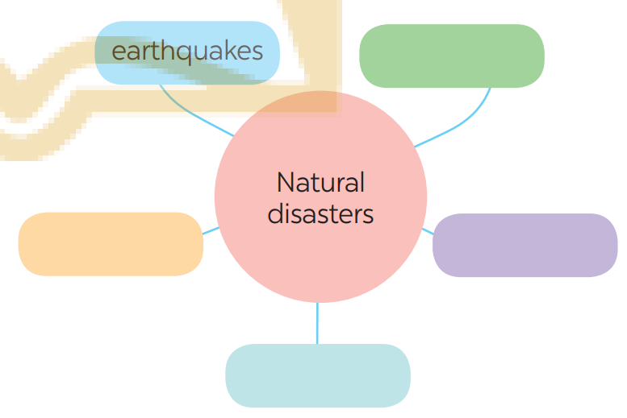
PRODUCTION
4
Work in groups. Complete the web with all of the words and phrases related to natural disasters you know.

Slide 25
LESSON 1: GETTING STARTED
LESSON 1: GETTING STARTED
Network
WARM-UP
Vocabulary
Listen and read.
PRESENTATION
Task 1: Read the conversation again. Complete each sentence with no more than TWO words from it.
Task 2: Write the natural disasters from the box under the pictures. Then listen, check, and repeat.
Task 3: Choose the correct answer to complete each sentence.
PRACTICE
PRODUCTION
Task 4: Work in groups. Complete the web with all of the words and phrases related to natural disasters you know.
CONSOLIDATION
Wrap-up
Homework

Slide 26
CONSOLIDATION
1
WRAP-UP
About natural disasters
Vocabulary
Topic of the unit
NATURAL DISASTERS

Slide 27

CONSOLIDATION
2
HOMEWORK
- Learn by heart all the words that you have just learnt.
- Do exercises in the workbook.
- Prepare for Lesson 2 - A closer look 1

Slide 28

Website: hoclieu.vn
Fanpage: facebook.com/sachmem.vn/

