Slide 1
Hello everyone !!!

Slide 2
Rule:
WARM-UP
I.N.I.T.I.A.L GAME
Work in 2 teams.
Look at 9 pictures.
Find the word for each picture, then take the first letter from each picture to form the mystery word.
Which team finds the mystery word first will become the winner.

Slide 3
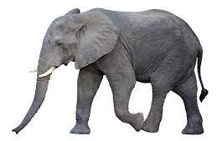
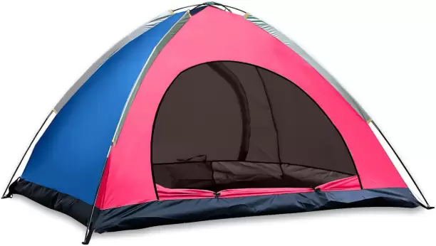
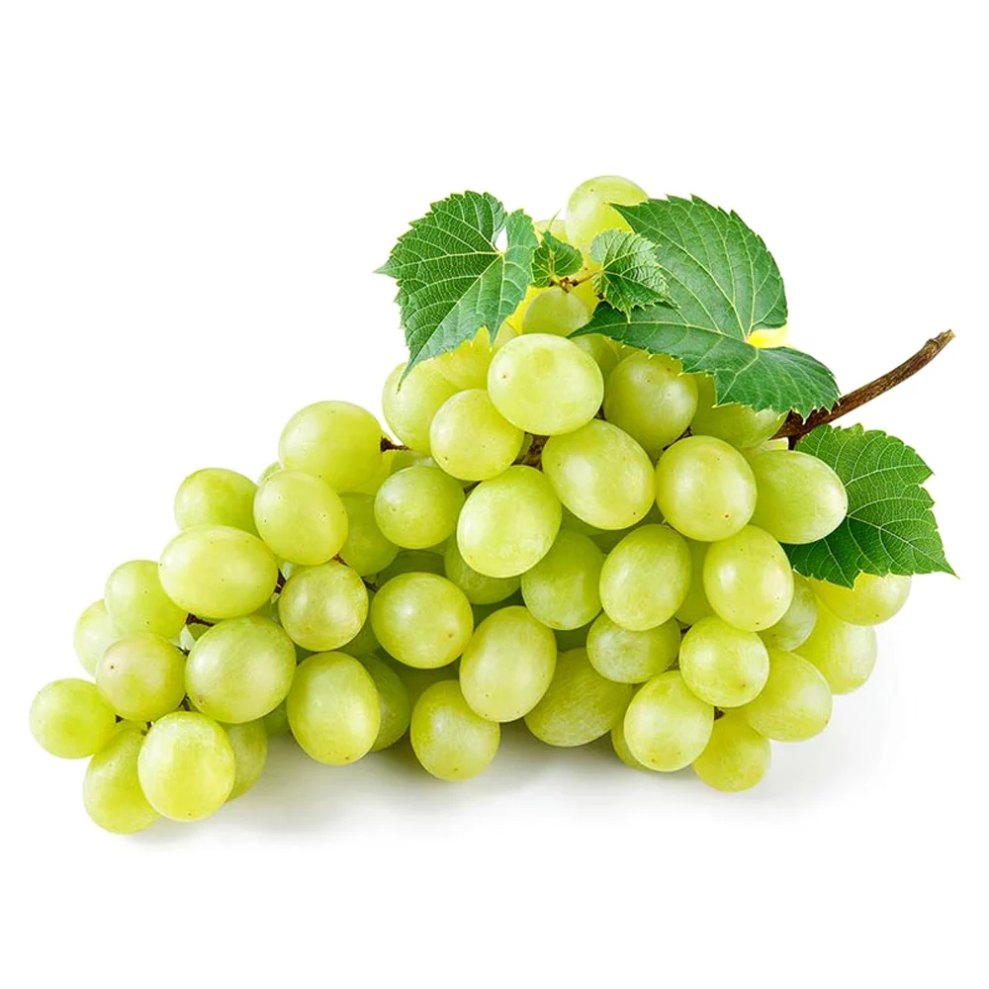
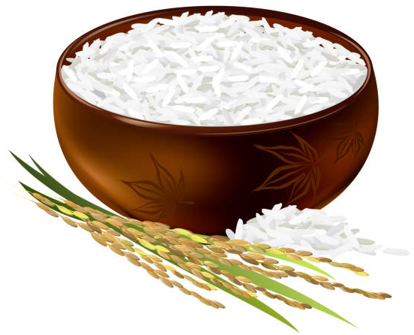
WARM-UP
I.N.I.T.I.A.L GAME
Tent
Eggs
Elephant
Nose
Apple
Grapes
Eagle
Rice
Sunflower

Slide 5
Unit
3
TEENAGERS
LESSON 1: GETTING STARTED
It’s great to see you again!

Slide 6
* VOCABULARY
forum (n):
diễn đàn
/ˈfɔːrəm/

Slide 7
stress (n):
sự căng thẳng
/ˌstres/

Slide 8
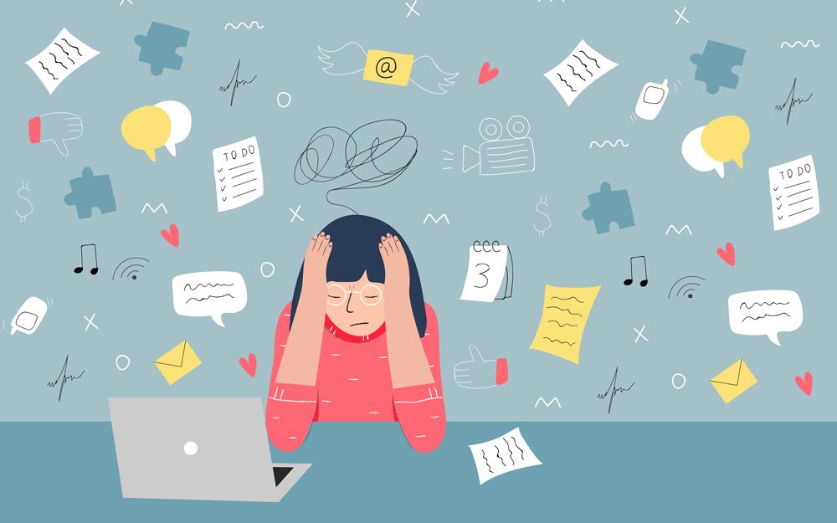
stressful (adj):
căng thẳng, tạo áp lực
/ˈstresfl/

Slide 9
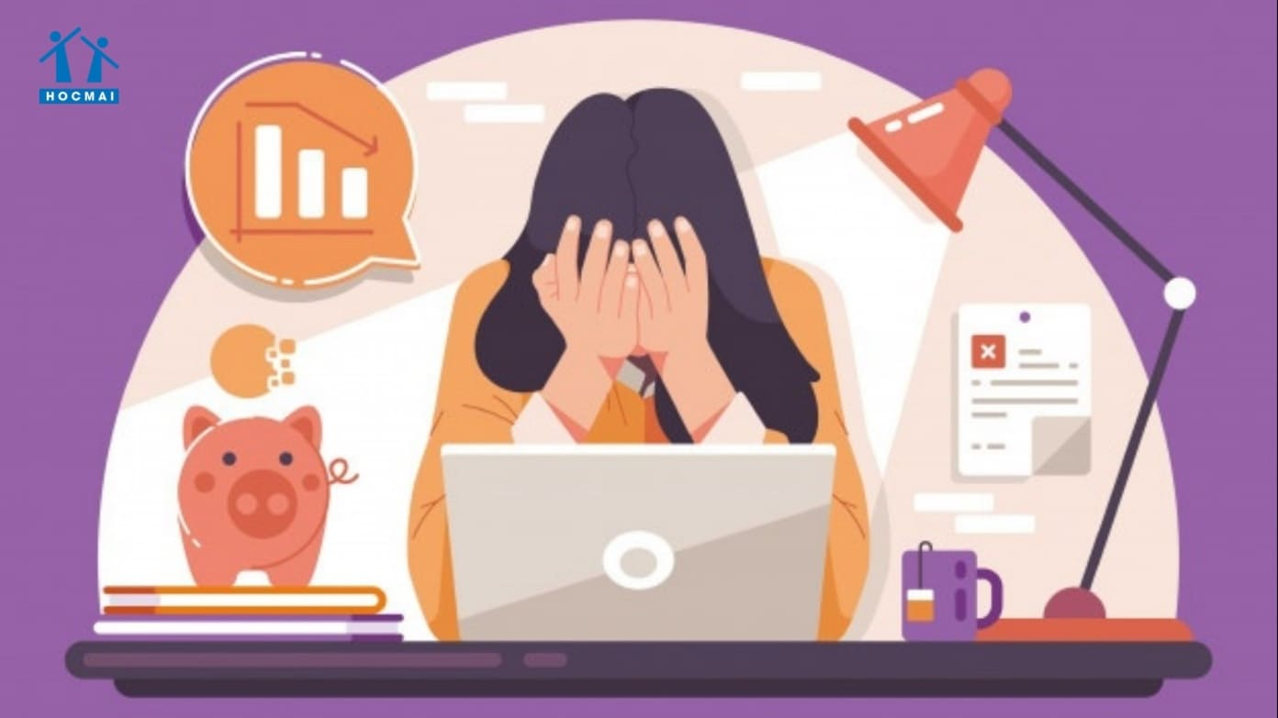
pressure (n):
áp lực
/ˈpreʃə(r)/

Slide 10
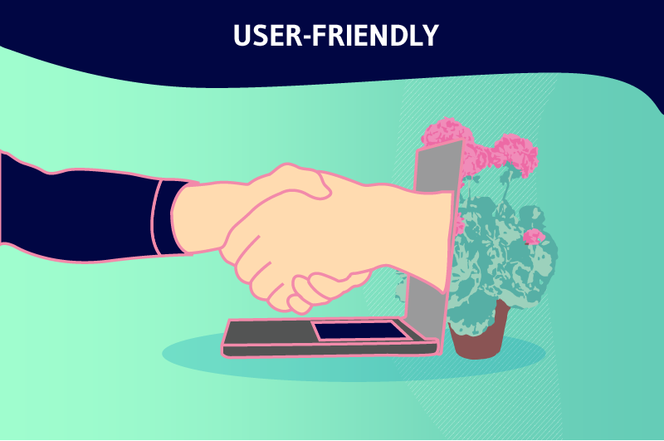
user-friendly (adj) :
thân thiện với người dùng
/ˈjuːzə-ˈfrendli/

Slide 11
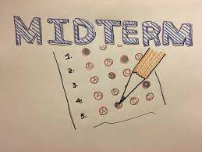
midterm (adj):
giữa kì
/ˌmɪdˈtɜːm/

Slide 12
* VOCABULARY
New words | Pronunciation | Meaning
1. forum (n) | /ˈfɔːrəm/ | diễn đàn
2. stress (n) | /stres/ | sự căng thẳng
3. stressful (adj) | /ˈstresfl/ | căng thẳng, tạo áp lực
4. pressure (n) | /ˈpreʃə(r)/ | áp lực
5. user-friendly (adj) | /ˌjuːzə ˈfrendli/ | thân thiện với người dùng, dễ dùng
6. midterm (adj) | /ˌmɪdˈtɜːm/ | giữa kì

Slide 13
* Checking vocab
Say words in English
diễn đàn
forum
Giữa kì
midterm
thân thiện với người dùng
user-friendly
stressful
căng thẳng, tạo áp lực
sự căng thẳng
stress
áp lực
pressure

Slide 14
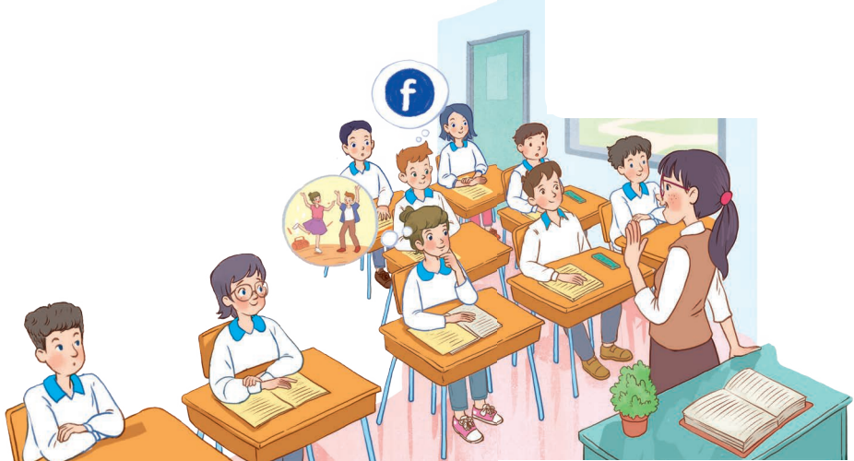
1. READ AND LISTEN
Look at the picture in the book and answer the questions:
- Who are the people?
- What might they be talking about?

Slide 15
1
Listen and read.
Teacher: It’s great to see you again, class. What’s going on? Minh: We’ve decided to use Facebook for our class forum, and we joined some school club activities. We’re also preparing for the midterm tests. It’s really stressful. Teacher: I’m sorry to hear that. I know exams may give you a lot of stress. But stay calm and work hard. What other pressure do you have? Minh: Well, we also have pressure from our parents and friends. Teacher: Do you? Let’s discuss these problems in your new Facebook group. By the way, why did you choose Facebook? Ann: Because it’s user-friendly. Teacher: Good! How about club activities? Do you find them enjoyable? Ann: Yes. This year there are some new clubs like arts and crafts, and music. The club leaders will provide us with a variety of activities to suit different interests. And there will also be competitions as usual. Teacher: Awesome! I hope you all can join the clubs you like.

Slide 16
1
Listen and read.
Teacher: It’s great to see you again, class. What’s going on? Minh: We’ve decided to use Facebook for our class forum, and we joined some school club activities. We’re also preparing for the midterm tests. It’s really stressful. Teacher: I’m sorry to hear that. I know exams may give you a lot of stress. But stay calm and work hard. What other pressure do you have? Minh: Well, we also have pressure from our parents and friends. Teacher: Do you? Let’s discuss these problems in your new Facebook group. By the way, why did you choose Facebook? Ann: Because it’s user-friendly. Teacher: Good! How about club activities? Do you find them enjoyable? Ann: Yes. This year there are some new clubs like arts and crafts, and music. The club leaders will provide us with a variety of activities to suit different interests. And there will also be competitions as usual. Teacher: Awesome! I hope you all can join the clubs you like.

Slide 17
2
Read the conversation again and write T (true) or F (False).
Sentences | T | F
1. The students finished their midterm tests
2. Minh mentions the different types of pressure they are facing.
3. The teacher tells them to stay calm and work hard.
4. The class will discuss their problems offline.
5. The school has different clubs for its students.
They are preparing for the midterm test.
The class will discuss their problems in their new Facebook group.

Slide 18
3
Write a word or phrases from the box under the correct pictures.
language club
pressure
1. _______________
2. _______________

Slide 19
3
Write a word or phrases from the box under the correct pictures.
arts and crafts club
forum
3. _______________
4. _______________

Slide 20
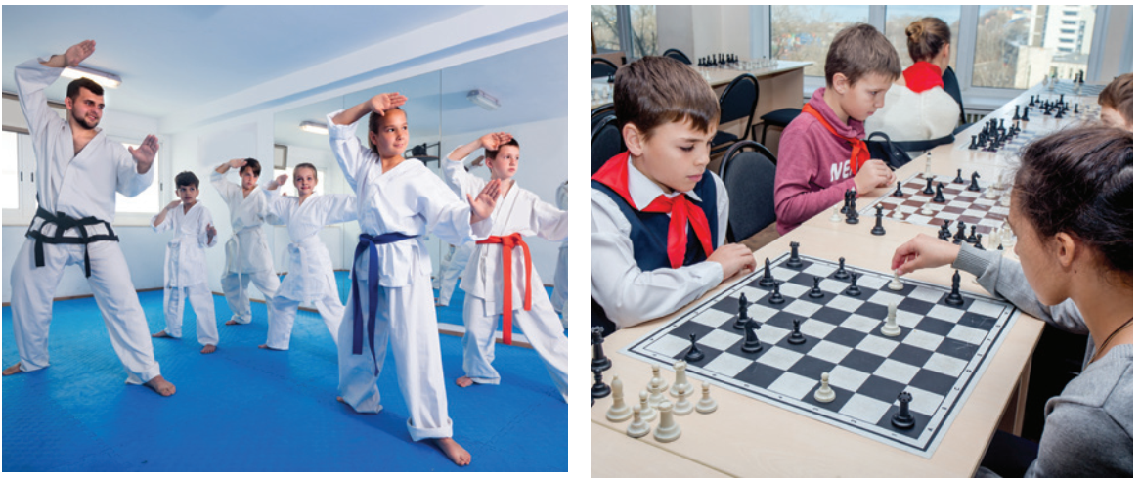
3
Write a word or phrases from the box under the correct pictures.
sports club
chess club
3. _______________
4. _______________

Slide 21
4
Complete each of the sentences with a word or phrase in 3. There is one extra word or phrase.
1. Minh is a member of our ______________. The greeting cards he makes are really creative.
2. Students can discuss their problems in their class ________.
3. We share the essays and stories that we write in English in our ______________.
4. She is not feeling very well this weekend because of all the _________
from her school work.
5. The coach of our ____________ tells us to drink plenty of water during our practice sessions.
Game

Slide 22
LUCKY NUMBERS
1
2
3
4
5
6
7
8
GA
2
4
6
8
10
12
14
GB
2
4
6
8
10
12
14

Slide 23
4
Complete each of the sentences with a word or phrase in 3. There is one extra word or phrase.
1. Minh is a member of our __________________. The greeting cards he makes are really creative.
arts and crafts club

Slide 24
4
Complete each of the sentences with a word or phrase in 3. There is one extra word or phrase.
2. Students can discuss their problems in their class ________.
forum

Slide 25
4
Complete each of the sentences with a word or phrase in 3. There is one extra word or phrase.
3. We share the essays and stories that we write in English in our ________________.
language club

Slide 26
4
Complete each of the sentences with a word or phrase in 3. There is one extra word or phrase.
4. She is not feeling very well this weekend because of all the
_________ from her school work.
pressure

Slide 27
4
Complete each of the sentences with a word or phrase in 3. There is one extra word or phrase.
5. The coach of our _____________ tells us to drink plenty of water during our practice sessions.
sports club

Slide 28
you get 2 plus points

Slide 29
you get 2 plus points

Slide 30
UNLUCKY NUMBER
You lose 2 points

Slide 31
4
Complete each of the sentences with a word or phrase in 3. There is one extra word or phrase.
1. Minh is a member of our __________________. The greeting cards he
makes are really creative.
2. Students can discuss their problems in their class ________.
3. We share the essays and stories that we write in English in our ________________.
4. She is not feeling very well this weekend because of all the _________
from her school work.
5. The coach of our _____________ tells us to drink plenty of water during our practice sessions.
arts and crafts club
forum
language club
pressure
sports club

Slide 32
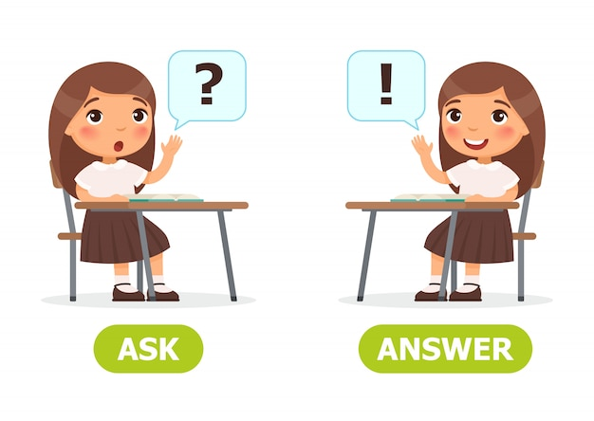
5
Work in pairs. Ask and answer the questions below. Report your friend’s answers to your class.
What types of social media do you use?
What kinds of pressure do you have?
What clubs do you participate in?
Why do you choose to participate in that club?

Slide 33
5
Work in pairs. Ask and answer the questions below.
Report your friend’s answers to your class.
What types of social media do you use?
I'm using Social Networks: Facebook; Instagram; Zalo; ...

Slide 34
5
Work in pairs. Ask and answer the questions below.
Report your friend’s answers to your class.
2. What kinds of pressure do you have?
I have pressure from my schoolwork, from my parents and also peer pressure.

Slide 35
5
Work in pairs. Ask and answer the questions below.
Report your friend’s answers to your class.
3. What clubs do you participate in?
I participate in chess club; sports club and English club.

Slide 36
5
Work in pairs. Ask and answer the questions below.
Report your friend’s answers to your class.
4. Why do you choose to participate in that club?
- I choose chess club because it improves my mental health.
- I choose English club because I will have a chance to practice EL

Slide 37
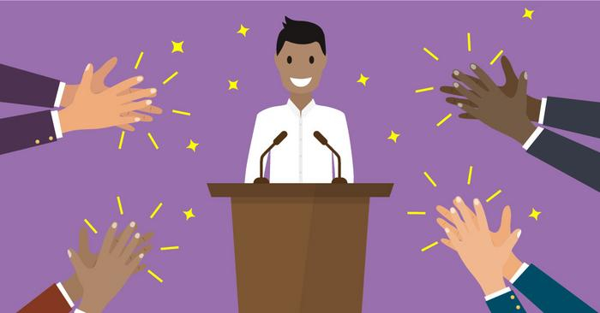
5
Report your friend’s answers to your class.
REPORTING
My friend, …, often use Facebook/ Instagram/ Zalo… to get information or keep in contact with her/his relationships.
…

Slide 38
*Homework
Name a list of school clubs and pressures.
Do exercises in the workbook.
Start preparing for the Project of the unit.

