Slide 3
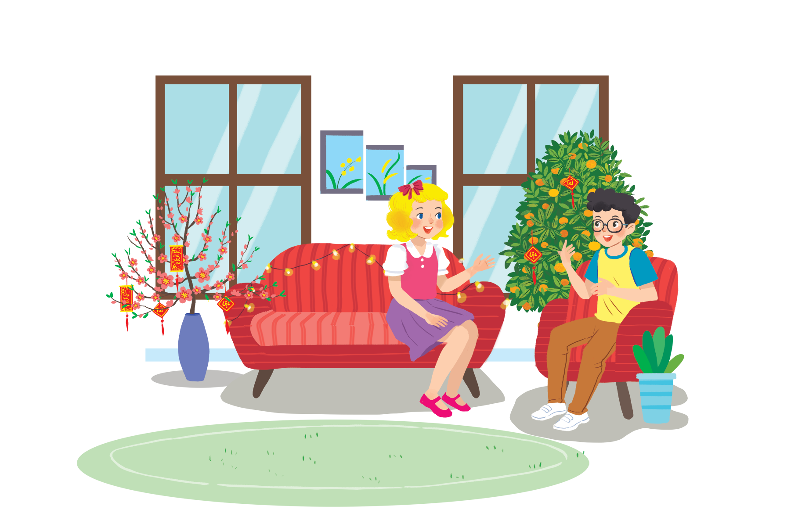
Listen and read.
Happy New Year!
Notes:
Thiếu tên bài đọc.

Slide 4
Happy New Year!
Linda: Phong, does Viet Nam celebrate New Years?
Phong: Yes, we do. We have Tet.
Linda: When is Tet?
Phong: At different times. This year, it’s in January.
Linda: What do you do at Tet?
Phong: We clean our homes and decorate them with ﬂowers.
Linda: Is Tet a time for family gatherings?
Phong: Yes. It’s a happy time for everybody.
Linda: Great.
Phong: Yes, and another good thing about Tet is that children get lucky money.
Linda: That sounds interesting. Is there anything special people should do?
Phong: We should say “Happy New Year” when we meet people, and we shouldn’t break anything.

Slide 5
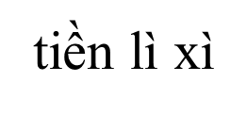
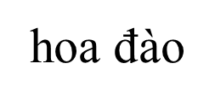
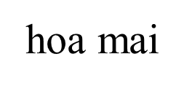
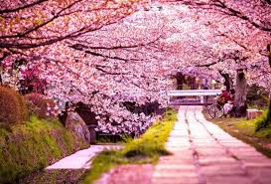
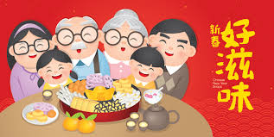
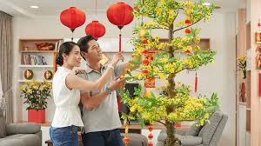
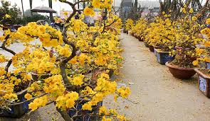
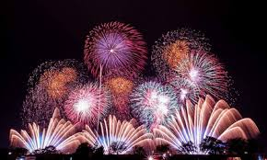
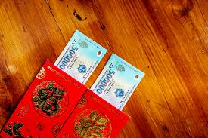
Trang trí nhà cửa
Pháo hoa

Slide 6
What are Linda and Phong talking about?
A.
New Years in the world
B.
Tet in Viet Nam
C.
What to eat and wear during tet

Slide 7
Complete the sentences about Tet with the information from the conversation in 1.
1.
January
This year Tet is in
.
.
2.
We decorate our
homes
.
.
3.
Tet is a time for family
gatherings
.
.
4.
Children get
lucky money
.
.
5.
People shouldn’t
break
anything.
anything.

Slide 8
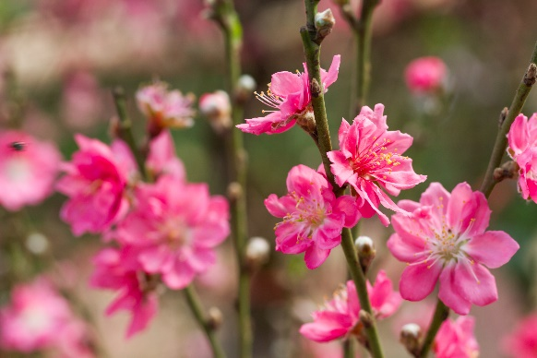
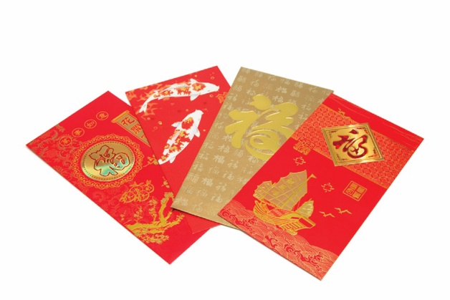
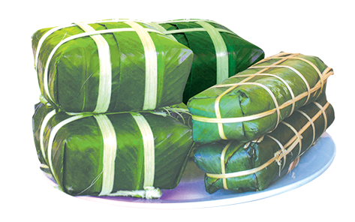
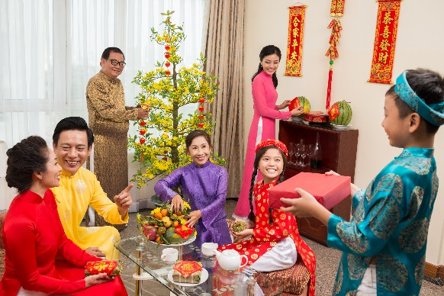
Match the words / phrases in the box with the pictures.
a. lucky money
a. lucky money
c. banh chung and banh tet
c. banh chung and banh tet
b. peach flowers
b. peach flowers
d. family gathering
d. family gathering
1
2
b. peach flowers
a. lucky money
3
4
c. banh chung and banh tet
d. family gathering

Slide 9
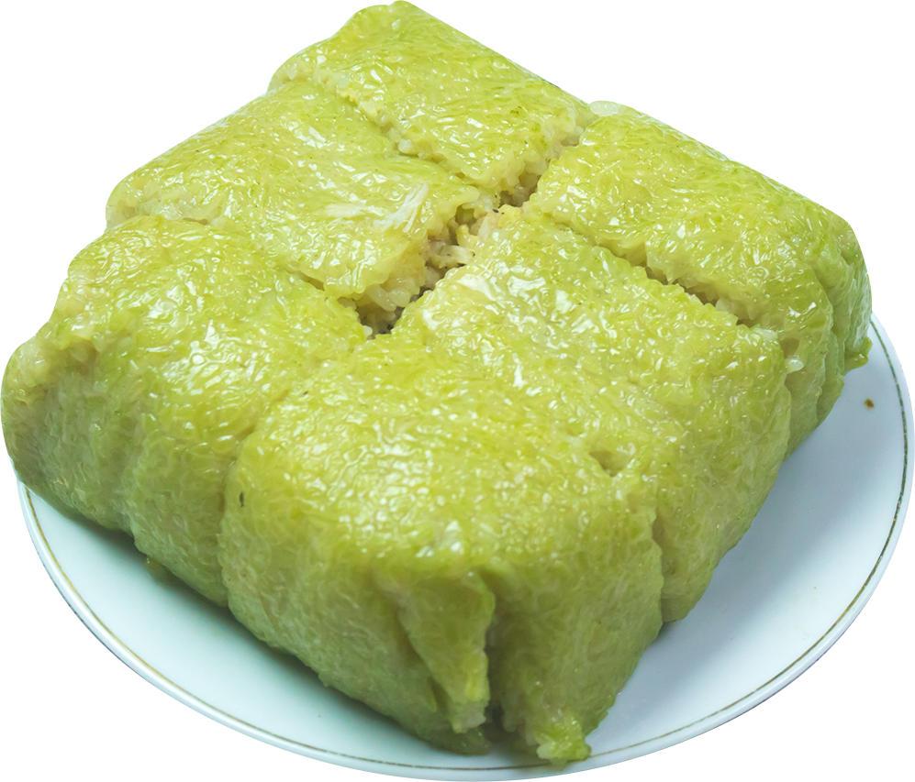
Is it about Tet?
Write two things or activities and share them with the class. The class listen and decide whether they are about or not about Tet.
Example:
Student: banh chung
Class: It’s about Tet.
Student: flying a kite.
Class: It’s not about Tet.

