Slide 2
Listening
Writing
Work in groups. Discuss the question.
Fill each blank in the network with the information about a travel attraction you know.
Listen again and tick () T (True) or F (False).
Use the notes in 3 to write a paragraph of about 50 words.

Slide 3
Listening

Slide 4
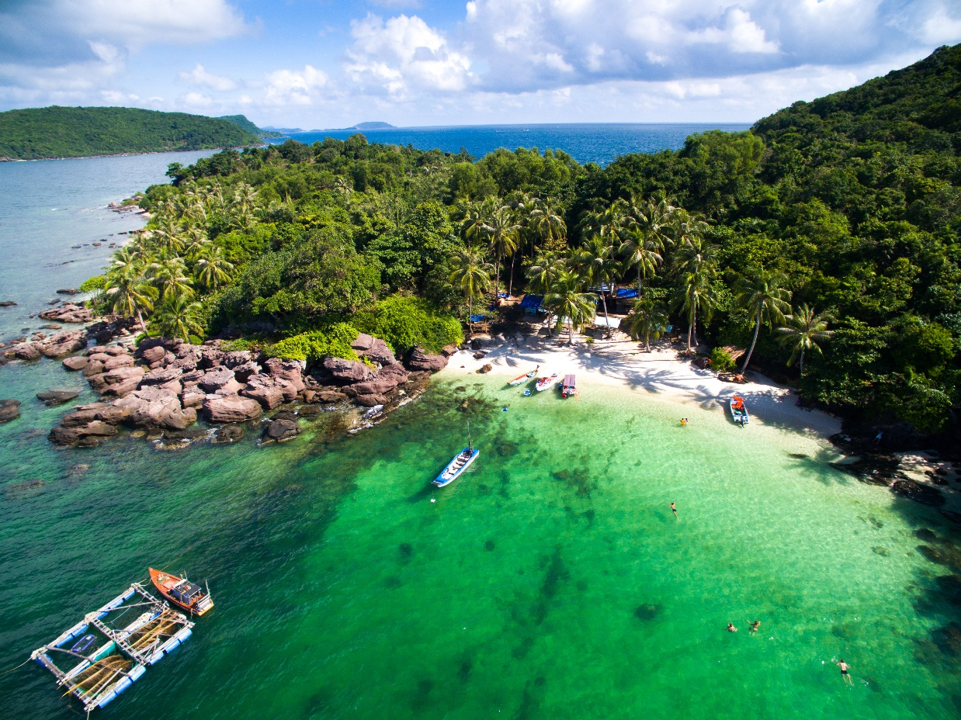
Work in groups. Discuss the question.
What do you know about Phu Quoc Island?
Listen to the talk and check your answers.

Slide 5
Listen again and tick () T (True) or F (False).
 |  | T | F
1. | Phu Quoc is a very beautiful island in Viet Nam.
2. | There are no green forests in Phu Quoc.
3. | Tourists can visit fishing villages and national parks there.
4. | You cannot play water sports in Phu Quoc.
5. | People sell interesting things at the markets.





T

Slide 6
AUDIO SCRIPT
Phu Quoc is a very beautiful island in Viet Nam. It is in Kien Giang. It has beautiful beaches and green forests. It also has resorts, hotels, and bars. The people here are friendly. Phu Quoc has an international airport, and travelling there is easy. Tourists can visit fishing villages, national parks, pagodas and temples. They also like to eat the seafood here. It is delicious. Sailing and fishing are popular water sports. You can buy interesting things at the markets on the island.

Slide 7
Writing

Slide 8
Fill each blank in the network with the information about a travel attraction you know.
(2) Where is it?
(3) How can you go there?
Phu Quoc
by plane
(1) Name of the attraction
island
(4) What is special about it?
(5) What can you do there?
national parks, pagodas and temples
Sailing and fishing are popular water sports.

Slide 9
Use the notes in 3 to write a paragraph of about 50 words.
I am writing about
It is in

Slide 10
I am writing about Ly Son island. It is in Quang Ngai province. You can go there by plane or by ship. It is special because of its pristine island with exotic seafood. It is also quite simply like heaven on a blue ocean for backpackers with its crystal clear waters full of reef wildlife, white sandy beaches, plush green garlic fields and spectacular volcano scenery. There, you can go diving and swim.

