Slide 2
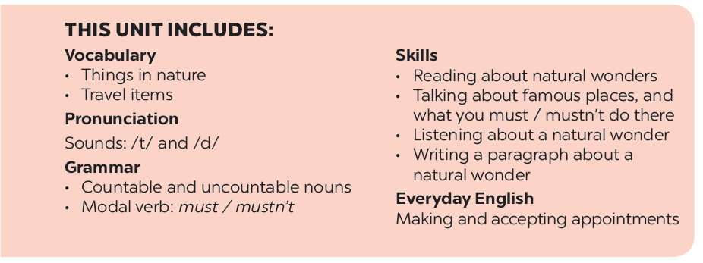

Slide 4
Listen and read.
Geography Club
Notes:
Thiếu tên bài đọc.

Slide 5
Geography Club
Alice: Hello, welcome to our Geography Club.
(Knock at door)
Alice: Come in, Elena. We’re just starting now.
But remember you must always be on time.
Elena: Sure. Sorry.
Alice: Today I’m going to talk about some natural wonders of Viet Nam.
Nick: Great! What’s that in the first picture?
Alice: It’s Ganh Da Dia in Phu Yen.
Elena: Wow. It looks amazing!
Nick: Is picture 2 Ha Long Bay?
Alice: Right. What do you know about it?
Nick: It has many islands.
Alice: Yeah! The scenery is wonderful. This picture shows Tuan Chau, a large island.
Tommy: How about picture 3?
…

Slide 6
VOCABULARY
Scenery (n)
phong cảnh
amazing(a)
tuyệt vời
natural wonder(n)
kì quan thiên nhiên
Island (n)
đảo, hòn đảo
desert(n)
sa mạc
mountain(n)
dãy núi
Waterfall(n)
thác nước

Slide 7
Complete the following sentences with the words from the box.
scenery
amazing
natural
islands
wonders
1.
People didn’t make Ganh Da Dia.
They are rocks.
natural
Ha Long Bay has thousands of big and small .
2.
islands
scenery
3.
Ha Long Bay is charming and the is wonderful.
Ganh Da Dia has rock columns of different shapes and sizes.
4.
amazing
5.
wonders
There are many natural and man-made in Viet Nam.

Slide 8
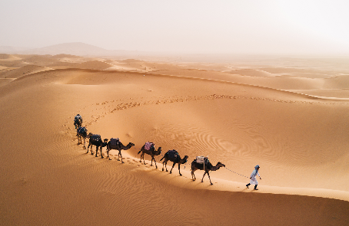
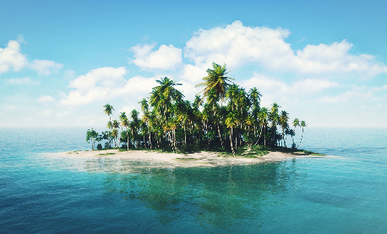
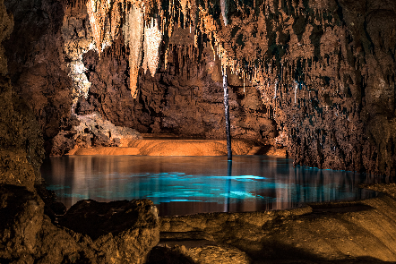
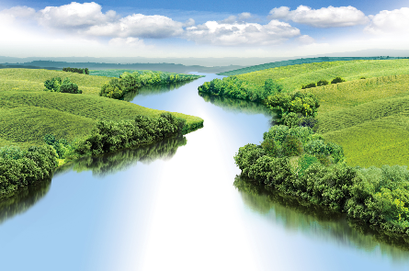
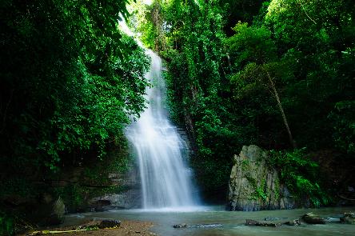
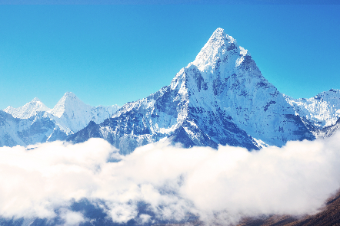
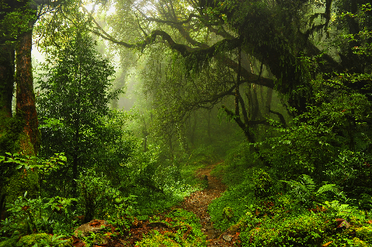
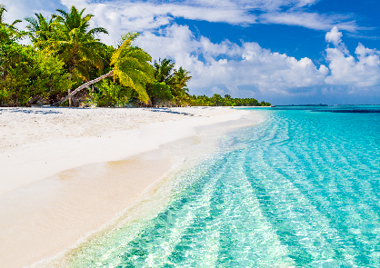
Listen and repeat the words, then label the pictures.
1. mountain
3. waterfall
5. cave
7. beach
2. river
4. forest
6. desert
8. island
a.
b.
c.
d.
e.
f.
g.
h.

Slide 9
1. mountain
3. waterfall
5. cave
7. beach
2. river
4. forest
6. desert
8. island
a.
a. desert

Slide 10
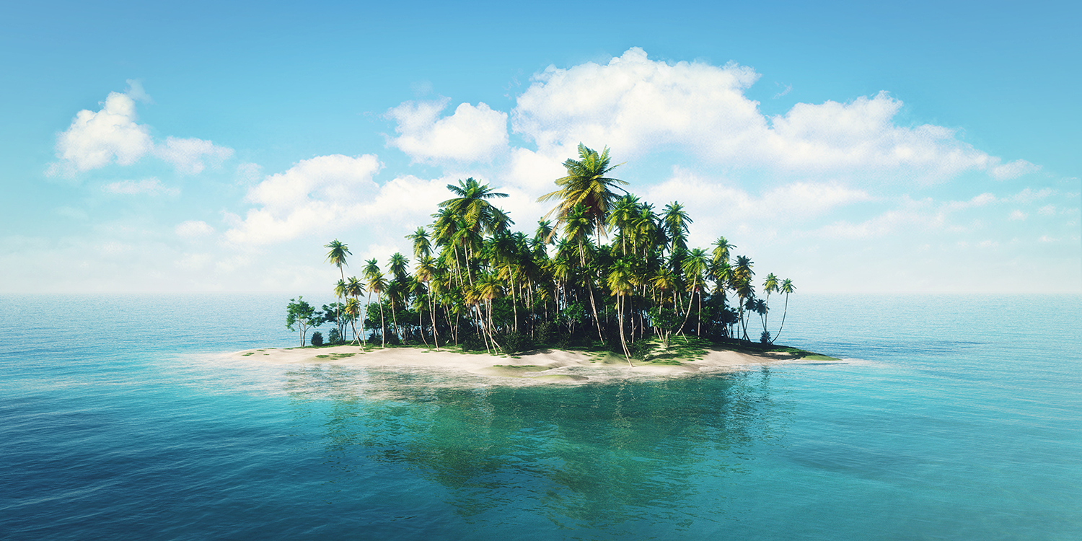
1. mountain
3. waterfall
5. cave
7. beach
2. river
4. forest
6. desert
8. island
b.
b. island

Slide 11
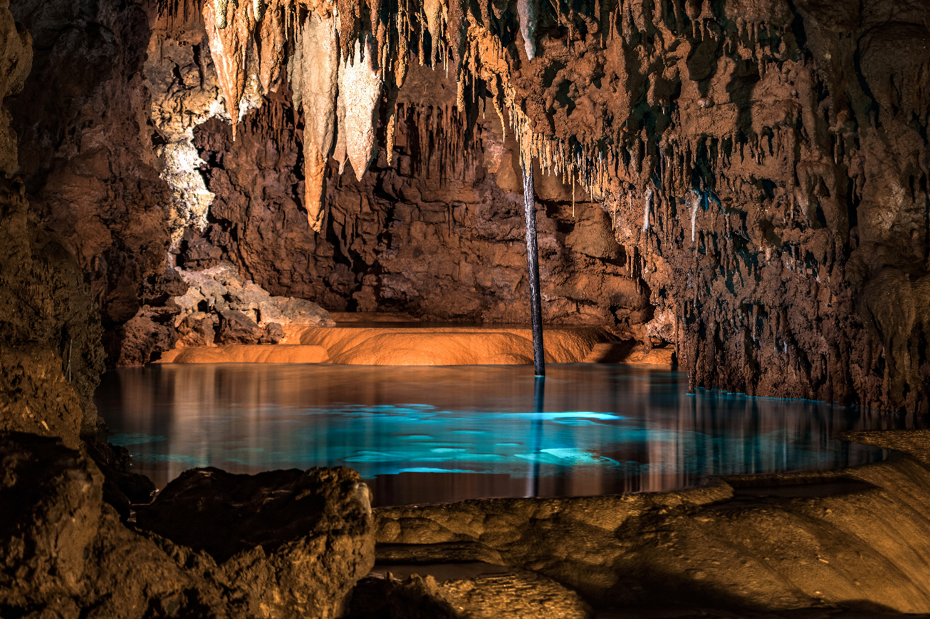
1. mountain
3. waterfall
5. cave
7. beach
2. river
4. forest
6. desert
8. island
c.
c. cave

Slide 12
1. mountain
3. waterfall
5. cave
7. beach
2. river
4. forest
6. desert
8. island
d.
d. river

Slide 13
1. mountain
3. waterfall
5. cave
7. beach
2. river
4. forest
6. desert
8. island
e.
e. waterfall

Slide 14
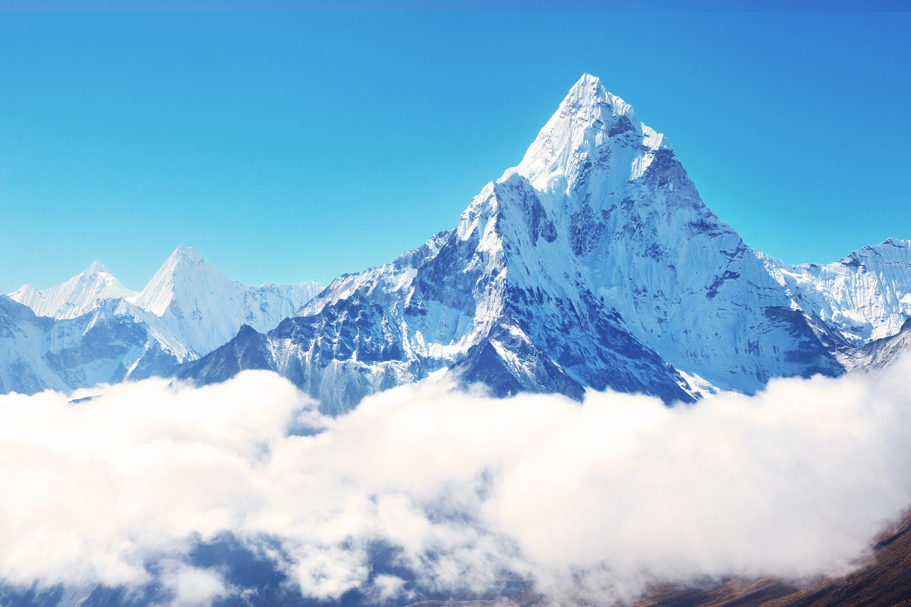
1. mountain
3. waterfall
5. cave
7. beach
2. river
4. forest
6. desert
8. island
f. mountain
f.

Slide 15
1. mountain
3. waterfall
5. cave
7. beach
2. river
4. forest
6. desert
8. island
g.
g. forest

Slide 16
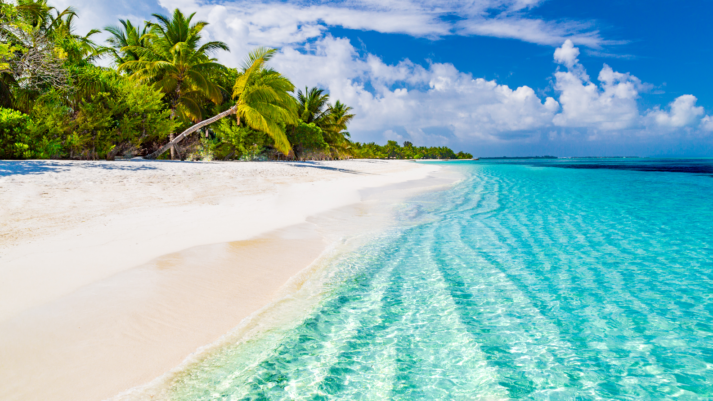
1. mountain
3. waterfall
5. cave
7. beach
2. river
4. forest
6. desert
8. island
h.
h. beach

Slide 17
Work in groups. Choose the correct answer to each of the questions.
1.
Which is an island in Viet Nam?
A.
Con Dao
B.
Son Doong
2.
Where is Mount Fansipan?
A.
In Lao Cai
B.
In Quang Binh
3.
Which of the following is a national park?
A.
Thong Nhat Park
B.
Cat Tien Park
4.
Which of the following wonders is a cave?
A.
Cuc Phuong
B.
Phong Nha
5.
Which waterfall is in Cao Bang?
A.
Giang Dien Waterfall
B.
Ban Gioc Waterfall

