Slide 1
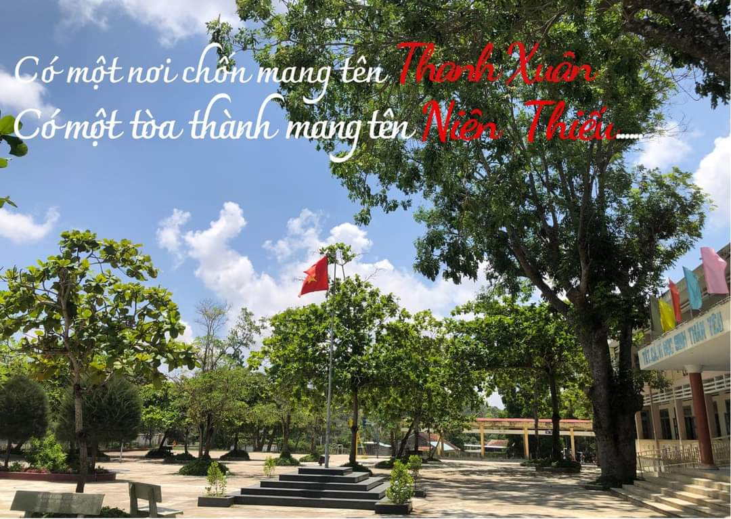
Teacher: Le Thi Cam Hang
Period 32: SKILLS 1

Slide 3

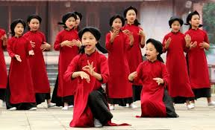
Game: Face to face
TRADITIONAL PERFORMANCES
Xoan singing

Slide 4
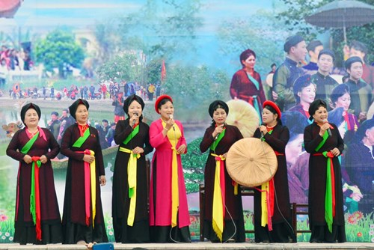

TRADITIONAL PERFORMANCES
Quan Ho singing

Slide 5
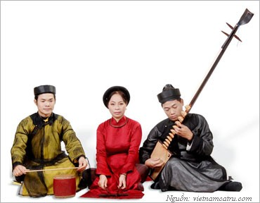
TRADITIONAL PERFORMANCES
Ca tru singing

Slide 6
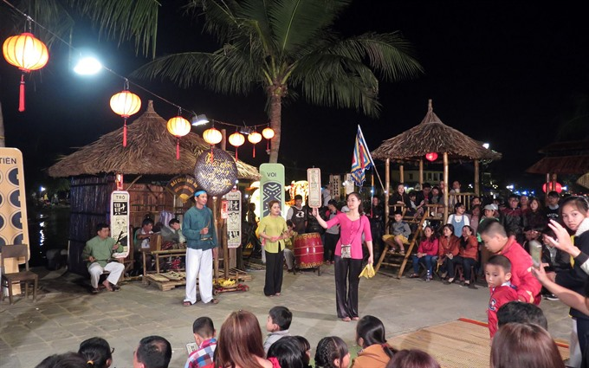
TRADITIONAL PERFORMANCES
Bai choi singing

Slide 7
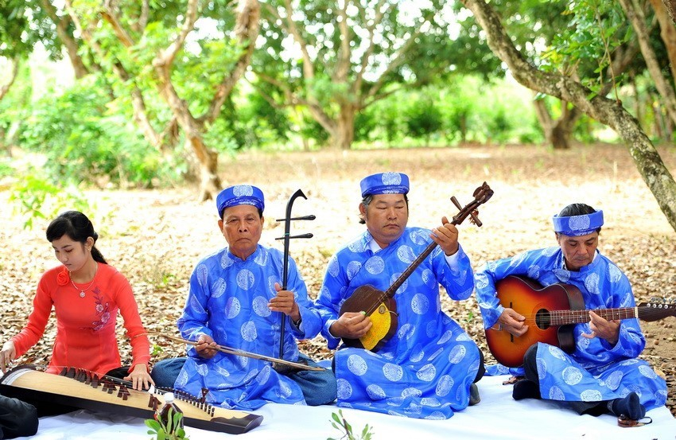
TRADITIONAL PERFORMANCES
Don ca tai tu

Slide 8
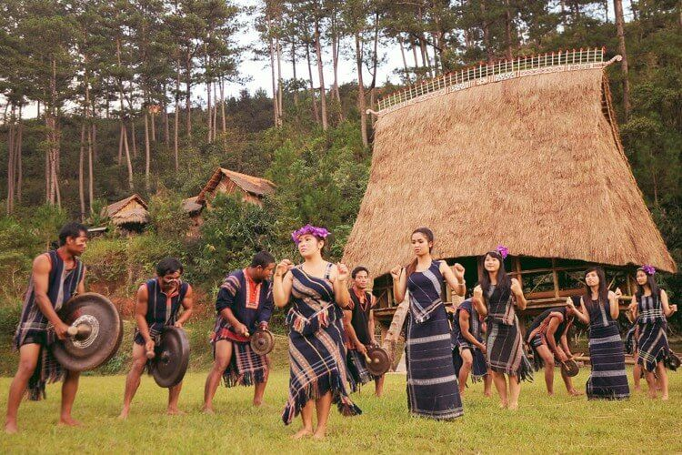
TRADITIONAL PERFORMANCES
Cultural space of Gong

Slide 9
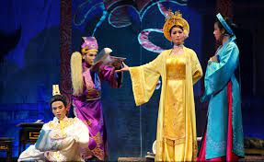
TRADITIONAL PERFORMANCES
Cai luong opera

Slide 10
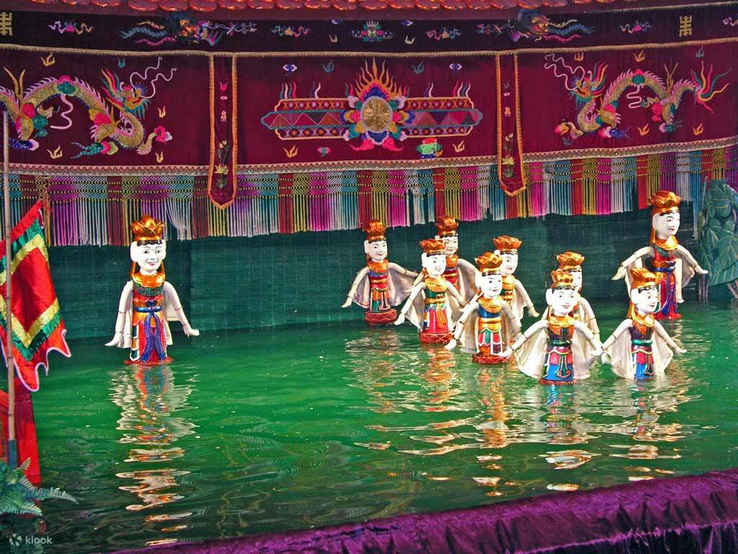
TRADITIONAL PERFORMANCES
Water puppet show

Slide 11



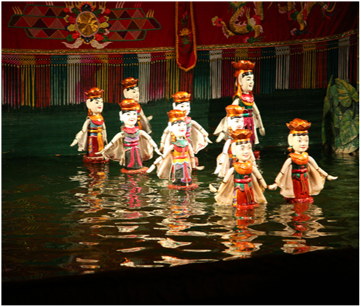
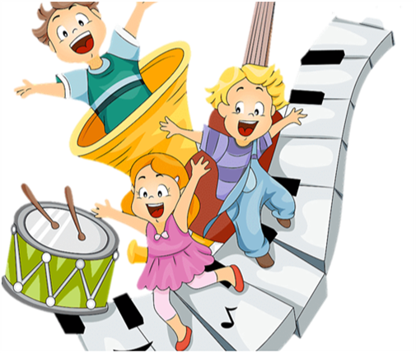
Saturday, November 18th,2023.
Unit
4
MUSIC AND ARTS
Period:32 SKILLS 1
READING
SPEAKING
Unit

Slide 12
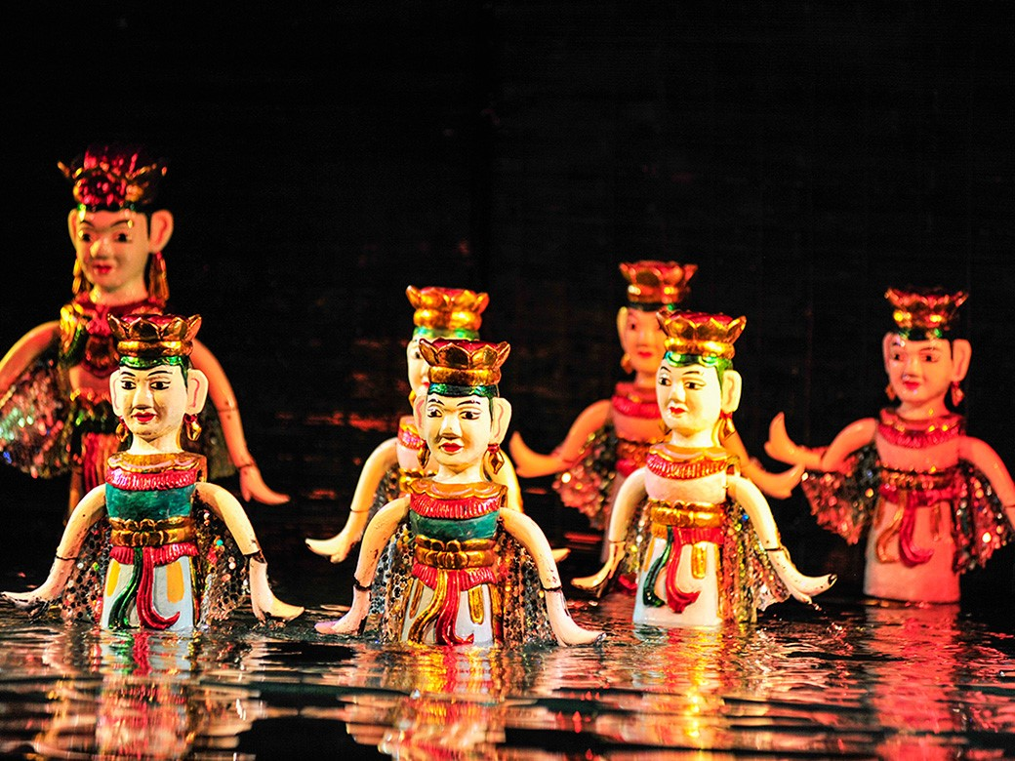
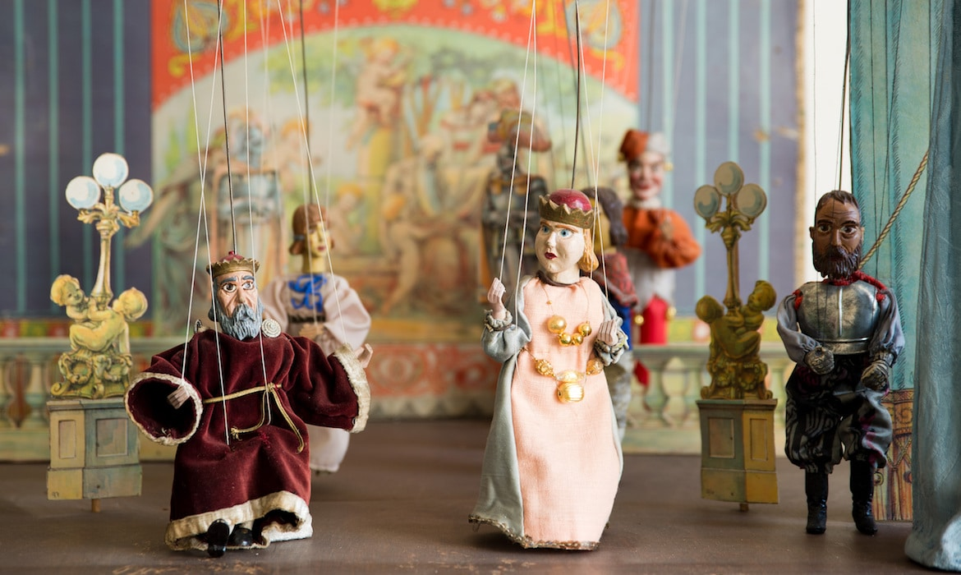
* VOCABULARY:
- puppetry (n) :
/ˈpʌpɪtri/
nghệ thuật múa rối

Slide 13
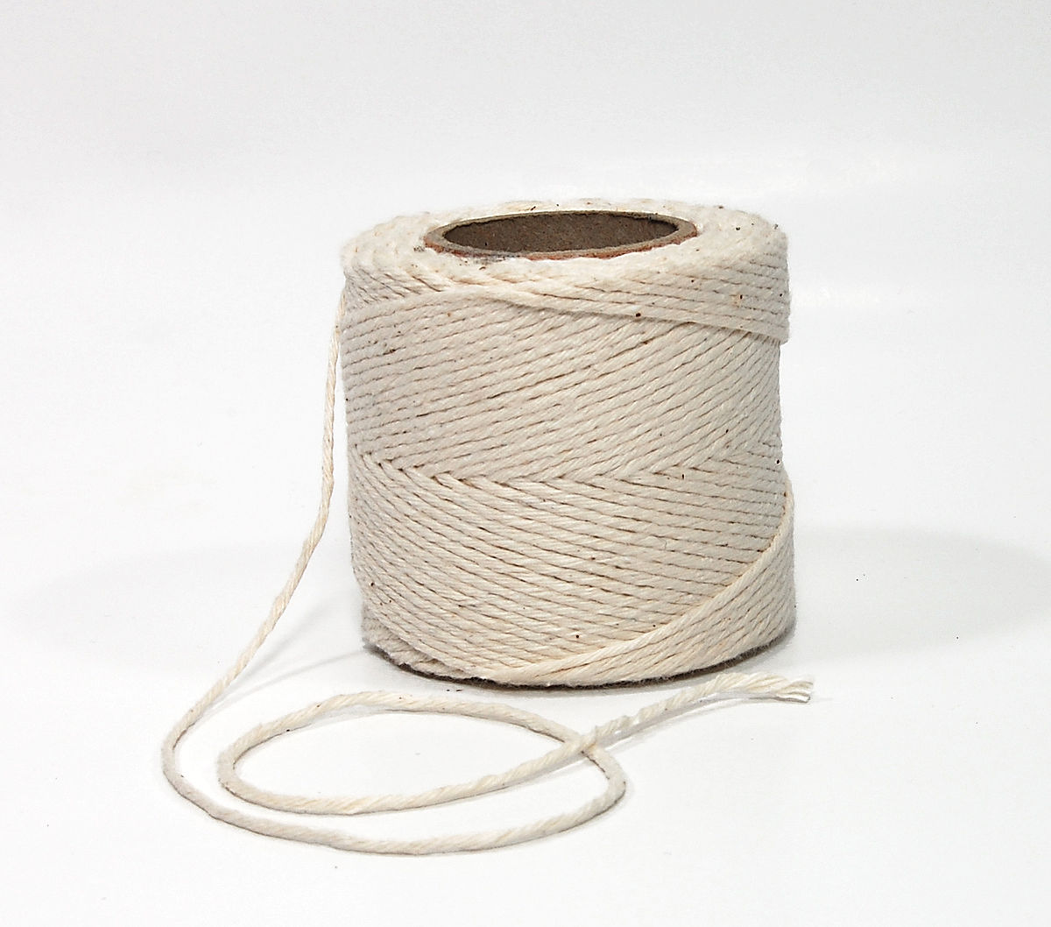
- string (n):
sợi dây
/strɪŋ/

Slide 14
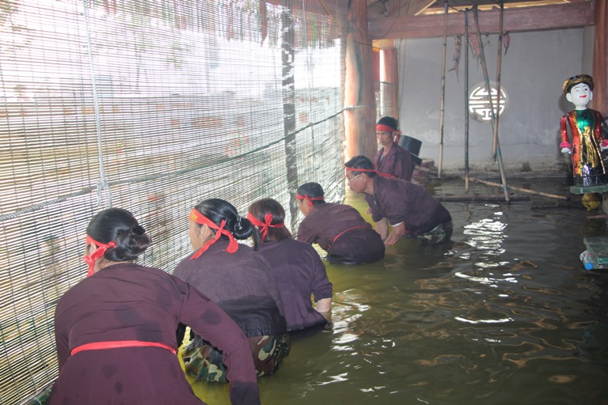
- control (v):
/kənˈtrəʊl/
điều khiển, kiểm soát

Slide 15
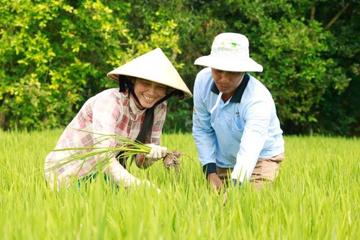
- rice farming (n. phr):
/raɪs ˈfɑːmɪŋ/
trồng lúa

Slide 16
* VOCABULARY:
New words | Pronunciation | Meaning
- puppetry (n) | /ˈpʌpɪtri/ | nghệ thuật múa rối
- string (n) | /strɪŋ/ | sợi dây
- control (v) | /kənˈtrəʊl/ | điều khiển, kiểm soát
- rice farming | /raɪs ˈfɑːmɪŋ/ | trồng lúa

Slide 17
* Checking vocabulary:
New words | Meaning
 | điều khiển, kiểm soát trồng lúa
 | sợi dây
 | nghệ thuật múa rối
- control (v)
- rice farming (n.phr)
- string (n)
- puppetry (n)

Slide 18

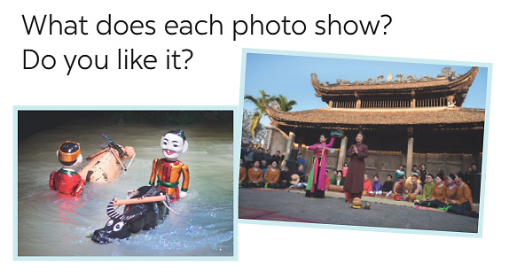
I. READING
1
Look at the pictures. Discuss the questions below with a partner.
- The second picture is the Quan Ho singing.
- The first picture shows a water puppet show.

Slide 19

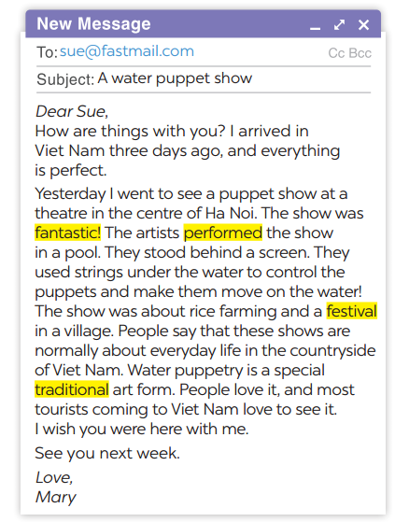
2
Read the email and match the highlighted words with their meanings.
1. showed or presented
2. following tradition
3. nice, interesting
4. event or celebration
→ performed
→ traditional
→ fantastic
→ festival

Slide 20
3
Read the email again and answer the questions.
1. Who went to see a water puppet show yesterday?
2. Where did the artists perform the show?
3. Who controlled the puppets?
4. What are water puppet shows normally about?
5. Is water puppetry a traditional Vietnamese art form?
Notes:
Lucky numbers: 1,4,8
Number 2: Question 1
Number 3: Question 2
Number 5: Question 3
Number 6: Question 4
Number 7: Question 5

Slide 21

LUCKY NUMBER!
1
2
3
4
5
6
7
8

Slide 22
1. Who went to see a water puppet show yesterday?
→ Mary did.

Slide 23
2. Where did the artists perform the show?
→ In a pool.

Slide 24
3. Who controlled the puppets?
→The artists did.

Slide 25
4. What are water puppet shows normally about?
→About everyday life in the countryside of Viet Nam.

Slide 26
5. Is water puppetry a traditional Vietnamese art form?
→ Yes, it is.

Slide 27

LUCKY NUMBER!
you get 2 plus points

Slide 28
LUCKY NUMBER!
you get 2 plus points

Slide 29
LUCKY NUMBER!
you get 2 plus points

Slide 30
What is the musical performance?

Slide 31
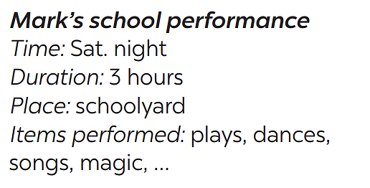

II. SPEAKING
4
Work in pairs. Ask and answer about Mark’s school musical performance last year.
Example:
A:
B:
A:
B:
When was the performance?
On Saturday night.
How long did it last?
Three hours.
……….

Slide 32

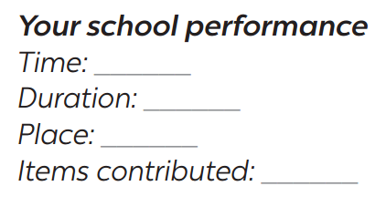
5
Make a plan for the performance and talk about the items you will contribute.
Your school is going to have a musical performance to celebrate Teachers’ Day.

Slide 33

* HOMEWORK
Do exercises 3,4 in the workbook.
Learn vocabulary by heart.
Prepare for the next lesson: Skills 2.

Slide 34


Thank you!
Goodbye!

