Slide 1
UNIT 5
AROUND TOWN

Slide 2
LESSON 2

Slide 3


WRAP-UP
WARM UP

Slide 4
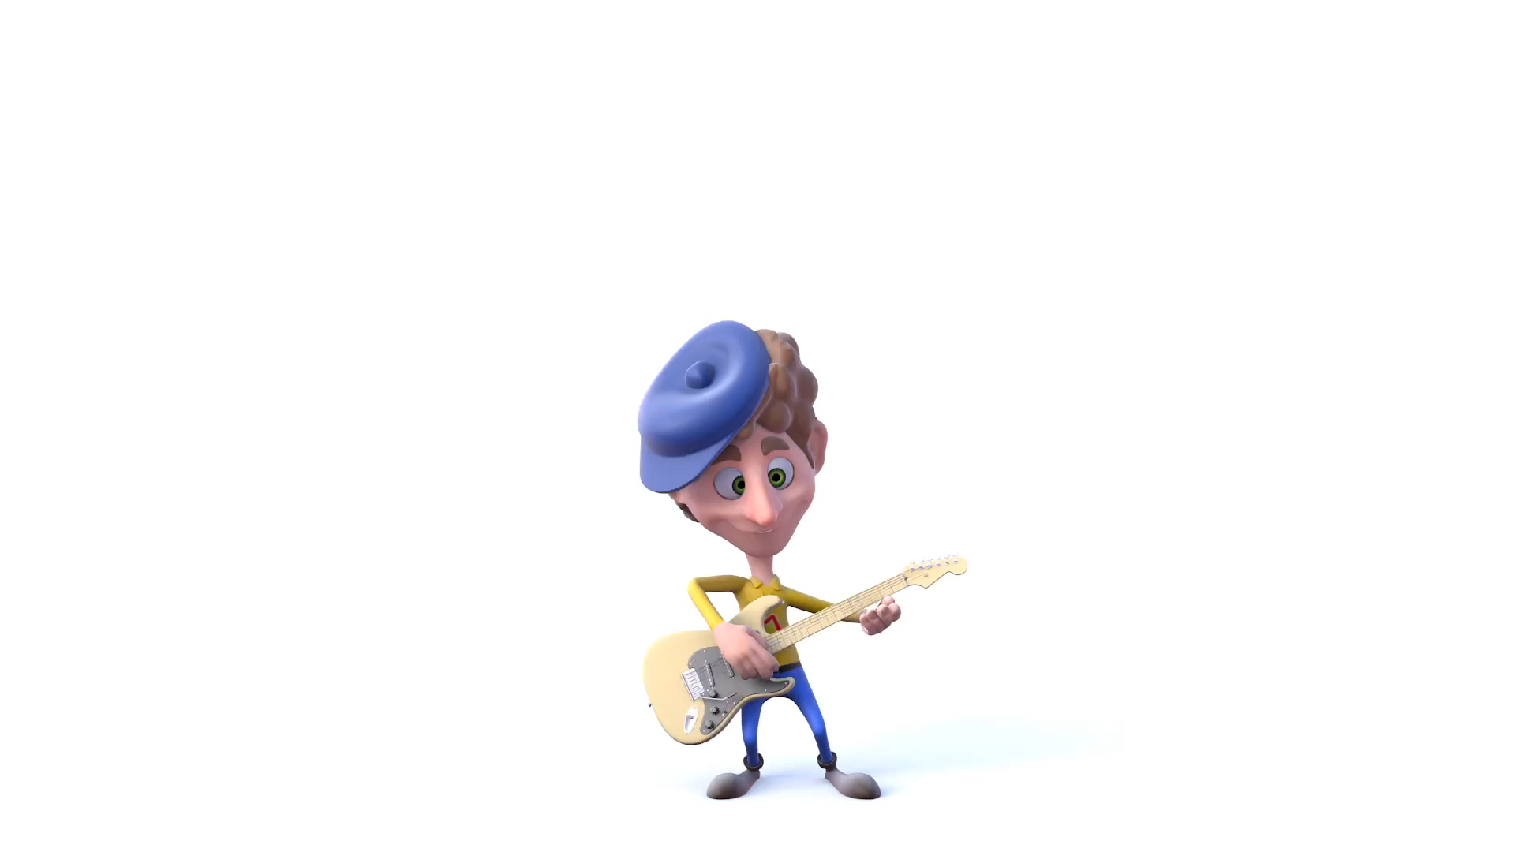
Listen to a song and sing a long.

Slide 5
GRAMMAR
1
THIS/THAT – THESE THOSE
2
OBJECT PRONOUNS

Slide 6
GRAMMAR
1
THIS/THAT – THESE THOSE

Slide 7

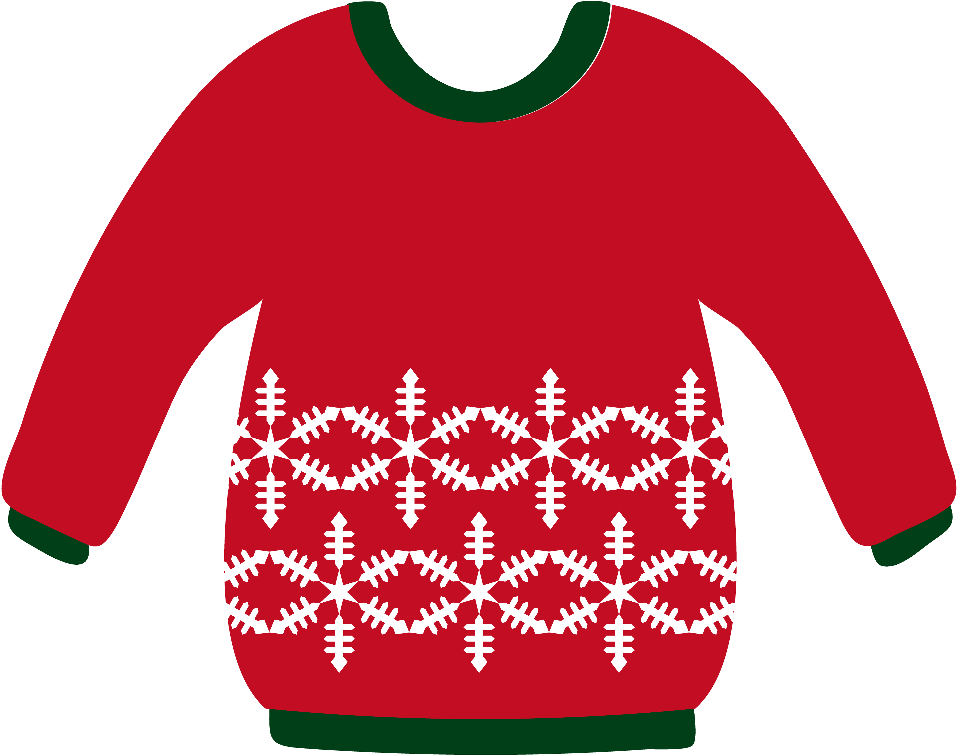
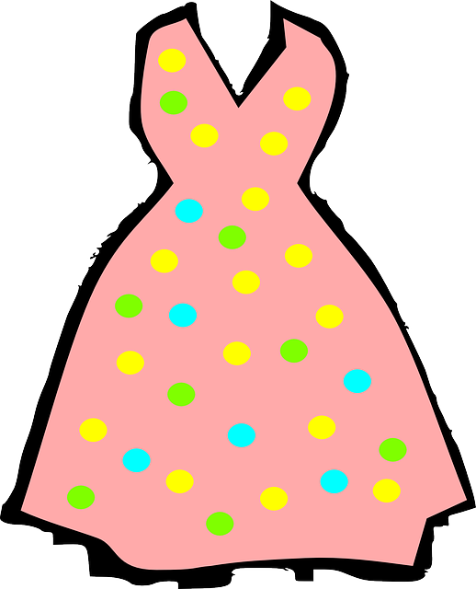
near
This is my sweater
far
That is her dress

Slide 8
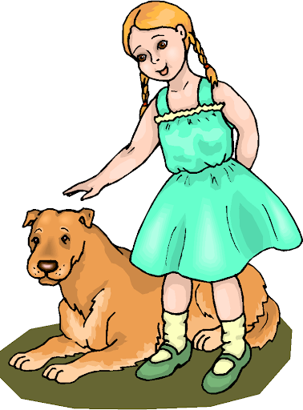



These are my dogs
Those are my birds.

Slide 9


DEMONSTRATIVES
Từ chỉ định
Sô ít
Số nhiều
GẦN
THIS
THESE
Here , near
Đây là……..
Đây là……..
THAT
THOSE
XA
Kia là......
Kia là......
There, far

Slide 10
GRAMMAR
2
OBJECT PROUNS

Slide 11
Look at example.
He likes this cap.
He likes it
They want to wear the shirts
They want to wear them.
Object pronouns
Theo sau một động từ
Đại từ tân ngữ

Slide 12
      SUBJECTS AND OBJECTS PRONOUN
SUBJECT PRONOUNS | OBJECT PRONOUNS
Làm chủ ngữ ở đầu câu
Theo sau một động từ
I
me
You
you
us
We
They
them
He
him
She
her
It
it

Slide 13

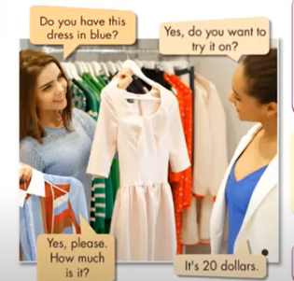
a. Listen and repeat.
Do you have this dress in blue?
Yes, do you want to try it on?
How much is this T-shirt?
Do you have that shirt in blue?
How much are those shoes over there?
do you have these socks in green?
Yes, please. How much is it?
It’s 20 dollars

Slide 14
b. Read the sentences . Circle the correct words
How much are that/these shoes?
Excuse me! how much is this/these shirt?
I like that skirt. Do you have it/them in black.
Do you have this/these shoes in black?
I like these shorts. Can I try it/them on?
What size are those/these pants over there?
How much is that/this shirt by the window?

Slide 15
c. Complete the dialogue with “ This, those, it or them”
Sales assistant: Hi, can I help you?
Customer: Yes, do you have (1) ________________T-shirt in (a) medium?
Sales assistant: Yes, here you are
Customer: Can I try (2)___________ on?
Sales assistant: Yes, the changing room’s over there.
( Later......)
Customer: Excuse me, I really like (3) _________________shoes by the window.
Do you have (4) ________________in brown?
Sales assistant : Yes, here you are
Customer: Oh, they’re great! How much are they?
Sale assistant: They’re 39 dollars.
Customer : Can I try (5) _____________on?
Sales assistant: Sure!
This
it
those
them
them

Slide 16
WRAP-UP
* Demonstratives:
This / That: for singular nouns
These/Those: for plural nouns
This / These: for things close to the speaker
That / Those: for things further away to the speaker
* Asking about price:
How much is / are …?
What is the price of …?
How much does + name of clothe + cost?
*Object pronouns:
“it” for singular nouns. “them” for plural nouns

Slide 17
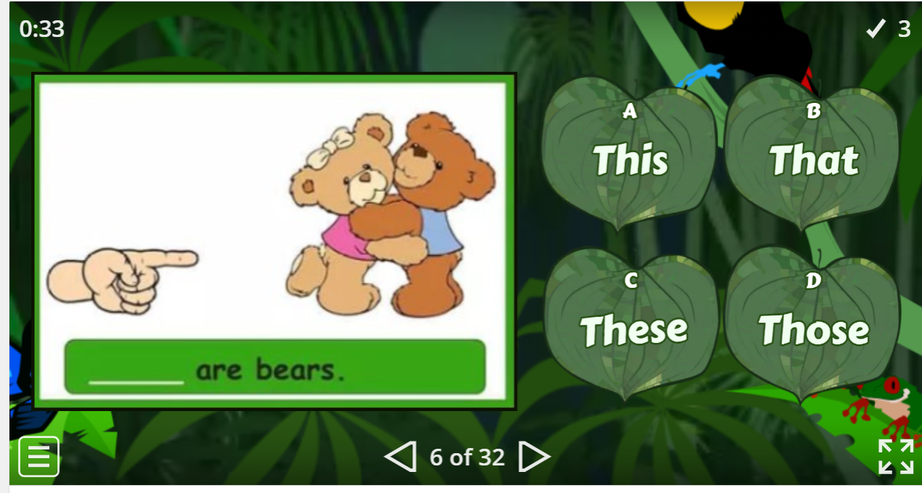


Slide 18
HOMEWORK
- Make 3 sentences, use the demonstratives and object pronouns.
- Do exercise in Work Book: Lesson 1 - Grammar (page 27).
- Prepare: Lesson 1 – Pronunciation and Speaking (page 40 – SB).

