Slide 1
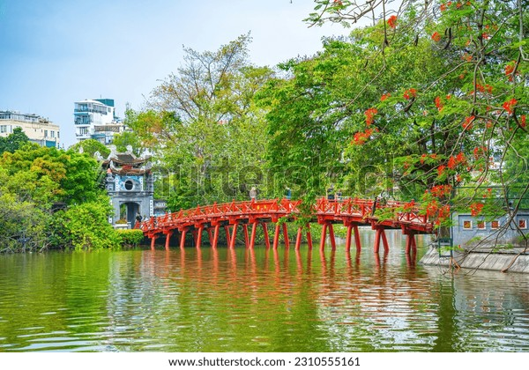
WELCOME  TO  OUR  CLASS
Cities of the world

Slide 2
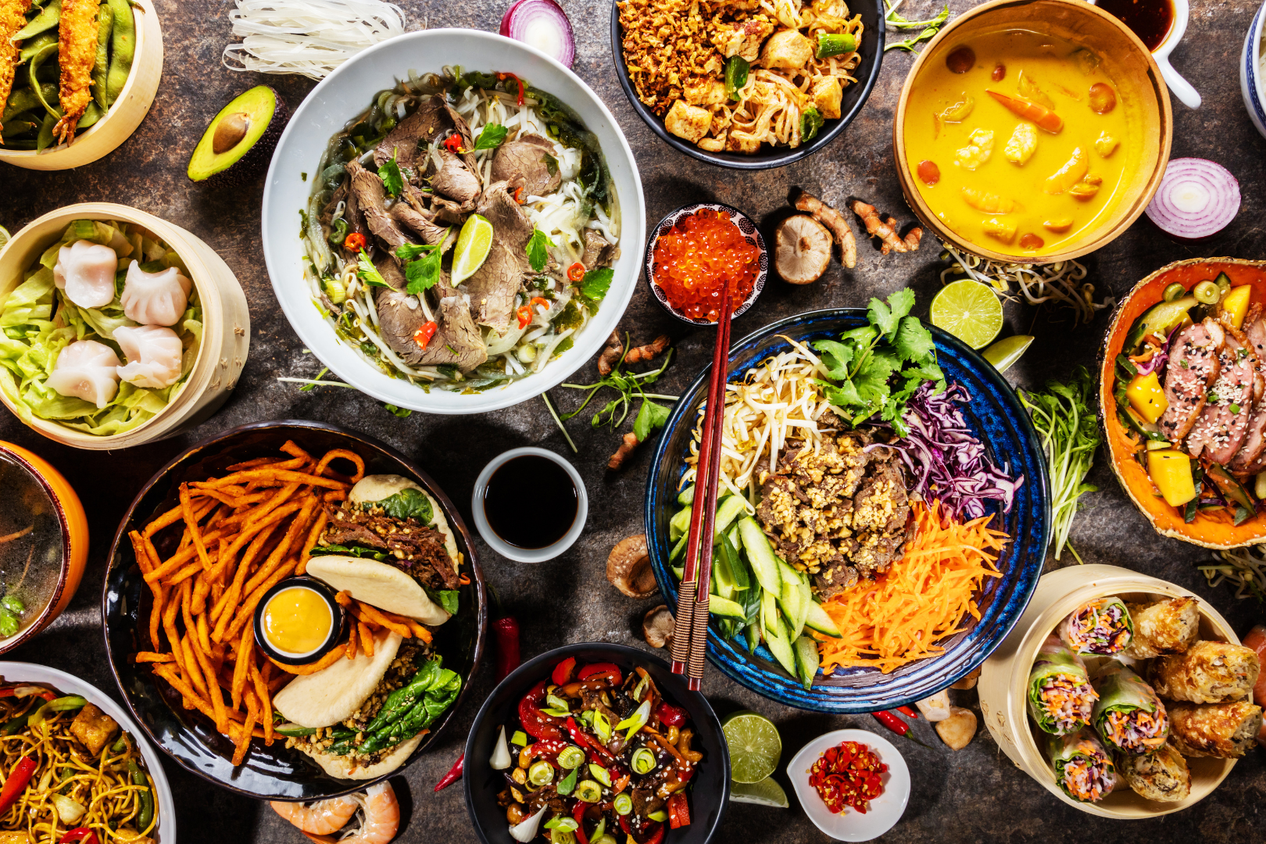
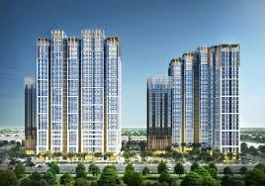
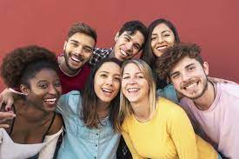
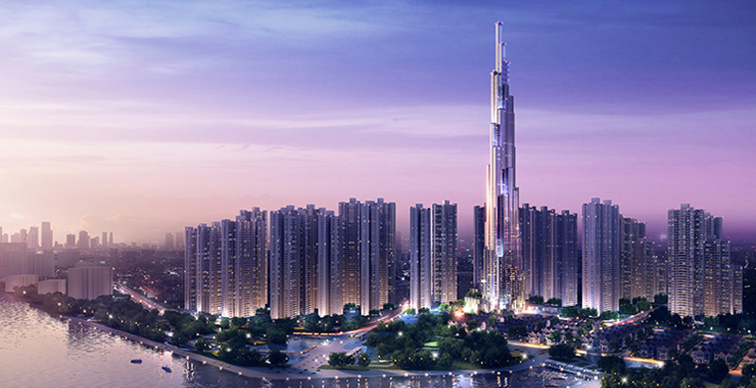
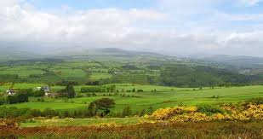
F_ _ _
Food
W_ _ _ _ _ r
Weather
B_ _ _ _ _ _ _
Building
P_ _ _ _ _
People
C _ _ _
City
L_ _ _ _ _ _ _e
Landscape

Slide 3
Wednesday, March 6th 2024
UNIT 9: CITIES OF THE WORLD
Vocabulary
1. 2. 3. 4. 5. 6. 7. 8. |  |  | 9. 10. 11. 12. 13. 14. 15. 16.
exciting
sôi động
wide
rộng
amazing
ngạc nhiên
helpful
hữu ích
clean
sạch
modern
hiện đại
cold
lạnh
beautiful
xinh đẹp
quiet
yên tĩnh
fast
nhanh
sunny
nhiều nắng
cute
dễ thương
friendly
thân thiện
delicious
thơm ngon
fantastic
kì lạ
tasty
ngon lành

Slide 4
Wednesday, March 6th 2024
UNIT 9: CITIES OF THE WORLD
17. 16. 19. 20. 21. 22.
towers (n)
:những tòa tháp
beach (n)
:bãi biển
river bank (n.ph)
:bờ sông
postcard (n)
: bưu thiếp
palace (n)
: cung điện
night market (n.ph)
: chợ đêm

Slide 5
Wednesday, March 6th 2024
UNIT 9: CITIES OF THE WORLD
Ex 1. Choose the best two options to complete the sentences.
1. The city is ________.
A. exciting
B. amazing
C. long
2. The weather is ________.
A. cold
B. quiet
C. sunny
3. The people are ________.
A. friendly
B. expensive
C. helpful
4. The buildings are ________.
A. tall
B. beautiful
C. fast
5. The food is ________.
A. cute
B. delicious
C. good

Slide 6
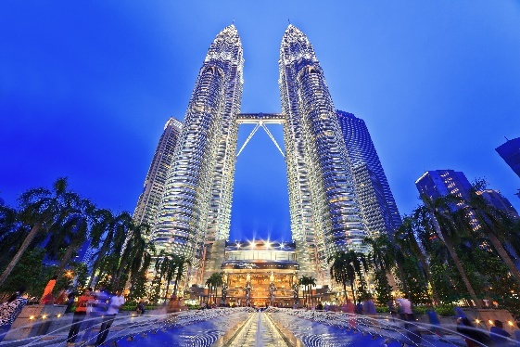
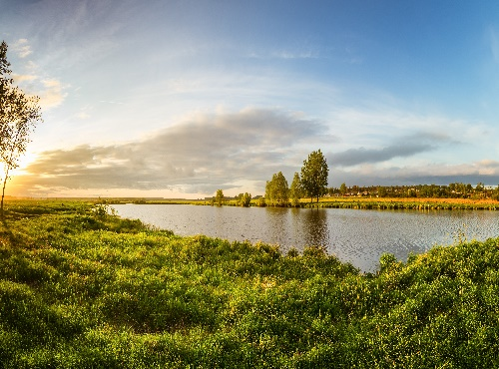
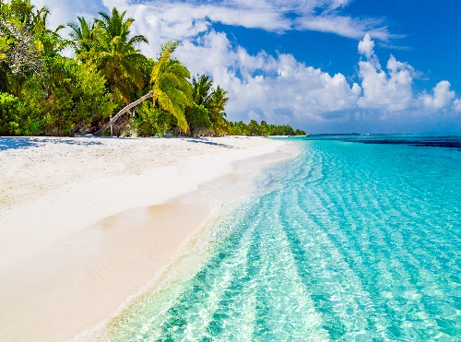
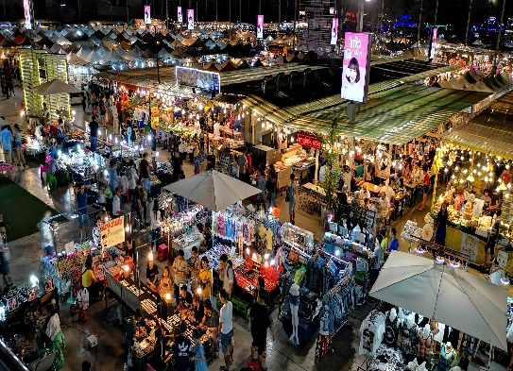
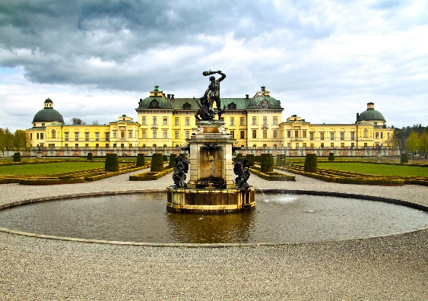
Wednesday, March 6th 2024
UNIT 9: CITIES OF THE WORLD
Ex 2. Write the words in the box under their pictures.
towers
beach
postcard
palace
river bank
night market
towers
river bank
beach
night market
palace
postcard

Slide 7
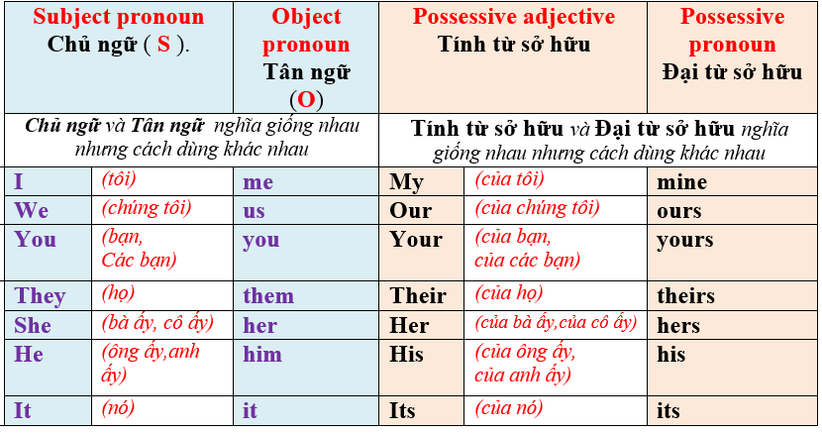
Wednesday, March 6th 2024
UNIT 9: CITIES OF THE WORLD

Slide 8
Wednesday, March 6th 2024
UNIT 9: CITIES OF THE WORLD
Ex 3. Complete the sentences with the correct possessive pronouns in the box.
yours
1. Hey, Phong. You’re wearing my hat. It’s not _____.
2. We’re looking for Mr. and Mrs. Smith’s house. Is that _____?
theirs
3. This is my drawing. It’s _____.
mine
Ours
4. This is your room. _____ is next door. So call us if you need anything.
5. Sue doesn’t need to borrow my pen. She’s got _____.
hers
theirs
hers
yours
mine
ours

Slide 9
Monday, March 4th 2024
UNIT 9: CITIES OF THE WORLD
Ex 4. Read the sentences and correct the underlined words.
1. Bangkok is an exciting city. I love it’s people.
its
2. We are watching the sunrise at Angkor Wat with ours local
friends.
our
3. Discover Beijing and Shanghai through theirs food tours.
their
4. Visit Hue and try your food.
its
5. Venice is your city and Jakarta is our.
ours
1
2
3
4
5
6
7

Slide 10
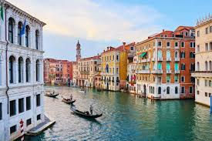
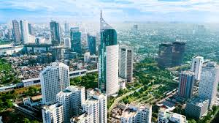
Wednesday, March 6th 2024
UNIT 9: CITIES OF THE WORLD
Venice is your city and Jakarta is our.
ours
Venice
Jakarta

Slide 11
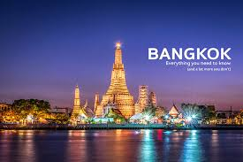
Monday, March 4th 2024
UNIT 9: CITIES OF THE WORLD
Bangkok is an exciting city. I love it’s people.
its

Slide 12
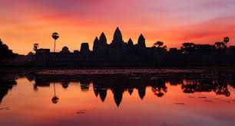
Wednesday, March 6th 2024
UNIT 9: CITIES OF THE WORLD
We are watching the sunrise at Angkor Wat with ours local friends.
our

Slide 13
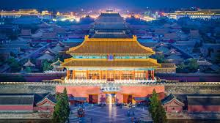
Wednesday, March 6th 2024
UNIT 9: CITIES OF THE WORLD
Discover Beijing and Shanghai through theirs food tours.
their
Beijing

Slide 14
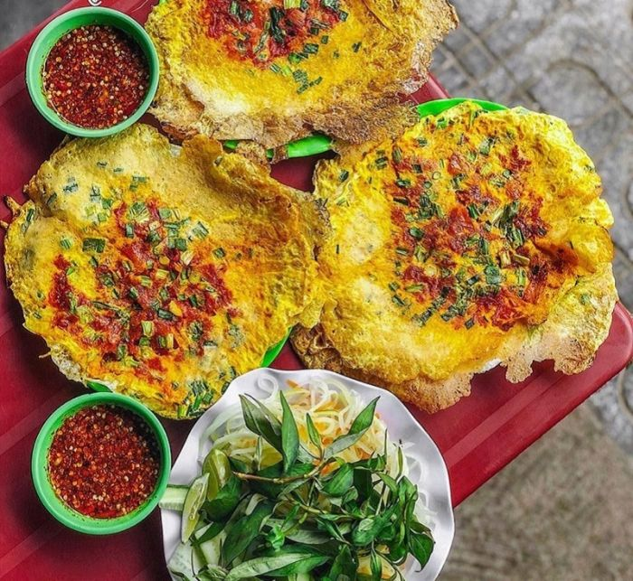
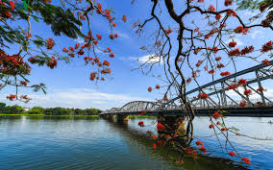
Wednesday, March 6th 2024
UNIT 9: CITIES OF THE WORLD
Visit Hue and try your food.
its

Slide 15
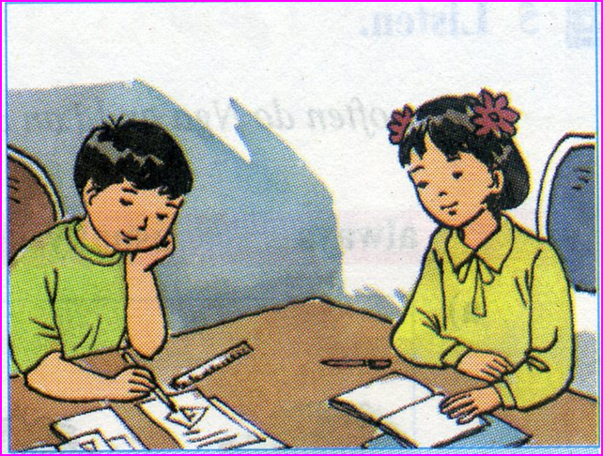
homework
Redo all exercises in the textbook
Prepare for REVIEW 3

