Slide 1
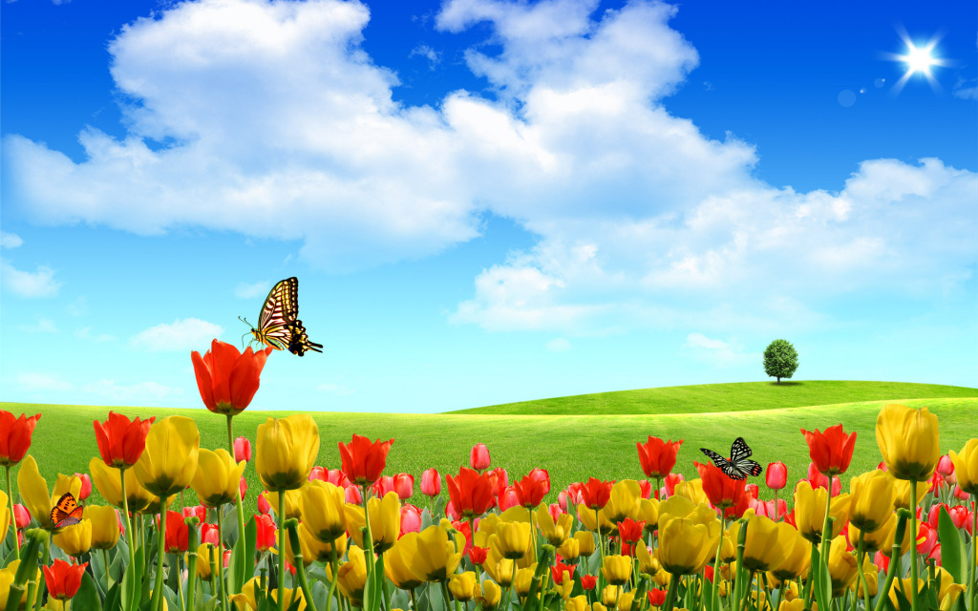
HELLO EVERY ONE!!!

Slide 2


Game
You choose a number, look at some
pictures and find out the keywords
1
2
3

Slide 3

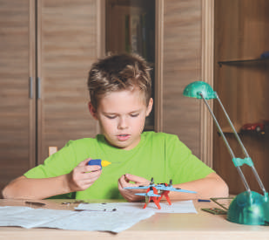
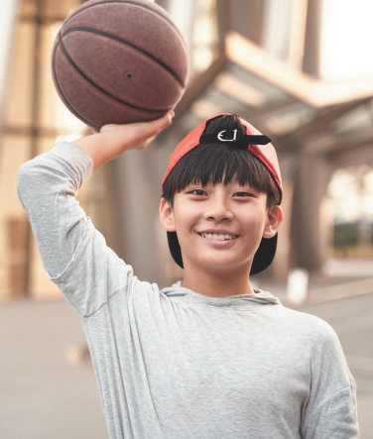

What do these pictures talk about?
HOBBY

Slide 4
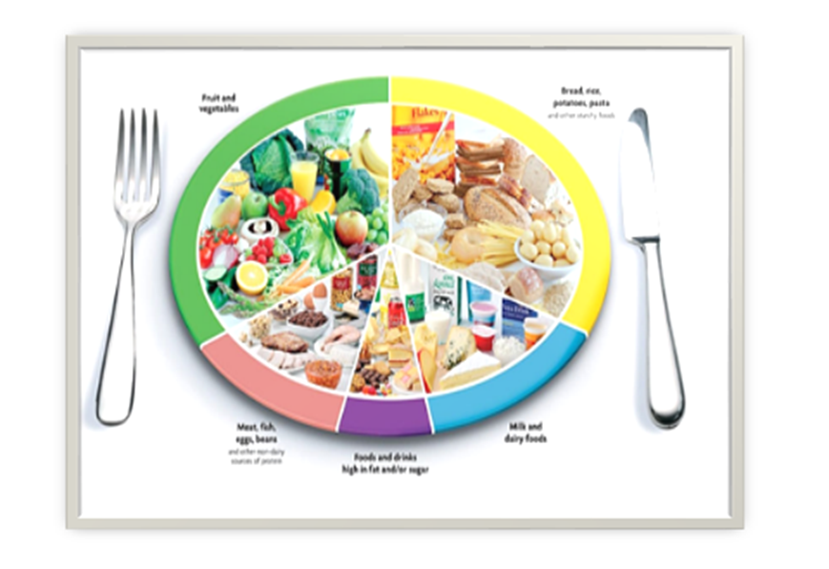
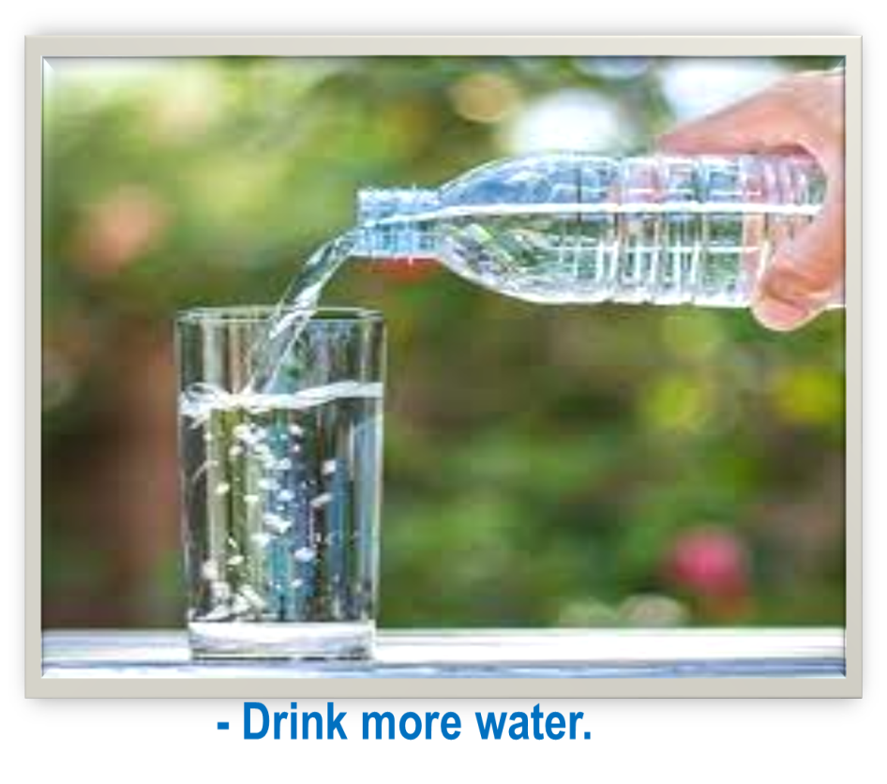
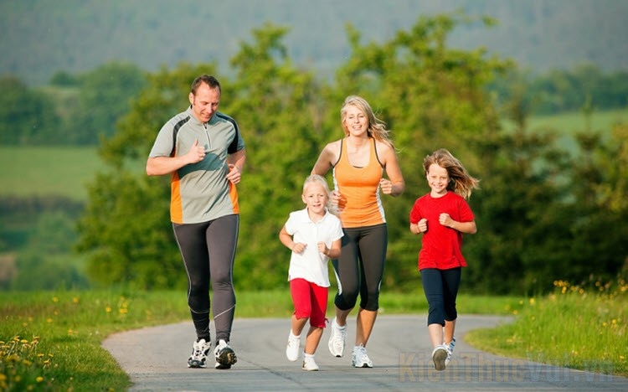
What do these pictures talk about?
Healthy living

Slide 5
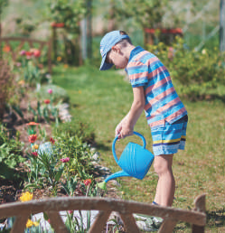
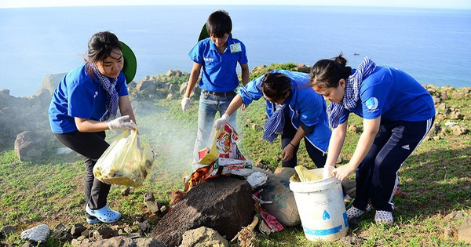
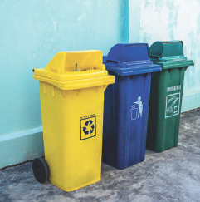
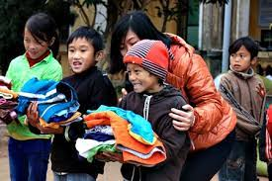
What do these pictures talk about?
COMMUNITY
SERVICE

Slide 6



REVIEW
1
LESSON 1: LANGUAGE
Pronunciation
Vocabulary
Grammar
UNITS
1-2-3
HOBBIES

Slide 7

* PRONUNCIATION
1
Circle the word in which the underlined part is pronounced differently. Then listen, check and repeat
1. A. proverb B. together C. exercise
2. A. learn B. earn C. hear
3. A. collected B. cleaned C. decided
4. A. listened B. helped C. watched
5. A. laugh B. ghost C. rough

Slide 8
* VOCABULARY
2
Put the phrases below in the correct columns.
raising money for charity
helping street children
doing sport
cleaning your room
collecting stamps
donating clothes
doing volunteer work
doing judo
Activities you do for…
yourself | your community
cleaning your room
collecting stamps
doing judo
doing sport
donating clothes
doing volunteer work
helping street children
raising money for charity

Slide 9
* VOCABULARY
3
Complete the sentences with the words and phrases below.
hobby, coloured vegetables, chapped lips, mountainous areas, taking photos, community
1. Eating ________________and exercising can help you keep fit and stay healthy.
2. The Donate a Book event helps children in _______________________.
3. My brother spends a lot of time making models. that’s his _________.
4. If you have ___________________, use lip balm.
5. There are many things you can do to help your ________________.
6. I love ________________ of the sunset
Game:
Lucky number

Slide 10
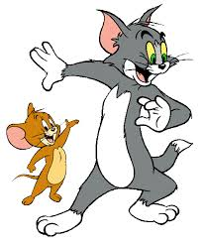
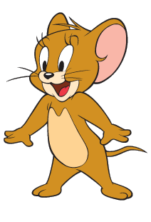
Questions: Lucky numbers
1
2
3
4
5
6
7
8

Slide 11
3
Complete the sentences with the words and phrases below.
hobby, coloured vegetables, chapped lips, mountainous areas, taking photos, community
1. Eating ____________________and exercising can help you keep fit and stay healthy.
coloured vegetables

Slide 12
3
Complete the sentences with the words and phrases below.
hobby, coloured vegetables, chapped lips, mountainous areas, taking photos, community
1.The Donate a Book event helps children in ___________________.
mountainous areas

Slide 13
3
Complete the sentences with the words and phrases below.
hobby, coloured vegetables, chapped lips, mountainous areas, taking photos, community
3. My brother spends a lot of time making models. that’s his _________.
hobby

Slide 14
3
Complete the sentences with the words and phrases below.
hobby, coloured vegetables, chapped lips, mountainous areas, taking photos, community
4. If you have _______________,use lip balm.
chapped lips

Slide 15
3
Complete the sentences with the words and phrases below.
hobby, coloured vegetables, chapped lips, mountainous areas, taking photos, community
5. There are many things you can do to help your ____________.
community

Slide 16
3
Complete the sentences with the words and phrases below.
hobby, coloured vegetables, chapped lips, mountainous areas, taking photos, community
6. I love ________________ of the sunset
taking photos

Slide 17


LUCKY NUMBER!
you get 2 plus points

Slide 18
LUCKY NUMBER!
you get 2 plus points

Slide 19
* VOCABULARY
3
Complete the sentences with the words and phrases below.
hobby, coloured vegetables, chapped lips, mountainous areas, taking photos, community
1. Eating _______________________ and exercising can help you keep fit and stay healthy.
2. The Donate a Book event helps children in _______________________.
3. My brother spends a lot of time making models. that’s his _________.
4. If you have ___________________, use lip balm.
5. There are many things you can do to help your ________________.
6. I love ________________ of the sunset
coloured vegetables
mountainous areas
hobby
chapped lips
community
taking photos

Slide 20
* GRAMMAR
4
Fill in the blanks with the correct tense of the verbs in brackets.
1. He often (read) ___________ books in dim light, so his eyes hurt.
2. ___________ you (do) ___________ the gardening at the weekend?
3. Ordinary people (need) ___________ about 2,000 calories a day to stay healthy.
4. I (cannot) ___________ ride a bicycle when I was 6.
5. Last summer Phong (not volunteer) _________________ to teach maths to street children.
6. We (join) ___________ the project Plant a Tree in 2019 to make our area green.
reads
Do
do
need
could not
didn’t volunteer
joined

Slide 21
* GRAMMAR
5
Turn the sentences into negative statements or questions.
1. She liked exercising. (not)
→ She ________________________________________________________.
2. My family always spends time doing housework together on Sundays. (not)
→ My family ___________________________________________________.
3. I used a lot of suncream during my holiday. (not)
→ I _________________________________________________________.
4. My community organised a fair to raise money for the homeless last week. (?)_________________________________________________________?
5. Tim makes beautiful pieces of art from dry leaves and sticks. (?)
→ __________________________________________________________?
didn’t like exercising
doesn’t always spend time doing housework together on Sunday
didn’t use a lot of sun cream during my holiday
Did your community organise a fair to raise money for the homeless last week
Does Tim make beautiful pieces of art from dry leaves and sticks

Slide 22
* CONSOLIDATION
1
WRAP-UP
Language
Pronunciation
Vocabulary
Grammar

Slide 23

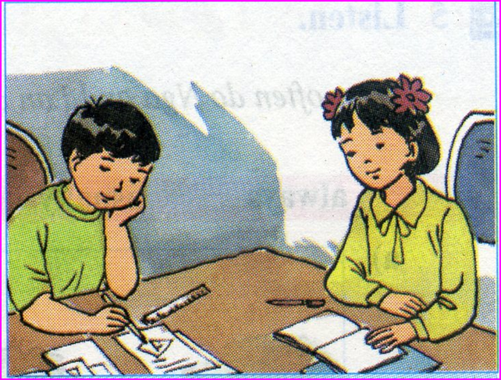
homework
Redo exercises
Prepare for Review 1 – Skills.

Slide 24

Goodbye.
See you again.

