Slide 1
Monday, November 25, 2002
Hello every one !!!
Mrs Thu Ba

Slide 2
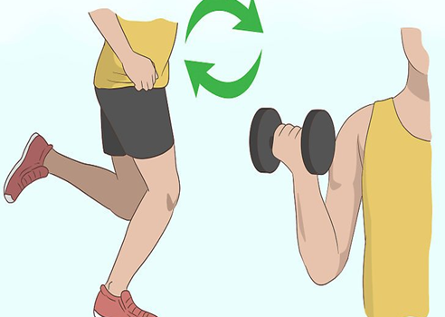
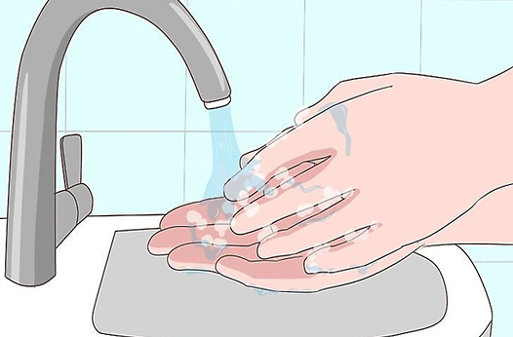
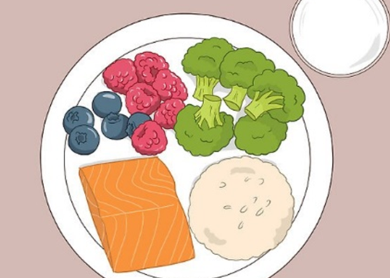
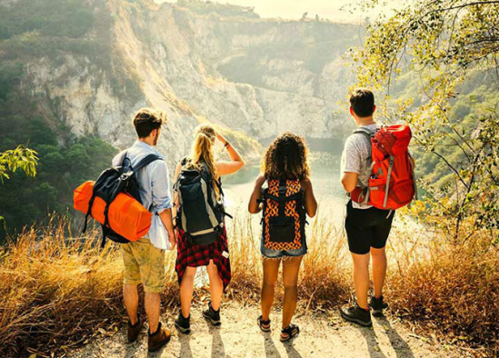
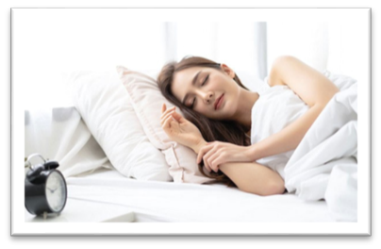
Warm up:
Game: Pelmanism
1
Get enough sleep
Personal hygiene
2
Do
exercise
3
4
5
Healthy diet
visit new places
How to get a healthy life
A
B
C
D
E

Slide 3
Warm up:
Game: Pelmanism
Some ways to get a healthy life
Do
exercise
Personal hygiene
Healthy diet
visit new places
Get enough sleep

Slide 4
How to get a healthy life

Slide 5
REVIEW
1
LESSON 2: SKILLS
Reading
Speaking
Listening
Writing
UNITS
1-2-3
HOBBIES

Slide 6
I. READING
1
Read the passage and choose the correct answer A, B, or C.
Happiness is the key to a healthy life. Here are some things you can do to make you happy.
Love others fully
When you love somebody, express your love. Don’t keep it to yourself. There are many ways to do it. For example, you can say “I love you” more often, do things together, and help them when they need you. You can make yourself and others happy by doing so.
Laugh more often
Laughter shows that you are happy, and it has the magic power of making others happy too. Laughter is like medicine. It helps people live longer.
Enjoy adventures
Visit a new place, do a new thing, or talk to a new person every week. You will get new knowledge and experience.

Slide 7
Choose the best answer

Slide 8
5
4
1
1. The phrase “the key” in the first line is closest in meaning to _________.
3
2
A. the first factor
B. the most important factor
C. the new factor

Slide 9
5
4
1
2. To show your love to other people, you ______.
3
2
A. give them money
B. take care of yourself
C. do things with them

Slide 10
5
3. The writer says “Laughter is like medicine” because _________.
4
1
3
2
A. it makes others laugh too
B. it helps you make friends
C. it helps people live longer

Slide 11
5
4
1
4. You can get knowledge and experience by ______
3
2
A. visiting new places
B. loving other people
C. laughing more often

Slide 12
5
4
1
5. The best title for this passage is “______”.
3
2
A. Live to be happy
B. Laughter is the power of happines
C. Happiness is hard to find

Slide 13
1
Read the passage and choose the correct answer A, B, or C.
1. The phrase “the key” in the first line is closest in meaning to ______. A. the first factor B. the most important factor C. the new factor
2. To show your love to other people, you ______. A. give them money B. take care of yourself C. do things with them

Slide 14
3. The writer says “Laughter is like medicine” because ______. A. it makes others laugh too B. it helps you make friends C. it helps people live longer
4. You can get knowledge and experience by ______. A. visiting new places B. loving other people C. laughing more often
5. The best title for this passage is “______”. A. Live to be happy B. Laughter is the power of happiness C. Happiness is hard to find

Slide 15
II. SPEAKING
2
Work in pairs. Interview each other, using the questions below. Take notes of the answers and then report the results to the class.
2
How much do you know about
community service?
1. Who can do community service?
2. Who needs community help?
3. What can you do to help them?

Slide 16
II. SPEAKING
2
Work in pairs. Interview each other, using the questions below. Take notes of the answers and then report the results to the class.
2
How much do you know about
community service?
1. Who can do community service?
➢ Anybody.

Slide 17
II. SPEAKING
2
Work in pairs. Interview each other, using the questions below. Take notes of the answers and then report the results to the class.
2
How much do you know about
community service?
2. Who needs community help?
➢ Street children, old and sick people, the poor , street animals, etc.

Slide 18
II. SPEAKING
2
Work in pairs. Interview each other, using the questions below. Take notes of the answers and then report the results to the class.
2
How much do you know about
community service?
3. What can you do to help them?
cooking / shopping for the old / the sick;
collecting books / clothes for street children;
opening classes to teach street children;
adopting a dog / a cat
…

Slide 19
III. LISTENING
3
Listen and complete each sentence with one word.
1. While camping, we have a lot of time for ____________. 2. When camping near the beach, we can build ____________. 3. We can have dinner by an ____________ fire. 4. At the campsite, there is no television or ____________. 5. Name one thing we should bring along when camping:
__________________________.
games
sandcastles
open
computer
food / water / compass/ sleeping bag/ insect cream

Slide 20
IV. WRITING
4
Write complete sentences to make a passage describing community activities
1. we / join / community activities / once a month.
_______________________________________________________ 2. last month / we / plant / trees / park.
_______________________________________________________ 3. we / dig / holes / put / young trees / in.
_______________________________________________________ 4. then / we / water / them / two or three weeks.
_______________________________________________________ 5. now / trees / grow / very well.
_______________________________________________________ 6. they / make / park / greener / air / fresher.
_______________________________________________________
We join community activities once a month.
Last month we planted (some) trees in the park.
We dug some holes to put the young trees in.
Then we watered them for two or three weeks.
Now the trees are growing very well.
They will make the park greener and the air fresher.

Slide 21
* CONSOLIDATION
1
WRAP-UP
Reading
Speaking
Listening
Writing
UNITS
1-2-3

Slide 22
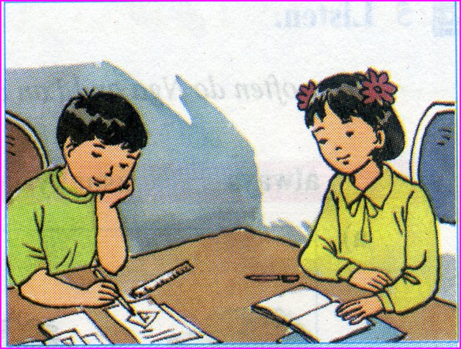
homework
Review all language contents.
Prepare: The first 45 minute - test

Slide 23
Thank you!
Goodbye!

