Slide 1
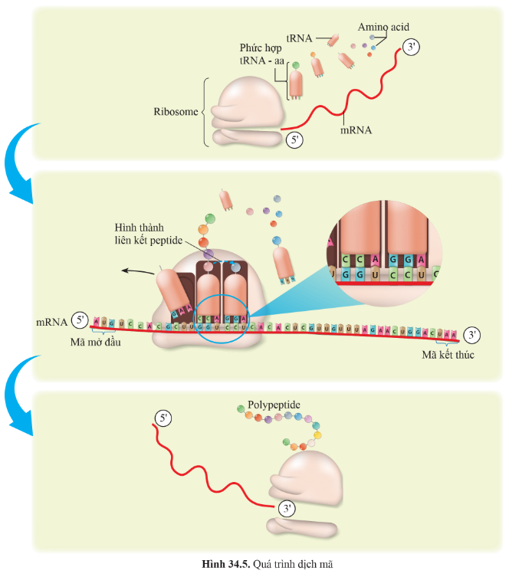

Slide 2
Ser
Thr
Val
Thr
Arg
Tir
Ser
Val
Met
Arg
Met
Arg
A
U
X
G
C
Tir
C
U
G
C
G
U
G
G
A
C
A
G
A
A
U
U
Gly
C
G
G
C
A
C
A
G
A
G
G
G
U
U
C
G
G
G
G
A
U
A
A
C
C
C
C
U
C
C
U
U
C

Slide 3
Ser
Ser
Thr
Arg
Val
Arg
Met
Arg
Val
G
Thr
C
G
C
A
Tir
G
Tir
A
U
C
Gly
X
G
G
C
G
U
U
G
A
A
G
U
C
A
Met
C
C
A
U
G
A
G
G
G
A
G
U
C
G
U
G
G
A
U
A
C
A
C
C
C
U
C
C
C
U
U

Slide 4
Ser
Tir
Thr
Thr
Val
Arg
Met
Ser
Arg
A
U
Arg
G
G
C
Tir
A
U
G
U
Gly
X
G
G
G
A
G
C
C
G
C
A
Met
Val
C
C
C
U
A
A
U
A
G
U
G
G
G
G
C
G
G
G
A
U
A
C
A
C
C
C
A
C
C
C
U
U
U
U

Slide 5
Ser
Tir
Thr
Thr
Val
Arg
Met
Ser
Arg
A
U
X
G
G
C
A
U
G
U
Tir
A
U
Gly
C
G
G
G
A
G
Met
Val
Arg
C
A
C
C
C
C
G
U
A
G
G
G
G
G
C
G
G
A
G
A
U
A
C
A
C
C
C
A
C
C
C
U
U
U
U
U

Slide 6
Met
Ser
Thr
Thr
Val
Arg
C
Ser
A
Arg
U
A
U
G
C
Tir
U
G
C
Gly
A
U
C
G
G
G
A
G
Met
Val
Arg
Tir
A
C
C
C
G
C
A
G
U
G
G
G
G
G
C
G
G
A
G
A
C
A
C
A
C
C
A
C
U
C
C
U
U
U
U
U

Slide 7
Arg
Arg
Val
Tir
Met
Arg
Thr
C
C
C
G
U
A
A
U
C
C
A
U
Gly
C
G
G
G
U
G
Met
Val
Arg
Tir
Ser
C
A
C
G
G
A
A
G
U
G
U
U
G
G
G
G
C
G
G
A
G
A
A
A
C
C
C
C
A
C
C
C
U
U
U
U

Slide 8
Arg
Ser
Met
Tir
Val
Arg
C
C
U
G
G
A
C
A
G
C
A
C
U
U
G
A
Gly
A
U
X
G
G
Met
Val
Arg
C
A
Tir
C
Ser
Thr
G
G
G
A
U
G
G
G
G
G
G
C
G
G
A
G
A
A
A
C
U
C
U
U
C
A
C
C
C
C
U
U
U

Slide 9
Arg
Ser
Met
Val
Tir
Arg
C
C
U
G
G
A
C
C
A
G
C
U
A
A
U
A
G
Gly
U
X
G
G
Met
Val
Arg
Tir
Ser
Thr
C
A
C
G
U
G
G
G
G
G
G
C
G
G
A
G
A
C
A
A
C
U
C
U
U
C
A
C
C
C
U
U
U

Slide 10
Dịch mã là quá trình tổng hợp chuỗi polypeptide dựa trên trình tự nucleotide của mRNA.
Các thành phần tham gia dịch mã: mRNA, tRNA, ribosome, amino acid tự do.

