Slide 1
Phu Hoa education and training office
HOA AN SECONDARY SCHOOL
Unit 3: FRIENDS
Period 24: New words & Reading
Teacher: Trương Thị Mỹ Hiền
Class: 6

Slide 2
Warm up:

Slide 3
Listen to a song twice and list all the verbs that you can hear.
27
25
23
30
29
28
26
24
22
21
20
19
18
17
16
15
14
13
12
11
10
09
08
07
06
05
04
03
02
01
00
Hết
giờ
doing
eating
drinking
Start
running
swimming
drawing
walking
cooking
sleeping

Slide 4
UNIT 3
FRIENDS

Slide 5
Thursday , October 27th, 2022
Unit 3: FRIENDS
Period 24: New words & Reading
I. NEW WORDS

Slide 6
Play badminton
(v)
/pleɪ ˈbædmɪntən/
Chơi cầu lông
She is playing badminton with her friends.
Cô ấy đang chơi cầu long với các bạn,

Slide 7
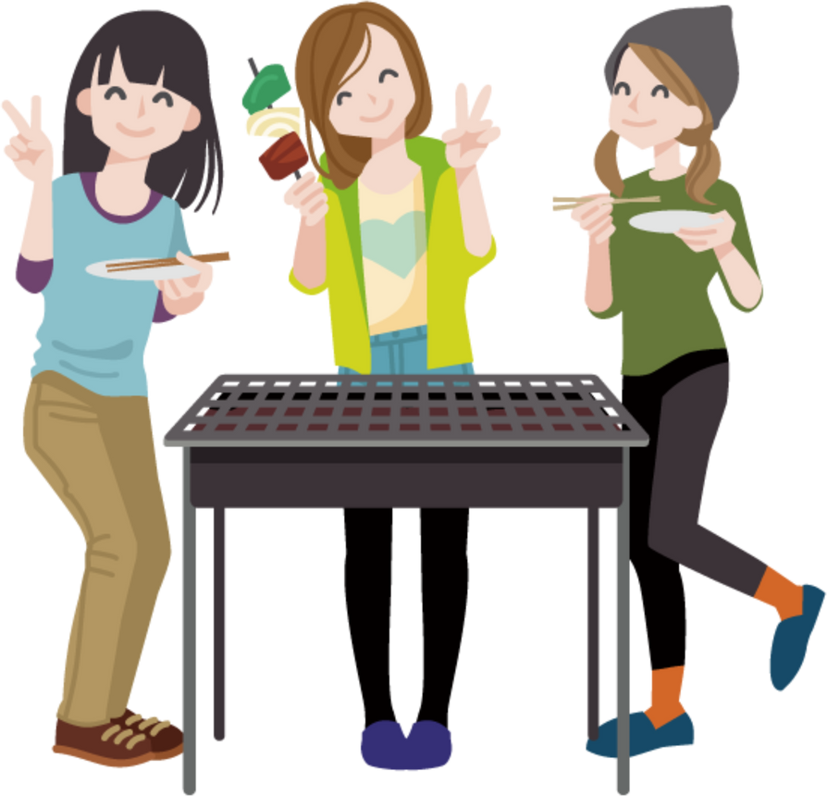
Have barbecue
(v)
/hæv ˈbɑːbɪkjuː/
Ăn đồ nướng
We are having barbecue now.
Do you want to come with us?
Chúng mình đang ăn thịt nướng.
Bạn có muốn đến cùng chúng tớ không?

Slide 8
Beach
(n)
/biːʧ/
Bãi biển
They are going to the beach this weekend.
Cuối tuần này họ sẽ đi đến bãi biển.

Slide 9
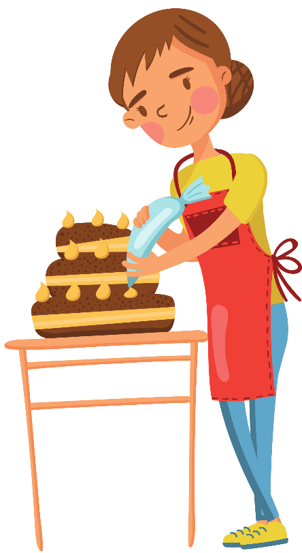
Make a cake
(v)
/meɪk ə keɪk/
Làm bánh
My mother is making a delicious cake for me.
Mẹ mình đang làm cho mình một chiếc bánh rất ngon.

Slide 10
Go to the mall
/gəʊ tuː ðə mɔːl/
Đi trung tâm thương mại
She is going to the mall to buy a dress for her mother.
Cô ấy đang đi đến trung tâm thương mại để mua cho mẹ của cô ấy một chiếc váy.

Slide 11
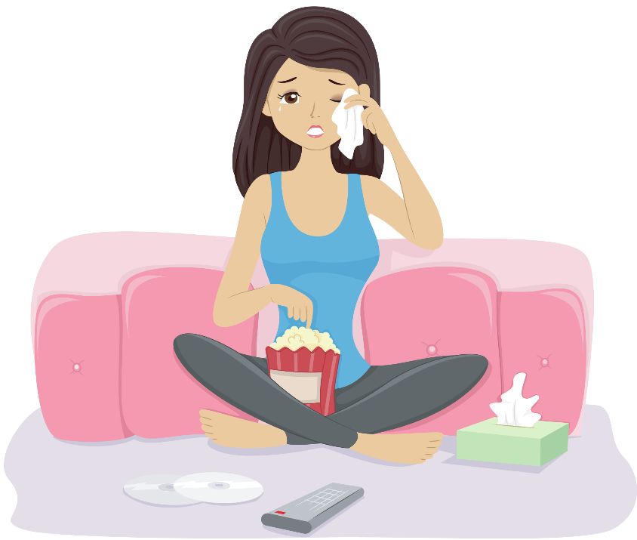
Watch a movie
(v)
/wɒʧ ə ˈmuːvi/
Xem phim
She is watching a movie in the living room.
Cô ấy đang xem phim ở phòng khách.

Slide 12
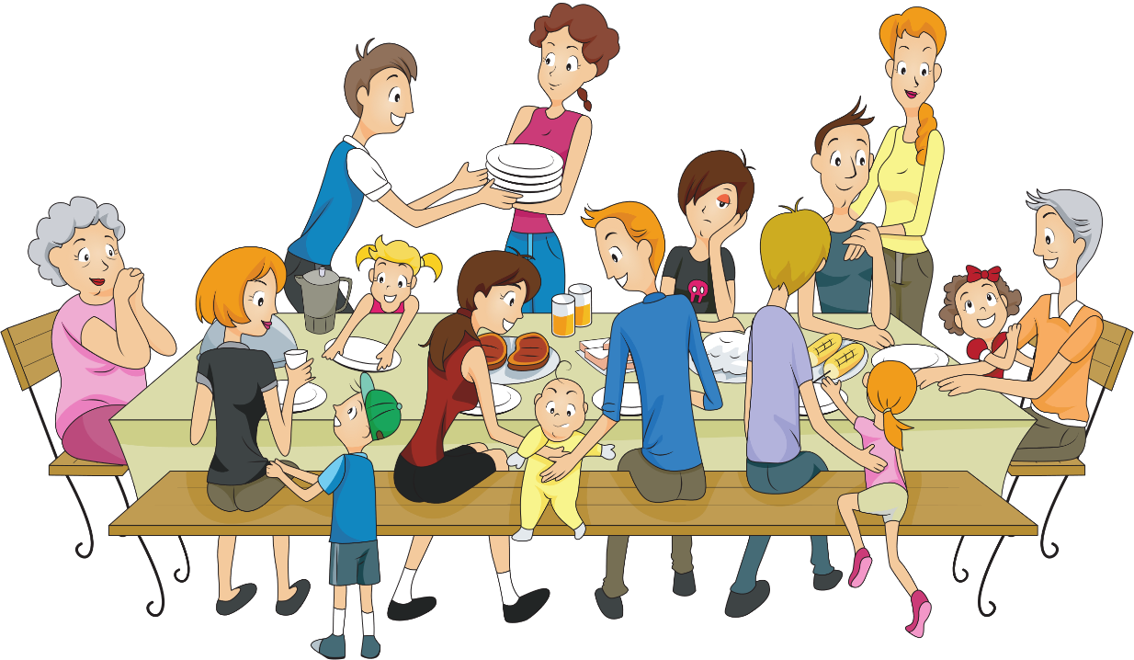
Have a party
(v)
/hæv ə ˈpɑːti/
Có 1 bữa tiệc
They are having a big party.
Họ đang có một bữa tiệc rất thịnh soạn.

Slide 13
Pizza
(n)
ˈpiːtsə/
Bánh pizza
Jenny is making a pizza for me.
Jenny đang làm bánh pizza cho tớ.

Slide 14
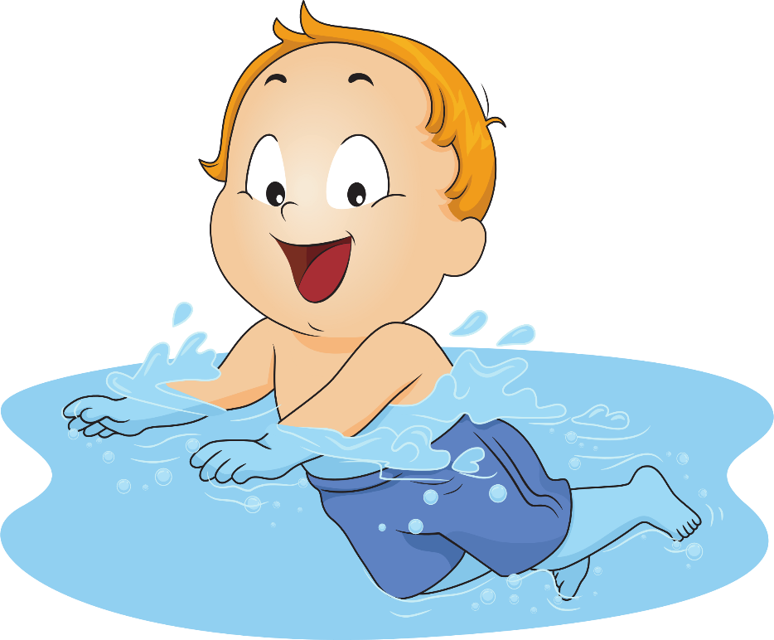
Go swimming
(v)
/gəʊ ˈswɪmɪŋ/
Đi bơi
He is going swimming with his friends this Sunday.
Anh ấy sẽ đi bơi cùng bạn vào Chủ nhật tuần này.

Slide 15
Watch television
(v)
/wɒʧ ˈtɛlɪˌvɪʒən /
Xem ti vi
The children are watching television in the bedroom.
Bọn trẻ đang xem ti vi ở trong phòng phủ.

Slide 16
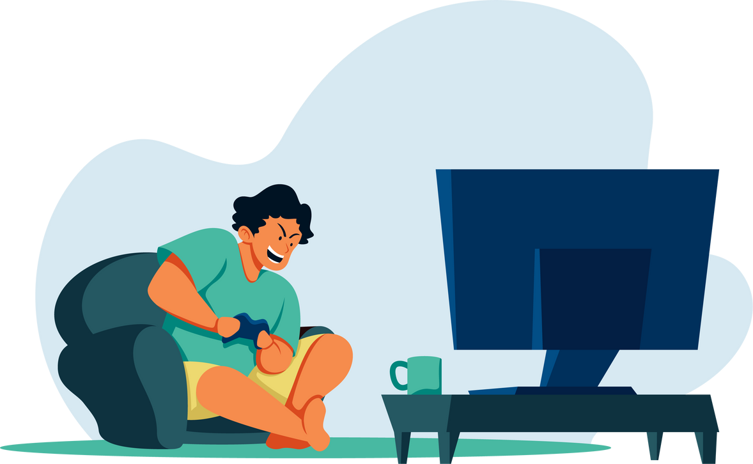
Play video games
(v)
/pleɪ ˈvɪdɪəʊ geɪm/
Chơi điện tử
My brother likes playing video games.
Anh trai mình thích chơi điện tử.

Slide 17
Page 25- student’s book
a. Fill in the table. Listen and repeat.
shopping a movie (X2) a party swimming TV badminton (a) pizza(x2)
to the beach a barbecue video games to the mall a cake (X2)
go
play
have
watch
make
shopping
__________
a movie
a pizza
__________
badminton
a party
__________
__________
__________
__________
__________
a pizza
a cake
swimming
video games
__________
__________
__________
TV
to the mall
__________
a barbecue
a movie
__________
__________
__________
__________
a cake
__________
__________
__________
to the beach
__________
__________

Slide 18
b. Add more words to the table
go | play | have | watch | make

Slide 19
II.Reading
Hey, Lisa, what are you doing on Friday?
Read the message and fill in the blanks
with the words from New Words.
I’m free ,Why?
having
I’m (1) _______a barbecue at my house. Do you want to come?
Sure, What time?
Come to my house at 6:00
going
I’m (2)__________swimming with my sister then. Can I come at 6:30?
Yeah, no problem. What are you doing this Saturday?
going
I’m(3)__________shopping with my mom in the morning.
playing
I’m (4)__________badminton at the sports center in the afternoon.
Do you want to come?
Sure, It sounds fun
Ok! I’ll see you this Friday. Bye
Bye, thanks for inviting me

Slide 20
Thursday , October 27th, 2022
Unit 3: FRIENDS
Period 24: New words & Reading
II.Reading
Notes:
- free (a) # busy :
sure (a):
No problem ! :
It sounds fun ! :
Thanks for inviting me:
Do you want to come ?
= Would you like to come?
Come to my house at ….

Slide 21
II.Reading
Hey, Lisa, what are you doing on Friday?
Read the message and fill in the blanks
with the words from New Words.
I’m free ,Why?
having
I’m (1) _______a barbecue at my house. Do you want to come?
Sure, What time?
Come to my house at 6:00
going
I’m (2)__________swimming with my sister then. Can I come at 6:30?
Yeah, no problem. What are you doing this Saturday?
going
I’m(3)__________shopping with my mom in the morning.
playing
I’m (4)__________badminton at the sports center in the afternoon.
Do you want to come?
Sure, It sounds fun
Ok! I’ll see you this Friday. Bye
Bye, thanks for inviting me

Slide 22
Make an invitation
A: Hey ,…… What are you doing on………?
B: I’m free. Why ?
A: I’m………………………….. Do you want to come ?
B: Sure . What time?
A: Come to my house at …….
B: I’m ………. with my….. Can I come at ……?
A: Yeah, No problem. What are you doing this ….?
B: I’m ……..with my ….. in the morning.
A:I’m playing……. at the sports center in the afternoon.
Do you want to come?
B: Sure. It sounds fun.
A: OK. I’ll see you this ….. Bye.
B: Bye . Thanks for inviting me.

Slide 24
WRAP-UP
* Collocation:
1. Go: to school, to the movies, sailing, for a walk, …
2. Play: ping-pong, tennis, chess, board games, …
3. Have: a party, a talk, a meeting, a headache, …
4. Watch: a movie , a film, a football match, …
5. Make: a cake, dinner, the bed,…
* Invitation:
1. Do you want to come? / Would you like to come?
2. Come to my house

Slide 25
HOMEWORK
- Learn by heart the collocation.
- Make sentences with collocation with “go”, have”, “watch”, “play” and “make”.
- Do exercises in Workbook: Lesson 2 - New words – Part a and b (page 16).
- Prepare: Lesson 2 – Grammar (page 26 – SB).

