Slide 1


Slide 2


Unit
2
LIFE IN THE COUNTRYSIDE
LESSON 1: GETTING STARTED
Last summer holiday
Giáo viên; Đào Kim Mười

Slide 3
LESSON 1: GETTING STARTED
WARM-UP
Video watching
Vocabulary
PRESENTATION
Task 1: Listen and read.
Task 2: Read the conversation and choose the correct answer to each question.
Task 3: Complete the sentences with the words and phrases from the box.
Task 4: Match the activities that people living in the countryside often do with the pictures.
PRACTICE
PRODUCTION
Task 5: Work in pairs. ask and answer about the pictures in 4.
CONSOLIDATION
Wrap-up
Homework

Slide 4

WARM-UP
1. What did you do last summer?
2. What is the video about?
Answer the questions:
LIFE IN THE COUNTRYSIDE

Slide 5
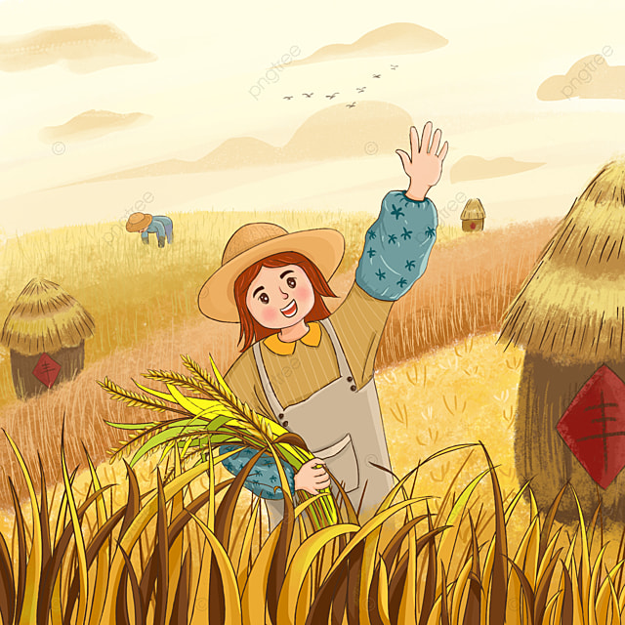

PRESENTATION
harvest (v)
/ˈhɑːvɪst/
thu hoạch

Slide 6
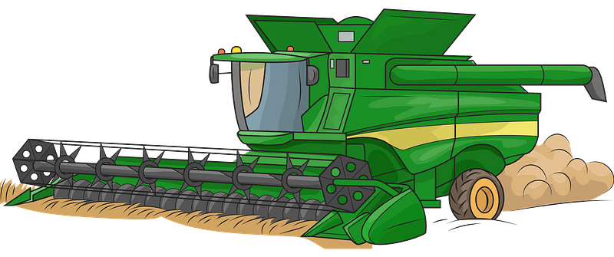
PRESENTATION
combine harvester (n)
/kəmˈbaɪn ˈhɑːvɪstər /
máy gặt

Slide 7
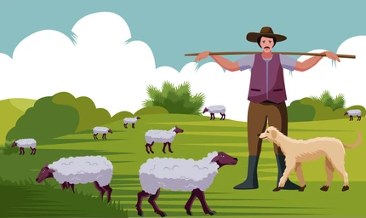
PRESENTATION
herd (v)
/hɜːd/
chăn (gia súc)

Slide 8
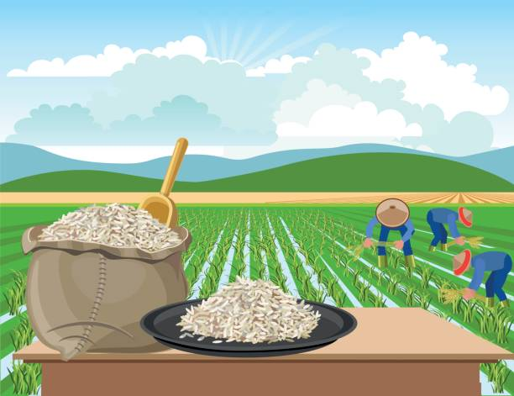
PRESENTATION
paddy field (n)
/ˈpædi ˌfiːld/
cánh đồng lúa

Slide 9
PRESENTATION
New words | Pronunciation | Meaning
1. harvest (v) | /ˈhɑːvɪst/ | thu hoạch
2. combine harvester (n) | /kəmˈbaɪn ˈhɑːvɪstər/ | máy gặt
3. herd (v) | /hɜːd/ | chăn
4. paddy field (n) | /ˈpædi ˌfiːld/ | đồng lúa

Slide 10
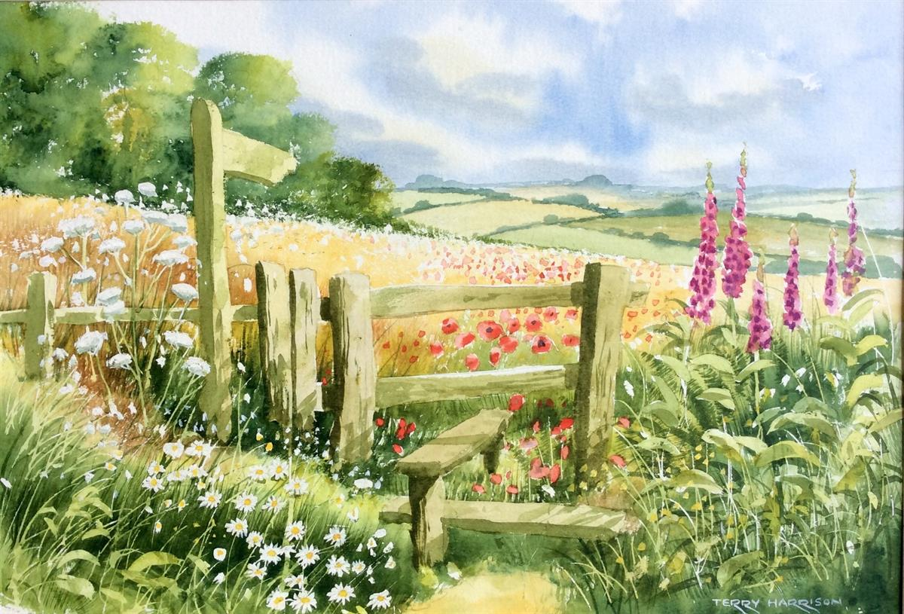
PRACTICE
1
Listen and read.
Nick: You look great with a tan, Mai!
Mai: Thank you. I’ve just come back from a very enjoyable summer holiday.
Nick: Really? Where did you stay?
Mai: I stayed at my uncle’s house in a small village in Bac Giang Province.
Nick: What did you do there?
Mai: A lot of things. It was harvest time. The villagers were harvesting rice with a combine harvester. I helped them load the rice onto a truck. Then we unloaded the rice and dried it.
Nick: Sounds great!
Mai: And sometimes I went with the village children to herd the buffaloes and cows. I made friends with them on my first day.
Nick: Were they friendly?
Mai: Yes, they were. They took me to the paddy fields to fly kites. And in the evening, we played traditional games like bamboo dancing and dragon-snake.
Nick: Oh, I envy you!
Mai: Things move more slowly there than in our city, but people seem to have a healthier life.

Slide 11
PRACTICE
2
Read the conversation again and choose the correct answer to each question.
1. How does Mai feel about her summer holiday?
A. She likes it.
B. She doesn’t like it.
C. She thought it was fine.
2. Where did she stay during her summer holiday?
A. At her friend’s house.
B. At her uncle’s house.
C. At her grandparents’ house.

Slide 12
PRACTICE
2
Read the conversation again and choose the correct answer to each question.
3. During harvest time, people harvest rice by ______.
A. themselves
B. using a truck
C. using a combine harvester
4. Mai thinks people in the countryside lead ______.
A. a healthy life
B. an exciting life
C. an interesting life

Slide 13
PRACTICE
3
Complete the sentences with the words and phrases from the box.
paddy field
herd
harvest time
load
combine harvester
1. It took them an hour to ___________ all the goods onto the truck.
2. Nowadays, people in my village use a __________________ to harvest their rice and separate the grains from the rest of the plant.
3. Today it is my turn to __________ the cows.
4. A place in which people grow rice is called a _______________.
5. A busy time when people cut and gather their crops is called _____________.

Slide 14
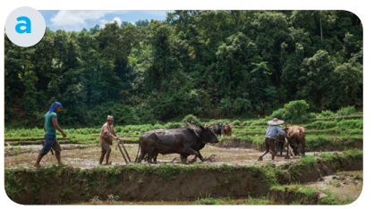
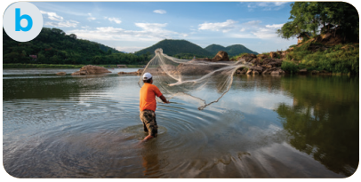
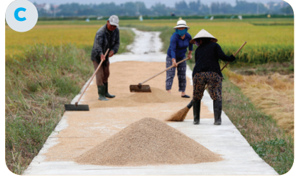
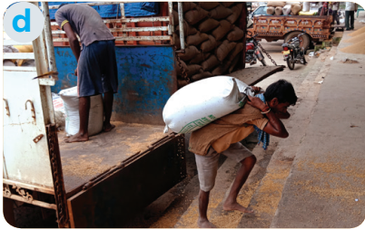
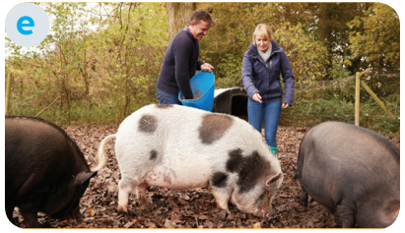
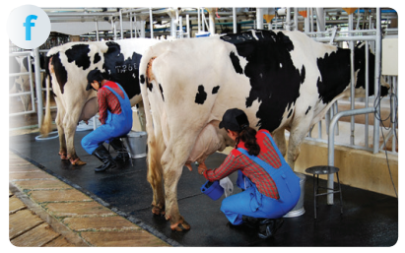
PRACTICE
4
Match the activities that people living in the countryside often do with the pictures.
1. unloading rice
2. ploughing fields
3. milking cows
4. feeding pigs
5. catching fish
6. drying rice

Slide 15



PRODUCTION
5
Work in pairs. ask and answer about the pictures in 4
Example:
A: What are they doing in picture a?
B: They’re ploughing fields

Slide 16

CONSOLIDATION
1
Wrap-up
What have we learnt in this lesson?
identify the topic of the unit
use lexical items related to life in the countryside
identify the language features that are covered in the unit

Slide 17

CONSOLIDATION
2
Homework
Do exercises in the workbook.
Start preparing for the Project of the unit.

Slide 18

Website: hoclieu.vn
Fanpage: facebook.com/www.tienganhglobalsuccess.vn/

