Slide 1


Slide 2



Unit
7
TRAFFIC
LESSON 2: A CLOSER LOOK 1
VOCABULARY
PRONUNCIATION
Unit
HOBBIES

Slide 3
WARM-UP: JUMBLED WORDS
MEANS OF TRANSPORT
1- OTBA
2- ITANR
3- NPEILARA
4- RCA
5- OTMIROEKB
-> BOAT
-> TRAIN
-> AIRPLANE
-> CAR
-> MOTORBIKE

Slide 4

VOCABULARY
road sign (n)
/ˈrəʊd saɪn/
biển báo giao thông

Slide 5
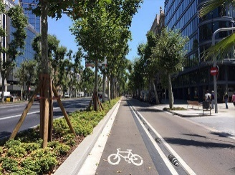
VOCABULARY
cycle lane (n)
/ˈsaɪkl leɪn/
làn đường
dành riêng cho xe đạp

Slide 6

VOCABULARY
traffic light (n.phr.)
/ˈtræfɪk laɪt/
đèn giao thông

Slide 7
VOCABULARY
New words | Pronunciation | Meaning
1. road sign (n.phr.) | /ˈrəʊd saɪn/ | biển báo giao thông
2. cycle lane (n.phr.) | /ˈsaɪkl leɪn/ | làn đường dành riêng cho xe đạp
3. traffic light (n.phr.) | /ˈtræfɪk laɪt/ | đèn giao thông

Slide 8
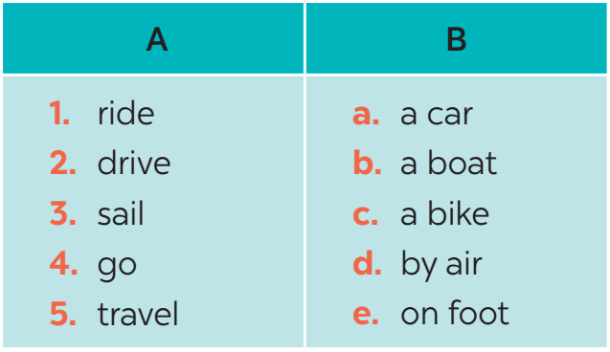
VOCABULARY
1
Match the words in A with the phrases in B.
1. c
2. a
3. b
4. e
5. d

Slide 9

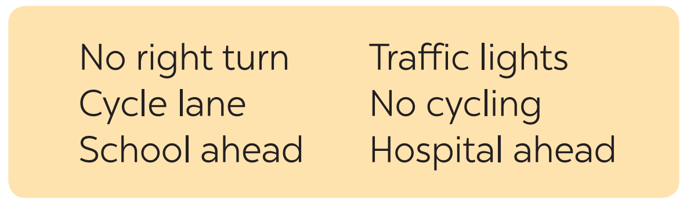




VOCABULARY
2
Look at these road signs. Then write the correct phrases under the signs.
1.
Traffic lights
2.
Hospital ahead
3.
No right turn
4.
Cycle lane
5.
School ahead
6.
No cycling

Slide 10

VOCABULARY
3
Work in pairs. Take turns to say which of the signs in 2 you see on the way to school.

Slide 11

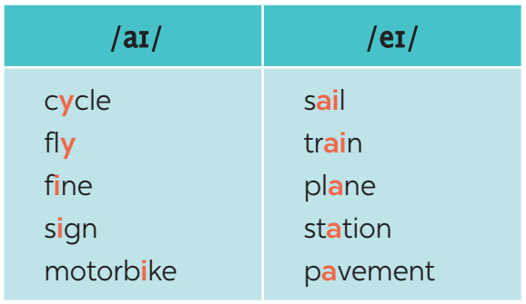
PRONUNCIATION
4
Listen and repeat. Pay attention to the sounds /aɪ/ and /eɪ/.

Slide 12


PRONUNCIATION
/aɪ/ and /eɪ/
Aims of the stage:
To help Ss identify the and classify the sounds
To give students authentic practice in pronouncing sounds in common words

Slide 13
PRONUNCIATION
5
Underline the words with the sound /aɪ/ and circle the words with the sound /eɪ/. Then listen, check and repeat
1. The bus station is far from my house.
2. Remember to ride your bike carefully.
3. We must obey traffіc rules for our safety.
4. You have to get there in time for the train.
5. Don’t ride on the pavement.

Slide 14
CONSOLIDATION
1
WRAP-UP
VOCABULARY
PRONUNCIATION

Slide 15

CONSOLIDATION
2
HOMEWORK
Exercises in the workbook

Slide 16

Website: hoclieu.vn
Fanpage: facebook.com/www.tienganhglobalsuccess.vn/

