Slide 1

UNIT 7: TRAFFIC
Lesson 1: Getting started

Slide 2
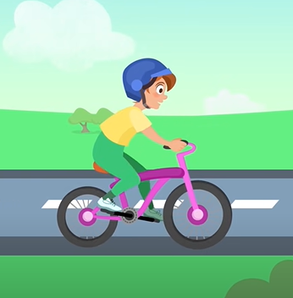
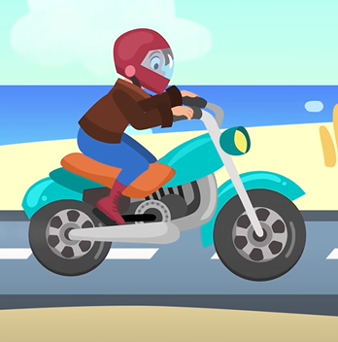
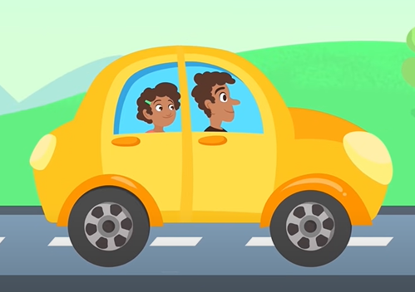
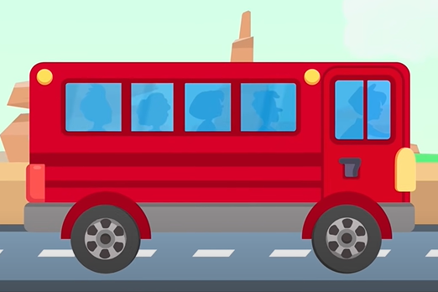
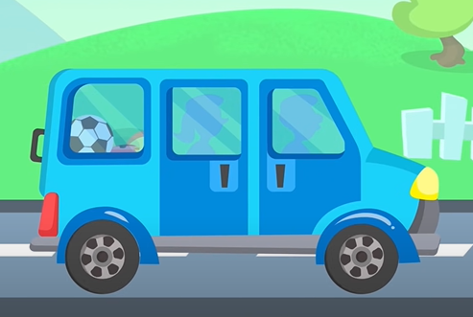
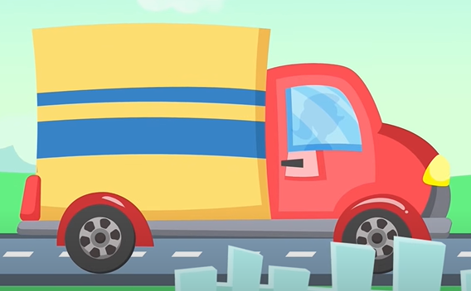
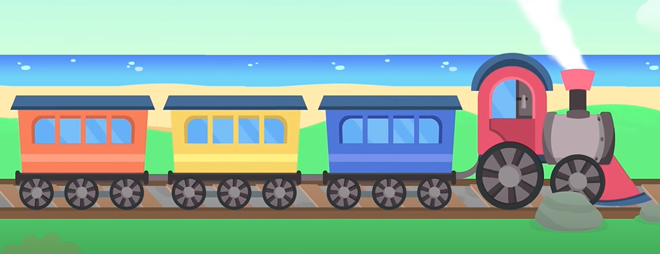
List some means of transportation you remember
bike
motorbike
car
bus
van
truck
train

Slide 3



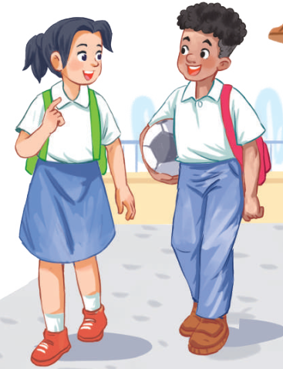
Unit
7
TRAFFIC
LESSON 1: GETTING STARTED
Meeting in the school yard
Unit
HOBBIES

Slide 4
Look and answer.
1. Who are they?
They are Lan and Mark.
2. Where are they?
They are in the school yard.
3. What are they talking about?
sports
traffic
films

Slide 5
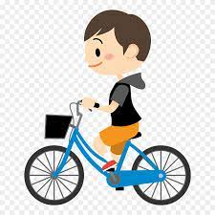
PRESENTATION
cycle (v)
/ˈsaɪkl/
ĐẠP XE

Slide 6
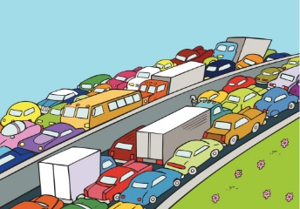
PRESENTATION
traffic jam (n)
/ˈtræfɪk dʒæm/
TẮC ĐƯỜNG

Slide 7
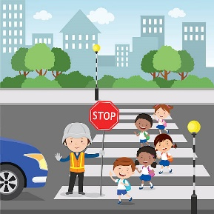
PRESENTATION
cross the road (v)
/krɒs ðə rəʊd/
BĂNG QUA ĐƯỜNG

Slide 8
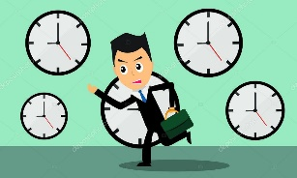
PRESENTATION
rush hour (n)
/ˈrʌʃ aʊə(r)/
GIỜ CAO ĐIỂM

Slide 9
PRESENTATION
New words | Pronunciation | Meaning
cycle (v) | /ˈsaɪkl/ | đạp xe
traffic jam (n) | /ˈtræfɪk dʒæm/ | tắc đường
cross the road (v) | /krɒs ðə rəʊd/ | băng qua đường
rush hour (n) | /ˈrʌʃ aʊə(r)/ | giờ cao điểm

Slide 10
crowded /ˈkraʊdɪd/(adj) :
careful /ˈkeəfl/ (adj) :
sounds really healthy
By the way:
Should : (modal verb)
Especially (adv):
Nomally (adv):
đông đúc
Cẩn thận
Nghe có vẻ rất tốt cho sức khỏe.
Nhân tiện
nên
đặc biệt
Bình thường

Slide 11
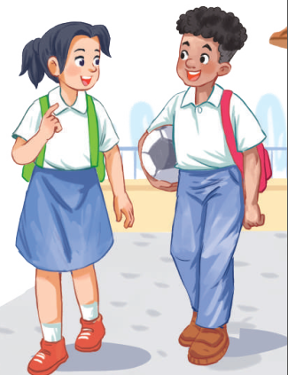

PRESENTATION: LISTEN AND READ
Lan: Hi, Mark. How are you?
Mark: Good, thanks. And you?
What did you do last Sunday?
Lan: I’m fine. Last Sunday afternoon,
I cycled round the lake near my home.
Mark: That sounds really healthy.
By the way, do you often cycle to
school too?
Lan: Yes, but sometimes my mum takes
me on her motorbike.
Mark: How far is it from your home
to school?
Lan: It’s about two kilometres.
Mark: How long does it take you to
cycle there?
Lan: About 10 minutes. Sometimes,
when there are traffic jams, it takes
longer.
Mark: You should be careful, especially
when you cross the road.
Lan: Right. The roads get really crowded.
Mark: Hey, how about going cycling
round the lake this Sunday?
Lan: Great! Can you come to my house
at 3 p.m.?
Mark: OK, Lan. See you then.

Slide 12
Look and answer.
3. What are they talking about?
sports
traffic
films
Lan: About 10 minutes. Sometimes,
when there are traffic jams, it takes
longer.
Mark: You should be careful, especially
when you cross the road.
Lan: Right. The roads get really crowded.
By the way, do you often cycle to
school too?

Slide 13
PRACTICE
2
Read the conversation and choose the correct answer
1. How does Lan often go to school?
A. By bicycle. B. By motorbike. C. On foot.
2. It normally takes Lan ___ to get to school.
A. two minutes B. ten minutes C. twenty minutes
3. Lan and Mark agree to go cycling ______.
A. tomorrow B. every day C. at the weekend

Slide 14
PRACTICE
3
Write one word from the conversation to complete each sentence.
1. Last Sunday afternoon, Lan ______ round the lake near her home.
2. Mark says to Lan: “You ______ be careful, especially when you cross the road.
3. Traffic ______ are a problem in big cities.
4. – ______ does your mum go shopping?
– She often walks.
5. This road is very __________ during the rush hours.,
cycled
should
jams
How
crowded

Slide 15
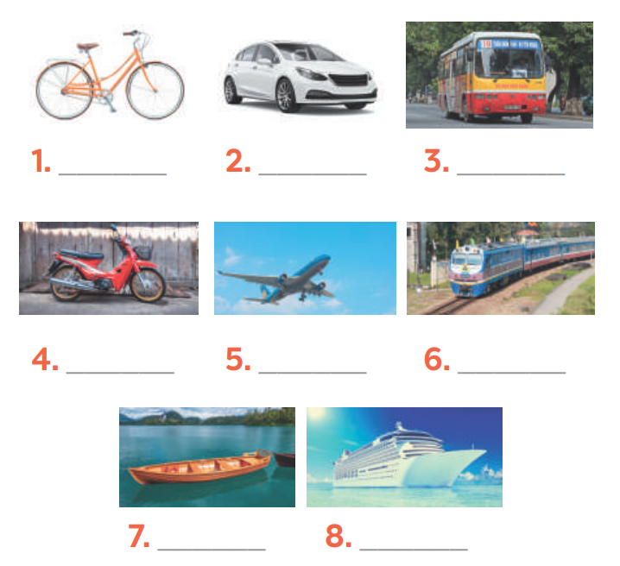
PRACTICE
4
Look at the pictures and write a word under each.
bicycle
car
bus
motorbike
air-plane
train
boat
ship

Slide 16
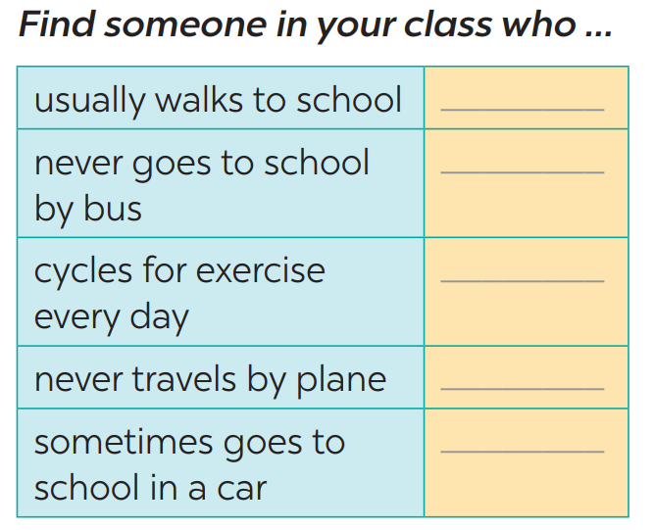

PRODUCTION
5
Find someone who … Write your friends’ names in the blanks. Then report to the class

Slide 17
CONSOLIDATION
1
WRAP-UP
TRAFFIC
MEANS OF TRANSPORT
TRAFFIC PROBLEMS
Topic of the unit
Vocabulary

Slide 18
CONSOLIDATION
HOMEWORK
talk about the traffic in your neighbourhood
Prepare the vocabulary for the next lesson: A closer look 1.

Slide 19


