Slide 1
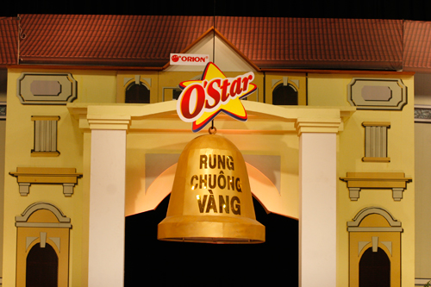

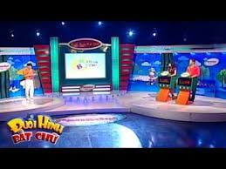
OLYMPIC
ENGLISH
Catch the word

Slide 2
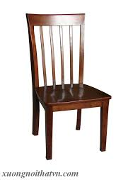
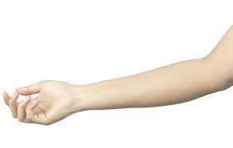
30
29
28
27
26
25
24
23
22
21
20
19
18
17
16
15
14
13
12
11
10
9
8
7
6
5
4
3
2
1
0
Picture 1
armchair

Slide 3


30
29
28
27
26
25
24
23
22
21
20
19
18
17
16
15
14
13
12
11
10
9
8
7
6
5
4
3
2
1
0
Picture 2
sunflower

Slide 4

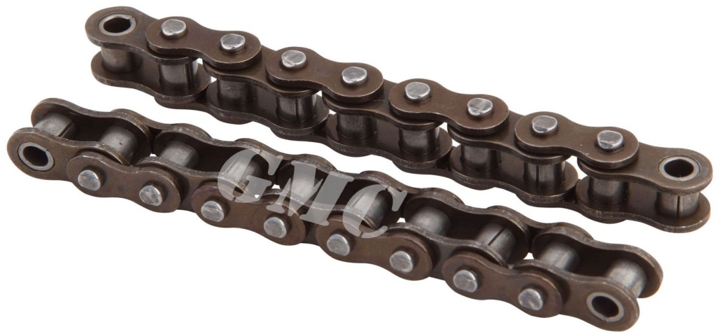
30
29
28
27
26
25
24
23
22
21
20
19
18
17
16
15
14
13
12
11
10
9
8
7
6
5
4
3
2
1
0
Picture 3
homesick

Slide 5
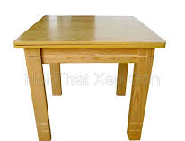
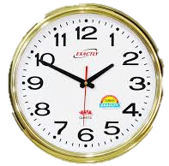
30
29
28
27
26
25
24
23
22
21
20
19
18
17
16
15
14
13
12
11
10
9
8
7
6
5
4
3
2
1
0
Picture 4
timetable

Slide 6
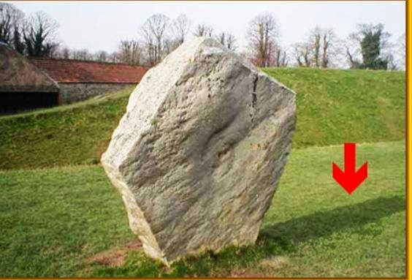
30
29
28
27
26
25
24
23
22
21
20
19
18
17
16
15
14
13
12
11
10
9
8
7
6
5
4
3
2
1
0
Picture 5
f | o | o | t | b | a | l | l

Slide 7

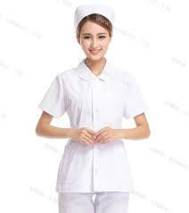
30
29
28
27
26
25
24
23
22
21
20
19
18
17
16
15
14
13
12
11
10
9
8
7
6
5
4
3
2
1
0
Picture 6
nurse

Slide 8
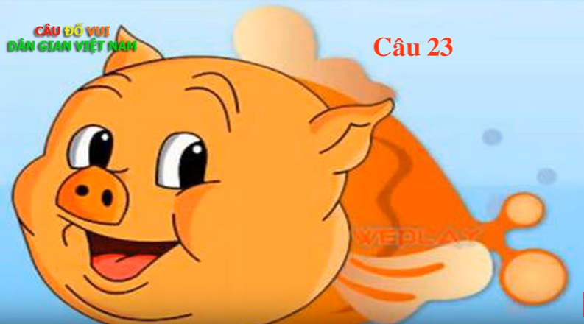
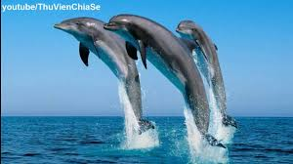
30
29
28
27
26
25
24
23
22
21
20
19
18
17
16
15
14
13
12
11
10
9
8
7
6
5
4
3
2
1
0
Picture 7
dolphin

Slide 9
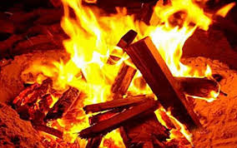
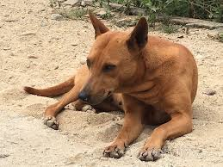
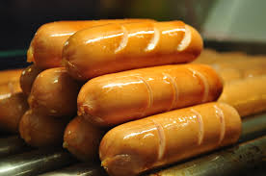
30
29
28
27
26
25
24
23
22
21
20
19
18
17
16
15
14
13
12
11
10
9
8
7
6
5
4
3
2
1
0
Picture 8
hotdog

Slide 10
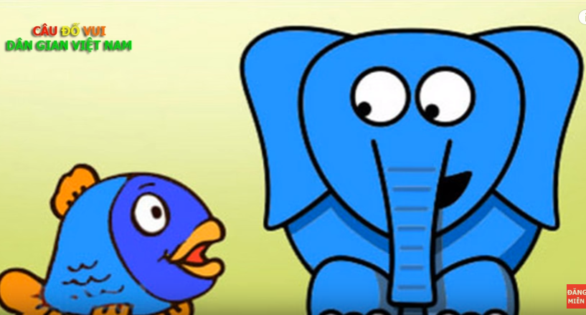
30
29
28
27
26
25
24
23
22
21
20
19
18
17
16
15
14
13
12
11
10
9
8
7
6
5
4
3
2
1
Picture 9
0
whale

Slide 11

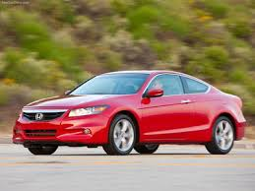
30
29
28
27
26
25
24
23
22
21
20
19
18
17
16
15
14
13
12
11
10
9
8
7
6
5
4
3
2
1
0
Picture 10
car

Slide 12
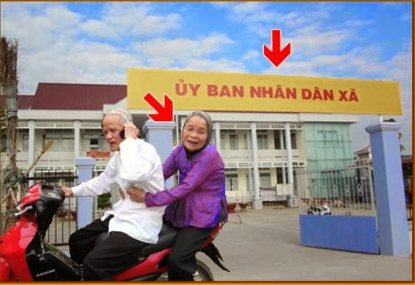
30
29
28
27
26
25
24
23
22
21
20
19
18
17
16
15
14
13
12
11
10
9
8
7
6
5
4
3
2
1
0
Picture 11
wife

Slide 13
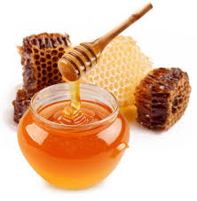
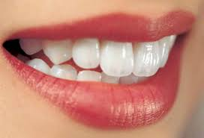
30
29
28
27
26
25
24
23
22
21
20
19
18
17
16
15
14
13
12
11
10
9
8
7
6
5
4
3
2
1
0
Picture 12
password

Slide 14
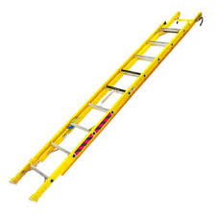
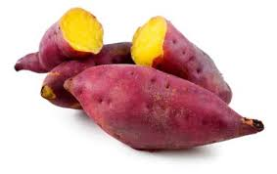
30
29
28
27
26
25
24
23
22
21
20
19
18
17
16
15
14
13
12
11
10
9
8
7
6
5
4
3
2
1
0
Picture 13
wandering

Slide 15
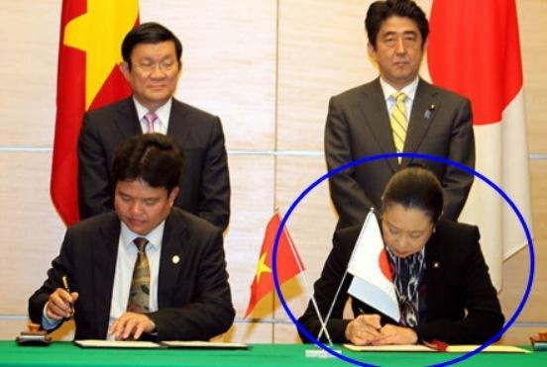
30
29
28
27
26
25
24
23
22
21
20
19
18
17
16
15
14
13
12
11
10
9
8
7
6
5
4
3
2
1
0
Picture 14
diary

Slide 16
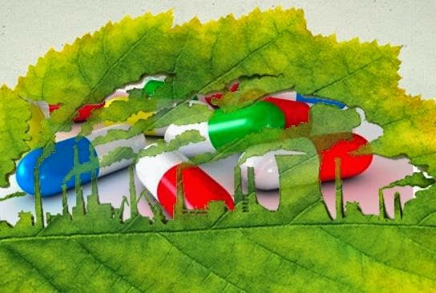
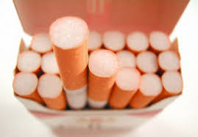
30
29
28
27
26
25
24
23
22
21
20
19
18
17
16
15
14
13
12
11
10
9
8
7
6
5
4
3
2
1
0
Picture 15
cigarette

Slide 17
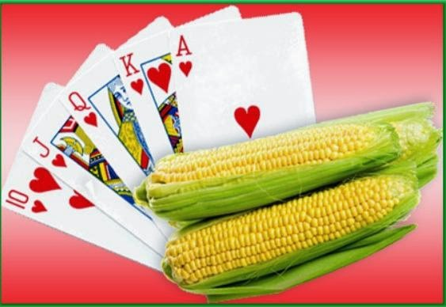

30
29
28
27
26
25
24
23
22
21
20
19
18
17
16
15
14
13
12
11
10
9
8
7
6
5
4
3
2
1
Picture 16
0
muscle

Slide 18
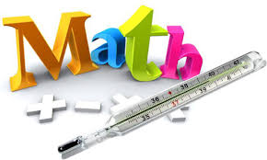
30
29
28
27
26
25
24
23
22
21
20
19
18
17
16
15
14
13
12
11
10
9
8
7
6
5
4
3
2
1
0
Picture 17
accountant

Slide 19
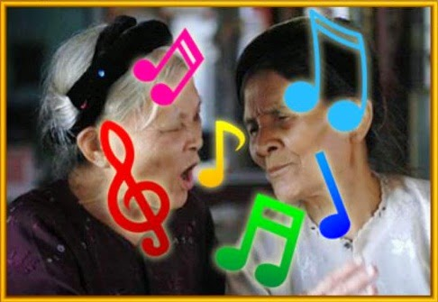
30
29
28
27
26
25
24
23
22
21
20
19
18
17
16
15
14
13
12
11
10
9
8
7
6
5
4
3
2
1
0
Picture 18
instrument

Slide 20
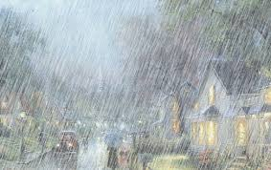
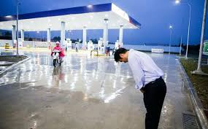

30
29
28
27
26
25
24
23
22
21
20
19
18
17
16
15
14
13
12
11
10
9
8
7
6
5
4
3
2
1
0
Picture 19
rainbow

Slide 21
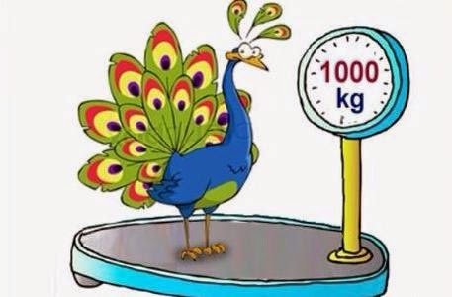
30
29
28
27
26
25
24
23
22
21
20
19
18
17
16
15
14
13
12
11
10
9
8
7
6
5
4
3
2
1
0
Picture 20
attack

Slide 22
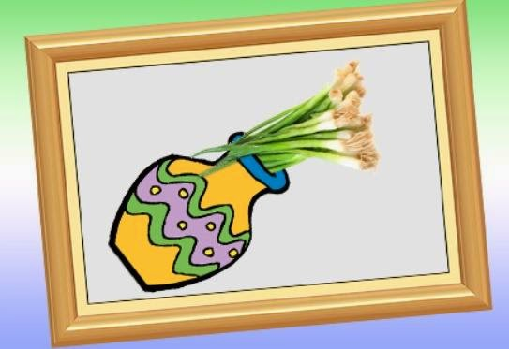
30
29
28
27
26
25
24
23
22
21
20
19
18
17
16
15
14
13
12
11
10
9
8
7
6
5
4
3
2
1
0
Picture 21
parallelogram

