Slide 1
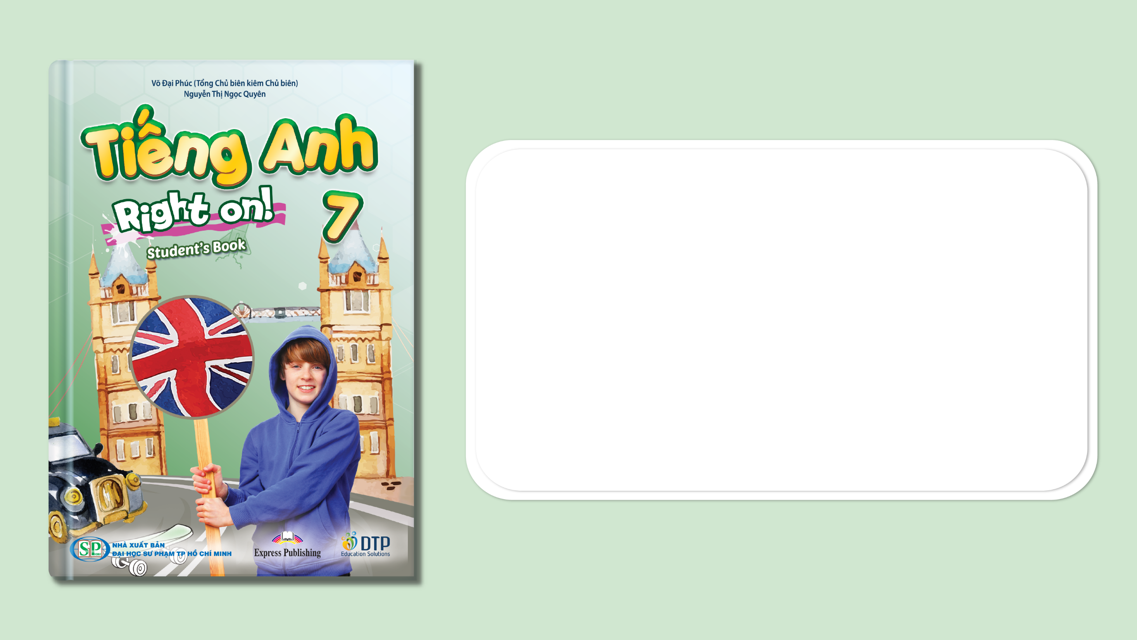
Unit 3: Arts and Music
Lesson 3f: Skills
Page 54

Slide 2
Lesson Outline
Warm-up
Reading
Consolidation
Wrap-up

Slide 3
Objectives
By the end of this lesson, students will be able to…
- listen and read for gist, key information, and detail.

Slide 4

WARM UP

Slide 5

Work in pairs.
What kind of fruit is this?
1. This kind of fruit is native to North America.
2. It can be eaten fresh or cooked.
3. It is a juicy red fruit having small brown seeds on its surface.

Slide 6
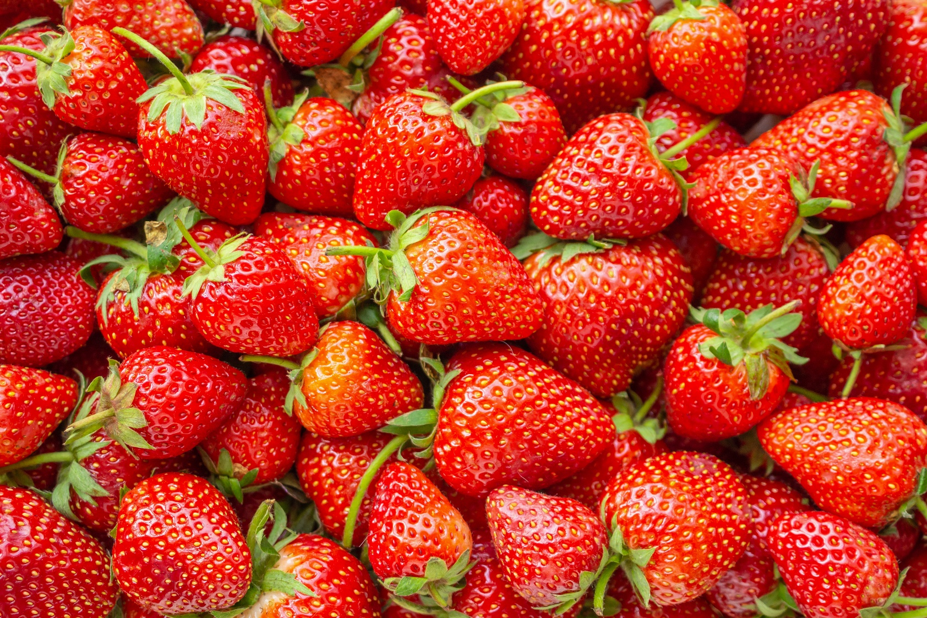
Answer key
STRAWBERRY

Slide 7
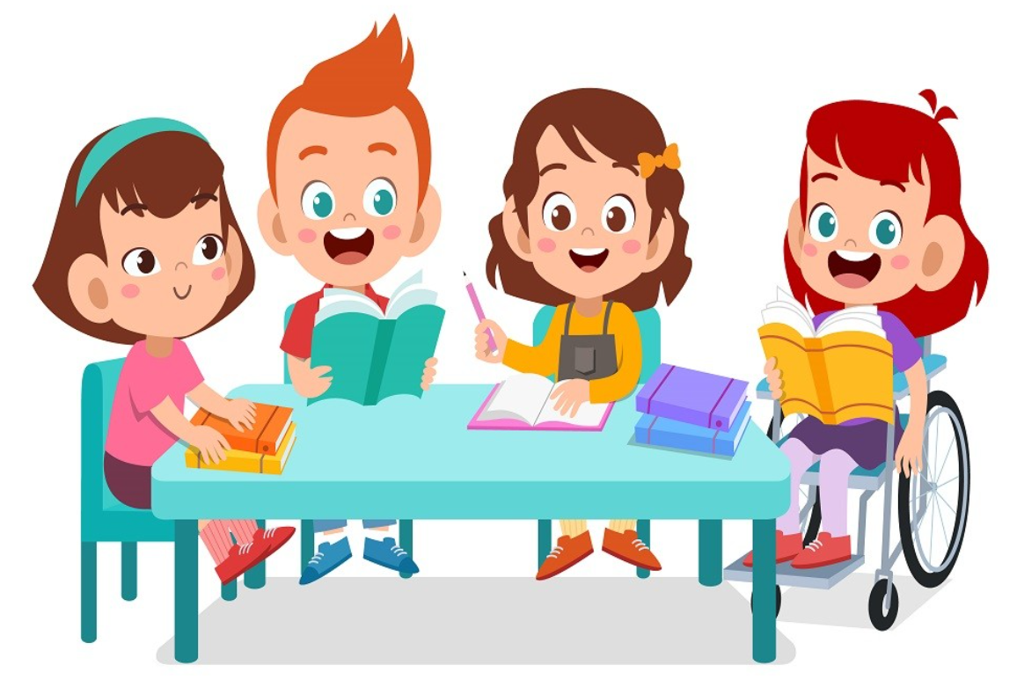
It’s time to learn …

Slide 8
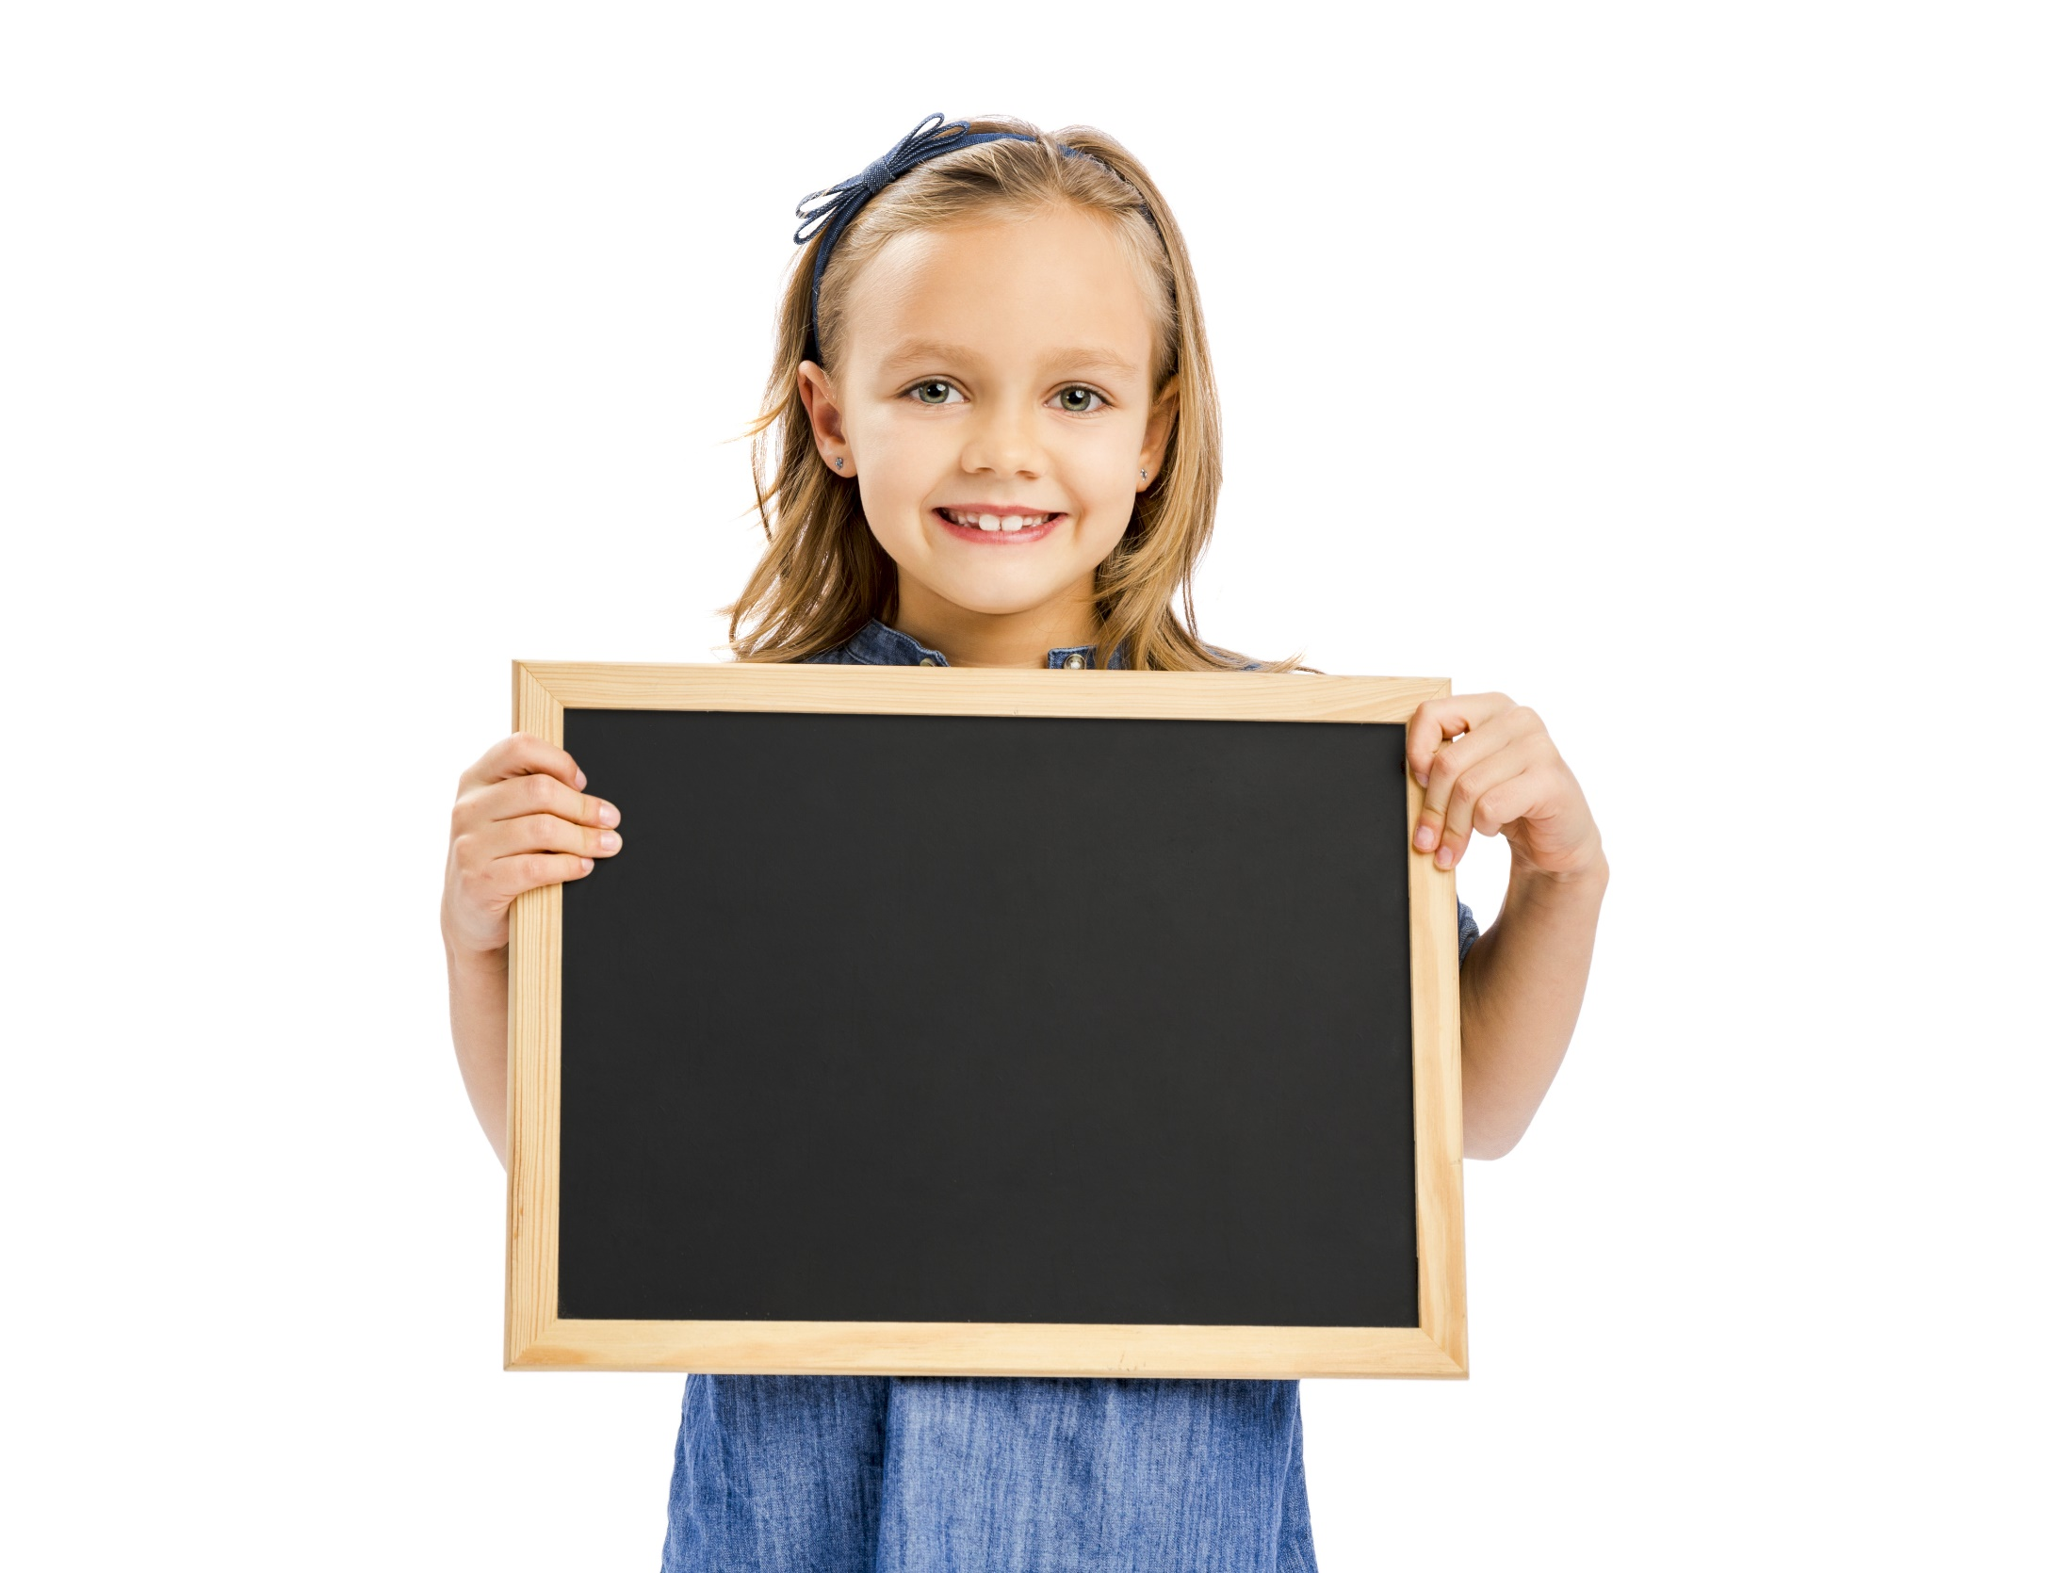
Reading

Slide 9
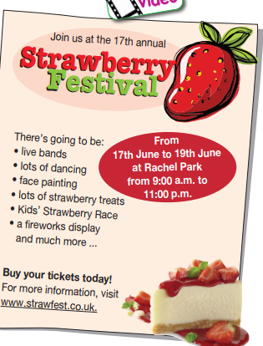
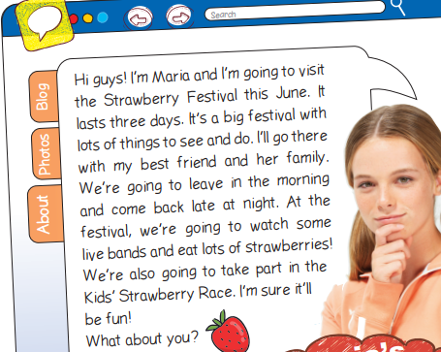
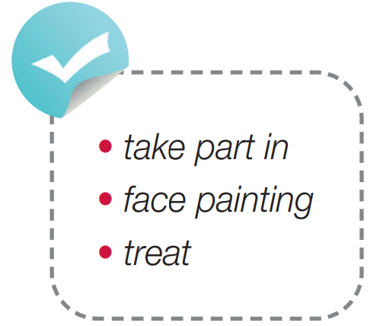
Pre-reading
Find these words in the text, try to guess what their meanings are.

Slide 10

Vocabulary
Listen and repeat. Click each phrase to hear the sound.
take part in /teɪk pɑːt ɪn/ (n) tham gia
face painting /feɪs ˈpeɪntɪŋ/ (n) thuật hóa trang
treat /triːt/ (n) sự chiêu đãi

Slide 11
Look at the IPA and the meaning of each word to read out the word.
/teɪk pɑːt ɪn/ (n) tham gia
/feɪs ˈpeɪntɪŋ/ (n) thuật hóa trang
/triːt/ (n) sự chiêu đãi

Slide 12
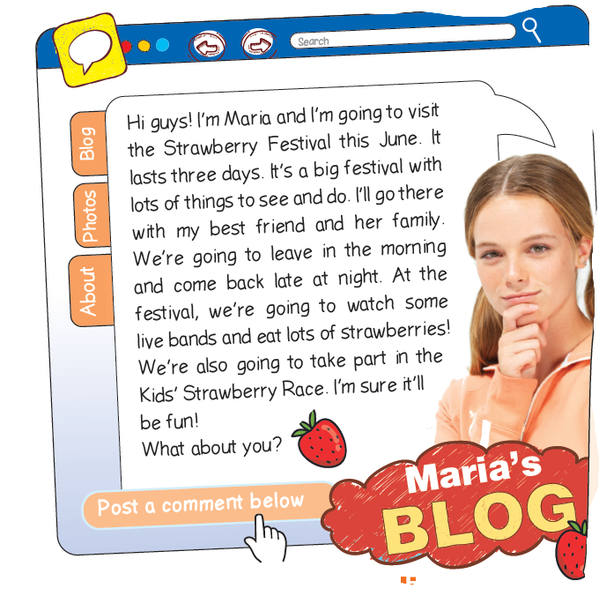
While-reading
How are they related?
1. What is this?
Mary’s blog.
2. What is it about?
It’s about a strawberry festival.

Slide 13
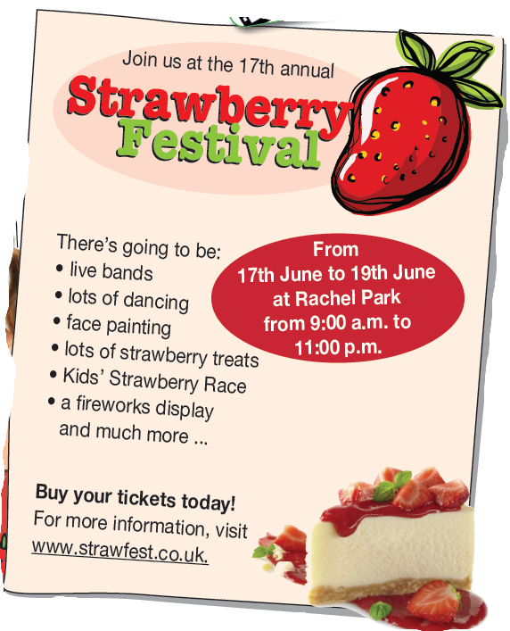
While-reading
How are they related?
1. What is this?
It’s a poster.
2. What is it about?
It’s also about a strawberry festival.

Slide 14
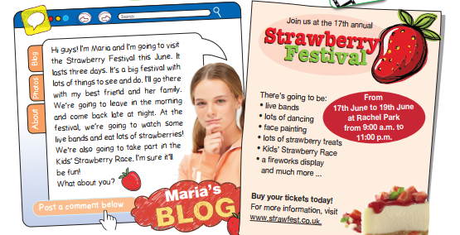
While-reading
How are they related?
They’re both about a strawberry festival.

Slide 15

While-reading
Listen and read the blog entry. Match the phrases (1-3)
tothe phrases (a-c) to make correct sentences.
1. What is this?
Mary’s blog.
2. What are you going to do?
Listen, read and match the phrases (1-3) to the phrases (a-c).

Slide 16
Listen and skim the text, underline the key words.
Hi guys! I’m Maria and I’m going to visit the Strawberry Festival this June. It lasts three days. It’s a big festival with
lots of things to see and do. I’ll go there with my best friend and her family. We’re going to leave in the morning
and come back late at night. At the festival, we’re going to watch some live bands and eat lots of strawberries!
We’re also going to take part in the Kids’ Strawberry Race. I’m sure it’ll be fun!
What about you?

Slide 17
Answer keys
1. The Strawberry Festival is a. in the morning.
2. They are going to leave b. live bands.
3. They are going to watch c. in June.

Slide 18
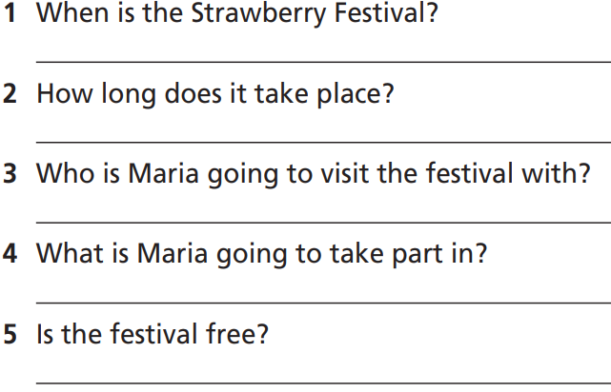
While-reading
Answer the questions.
1. How many questions are there?
Five.
2. What are you going to do?
Answer the questions.

Slide 19
While-reading
Answer the questions.
1. When is the Strawberry Festival?
2. How long does it take place?
3. Who is Maria going to visit the festival with?
4. What is Maria going to take part in?
5. Is the festival free?

Slide 20
Scan the text and underline the key words.
Hi guys! I’m Maria and I’m going to visit the Strawberry Festival this June. It lasts three days. It’s a big festival with
lots of things to see and do. I’ll go there with my best friend and her family. We’re going to leave in the morning
and come back late at night. At the festival, we’re going to watch some live bands and eat lots of strawberries!
We’re also going to take part in the Kids’ Strawberry Race. I’m sure it’ll be fun!
What about you?
(1)
(2)
(3)
(4)

Slide 21
There’s going to be:
• live bands
• lots of dancing
• face painting
• lots of strawberry treats
• Kids’ Strawberry Race
• a freworks display
and much more …
Buy your tickets today! For more information, visit
www.strawfest.co.uk.
From 17th June to 19th June at Rachel Park
from 9:00 a.m. to
11:00 p.m.
(5)

Slide 22
While-reading
Answer the questions.
1. When is the Strawberry Festival?
2. How long does it take place?
3. Who is Maria going to visit the festival with?
4. What is Maria going to take part in?
5. Is the festival free?
It’s in June (from 17th June to 19th June).
It takes place in 3 days.
She’s going to visit the festival with her best friend and her (best friend’s) family.
She’s going to take part in the Kids’ Strawberry Race.
No, it isn’t.

Slide 23
Extra Practice
Read the text again and choose the correct option.
First, underline the key words, then choose the correct answers.
1. Is the Strawberry Festival a big festival?
A. Yes, it is. B. No, it isn’t.
2. When are they going to leave?
A. In the morning. B. In the afternoon. C. In the evening.
3. The Strawberry Festival is…. .
A. the 15th annual B. the 16th annual C. the 17th annual
4. Where does the Strawberry Festival take place?
A. At Bushy Park. B. at Rachel Park. C. Lake District Park

Slide 24
Extra Practice
Now, read again to check the answers.
1. Is the Strawberry Festival a big festival?
A. Yes, it is. B. No, it isn’t.
It’s a big festival with lots of things to see and do.
2. When are they going to leave?
A. In the morning. B. In the afternoon. C. In the evening.
We’re going to leave in the morning.

Slide 25
Extra Practice
Now, read again to check the answers.
3. The Strawberry Festival is…. .
A. the 15th annual B. the 16th annual C. the 17th annual
Join us at the 17th annual.
4. Where does the Strawberry Festival take place?
A. At Bushy Park. B. at Rachel Park. C. Lake District Park
From 17th June to 19th June at Rachel Park.

Slide 26

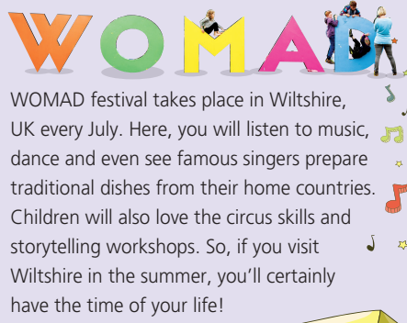
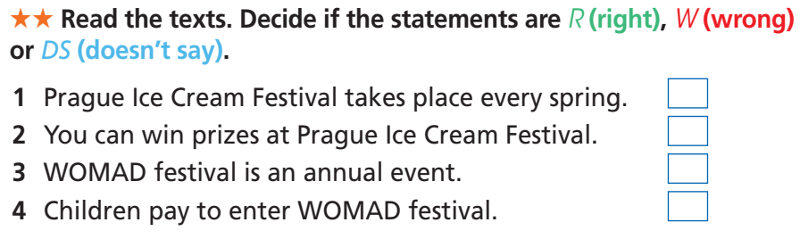
Extra Practice
WB page 31

Slide 27
Extra Practice
WB page 31
Skim the text and underline the key words.
(1)
Prague Ice Cream Festival is an exciting summer event for all lovers of ice cream. It is the largest festival of its kind in Central Europe. Famous ice cream makers prepare different ingredients to make all types of ice cream for you – gelato, soft, yoghurt, organic and even ice lollies. Come and have fun with your family and friends and win ‘delicious’ awards!
(2)

Slide 28
Extra Practice
WB page 31
Skim the text and underline the key words.
(3)
WOMAD festival takes place in Wiltshire, UK every July. Here, you will listen to music, dance and even see famous singers prepare traditional dishes from their home countries. Children will also love the circus skills and
storytelling workshops. So, if you visit Wiltshire in the summer, you’ll certainly have the time of your life!

Slide 29
Extra Practise
WB page 31
Answer keys
1. Prague Ice Cream Festival takes place every spring.
2. You can win prizes at Prague Ice Cream Festival.
3. WOMAD festival is an annual event.
4. Children pay to enter WOMAD festival.
W
R
R
DS

Slide 30

Post-Speaking
What would you like to do at the Strawberry
Festival?Why? Tell your partner.
Hi, B. What would you like to do at the Strawberry Festival?
I would like to watch live bands because I like
live music.
What else?
I would like to do face painting because it’s fun. And you?
I would like to watch the
freworks display because it’s beautiful.
That’s great.

Slide 31

CONSOLIDATION

Slide 32
Write a paragraph (60-80 words) about a festival in your country.
When is it?
Where is it?
What activities are there?

Slide 33
Suggested Answer Key
Hung King Temple festival is an national event held in Phu Tho. It takes place annually to commemorate Hung Kings - the founder of the nation. There are many different folk games such as human chess, bamboo swings, rice cooking competitions, “nem con”, wrestling, lion dance, etc. The highlight of the festival is the procession up to Den Thuong (Upper Temple) with participation of governmental leaders, villagers, and many visitors.

Slide 34

WRAP-UP

Slide 35
Today’s lesson
Vocabularies
take part in
face painting
treat
Reading: read for gist, key information, detail.
Listening: read for gist, information, detail.

Slide 36
Homework
Practise the vocabularies and make sentences using them.
Do the exercises in TA 7 Right on WB (page 31).
Prepare the next lesson (page 55 SB).

Slide 37
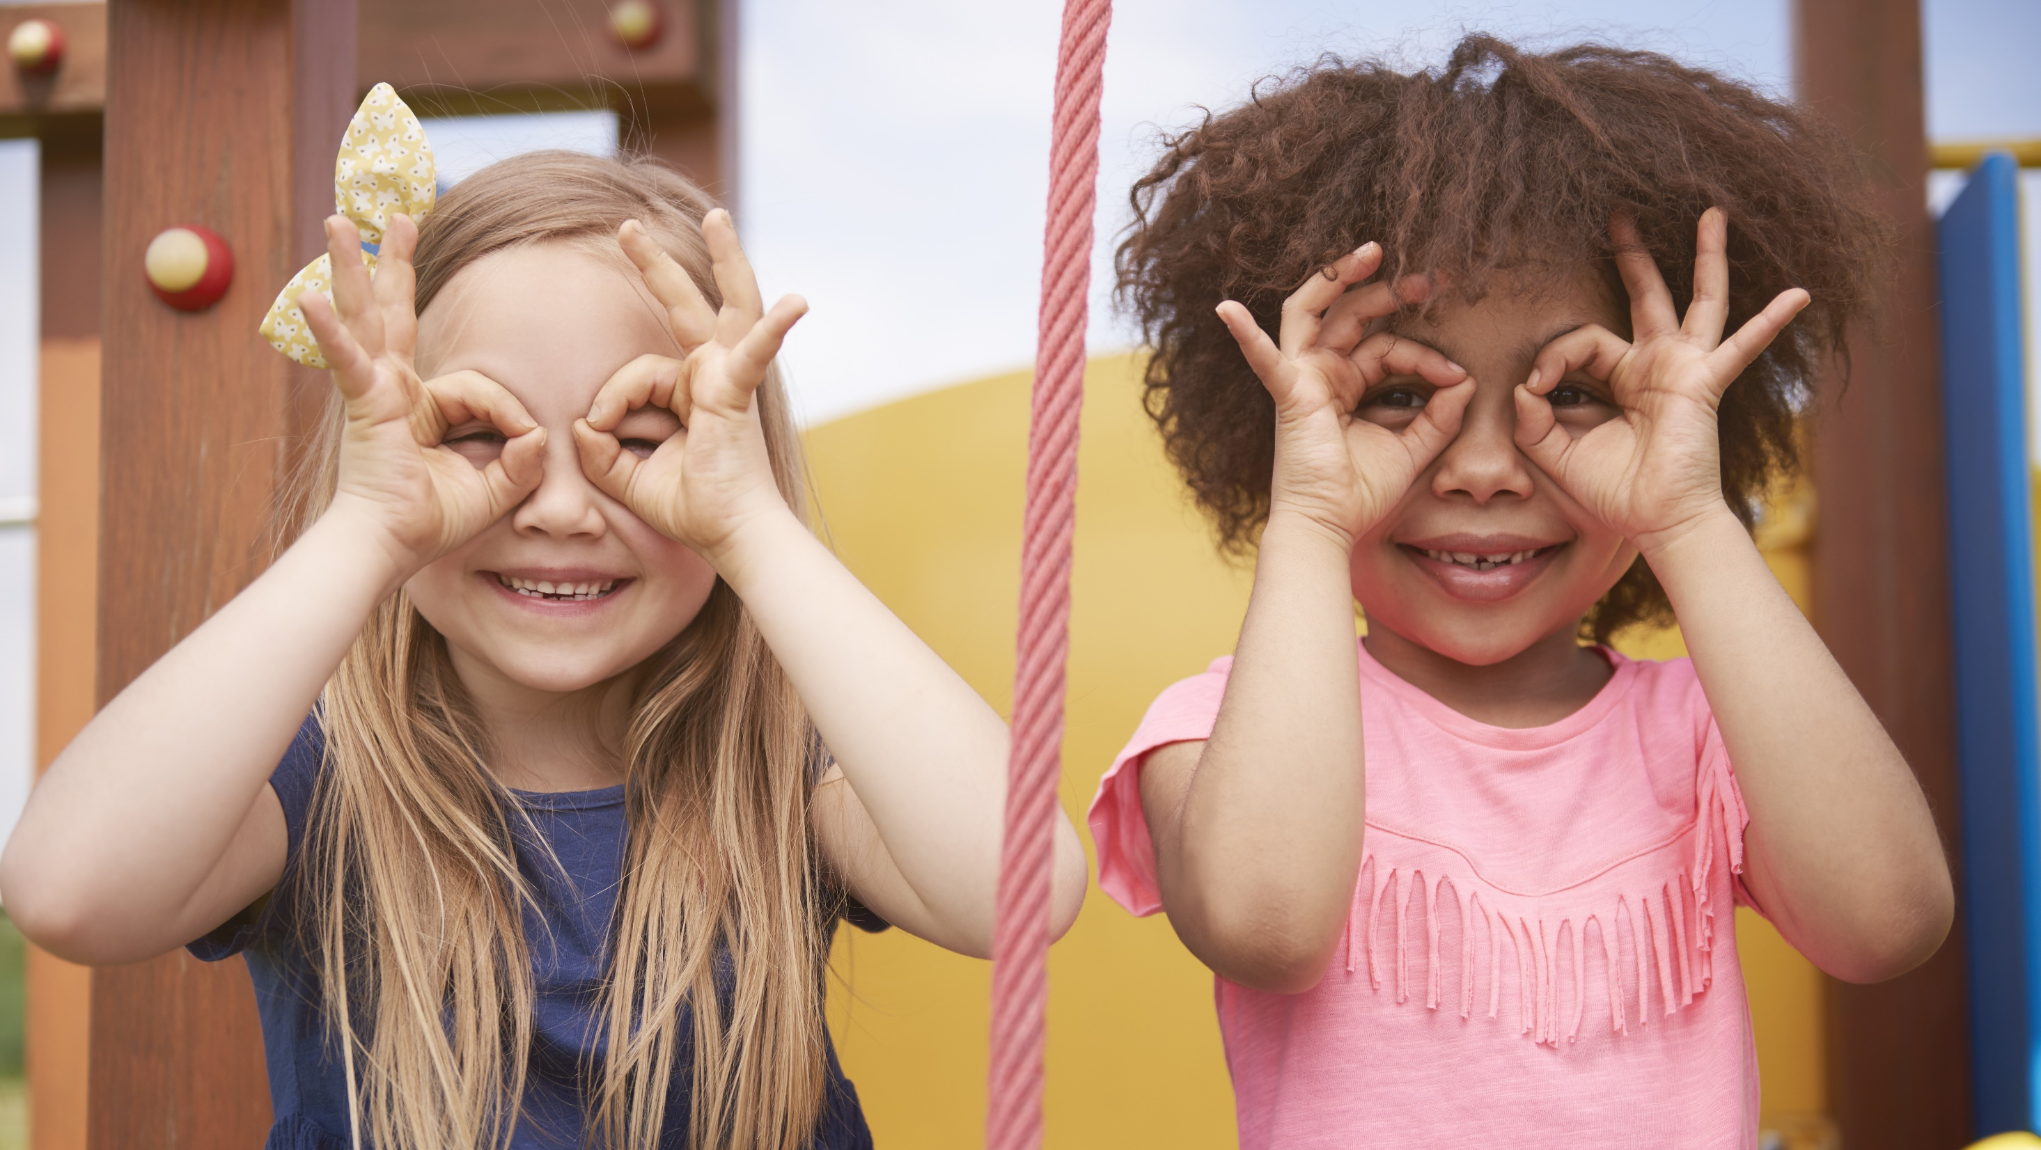
Enjoy your day!

