Slide 3
UNIT 8: GOING AWAY
LESSON 5: LANGUAGE FOCUS

Slide 4
INITIALS GAME

Slide 5
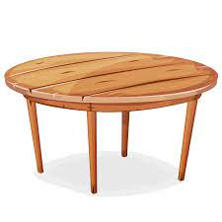
RULE:
Take the first letters from each picture and form the mystery word!
TABLE
RABBIT
ICE CREAM
PENCIL
T R I P

Slide 6
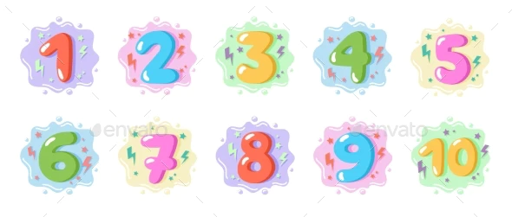
COMPUTER
ORANGE
NUMBER
DOCTOR
IRON
TOOTHPASTE
INSTRUMENT
OCTOPUS
NURSE
AIRPORT
LIBRARY

Slide 7
CONDITIONAL

Slide 8
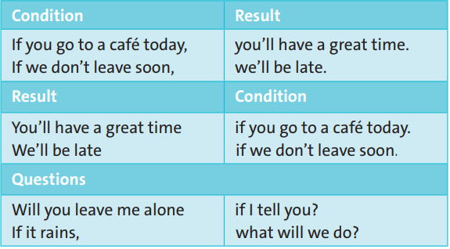
EXERCISE 1: Study the examples in the table. In your notebook, complete the Rules with condition and result.

Slide 9
EXERCISE 1: Study the examples in the table. In your notebook, complete the Rules with condition and result.
condition
result
condition

Slide 10
Rule - First conditional
We use the first conditional to talk about a condition in the future and the result of this condition.
Condition | Result
if + present simple, | S + will/won’t + infinitive
S + will/won’t + infinitive | if + present simple
Exercise:
1. If it’s sunny at the weekend, I ________ to the park.
2. I won't go to the park if it ______ at the weekend.
will go
rains

Slide 11
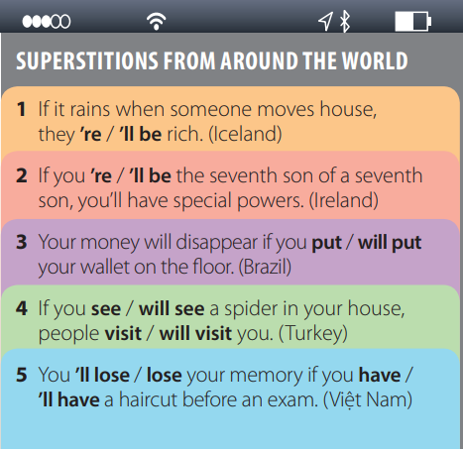
EXERCISE 2: Choose the correct words.

Slide 12
EXERCISE 3: The first conditional sentence is a kind of complex sentence. A complex sentence has ONE independent clause and at least one dependent clause.
If you go to school today … (dependent clause)
- …, you will meet an interesting person. (independent clause)

Slide 13
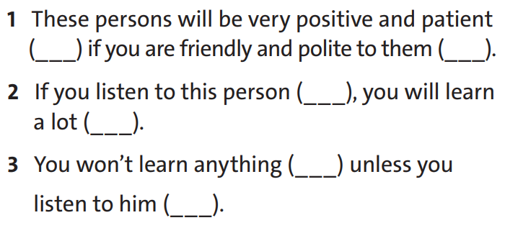
Now put I.C (independent clause) or D.C (dependent clause) into the brackets.
I.C
D.C
D.C
I.C
I.C
D.C

Slide 15
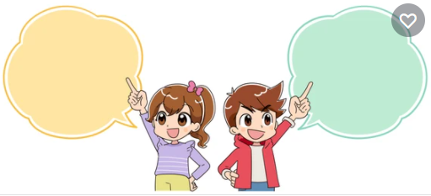
EXERCISE 4: Work in pairs. Ask and answer first conditional questions. Use what, where and who, the words in the box and your own ideas.
Example:
What will you do if you finish your homework early tonight?
If I finish it early, I’ll go out and meet some friends.

Slide 16
-Learn by heart all structures.
Workbook: Exercises page 57.
Prepare for the next lesson: Speaking

Slide 17
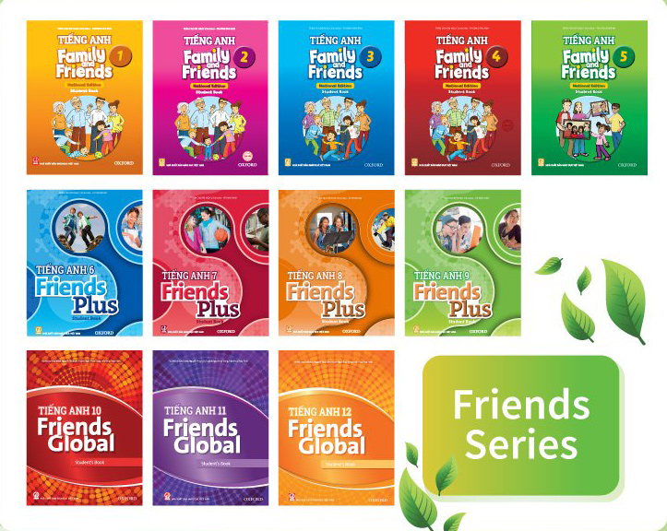
www.phuongnam.edu.vn

Slide 18
Thank you!
CTCP ĐẦU TƯ VÀ PHÁT TRIỂN GIÁO DỤC PHƯƠNG NAM

