Slide 2


Slide 3
GAME
ROLL A RANDOM
ASSOCIATION

Slide 4
1
Paris
2
new
photos
3
5
4
expensive
cool
awesome
cable car
8
6
boat
7

Slide 5
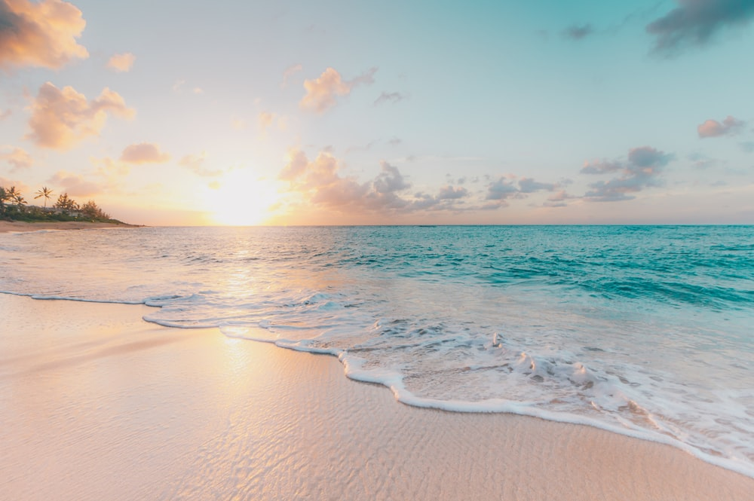
Unit 8
Going away
Lesson 3 - Language focus

Slide 6
Do they refer to the past, present or future?
1. I’m going to spend a week in Paris!
2. We are going to have a drink after each tennis class.

Slide 7
Complete the examples
EXERCISE 1
going to
1. We’re ______________ travel by train.
2. I _________ going away.
3. What _______ you going to do this summer?
’m not
are

Slide 8
RULES
1. We use be going to to talk about / future plans and intentions.
2. We make questions with / do + pronoun or noun + going to + verb.
present
be

Slide 9
I | am | going to + Vo
She/ He/ It/ Noun | is
You/ We/ They/ Nouns | are

Slide 10
affirmative or negative form
EXERCISE 2
’re going to visit
1. You ____________ (visit) your grandparents tomorrow. ✓
2. They ______________ (travel) by train. ✗
3. Lily ______________ (buy) a guidebook for Hà Nội. ✓
aren’t going to travel
’s going to buy

Slide 11
affirmative or negative form
EXERCISE 2
’m not going to take
4. I ______________ (take) my phone or my tablet. ✗
5. We ____________ (stay) in a modern hotel. ✓
6. Pavel ______________ (study) Vietnamese next year. ✗
’re going to stay
isn’t going to study

Slide 12

Question stress and rhythm
EXERCISE 3
E.g : Where are you going to stay?
going
buy
1. Are you to a ?
2. are we going to ?
3. is she going to ?
4. Are we to in a ?
torch
What
see
How
travel
going
stay
tent

Slide 13
Example
1. It be sunny tomorrow.
2. It be hot.
will
won’t

Slide 14
RULES
1. We use to make affirmative sentences about future predictions. The short form is _____________
2. We use will not for negative sentences. The short
form is __________
3. In questions, we use _________+ noun / pronoun + verb.
4. In short answers, we use Yes / No + pronoun +
________/________ .
will, ’ll
won’t
will
will won’t

Slide 15
+ | S + will + Vo
- | S + will not (won’t) + Vo
? | Will + S + Vo ..? → Yes, S + will No, S + will not

Slide 16
Write questions and answers
EXERCISE 5
Nick’s family / live / in a big house? ✗
2. Nick / make / many new friends? ✓
3. Nick / learn / a new language? ✗
→ Will Nick’s family live in a big house? No, they won’t.
→ Will Nick make many new friends? Yes, he will.
→ Will Nick learn a new language? No, he won’t.

Slide 17
Write questions and answers
EXERCISE 5
4. be / hot and sunny / in December? ✓
5. Nick’s family / have a barbecue on the beach /
in January? ✓
→ Will it be hot and sunny in December? Yes, it will.
→ Will Nick’s family have a barbecue on the beach in January? Yes, they will.

Slide 18
Write questions and answers
EXERCISE 5
6. Nick’s friends in London / visit / him next
summer? ✗
→ Will Nick’s friends in London visit him next summer?
No, they won’t.

Slide 19

Speaking

Slide 20
Make five predictions
EXERCISE 6
write a book
become famous
live in another town or city
Future
travel around the world
win the lottery

Slide 21
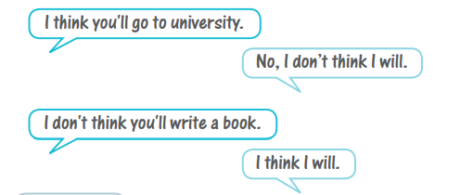
Make five predictions
EXERCISE 6

Slide 22

🍀 Learn by heart all structures.
🍀 Workbook: Exercises page 55.

Slide 23
Example:
We can take awesome photos together.

Slide 24



www.phuongnam.edu.vn

Slide 25



Thank you!
CTCP ĐẦU TƯ VÀ PHÁT TRIỂN GIÁO DỤC PHƯƠNG NAM

