Slide 3
HIDDEN PICTURES

Slide 4
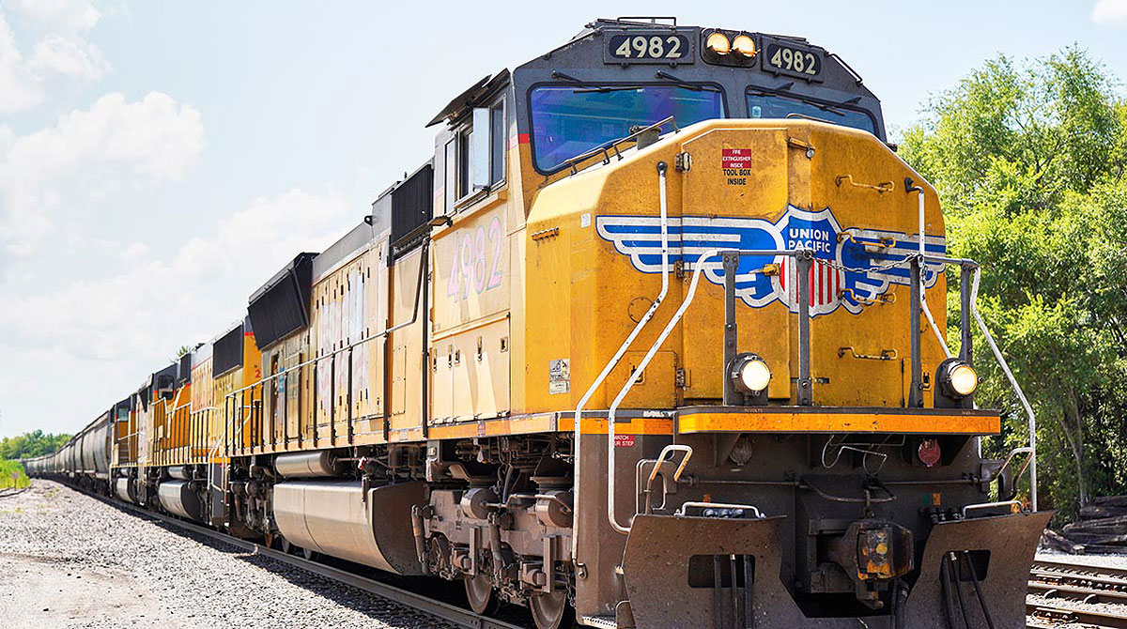
train

Slide 5
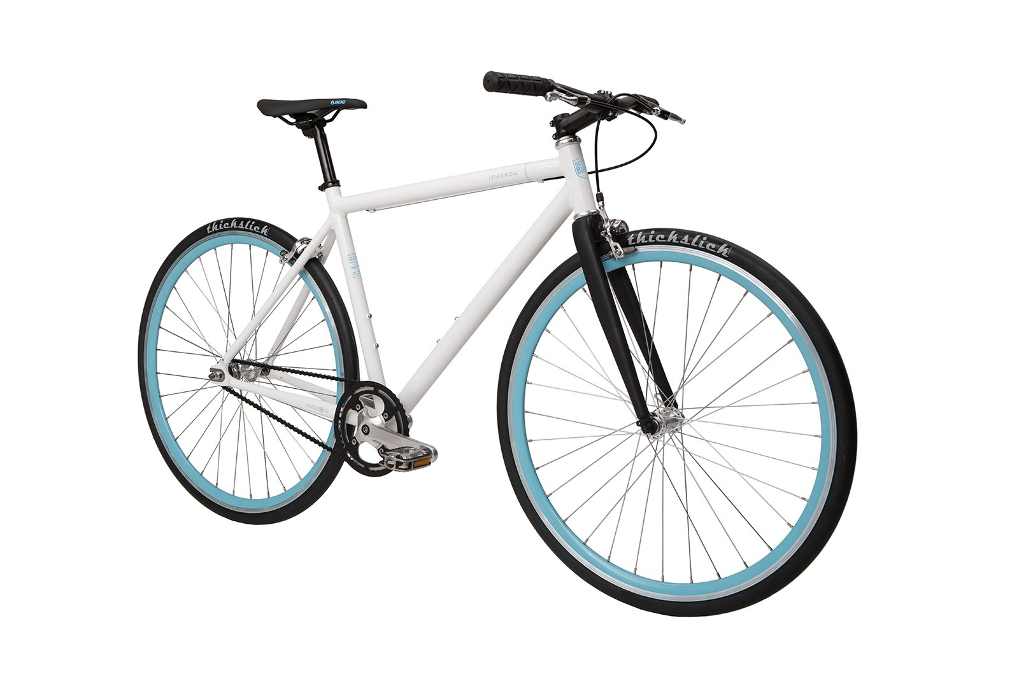
bike

Slide 6
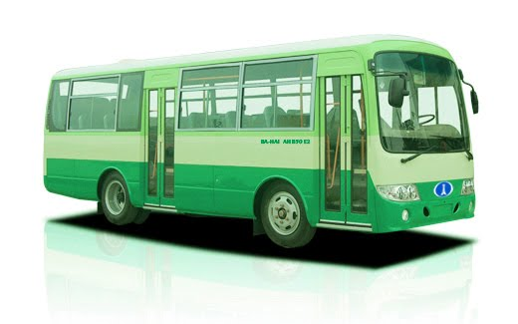
bus

Slide 7
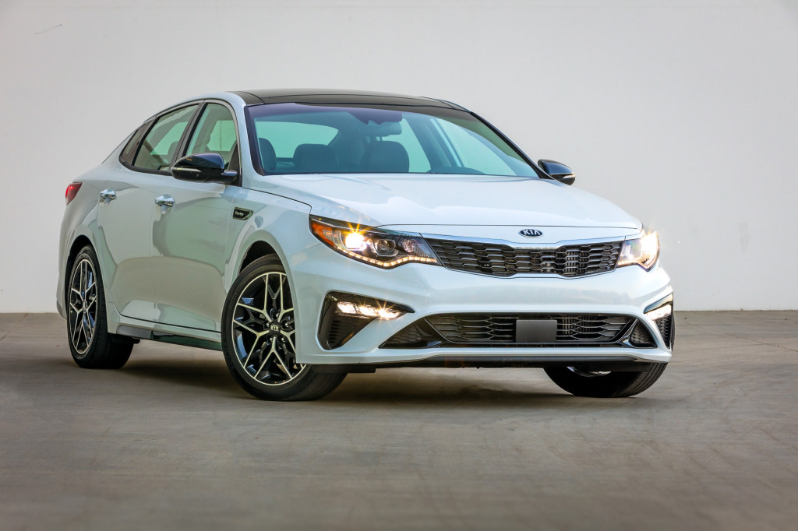
car

Slide 8
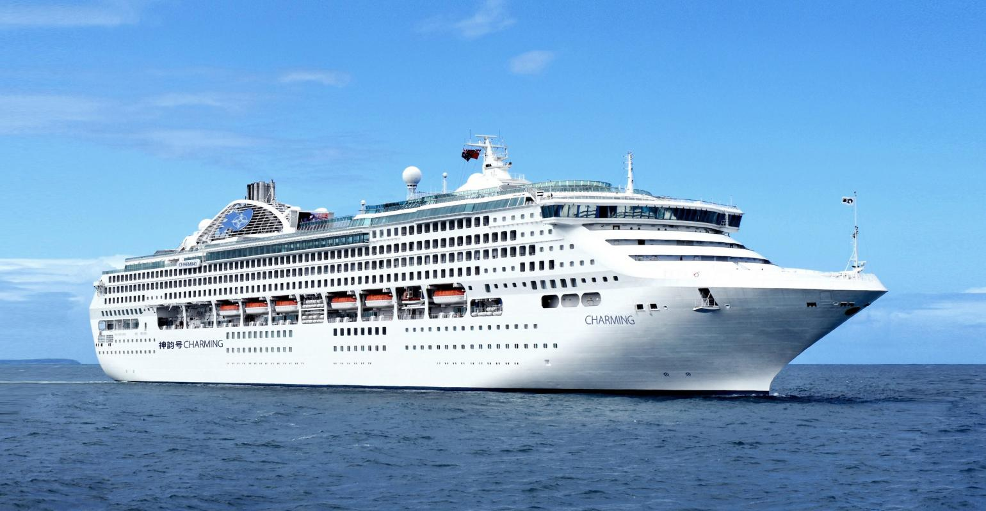
ship

Slide 9
What are these pictures about?

Slide 10
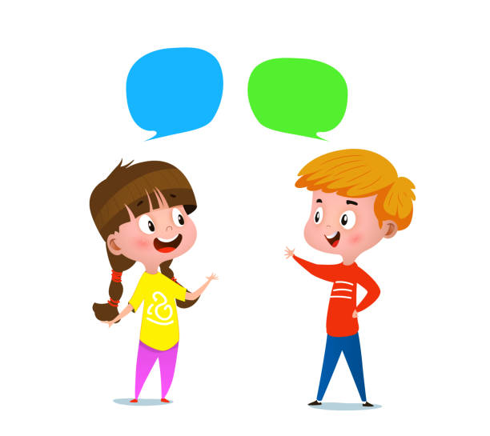
How do you travel when you go on holiday?

Slide 11
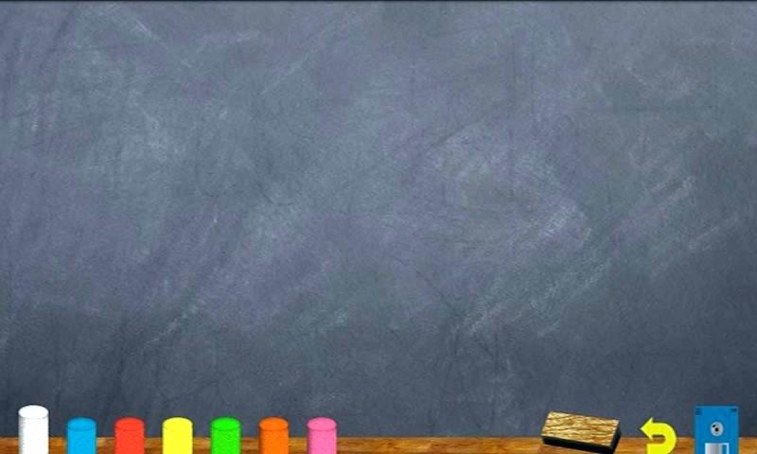
Unit 8:
GOING AWAY
LESSON 1: VOCABULARY – MEANS OF TRANSPORT

Slide 12
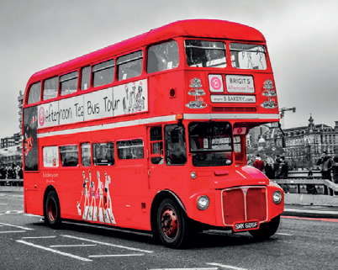
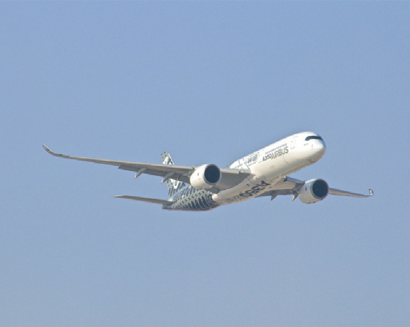
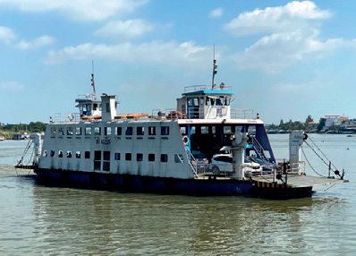
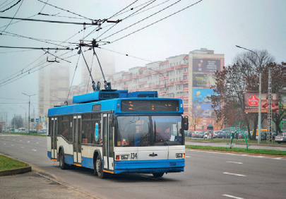
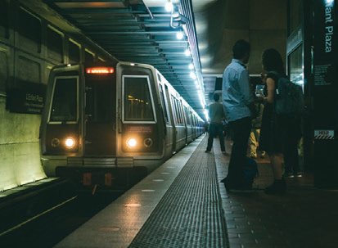
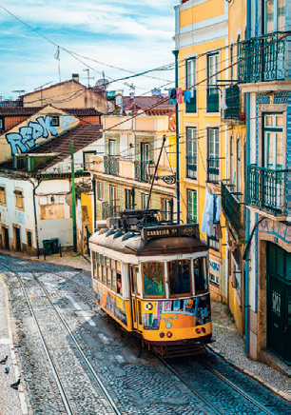
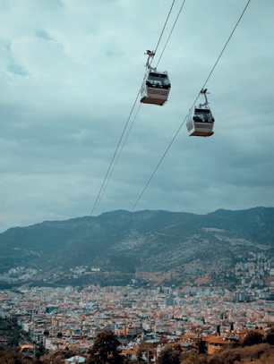
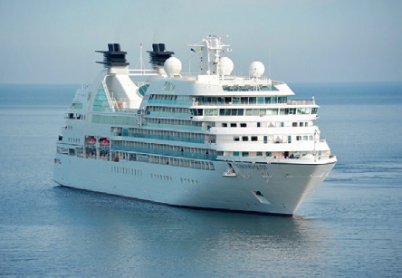
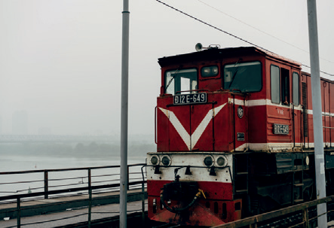
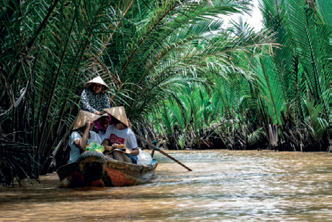
Look and match photos 1 - 10 with the words in the box. Listen and check.
1
2
3
4
5
bus
plane
ferry
trolleybus
subway train
6
7
8
9
10
tram
cable car
ship
train
boat

Slide 13
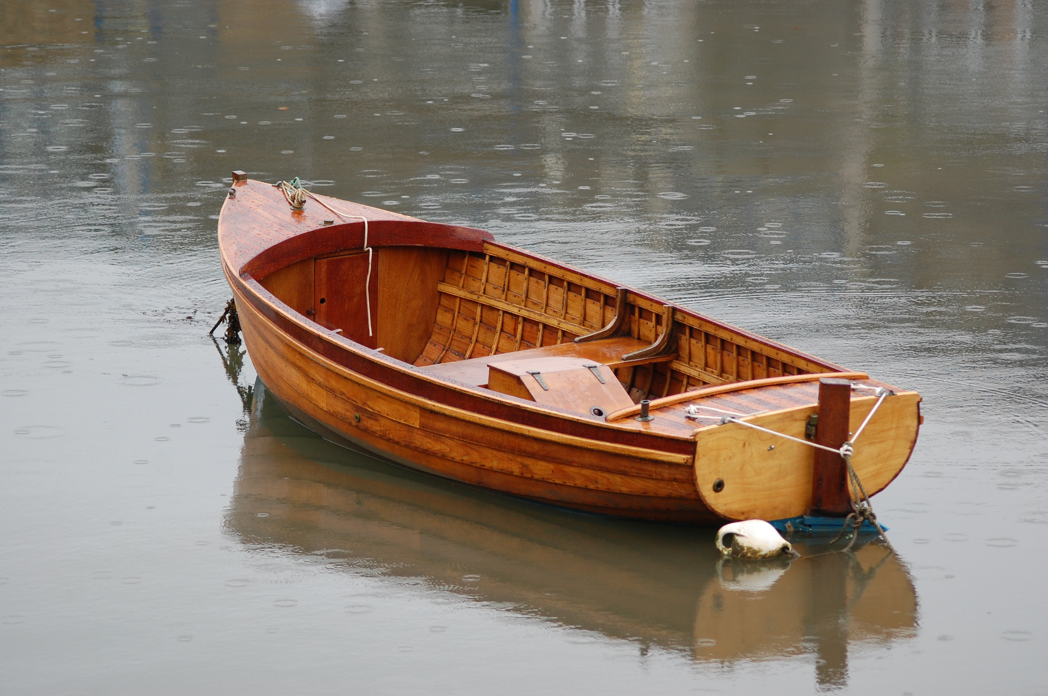
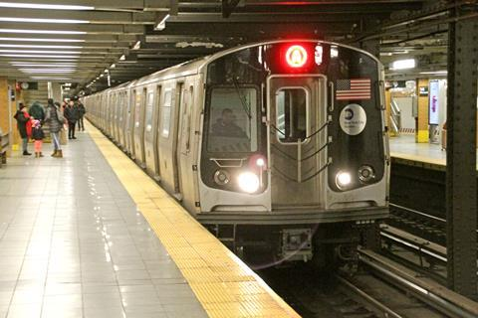
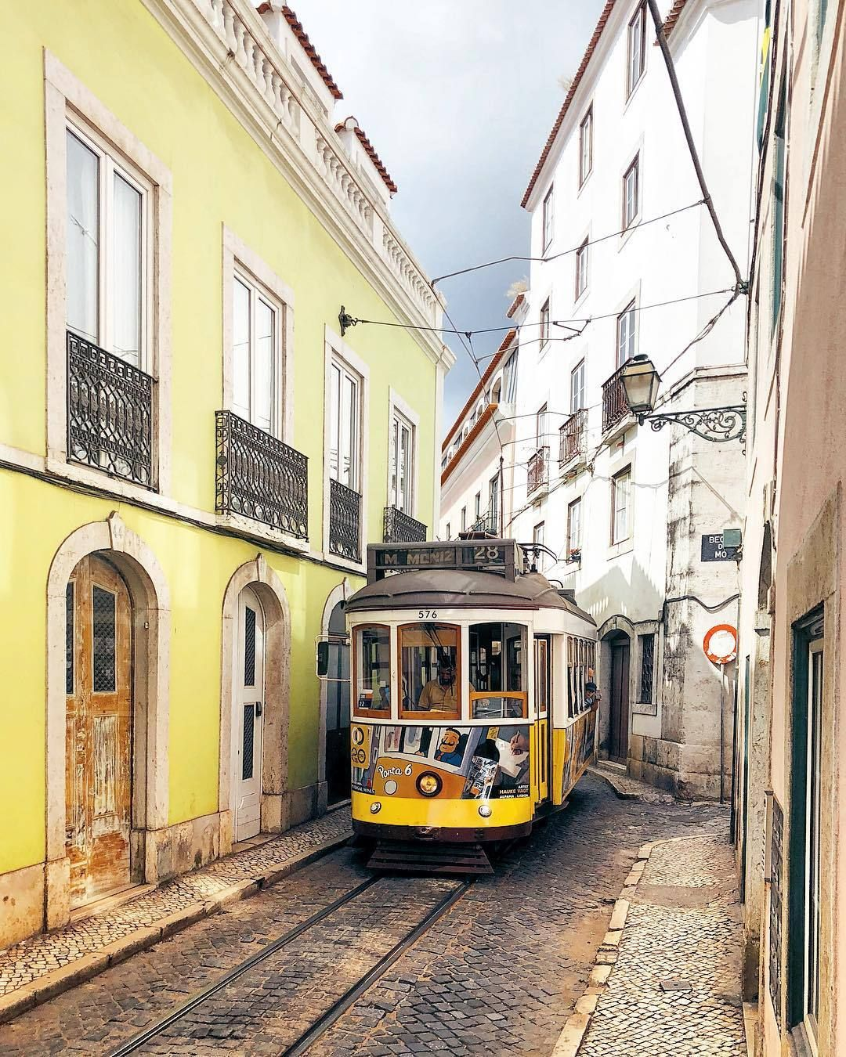
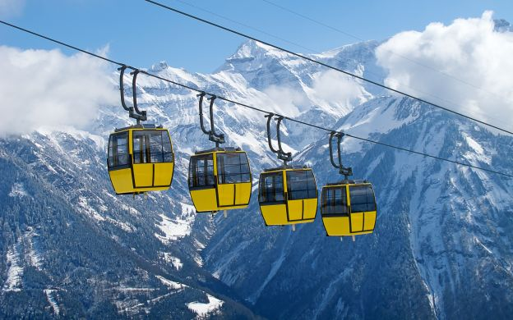
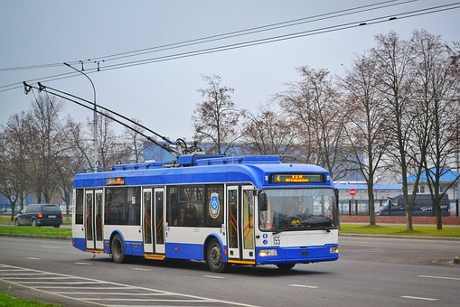
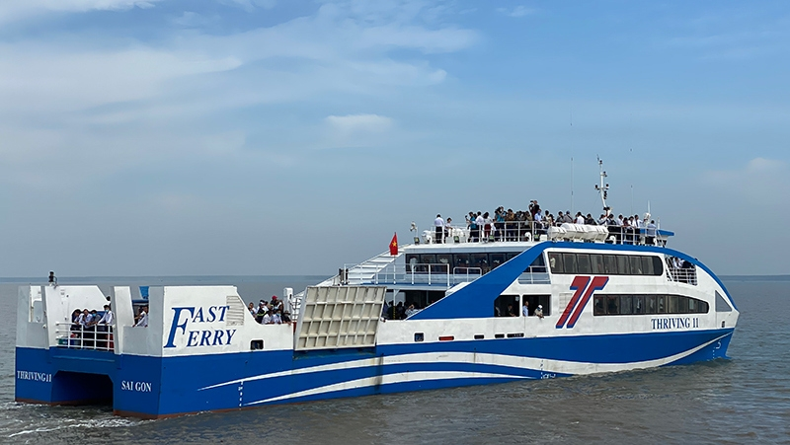
New words
- trolleybus (n) : xe điện bánh hơi
- boat (n) thuyền nhỏ
- tram (n) xe điện đường sắt
- subway train (n) tàu điện ngầm
- cable car (n) cáp treo
- ferry (n) phà
- channel (n) con kênh
a bus that uses power from electric wires above the street
a vehicle for passengers, which travels along metal tracks in the street

Slide 14
Which means of transport have you got in your country?

Slide 15
Travel Quiz
1) If you cross a channel or a river, which means do you choose? a. a train b. a ship c. a ferry
2) If you travel between hills and mountains, which means do you choose? a. cable car b. tram c. bus
3) Trolleybuses and trams cannot move without _________ . a. petrol b. coal c. electricity
4) You cannot see a ______ on a street. a. bus b. subway train c. tram

Slide 16
5) A ______ can travel between continents. a. cable car b. plane c. boat
6) A ________ can travel in a small river. a. ship b. boat c. bus
7) The first _______ system in the world is The London Underground. a. ferry b. subway c. bus
8) A trolleybus travels on streets while a ________ travels on railways. a. bus b. tram c. boat

Slide 17
Listen and complete the Key Phrases

Slide 18
KEY PHRASES
Talking about means of transport
I love/ like going on ____________.
When you go away, you should choose a suitable _________
_____________.
3) You should choose a _________ when you travel in a river.
4) You should go by ________ when you go to another country.
5) You can avoid traffic jams when you go by ______________.
holiday
means
of transport
boat
plane
subway train

Slide 19
OPTIONAL ACTIVITY: VOCABULARY

Slide 20
You use this to travel from one place to another in a city in Việt Nam.

Slide 21
GROUP – WORK

Slide 22
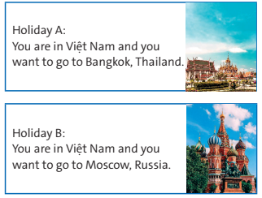
Imagine that you are going on holiday. Choose holiday A or B. Which means of transport should you choose? Why?

Slide 23
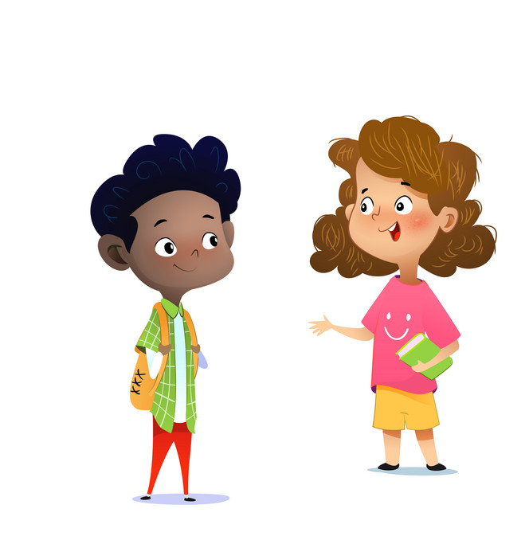
I am going on my holiday to Moscow, Russia, so I choose a plane for traveling. The plane is the fastest means of transport and it’s really great when traveling above the clouds, looking down on the landscapes below. Also, I can do many things like reading, playing games or listening to music while I’m on a plane.

Slide 24
Homework
- Learn by heart all the new words.
- Workbook: Exercises on page 54
- Prepare Lesson 2 – Reading.

Slide 25
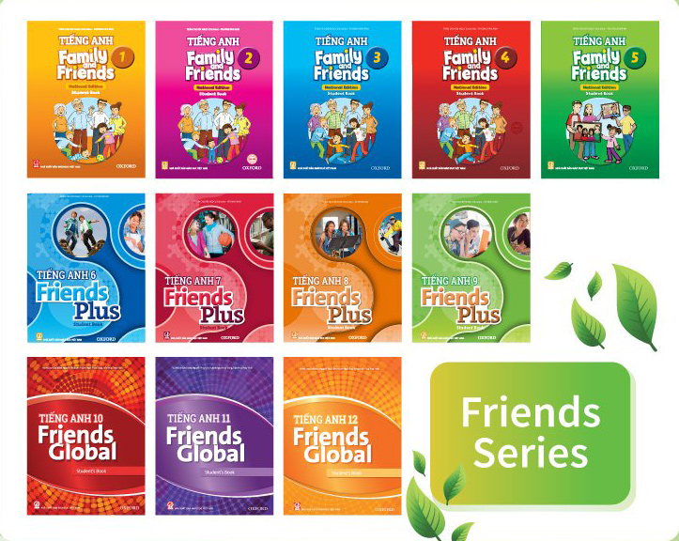
www.phuongnam.edu.vn

Slide 26
Thank you!
CTCP ĐẦU TƯ VÀ PHÁT TRIỂN GIÁO DỤC PHƯƠNG NAM

