Slide 1


Bài giảng điện tử
Unit 5: Food and Health
Lesson 8: CLIL

Slide 2

UNIT 5: FOOD AND HEALTH
LESSON 8: SCIENCE -
FOOD AND NUTRIENTS

Slide 3

STOP THE BUS

Slide 4
 | Healthy fruits | Healthy foods | Meals of the day
Letter “L”
Letter “B”
Letter “D”

Slide 5

Let’s look up these words.
water
mineral
fat
protein
vitamin
disease
carbohydrate

Slide 6
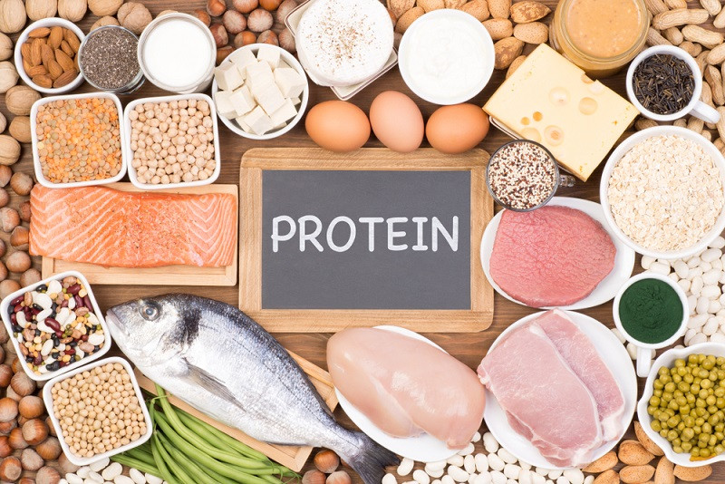
1. New words:
protein (n) : chất đạm

Slide 7
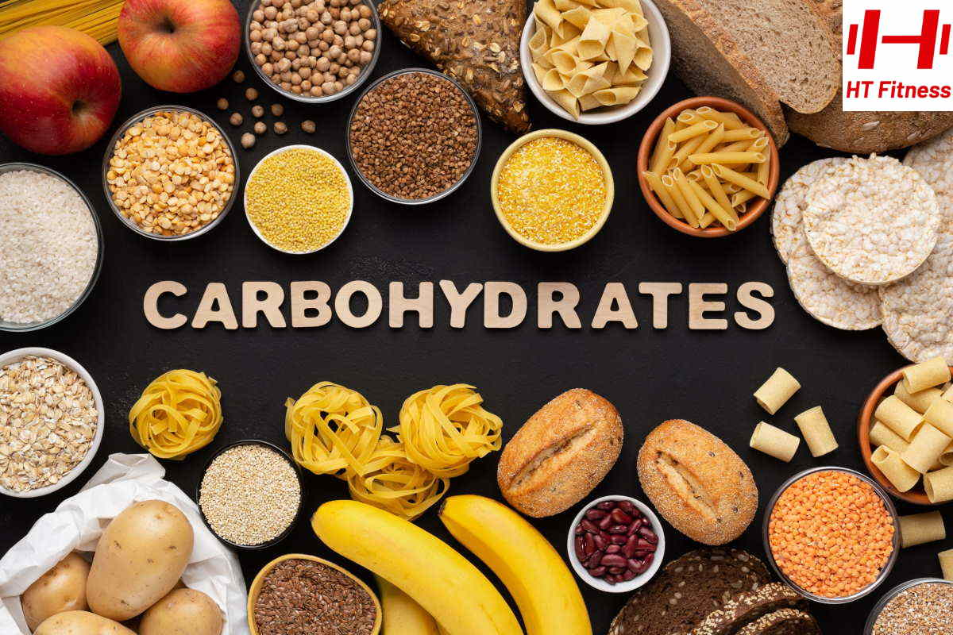
* New words:
carbohydrate (n)

Slide 8
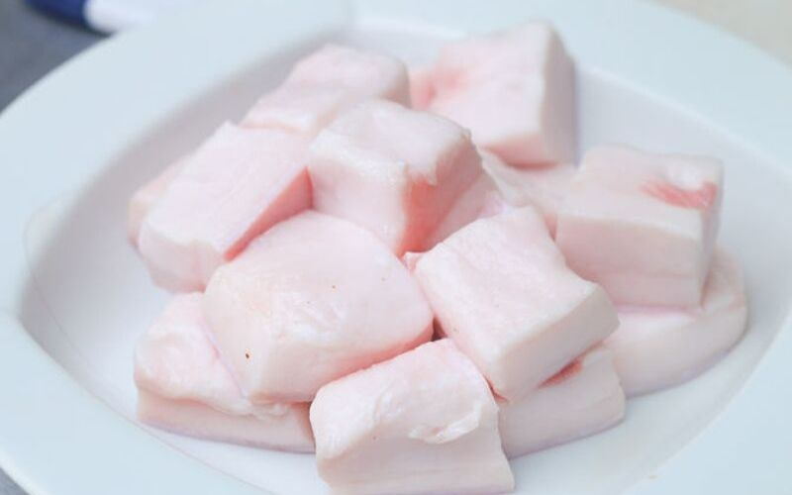
* New words:
fat (n)

Slide 9
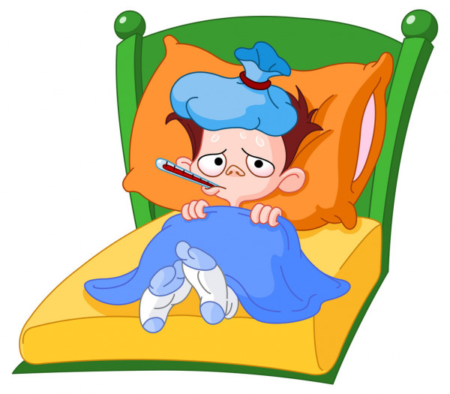
* New words:
disease (n)

Slide 10

* New words:
water (n)

Slide 11
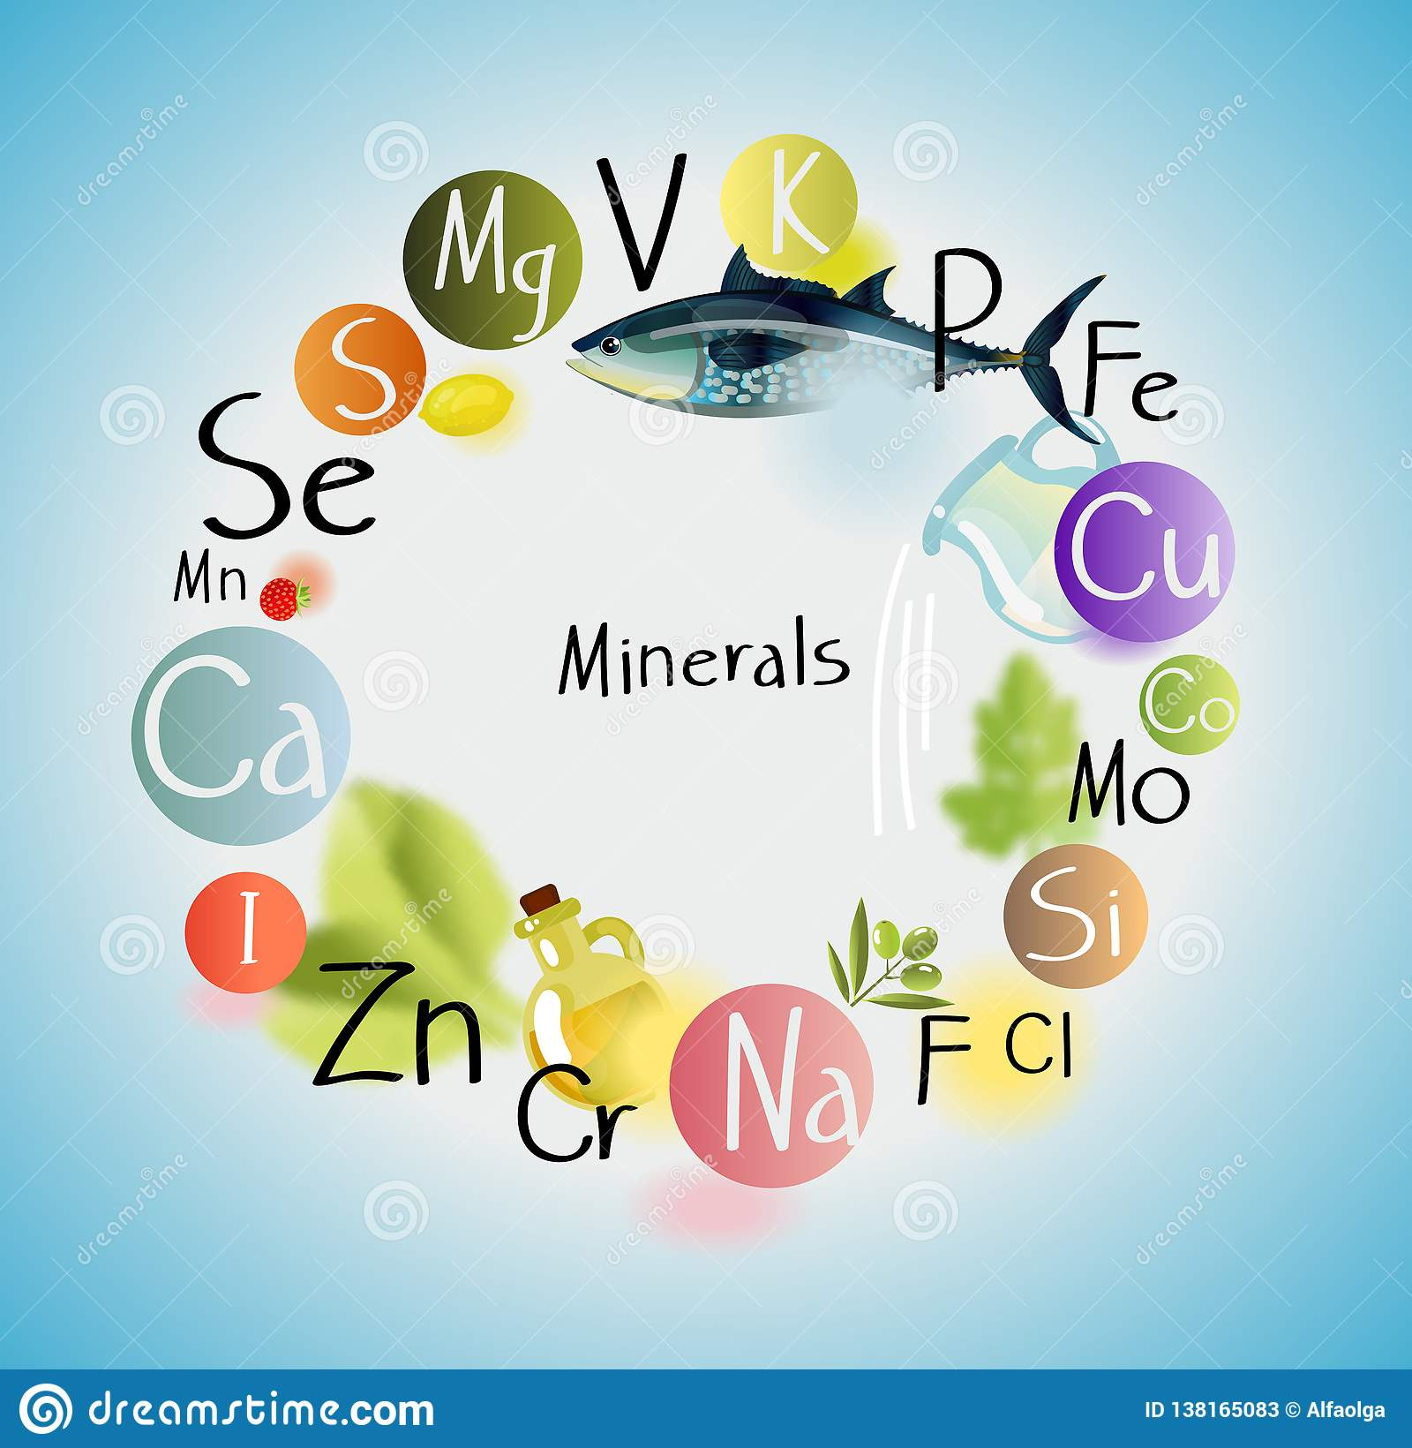
* New words:
mineral (n)

Slide 12
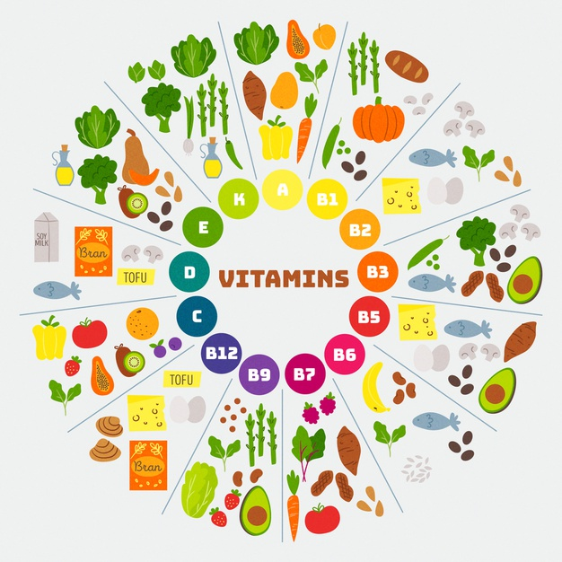
* New words:
vitamin (n)

Slide 13
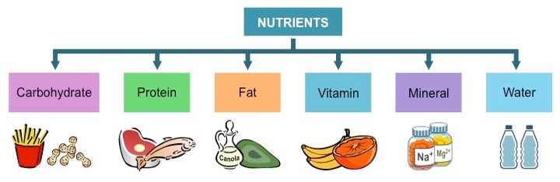
* New words:
nutrient (n)

Slide 14

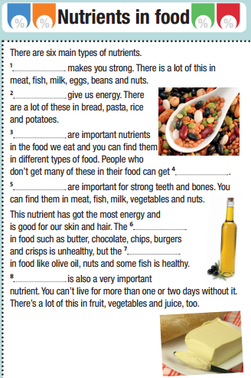
1/ Complete the text by using the given words:
water, minerals, fat (x2), protein, vitamins, diseases, carbohydrates
Minerals
fat
Protein
fat
Carbohydrates
Water
Vitamins
diseases

Slide 15
2/ Read the text again. Are the sentences True or False?
 | TRUE / FALSE
1/ There isn’t any protein in beans.
2/ You can get diseases if you don’t eat a lot of vitamins.
3/ Minerals are good for healthy teeth.
4/ Carbohydrates have got the most energy.
5/ Some types of fat are good for you.
6/ There isn’t any water in vegetables.
FALSE
TRUE
FALSE
FALSE
TRUE
FALSE

Slide 16
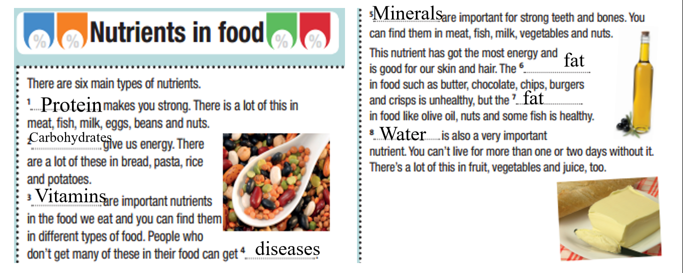

Slide 17
3/ Read the sentences and write the names of the food in the text.
 | Names of the food
1. It’s got animal fat in it. It’s from milk. We put it on bread.
2. It’s got vegetable fat in it. It’s in a bottle. We put it on salads. It’s very healthy.
3. It’s got a lot of protein in it. It’s white. We drink it.
4. These have got a lot of protein. You can cook them or eat them in a salad. They can be different colours.
5. It’s brown and very sweet. It’s delicious, but it’s got a lot of fat.
butter
olive oil
milk
beans
chocolate

Slide 18
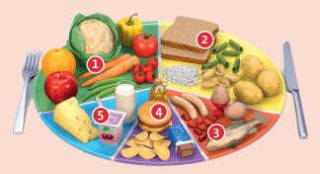
4/ Look at the picture of the dinner plate. What nutrients are there in the five food groups?

Slide 19
In group 1 there are vitamins, minerals and water.
In group 2 there are carbohydrates.
In group 3 there is protein.
In group 5 there is protein and minerals.
In group 4 there is fat.

Slide 20
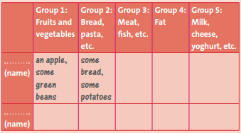

5/ Work in pairs. What do you eat every day? Ask and answer questions with your partner to complete the table. Then use the information to draw a dinner plate for your partner. Who eats the healthies food?
What kind of fruit do you
eat every day?
I eat an apple.

Slide 21

Who eat the healthiest food?

Slide 22

* Homework: - Learn by heart all the new words. - Prepare for the next lesson – Unit 5: Puzzles and games.

Slide 23



www.phuongnam.edu.vn

