Slide 1
Bài giảng điện tử
Unit 5: Food and Health
Lesson 7: Writing

Slide 3
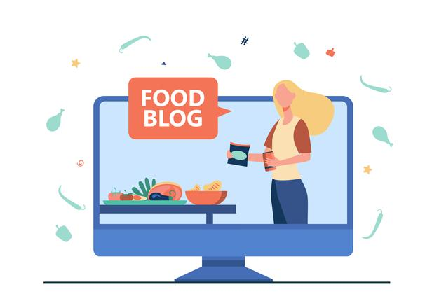
UNIT5: FOOD AND HEALTH
LESSON 7: WRITING - A FOOD BLOG

Slide 4
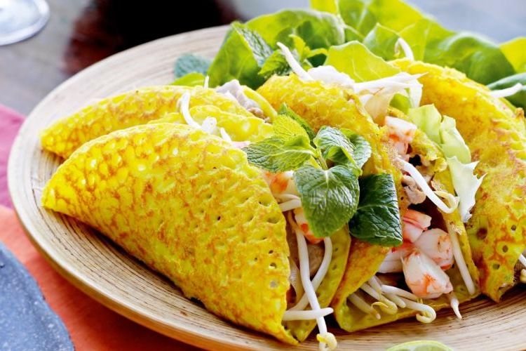
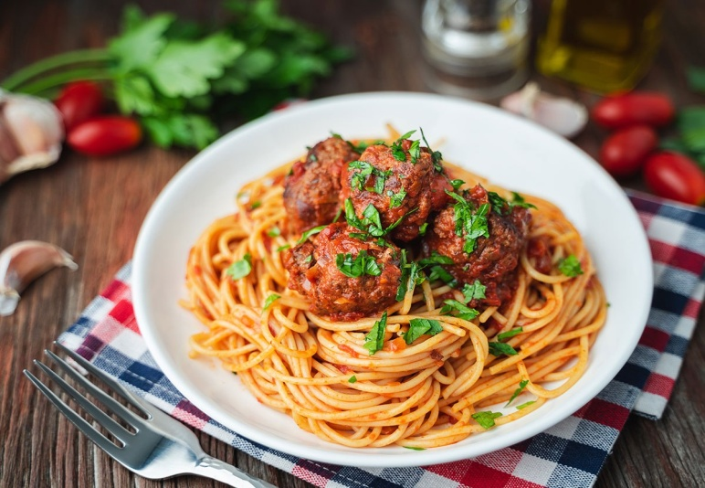
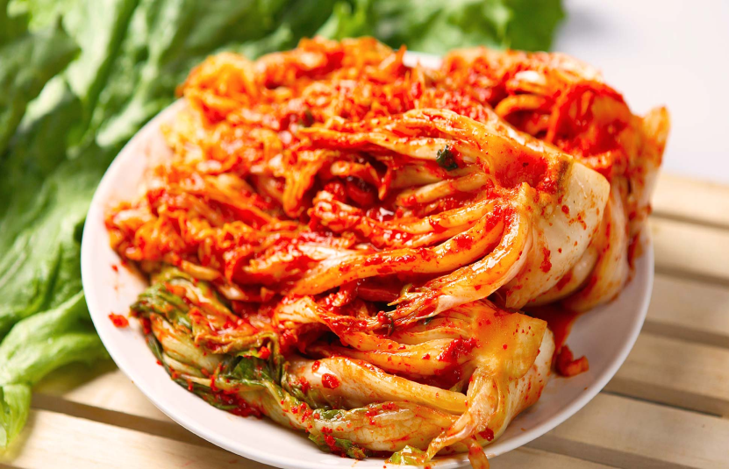
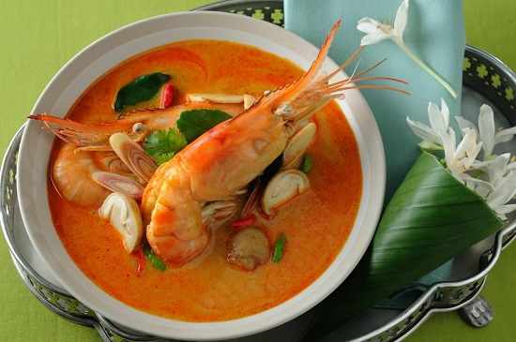
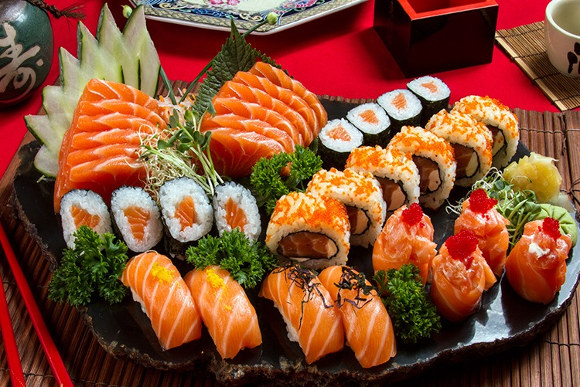
Pancake (Vietnamese food)
Pasta (Italian food)
Kimchi (Korean food)
Tom Yum (Thai food)
Sushi (Japanese food)

Slide 5
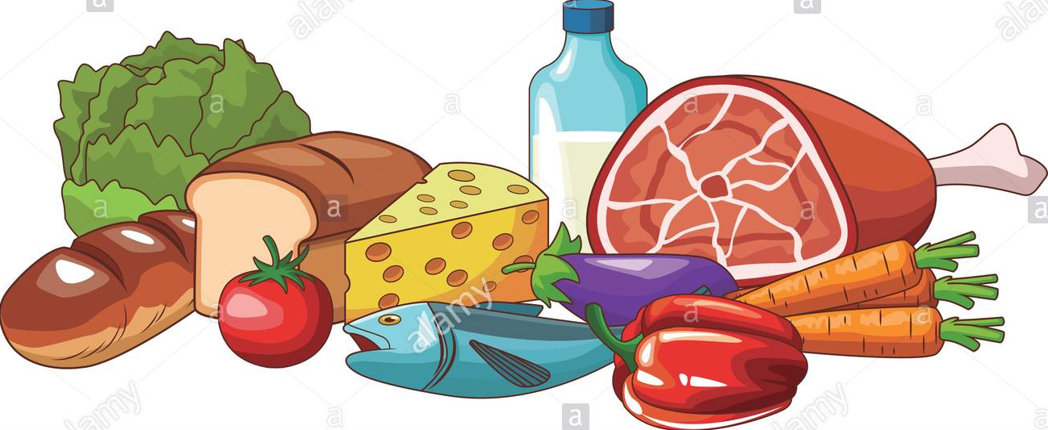
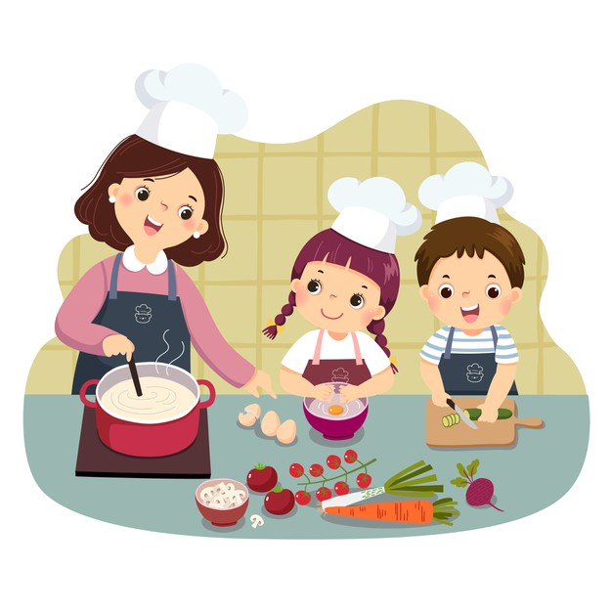
What things can you cook?
What would you like to cook?
Do you think it's important to learn how to cook?

Slide 6
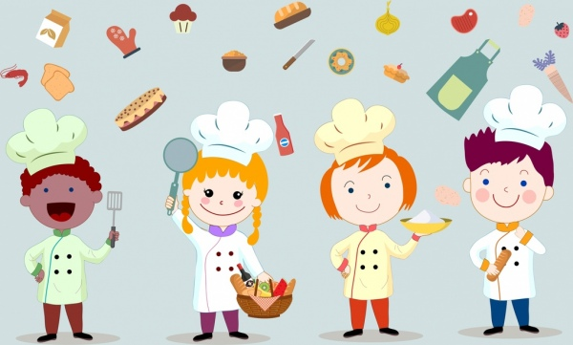
EXERCISE 1: Check the meanings of the words in the glossary. Then read Sally’s blog. What does she have for the starter? What is her favourite part of the meal?
GLOSSARY
tuna red pepper olives ingredients
chop starter main course dessert

Slide 7
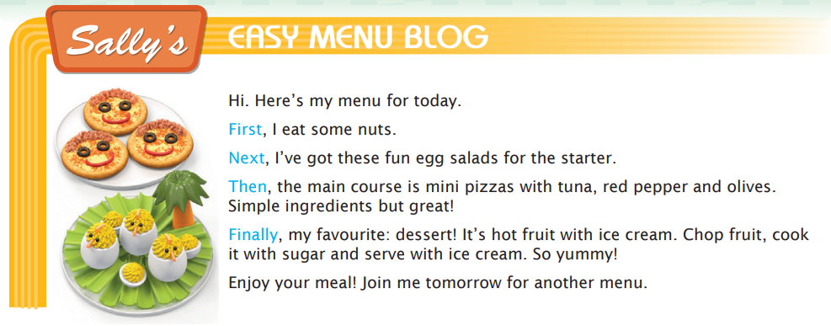
EXERCISE 1: Check the meanings of the words in the glossary. Then read Sally’s blog. What does she have for the starter? What is her favourite part of the meal?
What does she have for the starter?
→ She has egg salads.
What is her favourite part of the meal?
→ Her favourite part of the meal is the dessert.

Slide 8
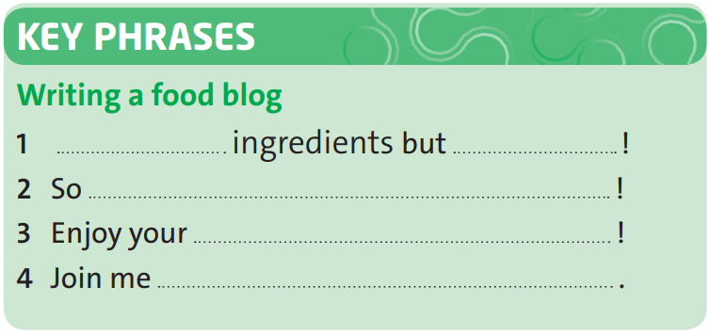
EXERCISE 2: Complete the Key Phrases with words from Sally's blog.
Simple
great
yummy
meal
tomorrow for another menu

Slide 9
EXERCISE 3: Look at the words and phrases in blue in the blog. Which two have the same meaning?
Which two have the same meaning?
→ Next and Then

Slide 10
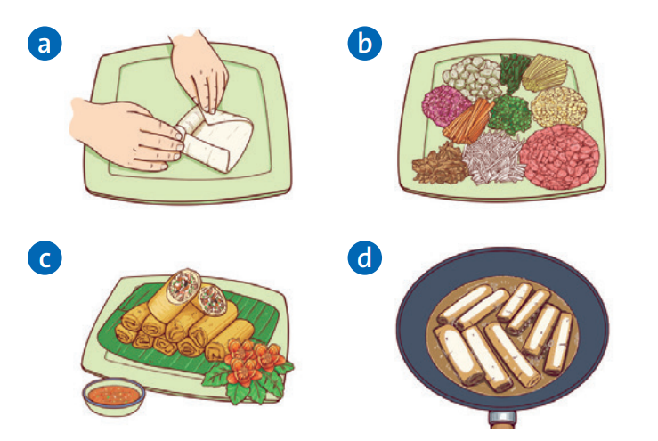
EXERCISE 4: Order pictures and sentences a-d. Then complete the sentences with the words in exercise 3.
Then/ Next
2
1
First
4
Finally
Next/ Then
3

Slide 11
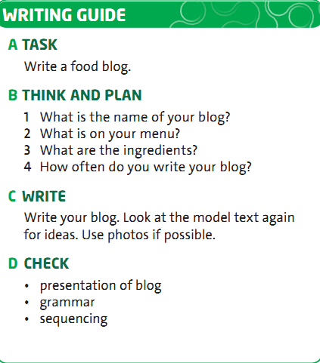
EXERCISE 5: Follow the steps in the writing guide.

Slide 12
- Learn by heart all structures.
- Workbook: Exercises page 41.
- Write a blog about food using sequencing words

Slide 13
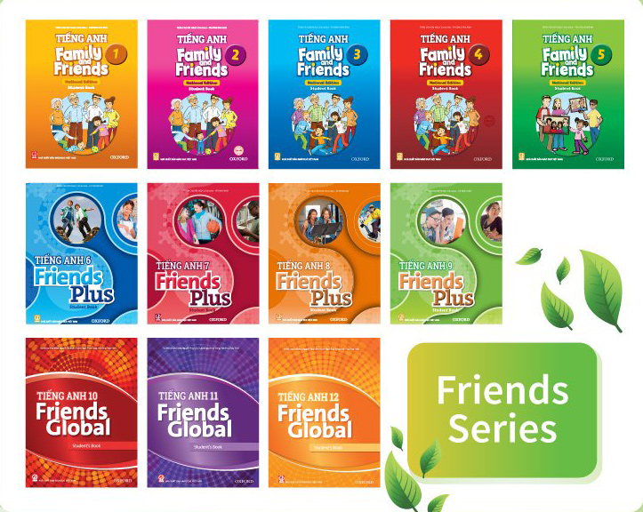
www.phuongnam.edu.vn

