Slide 1
Bài giảng điện tử
Unit 5: Food and Health
Lesson 5: Language Focus

Slide 3
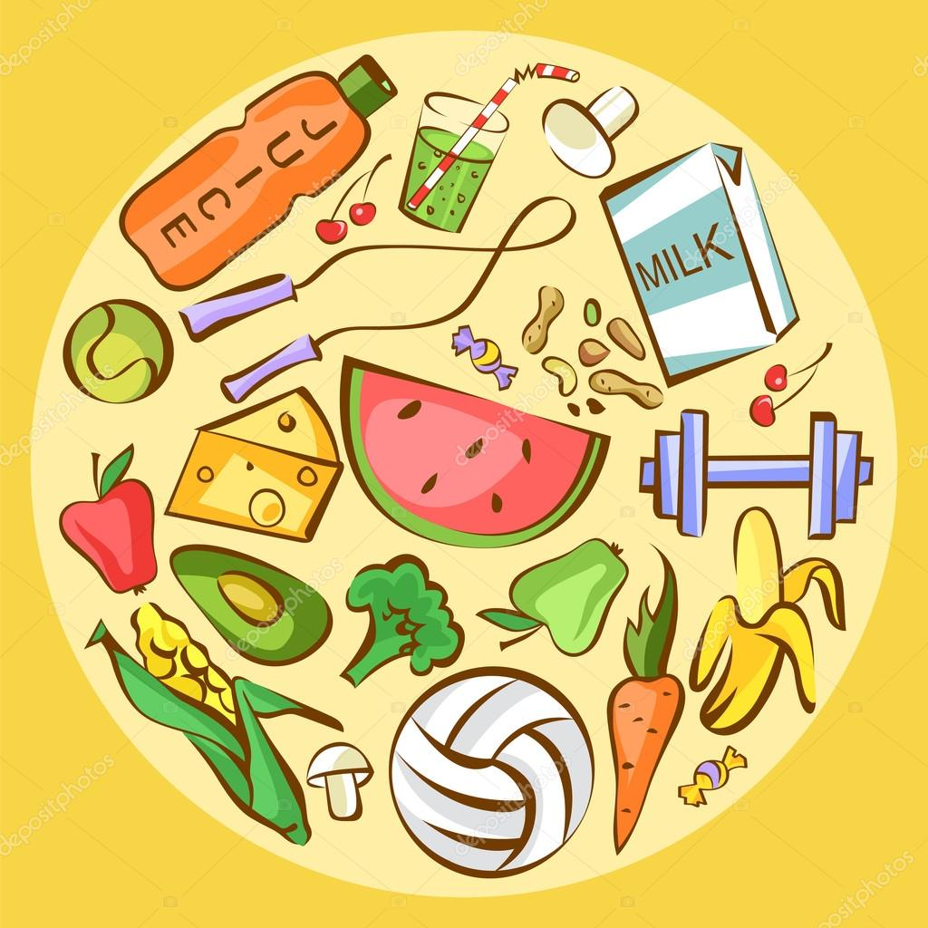
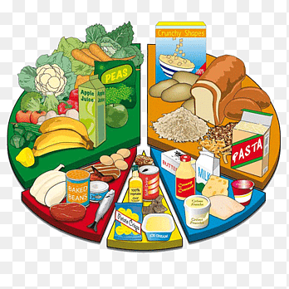
UNIT5: FOOD AND HEALTH
LESSON 2 : LESSON 5: LANGUAGE FOCUS
Verb + -ing
Imperatives
should / shouldn't

Slide 5
CHAIN GAME
You should go to bed early,...
GROUP A
GROUP B

Slide 6
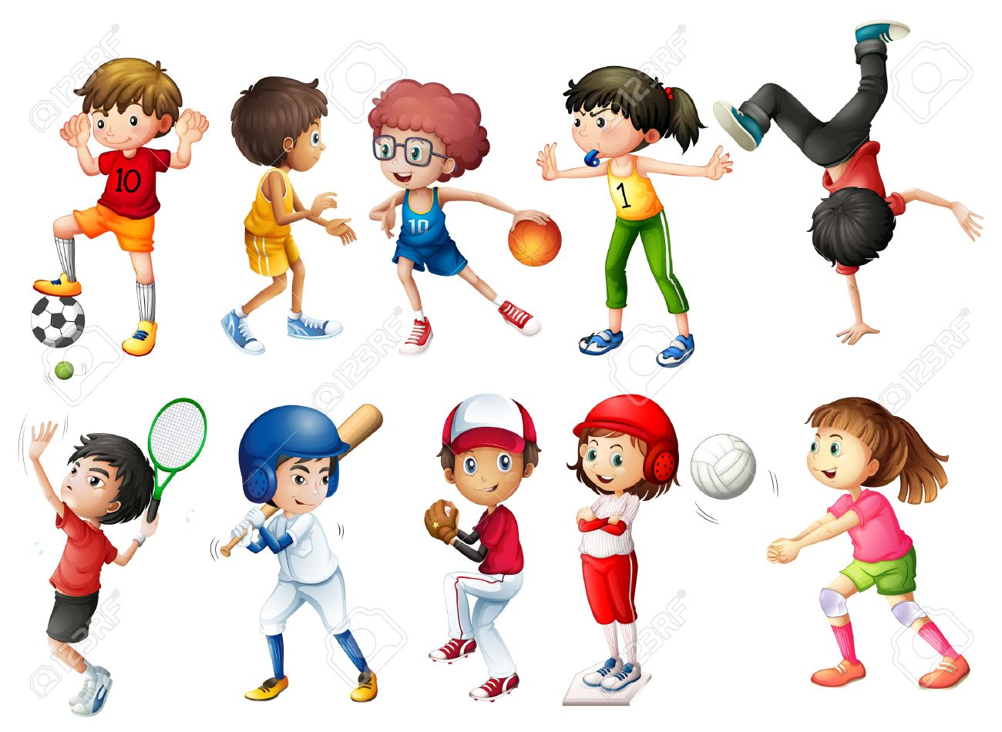
What sports do you like doing?
Which ones do you hate doing?
Eg: I like playing football.
I hate running.

Slide 7
EXERCISE 1: Read out the examples, then read through the rules with the class and elicit the answers.
Rules
1. What form of verb comes after like, prefer, hate and don’t mind?
→
2. What is the spelling of the -ing forms of the verbs run, sit and swim?
→
the -ing form
running, sitting, swimming

Slide 8
Grammar point:
+ Common verbs followed by the -ing form are:
→ hate, like, dislike, love, prefer, detest,...
Eg: I love swimming but I hate jogging.
→ phrases with mind:
wouldn't mind (= would like)
don't mind (= I am willing to)
would you mind (= will you please …?)
Eg: I wouldn't mind having some fish and chips.
I don't mind waiting for a few minutes.
Would you mind holding this for me?

Slide 9
EXERCISE 2: Students write their sentences individually.

Slide 10
EXERCISE 3: Look at the examples of imperatives. How do we make the negative form? Find examples in the Health quiz on page 66.
→ Don't eat.
→ Don't go to bed late.
→ Don't go to school.
❖ Grammar point:
➔ We use "should" / "shouldn't" + the infinitive of the main verb (without "to")
(+) S+ should + main verb
(-) S + shouldn't + main verb
(?) Should + S + main verb?
Eg: You should do more exercise.
You shouldn't stay up late.

Slide 11
EXERCISE 4: Students use imperatives to write about the classroom rules (Dos and Don'ts). Check the answers with the whole class and see who got the most correct answers.
DOS | DON'TS
1. Pay attention in class. | 1. Don't come to school late.
2. Keep the classroom clean. | 2. Don't litter in class.
3. Use kind words. | 3. Don't cheat in the exam.

Slide 12
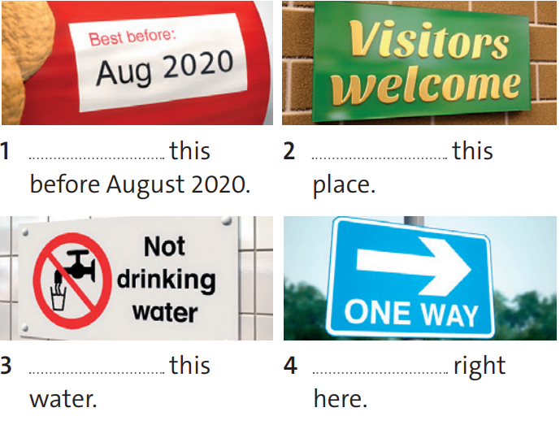
EXERCISE 5: Complete the sentences with the affirmative and negative imperative forms of the verbs in the box.
drink visit ask play go eat
Eat
Visit
Don't drink
Go

Slide 13
EXERCISE 6: Look at the examples. Then choose the correct answers to complete the Rules.
You should eat more vegetables.
You shouldn't go to bed late.
She shouldn't be lazy at school.
Rules
We use should / shouldn’t to give advice / give an instruction.
The he / she / it forms of should / shouldn’t are different / the same

Slide 14
EXERCISE 7: Your friend wants to be healthy. Complete the advice using should / shouldn’t.
stay up / late
eat / fruit and vegetables
do / exercise
drink / fizzy drinks
sit / on the sofa all day
→ You shouldn't stay up late.
→ You should eat fruit and vegetables.
→ You should do exercise.
→ You shouldn't drink fizzy drinks.
→ You shouldn't sit on the sofa all day.

Slide 15
EXERCISE 8: Work in groups. Compare your advice in exercise 7. Who has got the best advice?
What’s the best advice for a friend who wants to be healthy?
My advice is exercise, don't go to bed late and you should eat healthy food.

Slide 16
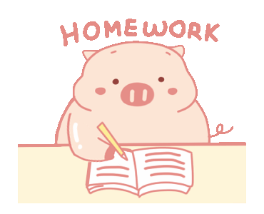
- Learn by heart all structures.
- Workbook: Exercises page 39.
- Write some sentences using
"should/shouldn't"

Slide 17
www.phuongnam.edu.vn

