Slide 1







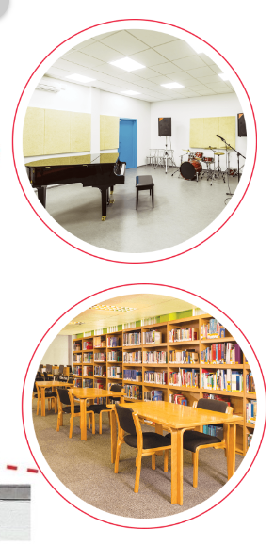
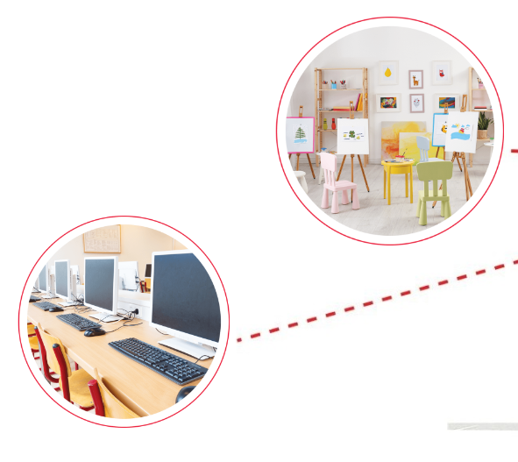





Unit 6
Our school
rooms
Lesson 2
Part: 4, 5, 6
https://www.facebook.com/msphampowerpoint

Slide 2

Table of contents
01.
Warm-up and review
MsPham
0936082789
02.
Listen and tick.
03.
Read and complete.
04.
Let’s play.
05.
Wrap-up

Slide 3
2
Warm-up and review
MsPham
0936082789

Slide 4






PLAY
MsPham-0936082789
Notes:
Ms Huyền Phạm - 0936.082.789 – YOUTUBE: MsPham. Facebook: Dạy và học cùng công nghệ.

Slide 5

Ms Huyền Phạm
0936.082.789
Notes:
Ms Huyền Phạm - 0936.082.789 – YOUTUBE: MsPham. Facebook: Dạy và học cùng công nghệ.

Slide 6

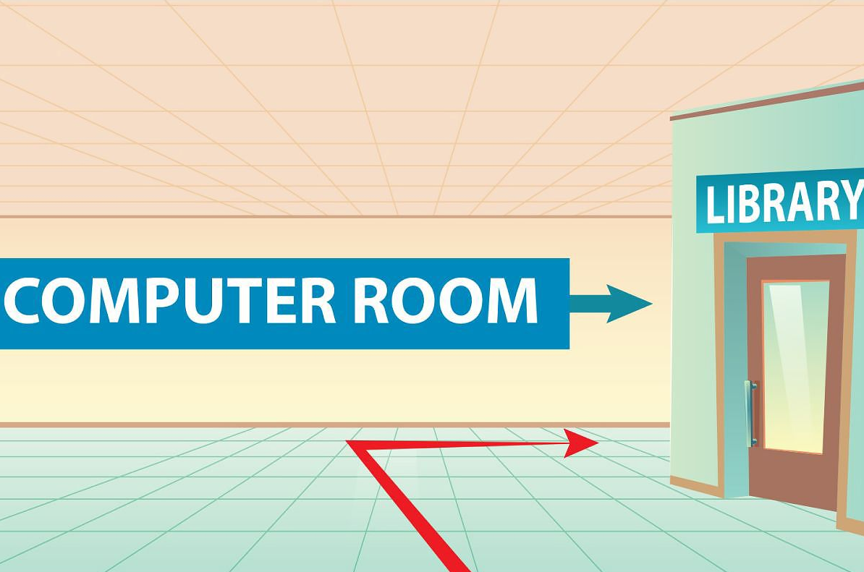

Fill in the blank
turn
______ right
Check

Slide 7
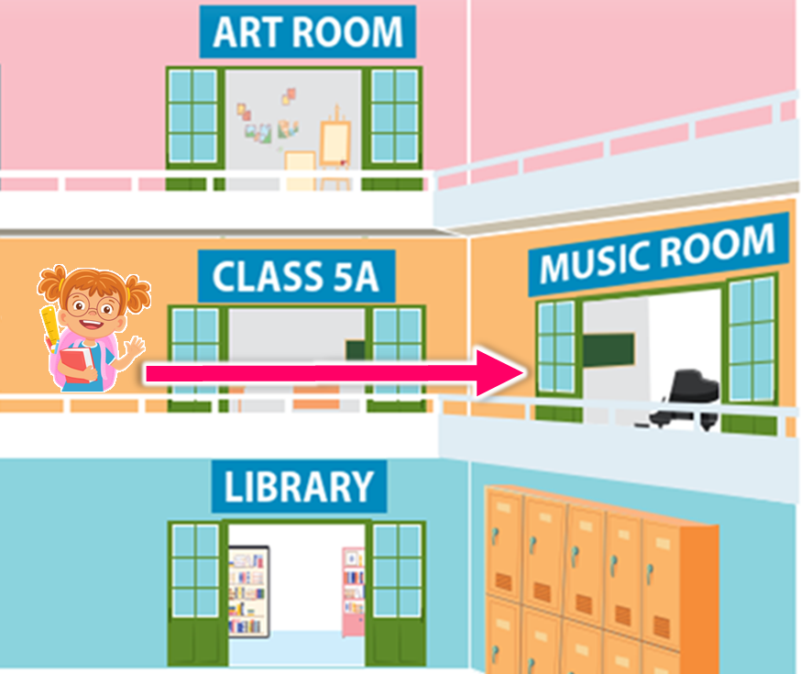
Fill in the blank
go ______
past
Check

Slide 8
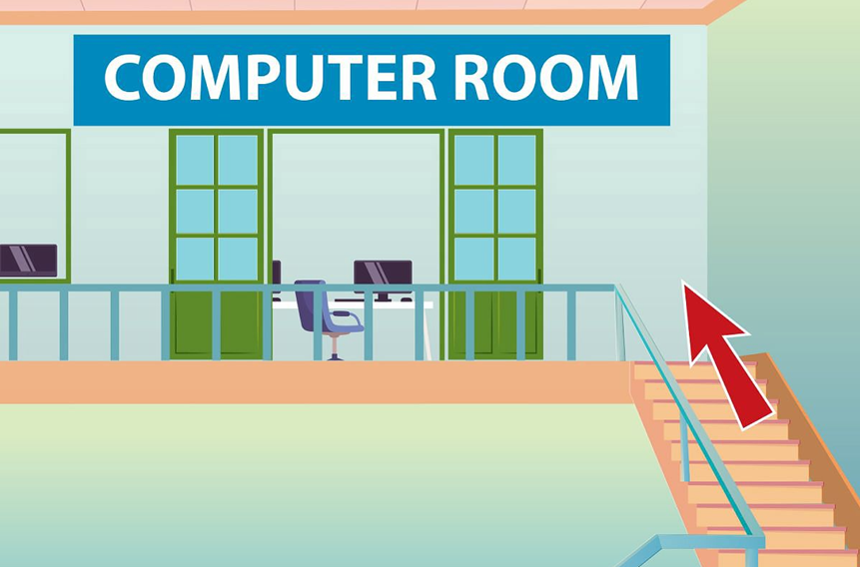
Fill in the blank
up
go ___stairs
Check

Slide 9

Fill in the blank
left
turn _______
Check

Slide 10
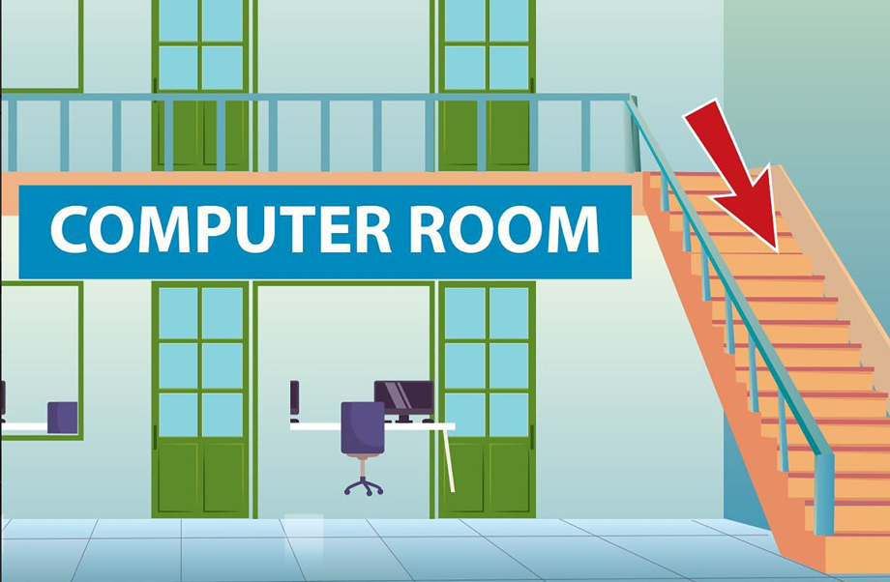
Fill in the blank
go down_____
stairs
Check

Slide 11
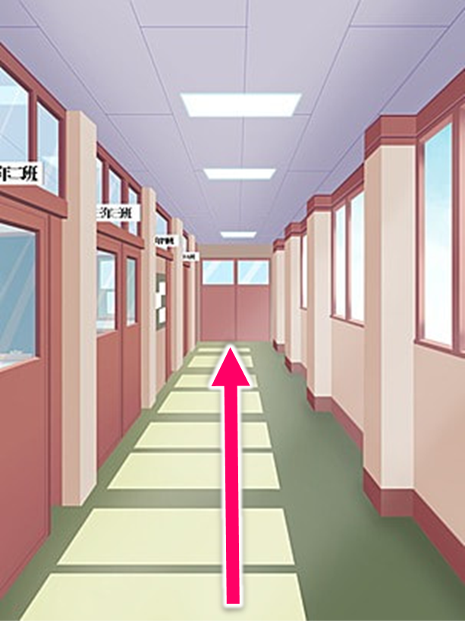
Fill in the blank
_____ along
go
Check

Slide 12



EXIT
Notes:
Ms Huyền Phạm - 0936.082.789 – YOUTUBE: MsPham. Facebook: Dạy và học cùng công nghệ.

Slide 13

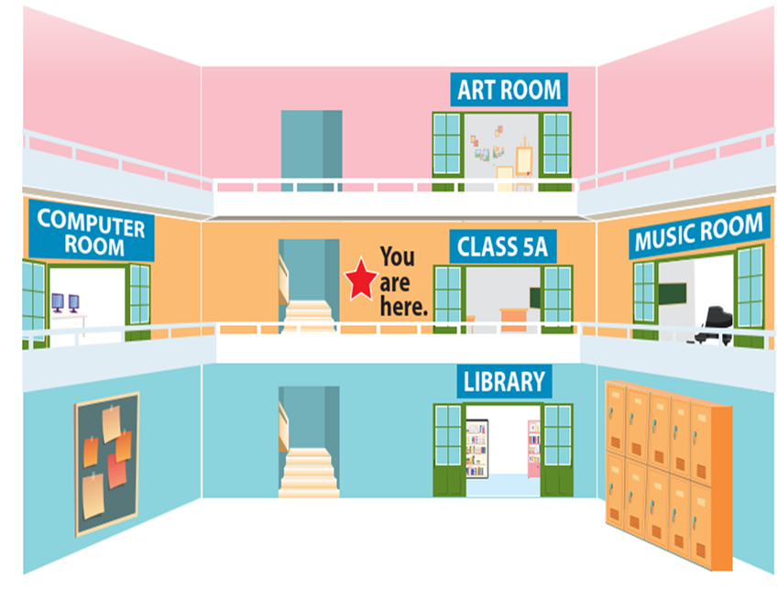

Review
Go upstairs.
It's on your left.
Go past
Class 5A
and turn right.
Go along
the corridor and turn left.
Go downstairs.
It's on your left.
Could you tell me the way
to the _____, please?

Slide 14
1
MsPham
0936082789
Listen and tick

Slide 15

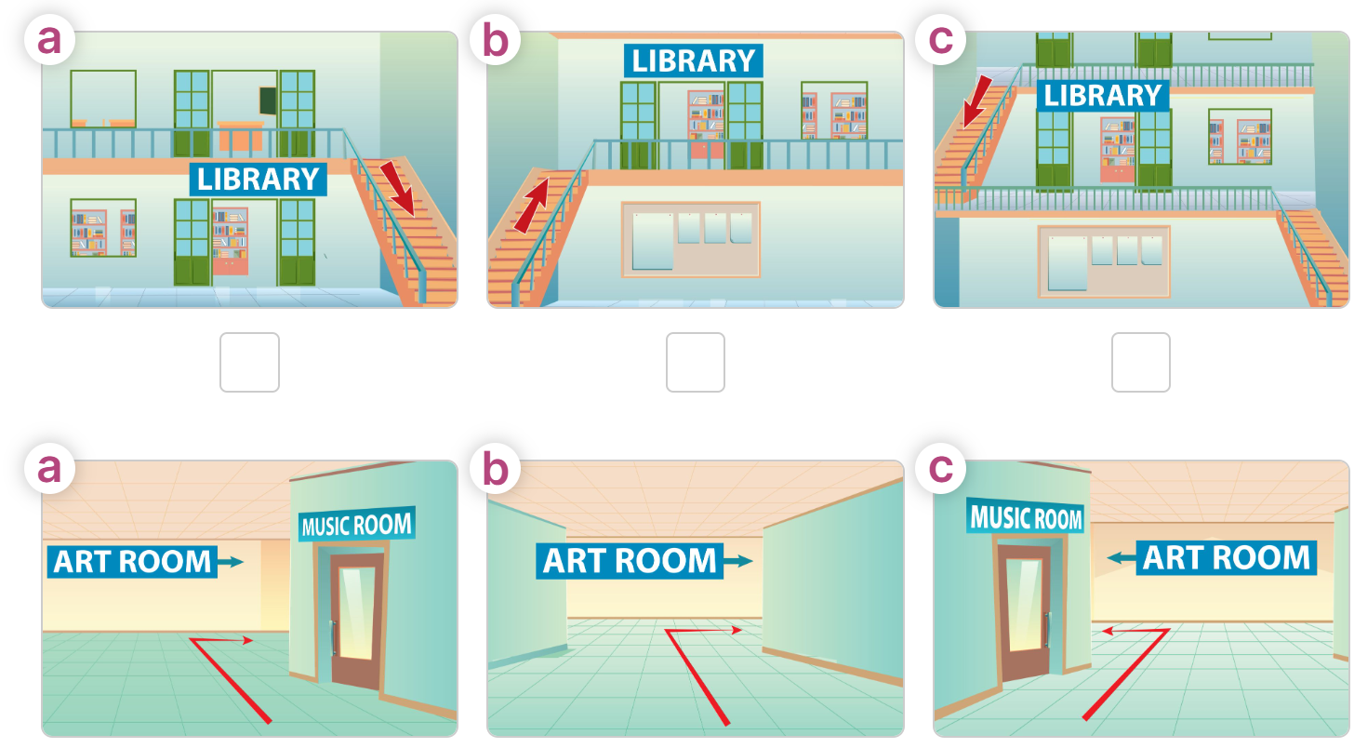
Listen and tick
1
MsPham
0936082789
2
Notes:
Click từng câu để nghe và nhắc lại

Slide 16


1.
A: Hi, I'm Lan. I'm a new pupil. Could you tell me the way to the library, please?
B: Sure. Go downstairs. It's on the first floor.
A: Thank you.
Let’s check.
1
MsPham
0936082789
Notes:
Click từng câu để nghe và nhắc lại

Slide 17
2.
A: What are you looking for, Linh?
B: I'm looking for the art room. Could you tell me the way there, please?
A: Go past the music room and turn right.
B: Thank you very much.
Let’s check.
2
MsPham
0936082789
Notes:
Click từng câu để nghe và nhắc lại

Slide 18
Let’s check.
1
MsPham
0936082789
2
Notes:
Click từng câu để nghe và nhắc lại

Slide 19
3
Read and complete.
MsPham
0936082789

Slide 20
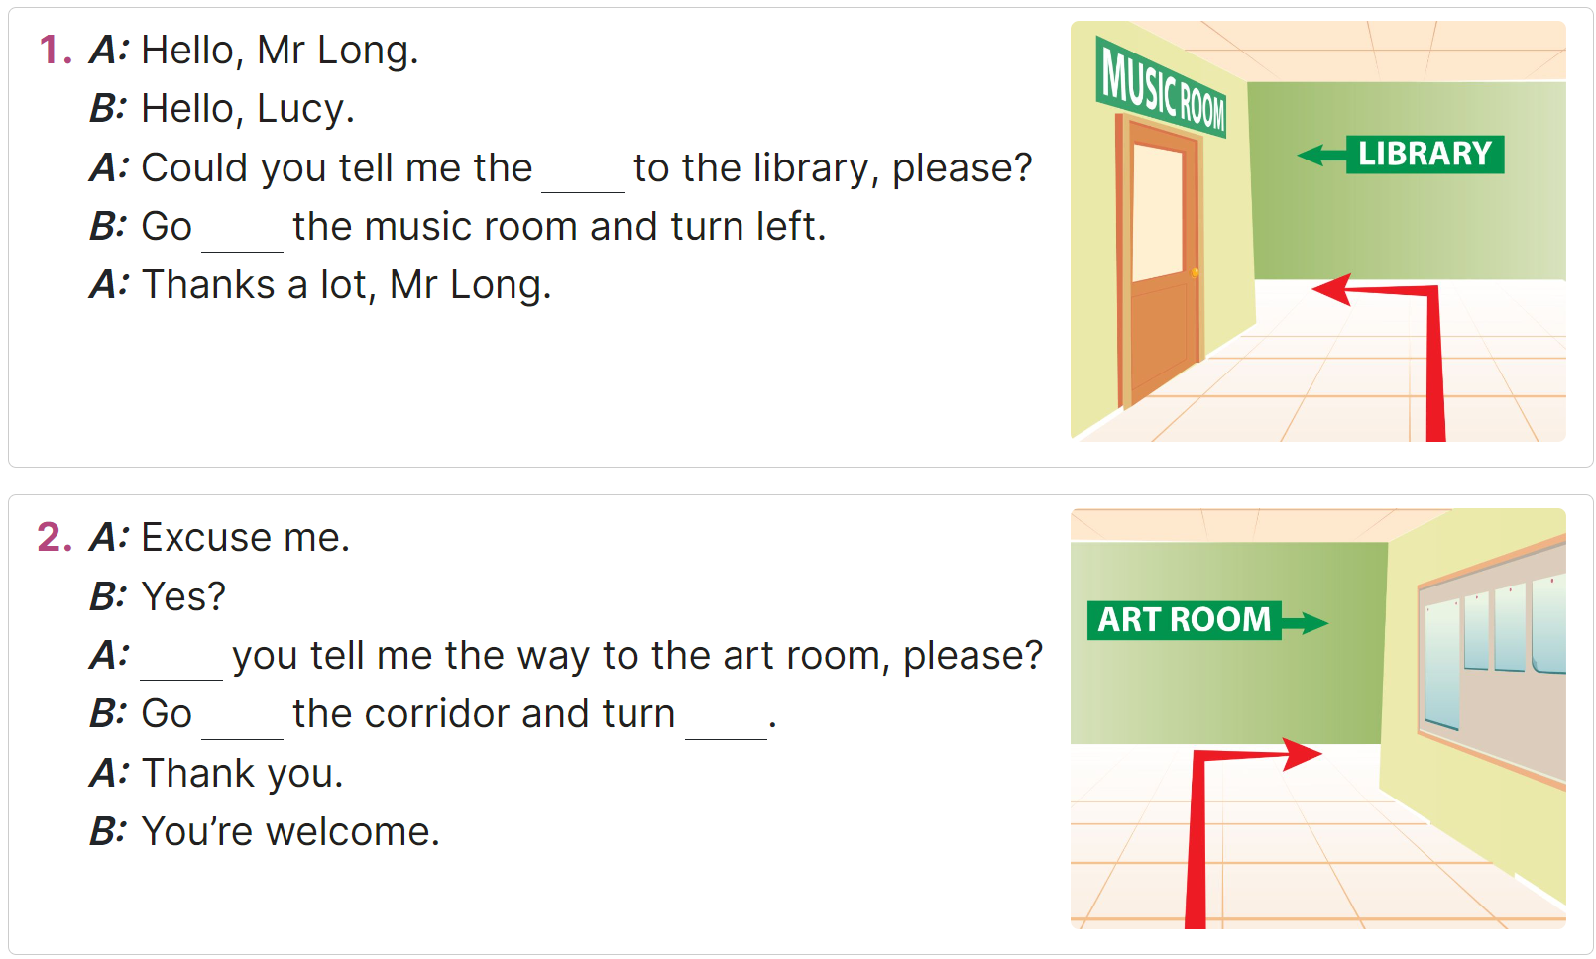
Read and complete
MsPham
0936082789

Slide 21
Let’s check.
1
A: Hello, Mr Long.
B: Hello, Lucy.
A: Could you tell me the way to the library, please?
B: Go past the music room and turn left.
A: Thanks a lot, Mr Long.
MsPham
0936082789
_____
_____

Slide 22
Let’s check.
2
MsPham
0936082789
A: Excuse me.
B: Yes?
A: Could you tell me the way to the art room, please?
B: Go along the corridor and turn right .
A: Thank you.
B: You're welcome.
_____
_____
_____.

Slide 23
4
MsPham
0936082789
Let’s play

Slide 24
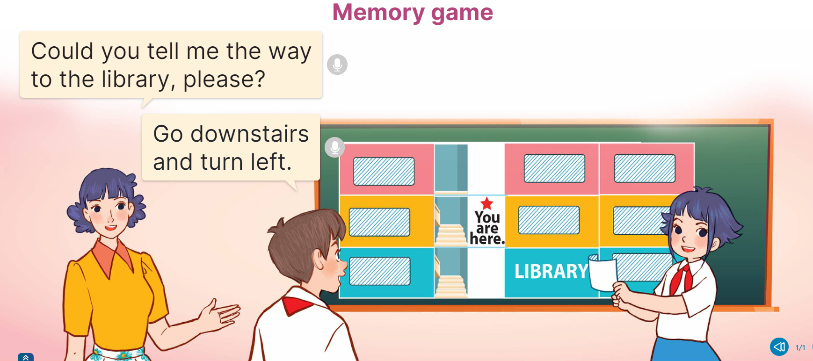
Let’s play
MsPham
0936082789

Slide 25








How to play
Look and remember in 30s
START
30s
MUSIC ROOM |  | ART ROOM | GYM Ư
CLASS 5B |  | CLASS 5A | COMPUTER ROOM
CLASS 3A |  | LIBRARY | CLASS 4B
MsPham
0936082789

Slide 26
How to play
Ask and answer
MUSIC ROOM |  | ART ROOM | GYM Ư
CLASS 5B |  | CLASS 5A | COMPUTER ROOM
CLASS 3A |  | LIBRARY | CLASS 4B
MsPham
0936082789

Slide 27
How to play
Could you tell me the way
to the library, please?
Example:
Go downstairs and turn left.
MUSIC ROOM |  | ART ROOM | GYM Ư
CLASS 5B |  | CLASS 5A | COMPUTER ROOM
CLASS 3A |  | LIBRARY | CLASS 4B
MsPham
0936082789

Slide 28
Let’s play
MUSIC ROOM |  | ART ROOM | GYM Ư
CLASS 5B |  | CLASS 5A | COMPUTER ROOM
CLASS 3A |  | LIBRARY | CLASS 4B
MsPham
0936082789

Slide 29
Could you tell me the way
to Class 4B, please?
Go downstairs, turn left and go past the library.
MUSIC ROOM |  | ART ROOM | GYM Ư
CLASS 5B |  | CLASS 5A | COMPUTER ROOM
CLASS 3A |  | LIBRARY | CLASS 4B
MsPham
0936082789

Slide 30
Could you tell me the way
to the music room, please?
Go upstairs and
turn right.
MUSIC ROOM |  | ART ROOM | GYM Ư
CLASS 5B |  | CLASS 5A | COMPUTER ROOM
CLASS 3A |  | LIBRARY | CLASS 4B
MsPham
0936082789

Slide 31
Could you tell me the way
to Class 5A, please?
It’s on your left.
MUSIC ROOM |  | ART ROOM | GYM Ư
CLASS 5B |  | CLASS 5A | COMPUTER ROOM
CLASS 3A |  | LIBRARY | CLASS 4B
MsPham
0936082789

Slide 32
Could you tell me the way
to Class 5B, please?
Go along the corridor.
It’s on your right.
MUSIC ROOM |  | ART ROOM | GYM Ư
CLASS 5B |  | CLASS 5A | COMPUTER ROOM
CLASS 3A |  | LIBRARY | CLASS 4B
MsPham
0936082789

Slide 33
Could you tell me the way
to the computer room, please?
Go past Class 5A.
It’s on your left.
MUSIC ROOM |  | ART ROOM | GYM Ư
CLASS 5B |  | CLASS 5A | COMPUTER ROOM
CLASS 3A |  | LIBRARY | CLASS 4B
MsPham
0936082789

Slide 34
Could you tell me the way
to the art room, please?
Go upstairs and turn left.
MUSIC ROOM |  | ART ROOM | GYM Ư
CLASS 5B |  | CLASS 5A | COMPUTER ROOM
CLASS 3A |  | LIBRARY | CLASS 4B
MsPham
0936082789

Slide 35
Could you tell me the way
to the gym, please?
Go upstairs, turn left and go past the art room.
MUSIC ROOM |  | ART ROOM | GYM Ư
CLASS 5B |  | CLASS 5A | COMPUTER ROOM
CLASS 3A |  | LIBRARY | CLASS 4B
MsPham
0936082789

Slide 36
WELLDONE!
MUSIC ROOM |  | ART ROOM | GYM Ư
CLASS 5B |  | CLASS 5A | COMPUTER ROOM
CLASS 3A |  | LIBRARY | CLASS 4B
MsPham
0936082789

Slide 37
5
MsPham
0936082789
Wrap-up

Slide 38
Review
Go upstairs.
It's on your left.
Go past
Class 5A
and turn right.
Go along
the corridor and turn left.
Go downstairs.
It's on your left.
Could you tell me the way
to the _____, please?

Slide 39
Thank you
For joining!
https://www.facebook.com/msphampowerpoint

