Slide 1













MsPham
0936082789
Unit 1
All about me
MsPham
0936082789
Speaking

Slide 2

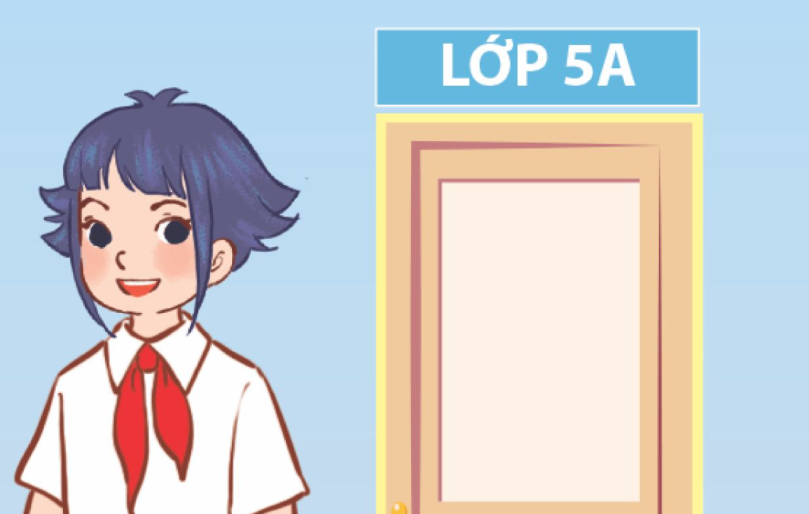
Look and answer
Look at picture 1.
Who’s this?
What class is she in?

Slide 3
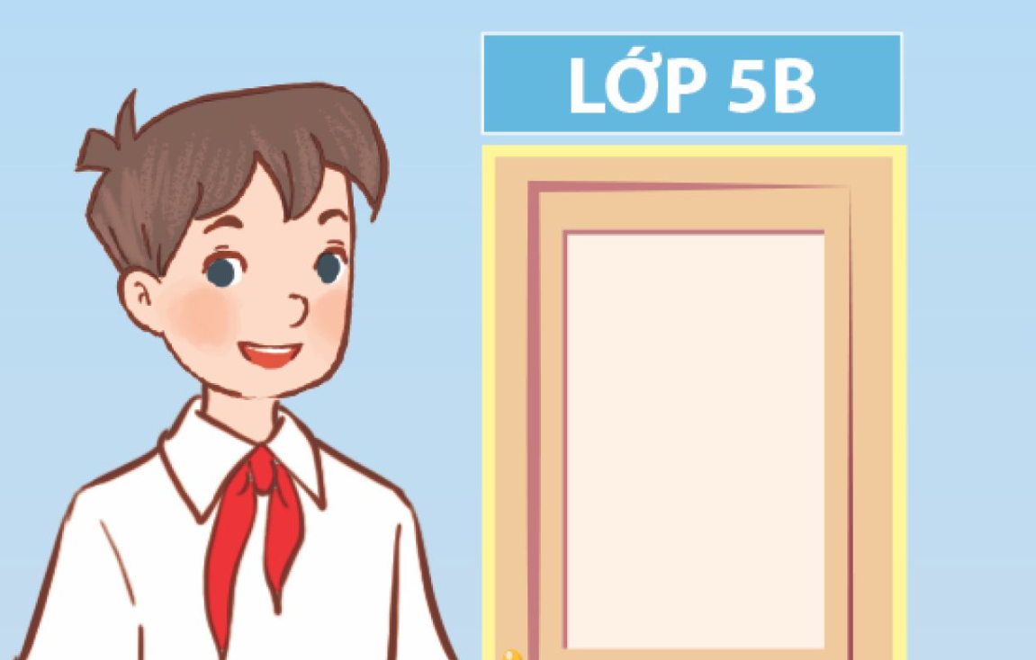
Look and answer
Look at picture 2.
Who’s this?
What class is he in?
What about you?

Slide 4
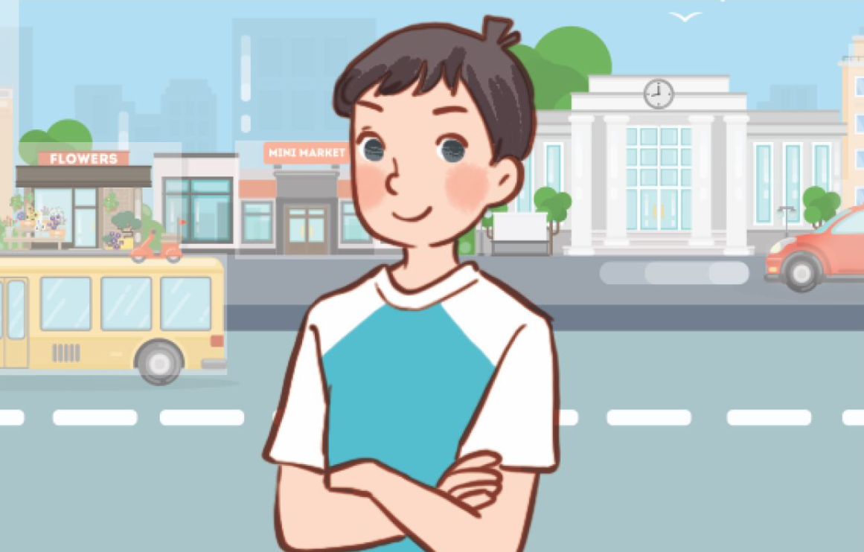
Look and answer
Look at picture 3.
Who’s this?
Where does she live?

Slide 5
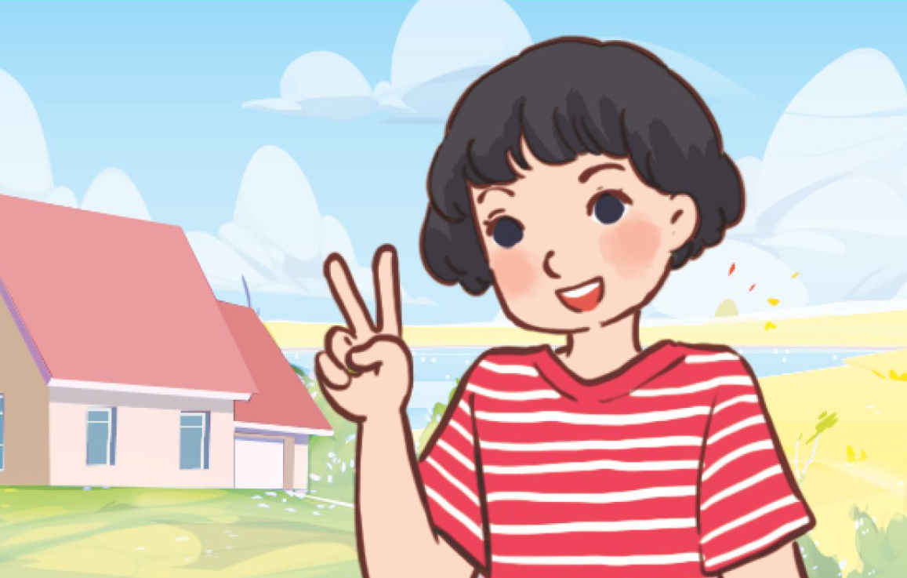
Look and answer
Look at picture 4.
Who’s this?
Where does she live?
What about you?

Slide 6
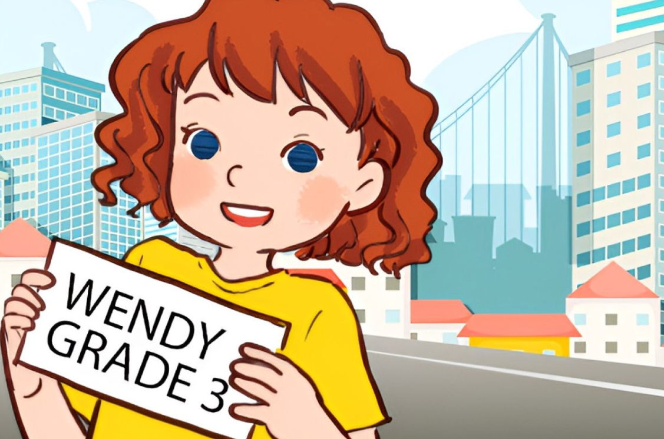
Look and answer
Look at picture 5.
Who’s this?
What class is she in?
Where does she live?

Slide 7

Look and answer
Look at picture 6.
Who’s this?
What class is he in?
Where does he live?
What about you?
Do you live in the city
or in the countryside?

Slide 8
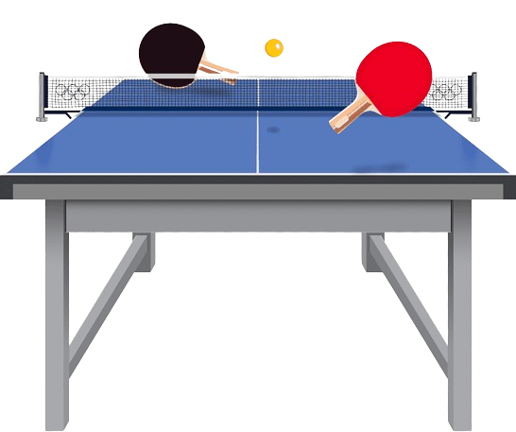
Look and answer
Look at picture 7.
Do you know this sport?
What’s your favourite sport?
Who do you play with?
When do you often play it?

Slide 9

Look and answer
Look at picture 8.
What color is it?
My favourite colour is blue.
What’s your favourite colour?

Slide 10

Look and answer
Look at picture 9.
What animal is it?
Did you ever see it?
Can you name some
animals you know?
What’s you favourite animal?

Slide 11
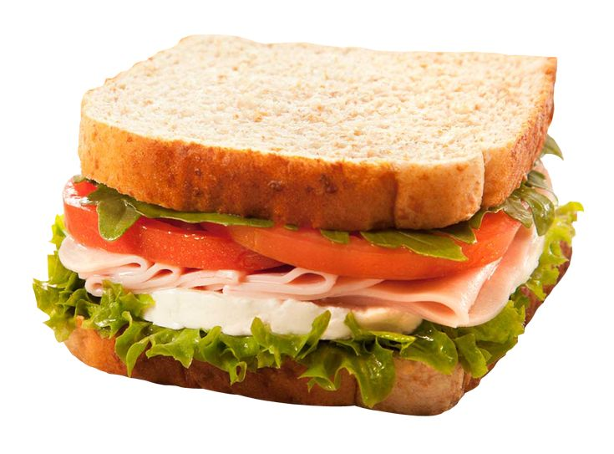
Look and answer
Look at picture 10.
What is it?
Yeah, It’s a kind of food.
Do you like it?
I like chicken, What about you?
What’s your favourite food?

Slide 12
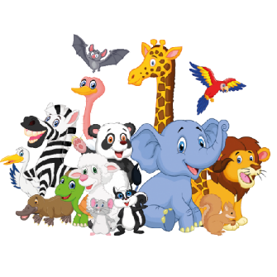




















Speaking test
What is your favourite animal?
Ms.
HuyenPham
What your name?
How old are you?
I love _______.
My name’s ____.
I’m ____ years old.
What is your favourite food?
What class are you in?
Can you tell me about yourself?
My favourite
food is ____.
I’m in Class
____ .
What is your favourite color?
Where do you live?
I like _______.
I live in (a/the)
____ .
What is your favourite subject?
What is your favourite sport?
When is
your birthday?
My favourite subject is ____.
I like ____.
My birthday is in ____.

Slide 13
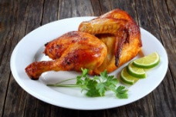
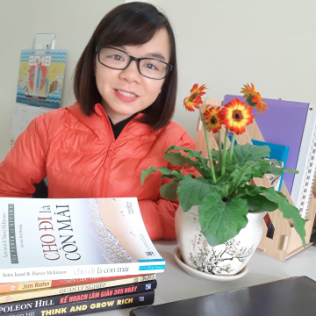
Presentation
I love
Ms.
HuyenPham
My name’s
I’m eleven
rabbits.
Ms.Huyen
years old.
My favourite
food is
I’m in
chicken.
Class 5A
I like
blue.
I live in
the city.
My favourite subject is
I like playing
My birthday is in
English.
table tennis.
June.

Slide 14
Presentation
I love
Ms.
HuyenPham
My name’s
I’m _______.
_______.
_______.
years old.
My favourite
food is
I’m in
_______.
Class _____.
I like
_______.
I live in
the _______.
My favourite subject is
_______.
I like playing
My birthday is
_______.
in _______.

Slide 15




Presentation
Ms.
HuyenPham
Hello. Let me tell
you about myself.

Slide 16
MsPham
0936082789
Thank you!
MsPham
0936082789
For joining!

