Slide 1
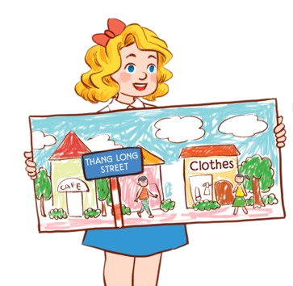
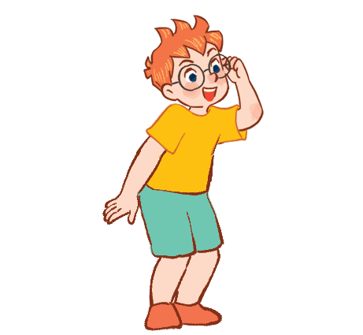
Mến gửi quý thầy cô!
Bộ bài giảng Tiếng Anh 1 - 4 Global này được biên soạn bởi MsPham, là công sức lao động và là tâm huyết của MsPham. Vì vậy, khi đăng kí nhận bài giảng, quý thầy cô được tùy ý chỉnh sửa cho phù hợp mục đích giảng dạy của mình.
Tuy nhiên, mọi hình thức chia sẻ, trao đổi, mua bán, cho tặng bộ bài giảng này đều vi phạm và là ăn cắp.
Kính mong thầy cô cùng mình giữ gìn sự cao quý của nghề giáo và cùng nhau tôn trọng công sức của đồng nghiệp.
Trân trọng!
MsPham – 0936082789
Unit 11
MsPham
0936082789
Lesson 3 – Period 1

Slide 2
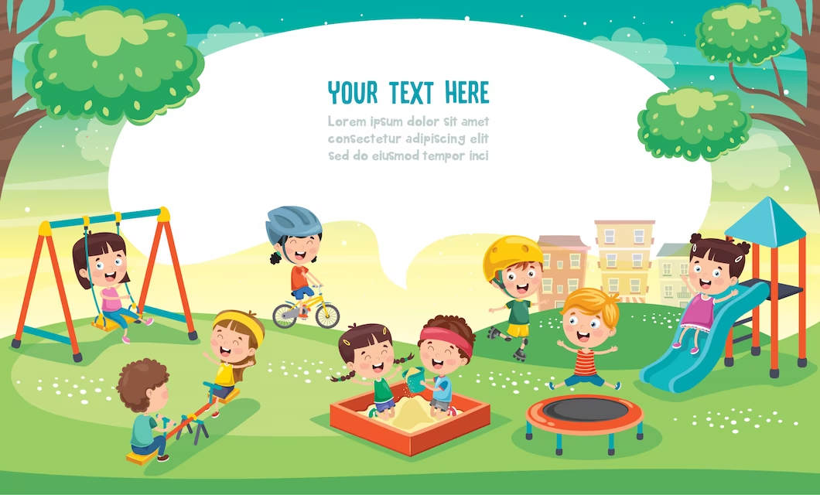
WARM UP

Slide 4
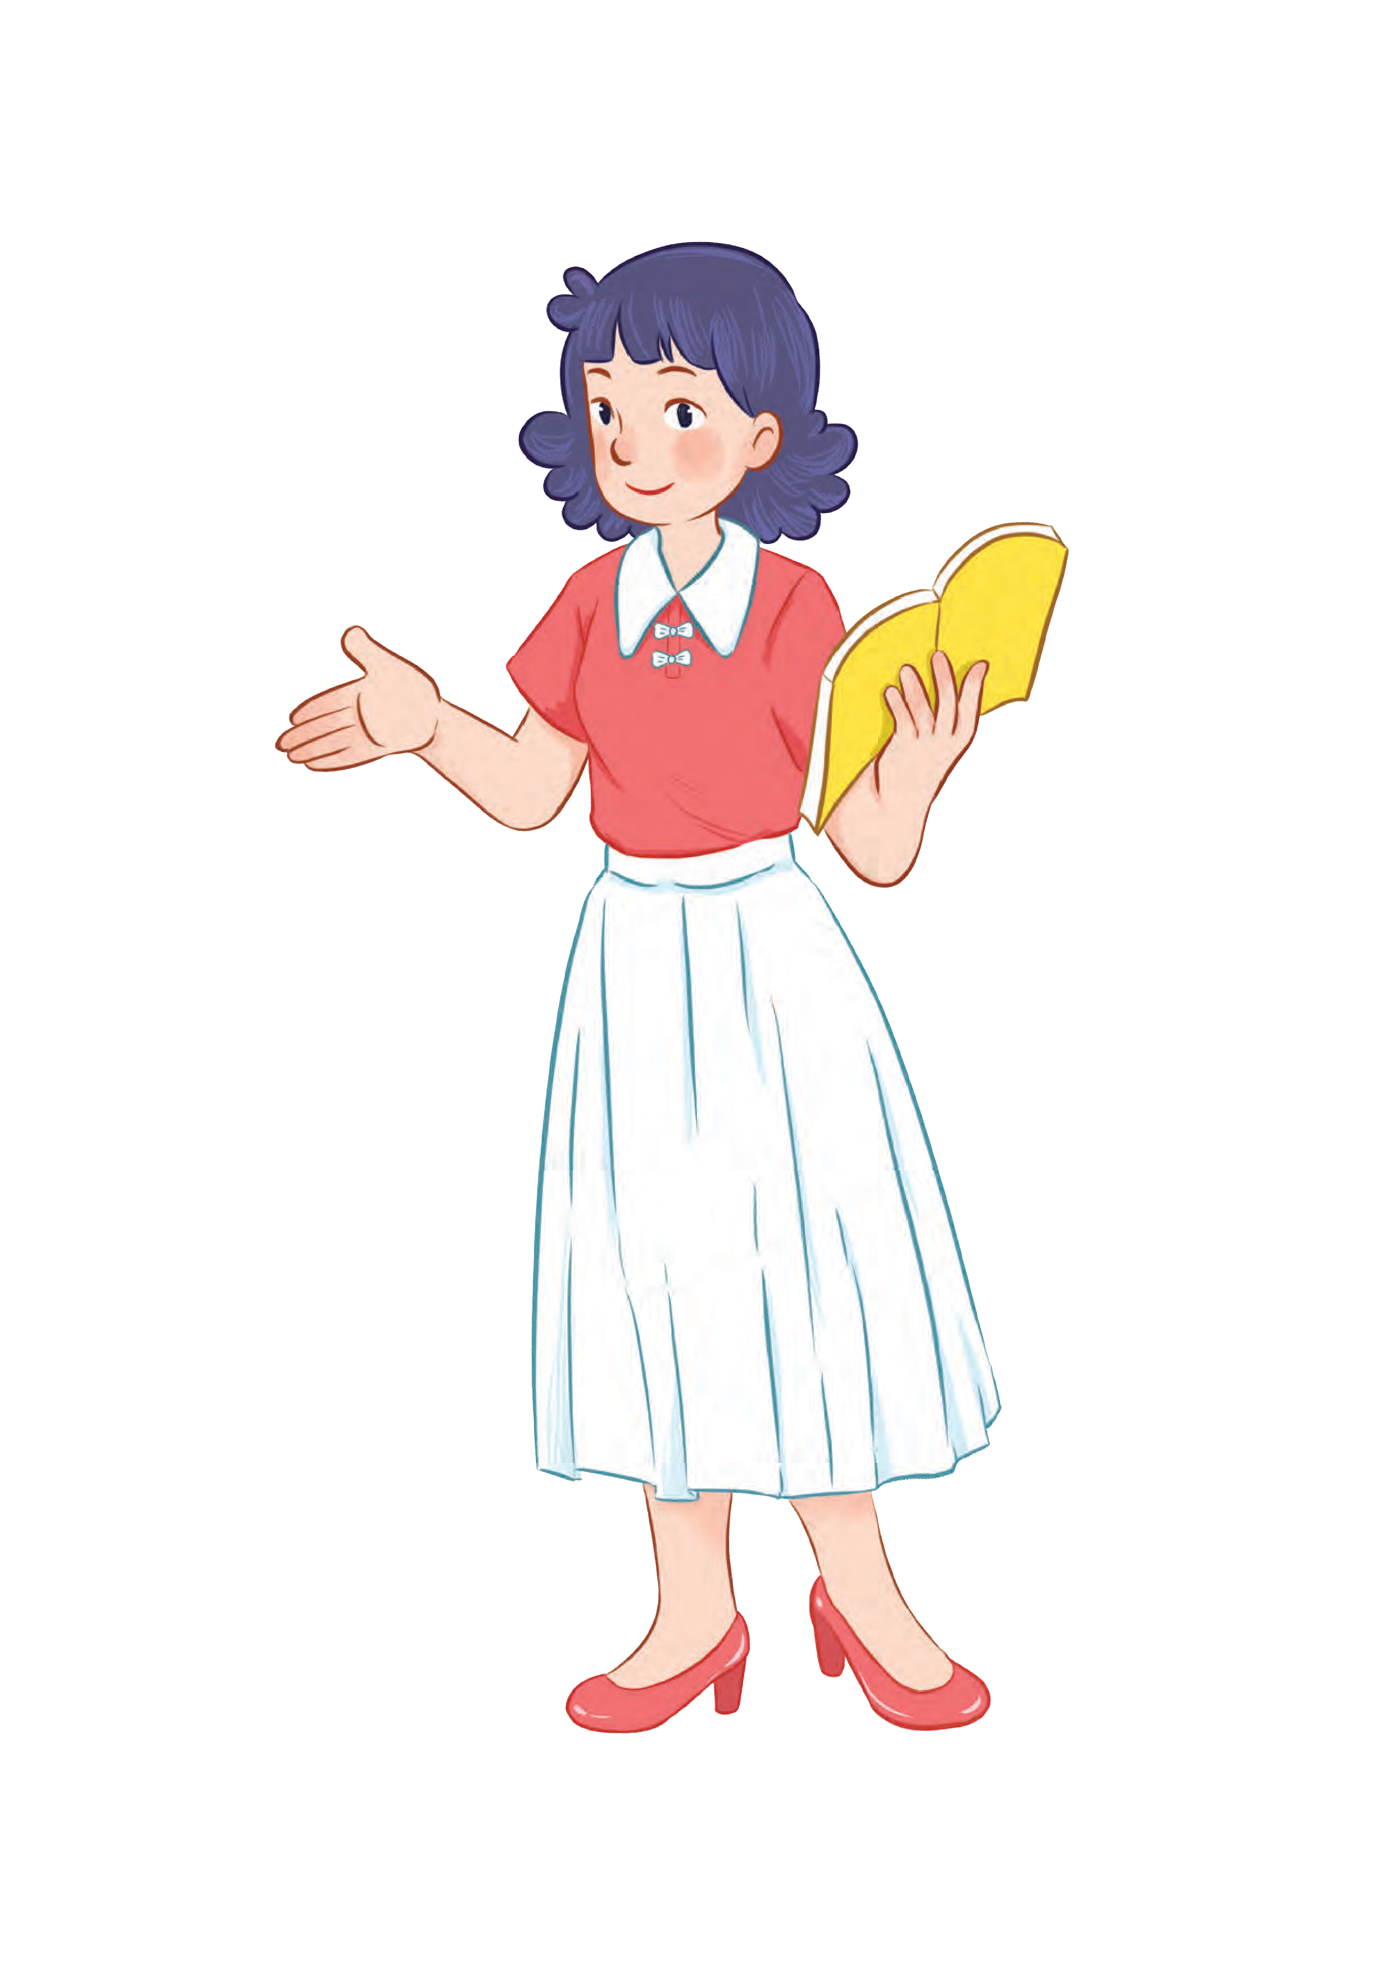
Phonics
MsPham
0936082789

Slide 6
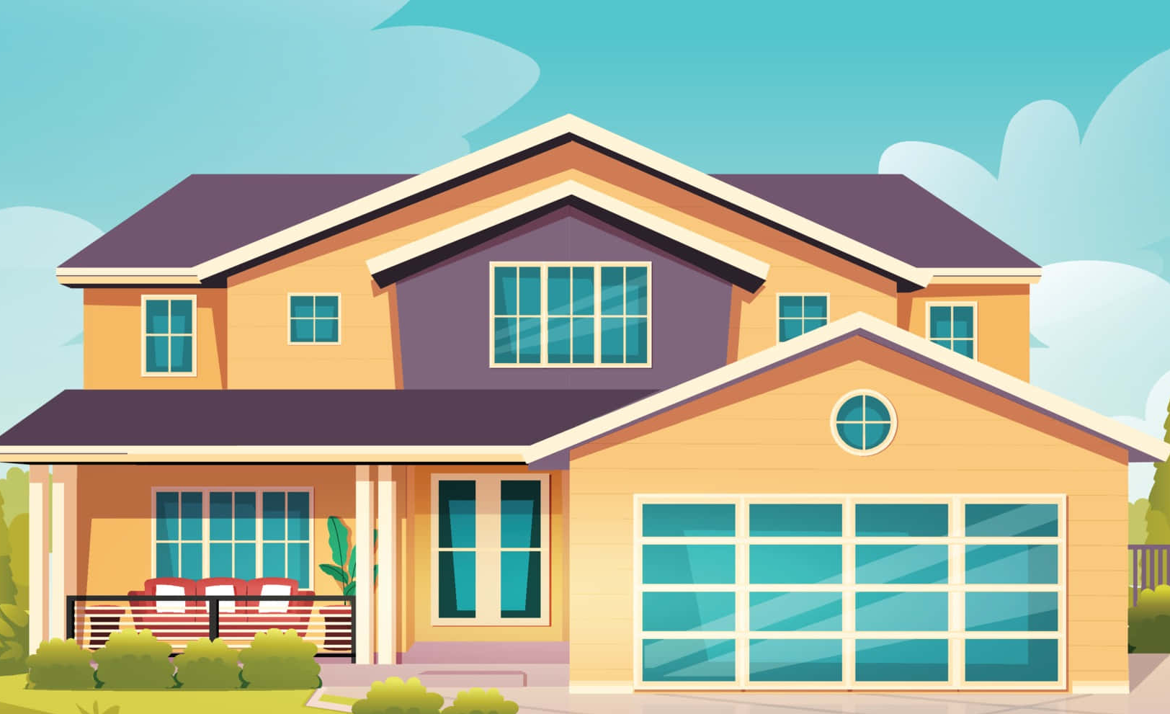
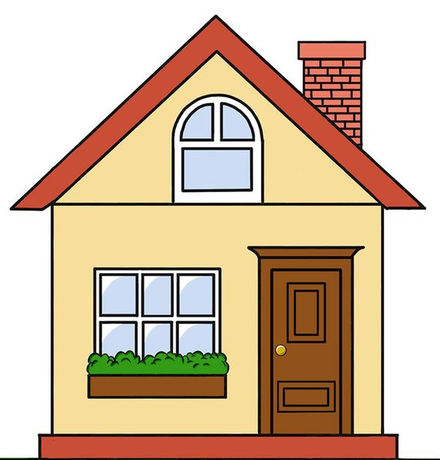
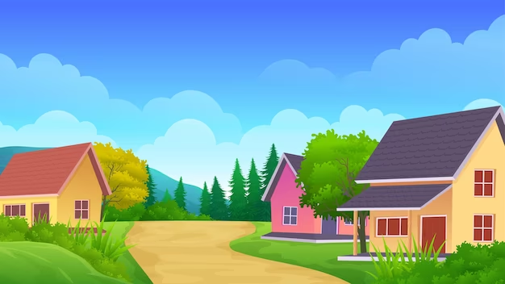
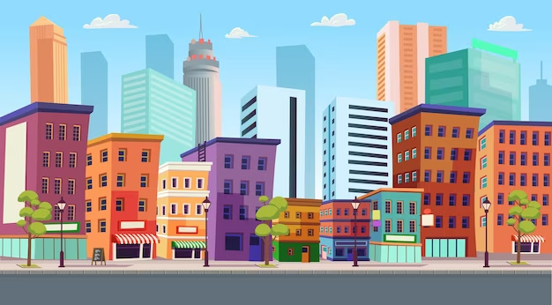
Phonics
big
i
/ɪ/
/bɪg/
village
/ˈvɪlɪdʒ/
city
/ˈsɪti/

Slide 8
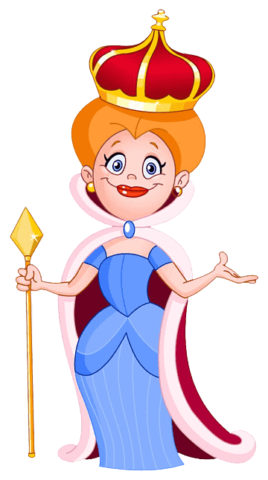
Phonics
street
ee
/i:/
/striːt/
seed
/siːd/
queen
/kwiːn/

Slide 9
Phonics
i
/ɪ/
ee
/i:/

Slide 10
MsPham
0936082789
LET’S PLAY!
Look and say
Play

Slide 11
Check
Next
village

Slide 12
is
Check
Next
seed

Slide 13
is
Check
Next
big

Slide 14
is
Check
Next
city

Slide 15
is
Check
Next
street

Slide 16
is
Check
Next
queen

Slide 17
You’re welldone!

Slide 18
Practice
MsPham
0936082789

Slide 19
1
Listen and repeat.
i
big
They live in a big village.
ee
street
They live in Green Street.
MsPham
0936082789

Slide 20
2
Listen and circle.
1.
2.
a. I am in a big town.
b. I am in a green town.
c. I am at Green Hotel.
a. He is in a big town.
b. He is at Green Hotel.
c. He is in a big hotel.
MsPham
0936082789

Slide 21
2
Let’s chant.
Little Bee,
Little Bee, Little Bee
Where do you live?
I live in Green Street.
Green Street, Green Street.
Here you are, Little Bee.
Little Fish, Little Fish
Where do you live?
I live in a big village.
A big village, a big village.
Here you are, Little Fish.
Little Bee
Little Fish,
Little Fish
Where do you live?
Where do you live?
I live
in Green Street.
I live
in a big village.
Green Street,
Green Street.
A big village,
a big village.
Here you are, Little Bee.
Here you are, Little Fish.

Slide 22
2
Let’s chant.
Little Bee,
Little Bee, Little Bee
Where do you live?
I live in Green Street.
Green Street, Green Street.
Here you are, Little Bee.
Little Fish, Little Fish
Where do you live?
I live in a big village.
A big village, a big village.
Here you are, Little Fish.
Little Bee
Little Fish,
Little Fish
Where do you live?
Where do you live?
I live
in Green Street.
I live
in a big village.
Green Street,
Green Street.
A big village,
a big village.
Here you are, Little Bee.
Here you are, Little Fish.

Slide 23
2
Let’s chant.
Little Bee,
Little Bee, Little Bee
Where do you live?
I live in Green Street.
Green Street, Green Street.
Here you are, Little Bee.
Little Fish, Little Fish
Where do you live?
I live in a big village.
A big village, a big village.
Here you are, Little Fish.
Little Bee
Little Fish,
Little Fish
Where do you live?
Where do you live?
I live
in Green Street.
I live
in a big village.
Green Street,
Green Street.
A big village,
a big village.
Here you are, Little Bee.
Here you are, Little Fish.

Slide 24
Thank you!
MsPham
0936082789
For joining!

