Slide 1







Mến gửi quý thầy cô!
Bộ bài giảng Tiếng Anh 1 - 4 Global này được biên soạn bởi MsPham, là công sức lao động và là tâm huyết của MsPham. Vì vậy, khi đăng kí nhận bài giảng, quý thầy cô được tùy ý chỉnh sửa cho phù hợp mục đích giảng dạy của mình.
Tuy nhiên, mọi hình thức chia sẻ, trao đổi, mua bán, cho tặng bộ bài giảng này đều vi phạm và là ăn cắp.
Kính mong thầy cô cùng mình giữ gìn sự cao quý của nghề giáo và cùng nhau tôn trọng công sức của đồng nghiệp.
Trân trọng!
MsPham – 0936082789
Unit 11
MsPham
0936082789
Lesson 2 – Period 1

Slide 2

MsPham
0936082789
WARM UP

Slide 3

MsPham
0936082789
https://www.youtube.com/watch?v=3EDzQeh7mWE

Slide 4


Vocabulary
MsPham
0936082789

Slide 5

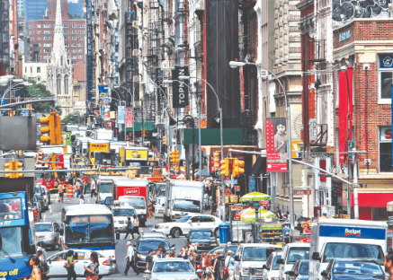
Vocabulary
busy
/ˈbɪzi/
bận rộn, nhộn nhịp
MsPham
0936082789
a busy street
Đường phố nhộn nhịp

Slide 6
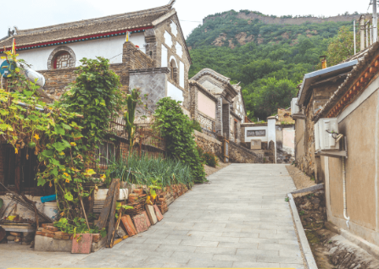
Vocabulary
quiet
/ˈkwaɪət/
Yên tĩnh
MsPham
0936082789
a quiet village
Ngôi làng yên tĩnh

Slide 7
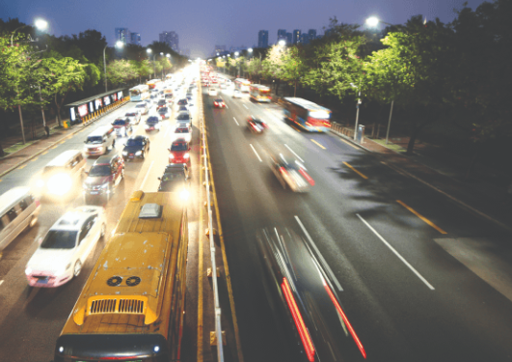
Vocabulary
noisy
/ˈnɔɪzi/
Ồn ào, huyên náo
MsPham
0936082789
a noisy road
Con đường ồn ào

Slide 8
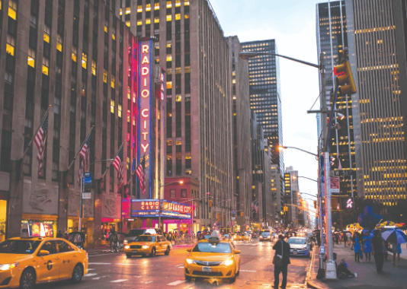
Vocabulary
big
/ˈbɪg/
To, lớn
MsPham
0936082789
a big city
Thành phố lớn

Slide 9
Vocabulary
busy
: bận rộn, nhộn nhịp
quiet
: Yên tĩnh
big
: To, lớn
noisy
: Ồn ào

Slide 10
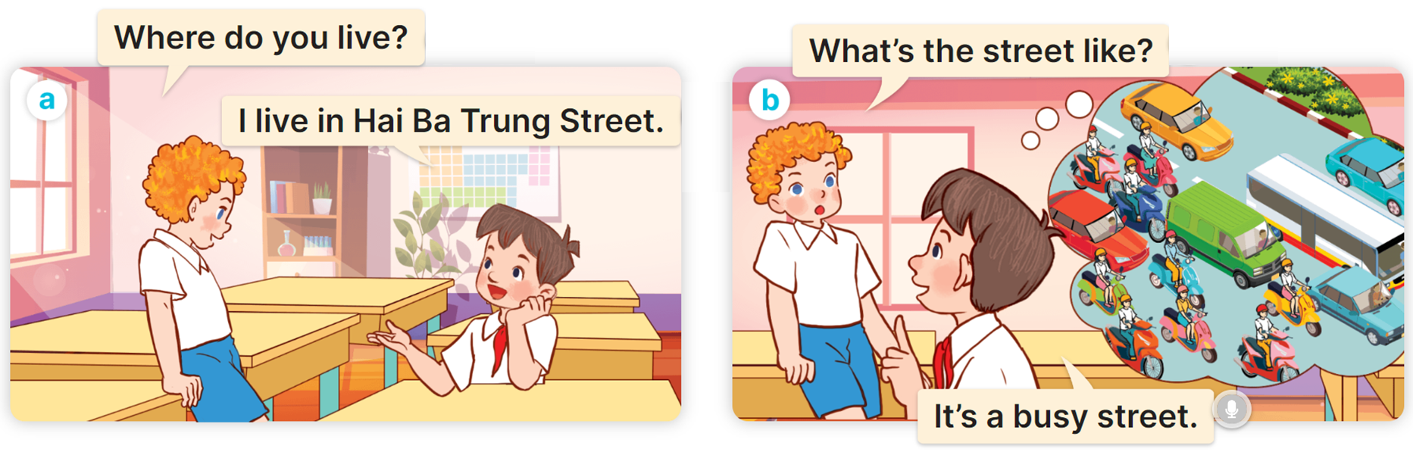

1
Look, listen and read.
MsPham
0936082789

Slide 11
Structure
MsPham
0936082789

Slide 12




1
Cách hỏi đặc điểm một nơi nào đó như thế nào
What’s the ______ like?
It’s _________.
(Con đường như thế nào?)
Ex:
What’s the road like?
MsPham
0936082789
It’s a noisy road.
(Đó là một con đường ồn ào.)

Slide 13
Practice
MsPham
0936082789

Slide 14
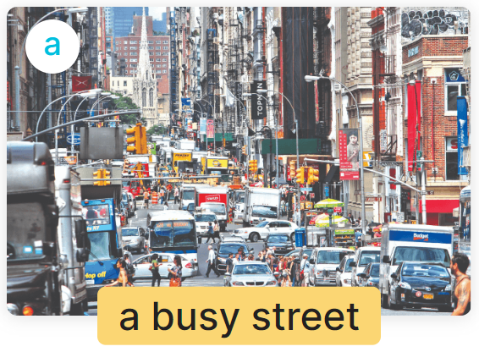
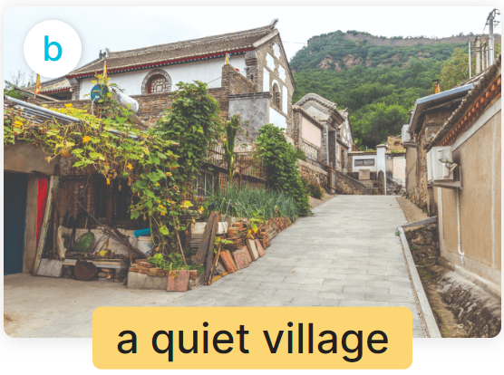
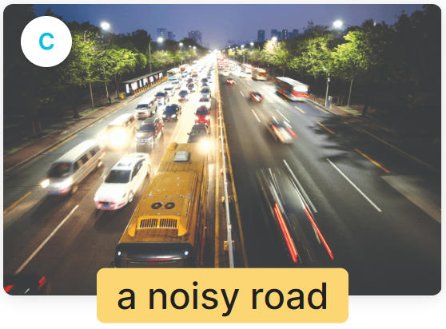

2
Listen, point and say.
What’s the ______ like?
It’s _________.
MsPham
0936082789

Slide 15

2
Listen, point and say.
MsPham
0936082789
What’s the street like?
It’s a busy street.

Slide 16
2
Listen, point and say.
MsPham
0936082789
What’s the village like?
It’s a quiet village.

Slide 17
2
Listen, point and say.
MsPham
0936082789
What’s the road like?
It’s a noisy road.

Slide 18
2
Listen, point and say.
MsPham
0936082789
What’s the city like?
It’s a big city.

Slide 19
2
Listen, point and say.
What’s the ______ like?
It’s _________.
MsPham
0936082789
a busy street
a quiet village
a noisy road
a big city

Slide 20





MsPham
0936082789
START

Slide 21



What’s the city like?
It’s _________.
small city
big road
big city

Slide 22
What’s the road like?
It’s _________.
a noisy road
a noisy city
a quiet road
Next

Slide 23
What’s the street like?
It’s _________.
a big street
a busy street
a quiet street

Slide 24
What’s the village like?
It’s _________.
a noisy village
a quiet village
a quiet
moutain

Slide 25
What’s the city like?
It’s big road.
It’s small town.
It’s big city.

Slide 26
What’s the village like?
It’s quiet village.
It’s busy street.
It’s noisy road.
Next

Slide 27
What’s the street like?
It’s busy road.
It’s busy street.
It’s busy city.

Slide 28
It’s a
noisy road.
What’s the
town like?
What’s the
street like?
What’s the
road like?

Slide 29





Slide 30
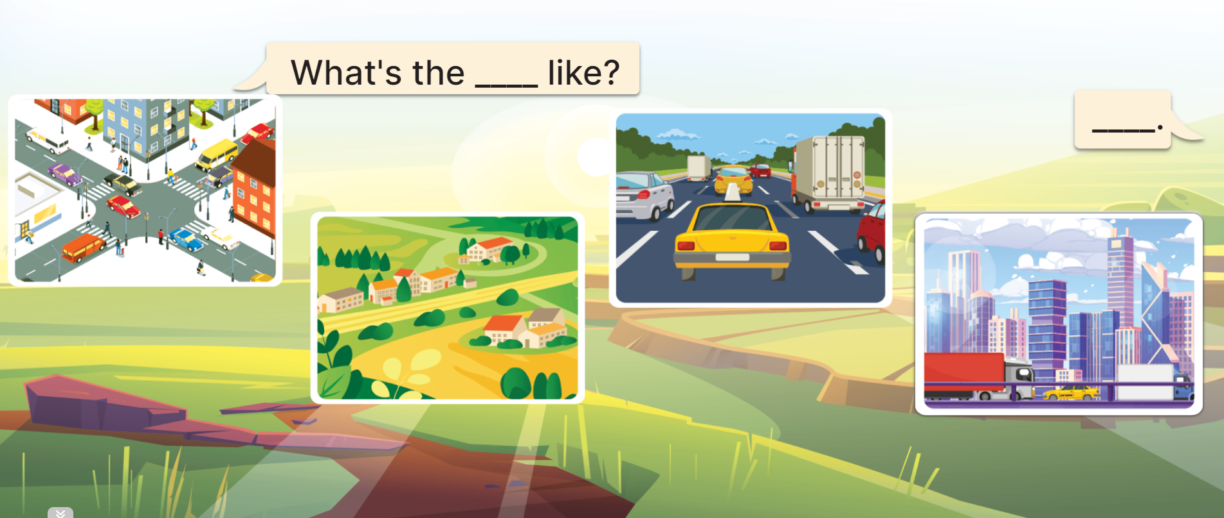
3
Let’s talk.
MsPham
0936082789
What’s the ____________ like?
street
It’s _____
_________.
a
busy street

Slide 31
3
Let’s talk.
MsPham
0936082789
What’s the ____________ like?
village
It’s _____
_________.
a
quiet village

Slide 32
3
Let’s talk.
MsPham
0936082789
What’s the ____________ like?
road
It’s _____
_________.
a
noisy road

Slide 33
3
Let’s talk.
MsPham
0936082789
What’s the ____________ like?
city
It’s _____
_________.
a
big city

Slide 34
3
Let’s talk.
MsPham
0936082789
What’s the ____________ like?
It’s _____
_________.

Slide 35
Review
MsPham
0936082789

Slide 36
MsPham
0936082789
(______ như thế nào?)
What’s the ______ like?
It’s _________.
(Đó là ____)
MsPham
0936082789

Slide 37
Thank you!
MsPham
0936082789
For joining!

