Slide 1
Unit 12
Jobs
Lesson 1 - Period 1

Slide 2
MsPham-0936082789
Warm - up
MsPham-0936082789
MsPham-0936082789
Play
MsPham-0936082789

Slide 4
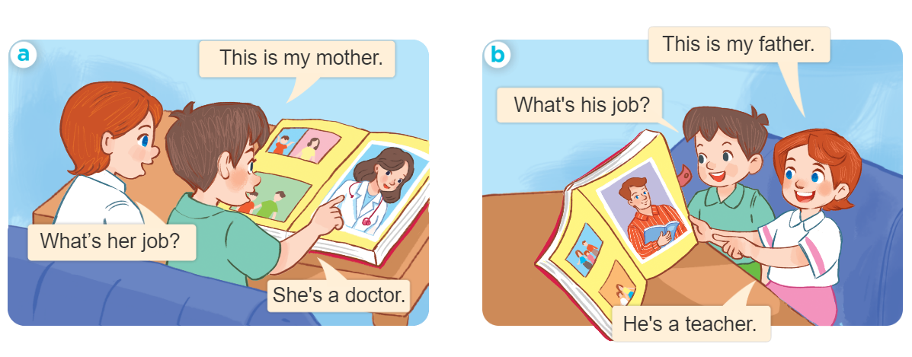
MsPham-0936082789
1
Look, listen and repeat.
MsPham-0936082789
MsPham-0936082789
MsPham-0936082789
MsPham-0936082789
Notes:
Click phần text để nghe từng câu.
Click hình loa để nghe hoặc dừng.
From MsPham

Slide 5
MsPham-0936082789
Vocabulary
MsPham-0936082789
MsPham-0936082789
a doctor
MsPham-0936082789
/əˈdɒktər/
bác sĩ
MsPham-0936082789
Notes:
Click phần text để nghe.
From MsPham-0936082789

Slide 6
MsPham-0936082789
Vocabulary
MsPham-0936082789
MsPham-0936082789
a driver
MsPham-0936082789
/əˈdraɪvər/
Lái xe
MsPham-0936082789
Notes:
Click phần text để nghe.
From MsPham-0936082789

Slide 7
MsPham-0936082789
Vocabulary
MsPham-0936082789
MsPham-0936082789
a teacher
MsPham-0936082789
/əˈtiːtʃər/
Thầy giáo, cô giáo
MsPham-0936082789
Notes:
Click phần text để nghe.
From MsPham-0936082789

Slide 8
MsPham-0936082789
Vocabulary
MsPham-0936082789
MsPham-0936082789
a worker
MsPham-0936082789
/əˈwɜːrkər/
Công nhân
MsPham-0936082789
Notes:
Click phần text để nghe.
From MsPham-0936082789

Slide 9
MsPham-0936082789
Vocabulary
Job
(Nghề nghiệp)
doctor
: bác sĩ
/ˈdɒktə(r)/
MsPham-0936082789
driver
: lái xe
MsPham-0936082789
/ˈdraɪvər/
MsPham-0936082789
teacher
: giáo viên
ˈtiːtʃər/
worker
: công nhân
/ˈwɜːrkər/
her
: của cô ấy
/hɜːr/
his
: của anh ấy
/hɪz/
MsPham-0936082789
Notes:
Click phần text để nghe.
From MsPham-0936082789

Slide 10
Structures
Cách hỏi và trả lời về nghề nghiệp:
What’s her/his job?
(Nghề nghiệp của cô ấy/ anh ấy là gì?)
MsPham-0936082789
She / he’s + a/ an + (job).
(Cô ấy / anh ấy là một _______.)

Slide 11
2
Listen, point and say.
What’s her/his job?
She’s / He’s _______.
a doctor
a driver
a teacher
a worker

Slide 12
Let’s play!
MsPham-0936082789

Slide 13
What’s her jobs?
She’s _________.
a doctor
MsPham-0936082789
Answer

Slide 14
What’s his jobs?
He’s _________.
a driver
Answer

Slide 15
What’s his jobs?
He’s _________.
a worker
MsPham-0936082789
Answer

Slide 16
What’s her jobs?
She’s _________.
a teacher
MsPham-0936082789
Answer

Slide 17
What’s ____ job?
She’s a teacher.
her
MsPham-0936082789
Answer

Slide 18
his
What’s ____ job?
He’s a driver.
MsPham-0936082789
Answer

Slide 19
What’s his job?
_____ a doctor.
He’s
MsPham-0936082789
Answer

Slide 20
What’s her job?
_____ a worker.
She’s
MsPham-0936082789
Answer

Slide 21
What’s your job?
_____ a student.
I’m
MsPham-0936082789
Answer

Slide 22
Great!
MsPham-0936082789

Slide 23
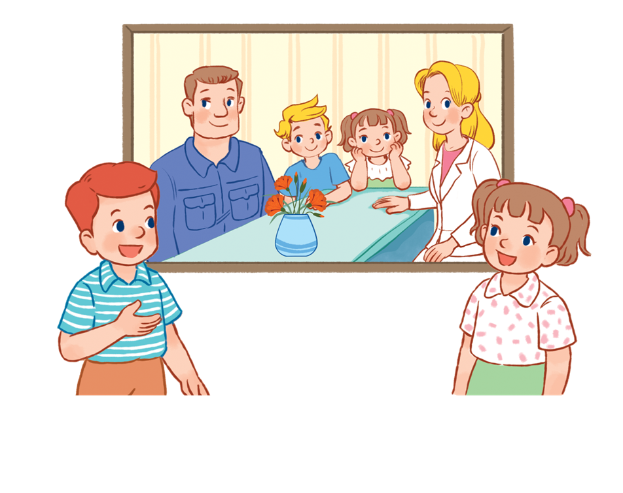
3
Let’s talk.
MsPham
0936082789
What’s _____ job?
______ is _______.
What's your name?
.

Slide 24
Thanh you!

