Slide 1
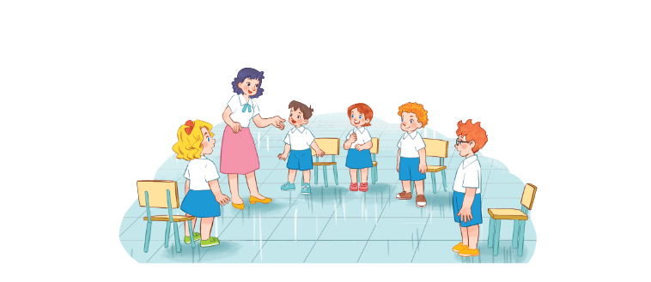
Unit 6
Classroom instruction
Lesson 2 - period 1

Slide 2
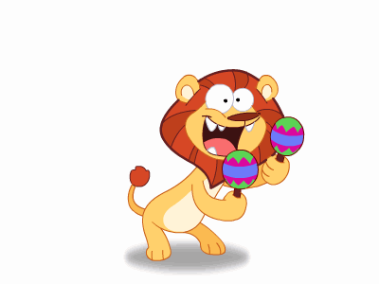
Warm - up
Play

Slide 3
1
Look, listen and repeat.

Slide 4
Structrues
Mẫu câu xin phép/ hỏi ai một cách lịch sự:
Yes, you can.
May I _______?
(Vâng/Ừ, được.)
(Em có thể ______ được không?)
No, you can’t.
(Không, không được.)

Slide 5
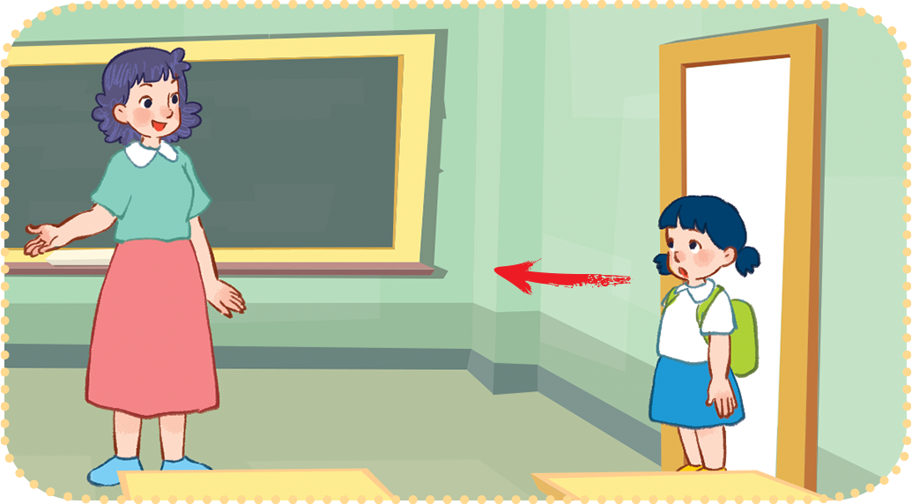
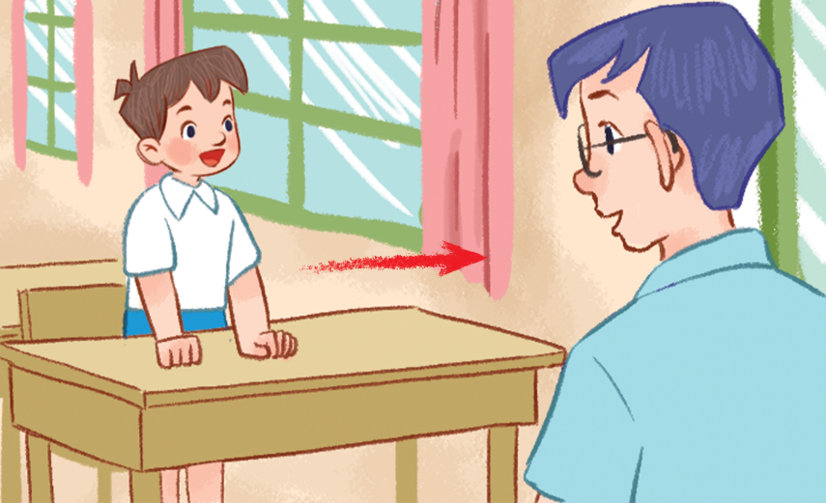
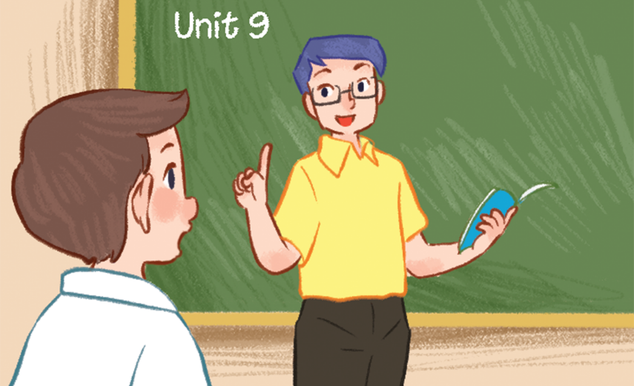
Vocabulary
come in
: (đi) vào
/kʌm ɪn/
go out
: Ra ngoài
/gəʊ aʊt/
speak Vietnamese
/spiːk/
: Nói Tiếng Việt

Slide 6
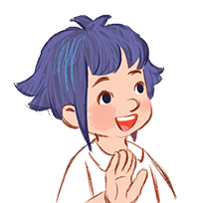
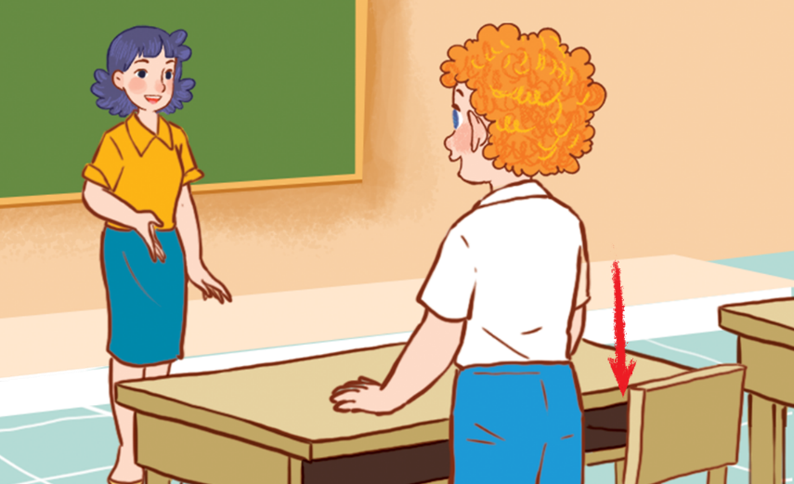
2
Listen, point and say.
Yes, you can.
May I _______?
No, you can’t.
speak Vietnamese
open
the book
go out
sit down

Slide 7
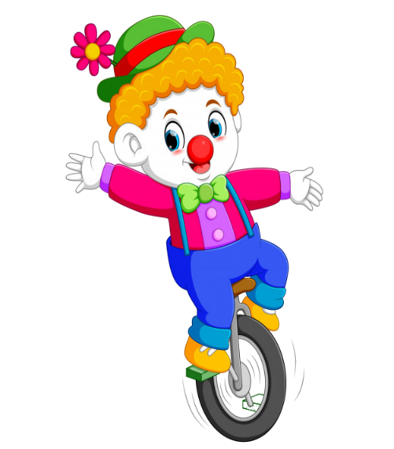

Slide 8
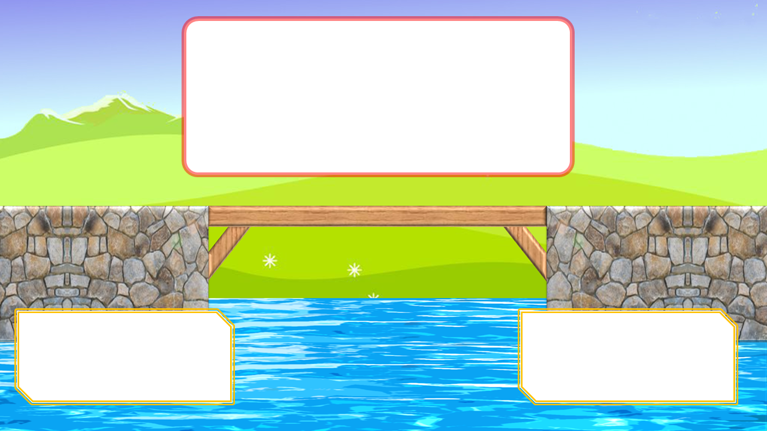
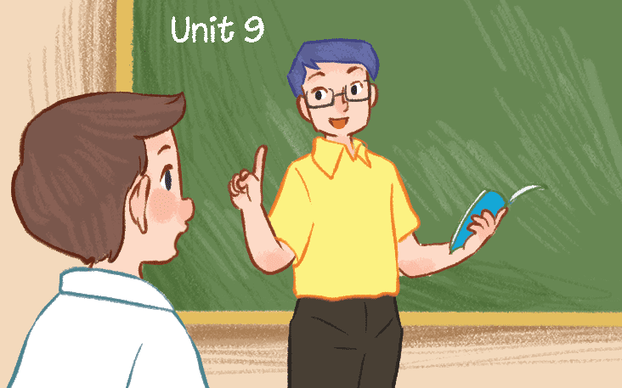
May I speak Viet namese?
Goodbye, class.
Hello, teacher.
Yes, you can.
No, you can’t.

Slide 9
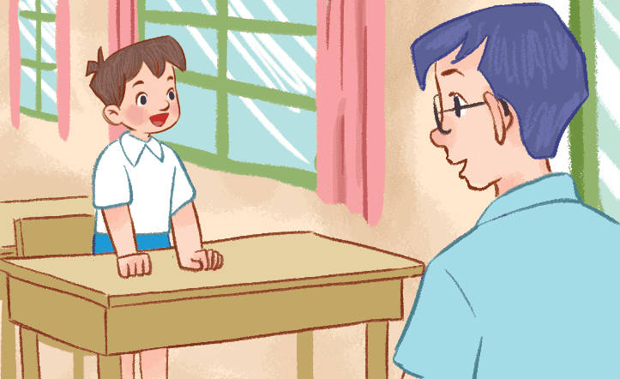
May I go out?
Yes, you can.
No, you can’t.
Nice to meet you.
Thanks.

Slide 10
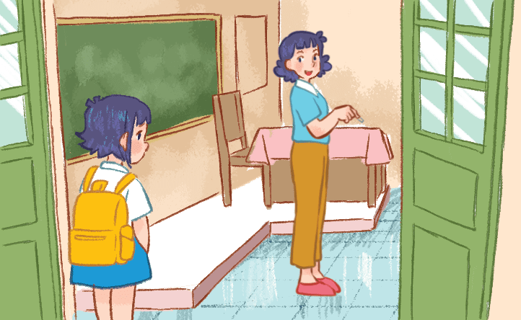
May I come in?
Yes, you can.
No, you can’t.
Nice to meet you.
Thanks.

Slide 11
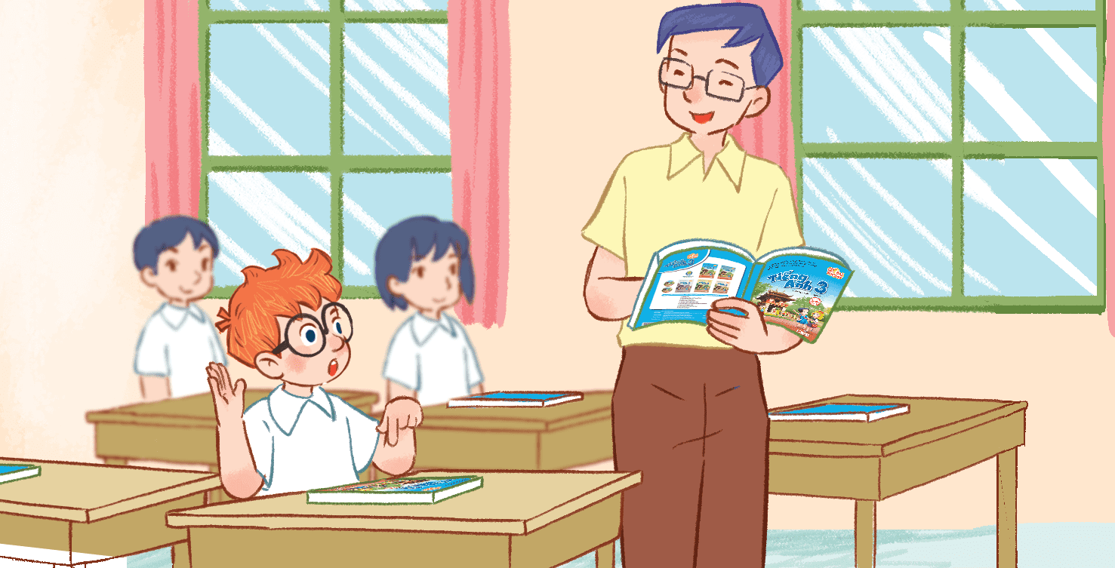
May I open the book?
Goodbye, class.
Hello, teacher.
Yes, you can.
No, you can’t.

Slide 12
May I _____?
Goodbye, class.
Hello, teacher.
go out
sit down

Slide 13
____ I open the book?
May
Is
Nice to meet you.
Thanks.

Slide 14
May I ____ Vietnamese?
Goodbye, class.
Hello, teacher.
come
speak

Slide 15
May ____ go out?
I
you
Nice to meet you.
Thanks.

Slide 16
Welldone!

Slide 17
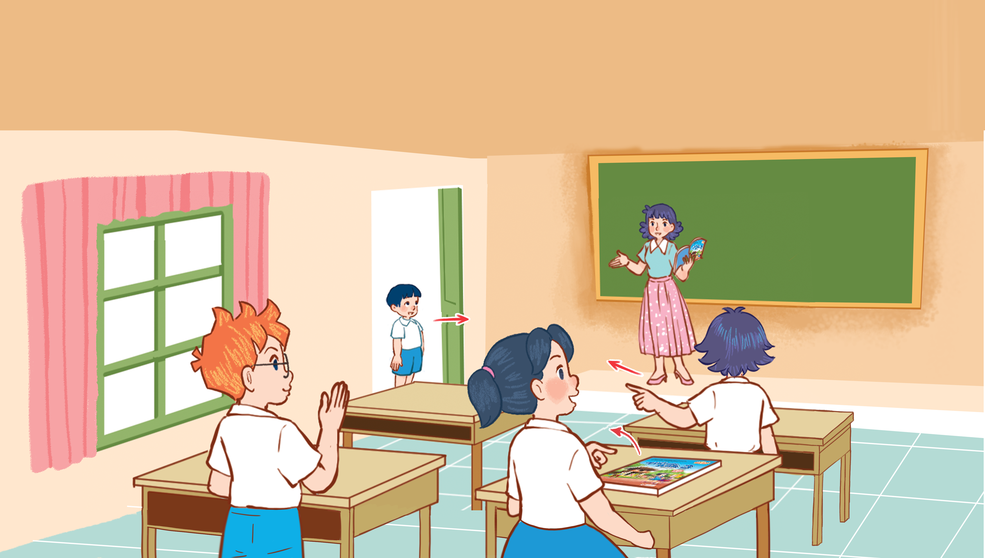
3
Let’s talk.

Slide 18
Thankyou

