Slide 1
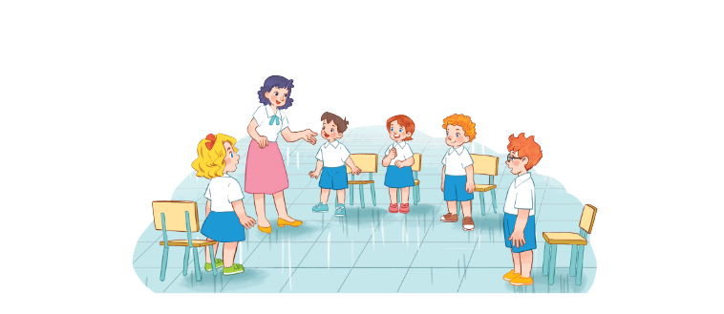
Unit 7
Classroom instructions
Lesson 1 - period 1

Slide 2
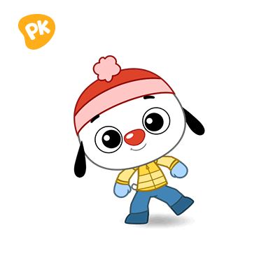
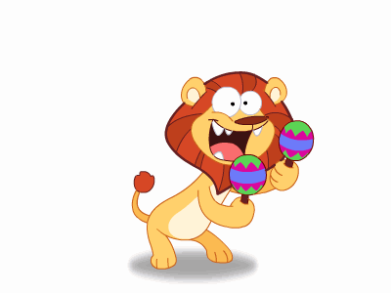
Warm - up
Play

Slide 3
1
Look, listen and repeat.

Slide 4
Vocabulary
open your book
/ˈəʊpən jɔː bʊk/
Mở

Slide 5
Vocabulary
close your book
/kləʊs jɔː bʊk/
Đóng, gập

Slide 6
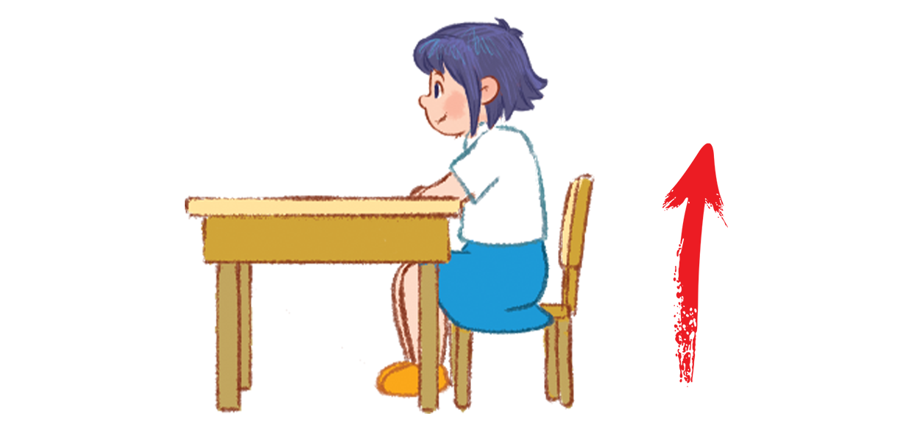
Vocabulary
stand up
/stænd ʌp/
Đứng lên

Slide 7
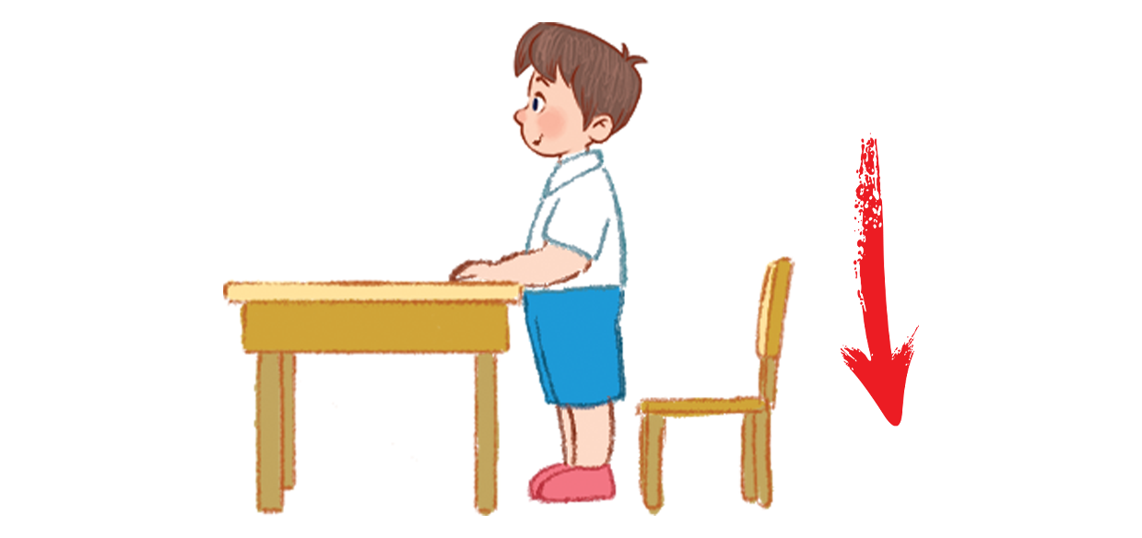
Vocabulary
sit down
/sɪt daʊn/
Ngồi xuống

Slide 8
Vocabulary
sit down
: Ngồi xuống
/sɪt daʊn/
stand up
: Đứng lên
/stænd ʌp/
open your book
: Mở sách
/ˈəʊpən jɔː bʊk/
close your book
: Đóng (Gấp) sách
/kləʊs jɔː bʊk/

Slide 9
2
Listen, point and say.
_______, please!
Open
your book
Close
your book
Stand up
Sit down

Slide 10
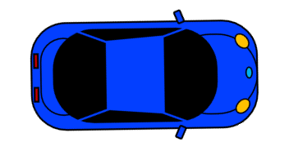
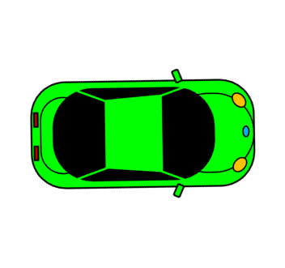
RACING CAR
START

Slide 11
Question
1
2
3
4
5
6
7
8
End

Slide 12
Close your book, please.
1
2
3
Back

Slide 13
Open your book, please.
1
2
3
Back

Slide 14
Stand up, please.
1
2
3
Back

Slide 15
Sit down, please.
1
2
3
Back

Slide 16
____ your book, please.
Close
Oven
Class
Back

Slide 17
____ your book, please.
Oven
Cloze
Open
Back

Slide 18
___ down, please.
Stand
Stend
Sit
Back

Slide 19
____ up, please.
Stand
Sit
Open
Back

Slide 20
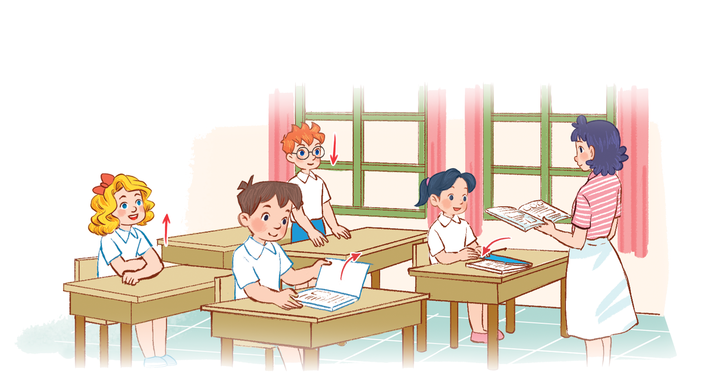
3
Let’s talk.
Open your book, please.

Slide 21
Thankyou

