Slide 1
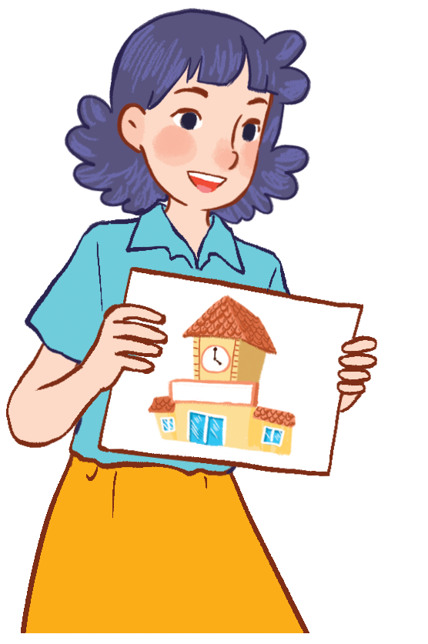
Unit 6
Our school
Lesson 3 - period 2

Slide 2
0
0
0
O
O
O
X
X
X
1
2
3
X
X
X
0
0
0
O
O
O
X
X
X
4
5
6
X
X
X
0
0
0
O
O
O
X
X
X
7
8
9
X
X
X
End

Slide 3
Make sentences
your
this
Yes
?
Is this your classroom?
Yes, it is.
Back
Answer

Slide 4
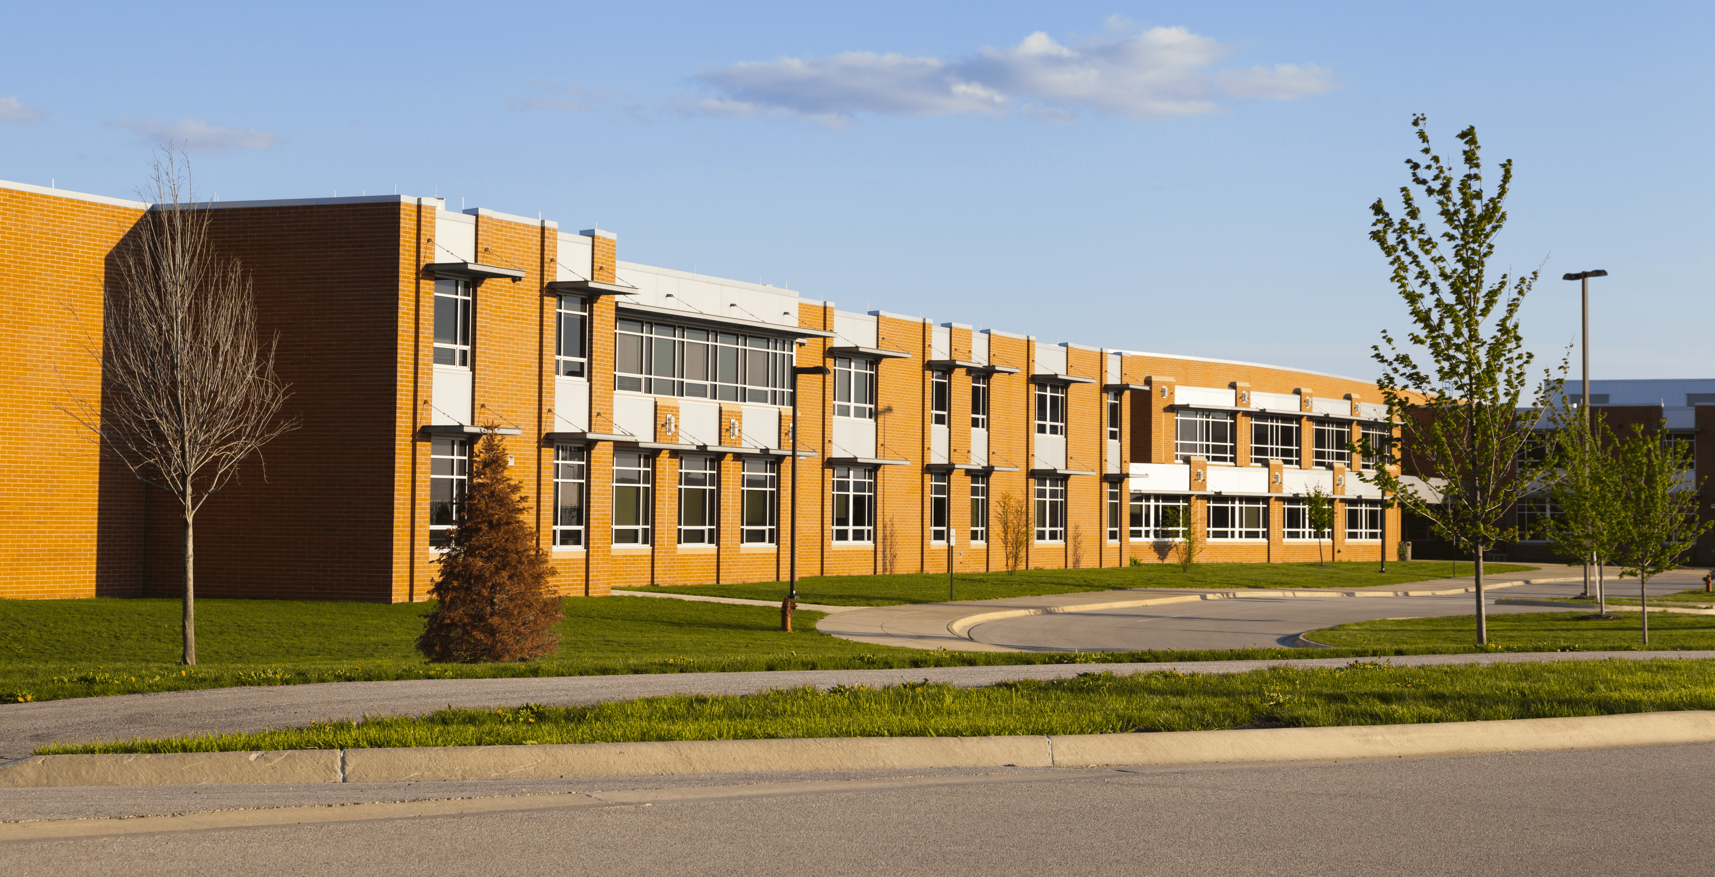
Make sentences
your
this
No
?
Is this your school?
No, it isn’t.
Back
Answer

Slide 5
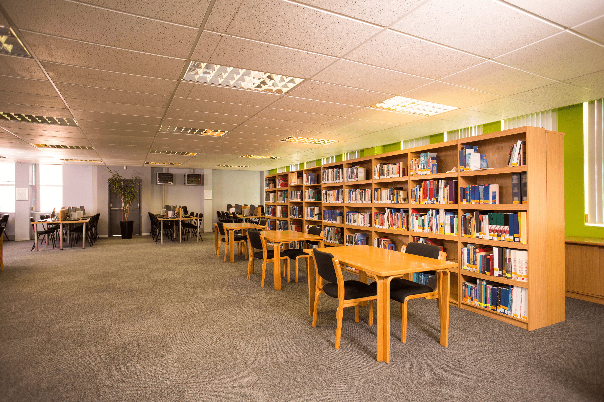
Make sentences
Let’s
to
Ok
the
Let’s go to the library?
Ok, let’s go.
Back
Answer

Slide 6
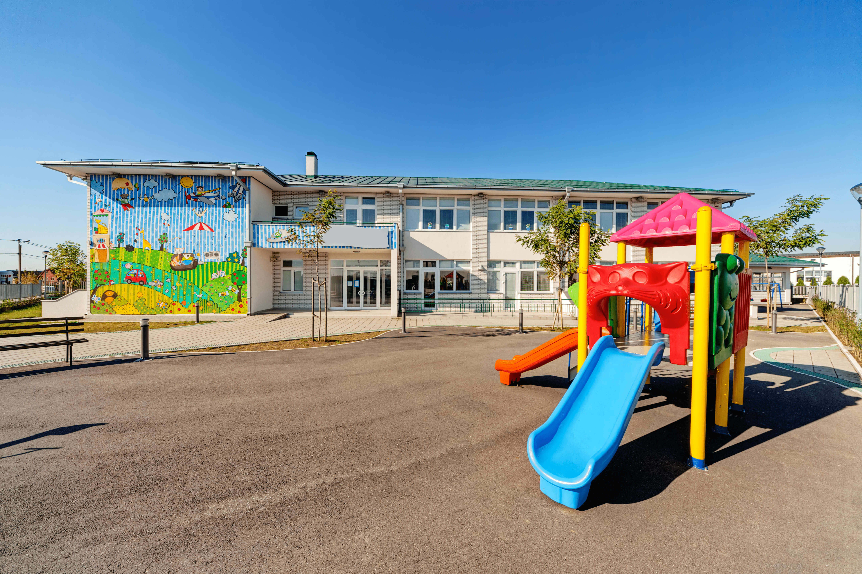
Make sentences
that
our
Yes
playground
Is that our playground?
Yes, It is.
Back
Answer

Slide 7
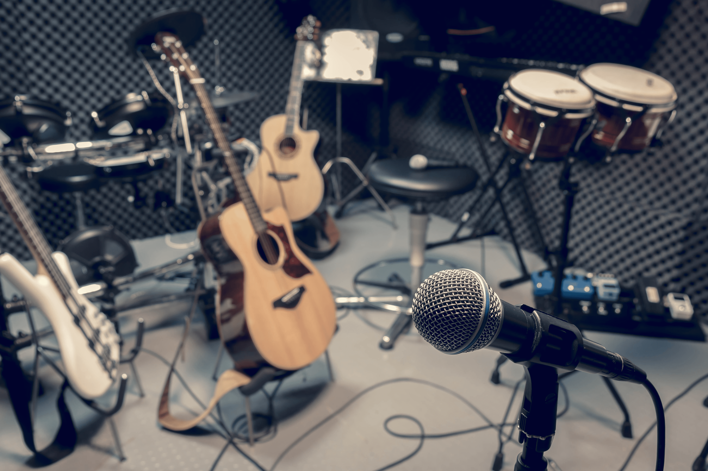
Make sentences
Let’s
I
like
go
singing
music room
I like singing.
Let’s go to the music room.
Back
Answer

Slide 8
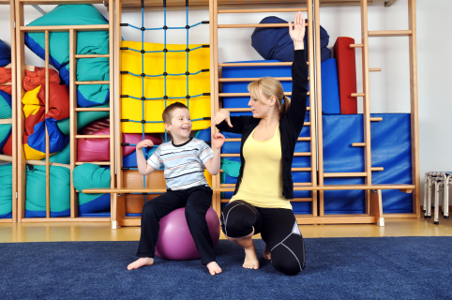
Make sentences
Let’s
go
let’s go.
the
Let’s go to the gym?
Ok, let’s go.
Back
Answer

Slide 9
Make sentences
Is
this
No
our
Is this our computer room?
No, it isn’t.
Back
Answer

Slide 10
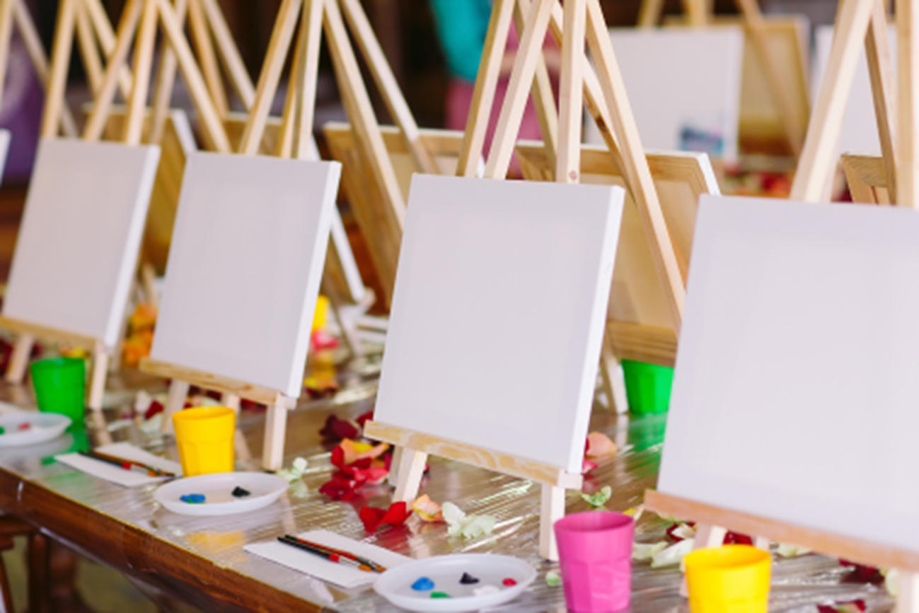
Make sentences
Let’s
go
Ok
the
Let’s go to the art room?
Ok, let’s go.
Back
Answer

Slide 11
4
Read and complete
art classroom go our
Hi. My name is Minh. Welcome to our school! This is my (1) classroom .
Here is the (2) art room. Now, let’s (3) go to the music room. We like (4) our school very much.
______
______
______
______

Slide 12
5
Let’s write.
Welcome to my school! This is my _________.
This is our __________ . Now, let’s go to the __________.

Slide 13
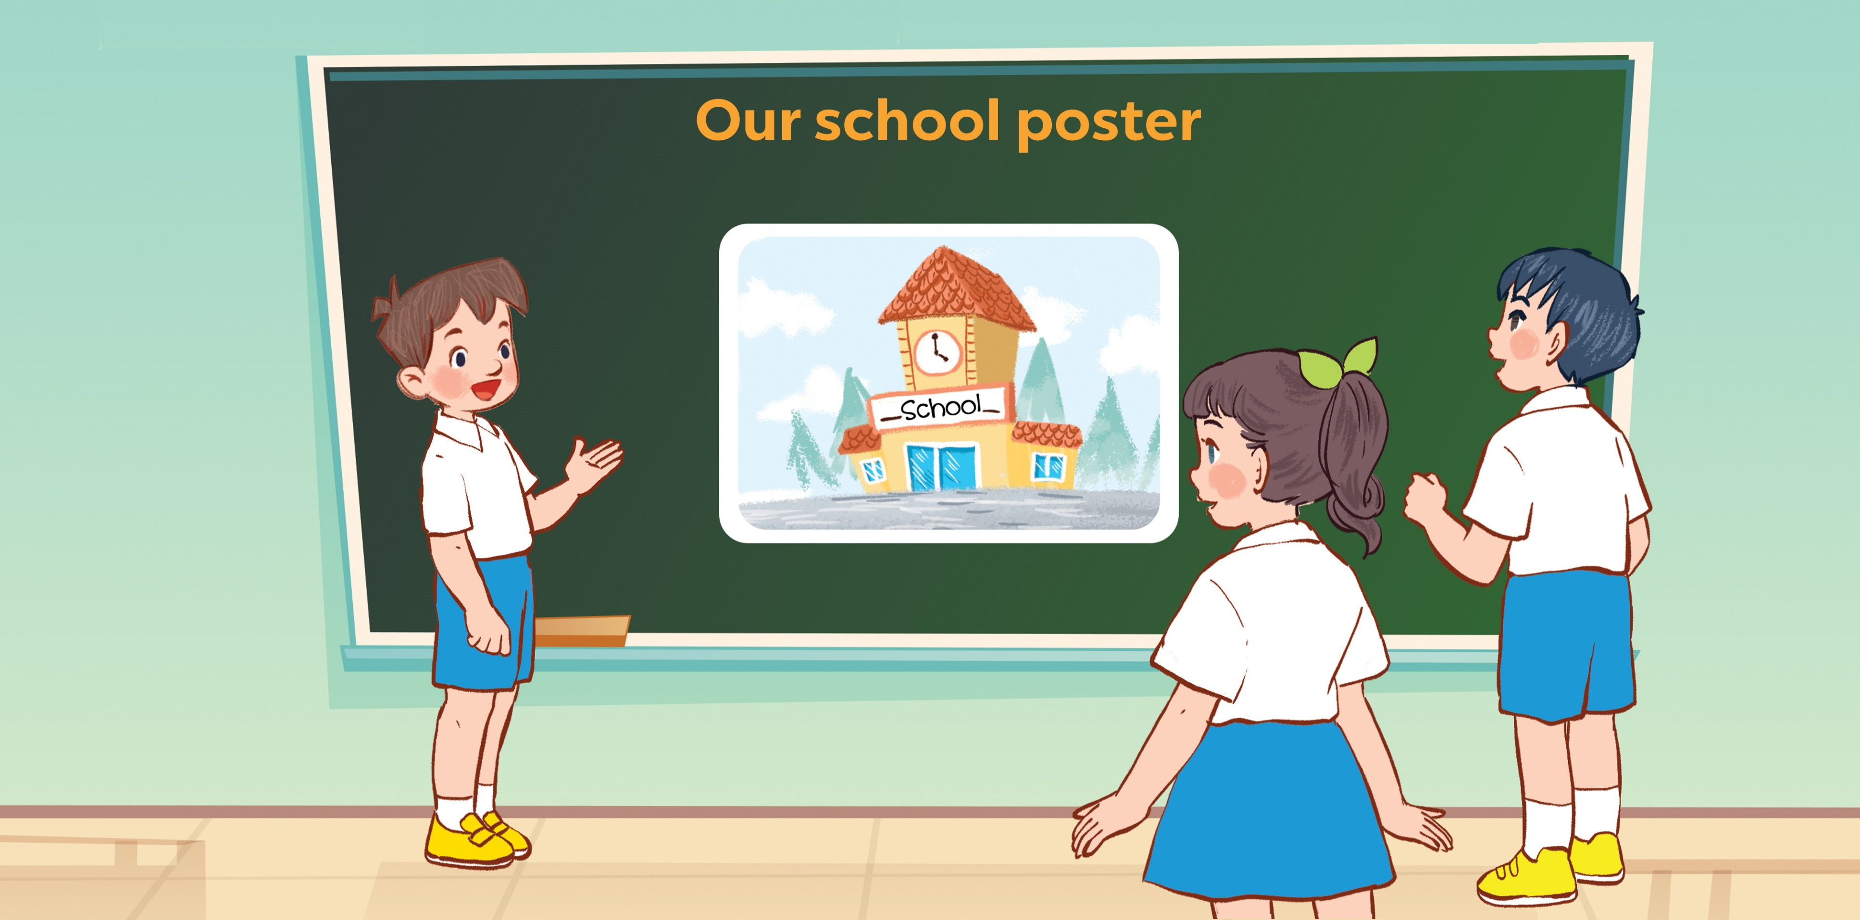
5
Project

Slide 14
Thank you
For enjoying!

