Slide 1
Unit 6: World Heritages
Lesson 3.2: Speaking & Writing
Page: 67

Slide 2
Lesson Outline
Warm-up
Writing
Speaking
Consolidation
Wrap-up

Slide 3
By the end of this lesson,
students will be able to:
Writing:
learn how to write an attractive description, using a past participle clause
write a description of a tourist attraction
Speaking
talk about a heritage site in Vietnam

Slide 5
Number the sentences (1–5)
Located in Ba Ria province and just a few hours drive from Ho Chi Minh City, Vung Tau is truly an ideal place for a change of atmosphere.
The road leading to Vung Tau is full of beautiful scenery to take some souvenir photos.
Have you ever been to Vung Tau? If not, let me tell you about Vung Tau.
Vung Tau doesn't have many places to entertain, but it doesn't stop people from going there and enjoying their weekends.
Vung Tau is a familiar place for people in Southeast Vietnam.
3
4
1
5
2

Slide 7
a. Read the Writing Skill box and the description of Hue again. Then, underline the Past Participle clauses used in the description.

Slide 8
Writing attractive descriptions using Past Participle clauses
We can use a Past Participle clause at the beginning of a sentence to focus on an important feature of the thing we are describing.
Located on top of a mountain, Yên Tử Mountain is famous for its pagodas.
Set in the beautiful Chulka rainforest, Shambala Resort offers amazing views of nature.
They are commonly used in advertising and articles to catch the reader's attention with interesting facts or detail. They should only be used once or twice at the beginning of the passage.

Slide 9
Located beside the Hương River, the old capital of Huế was the home of the Nguyễn emperors. Built in the early 19th century, the walled city was a symbol of the emperor's power. The city was made with brick and stone. If you like history, you'll really like Huế.

Slide 10
b. Rewrite the sentences using a Past Participle clause at the beginning of a sentence to focus on the features in bold.
1. Thang Long is found in the center of Hanoi and was built in 1010.
2. Phong Nha-Ke Bàng is famous for its karst landscapes and is also known for its caves.
3. Tràng An Complex is located in Ninh Bình. It is the only natural and cultural heritage in Vietnam.
4. Hạ Long Bay is visited by 2.5 million tourists a year and it is one of Vietnam's most popular heritage sites.
5. Chùa Cầu was built in the 16th and 17th centuries. It's the only known covered bridge with a Buddhist temple.

Slide 11
b. Rewrite the sentences using a Past Participle clause at the beginning of a sentence to focus on the features in bold.
Thang Long is found in the center of Hanoi and was built in 1010.
2. Phong Nha-Ke Bàng is famous for its karst landscapes and is also known for its caves.
Built in 1010, Thăng Long is found in the center of Hanoi.
Known for its caves, Phong Nha-Kẻ Bàng is also famous for its karst landscapes.

Slide 12
b. Rewrite the sentences using a Past Participle clause at the beginning of a sentence to focus on the features in bold.
3. Tràng An Complex is located in Ninh Bình. It is the only natural and cultural heritage in Vietnam.
4. Hạ Long Bay is visited by 2.5 million tourists a year and it is one of Vietnam's most popular heritage sites.
Located in Ninh Bình, Tràng An Complex is the only natural and cultural heritage in Vietnam.
Visited by 2.5 million tourists a year, Hạ Long Bay is one of Vietnam's most popular heritage sites.

Slide 13
b. Rewrite the sentences using a Past Participle clause at the beginning of a sentence to focus on the features in bold.
5. Chùa Cầu was built in the 16th and 17th centuries. It's the only known covered bridge with a Buddhist temple.
Built in the 16th and 17th centuries, Chùa Cầu is the only known covered bridge with a Buddhist temple.

Slide 14
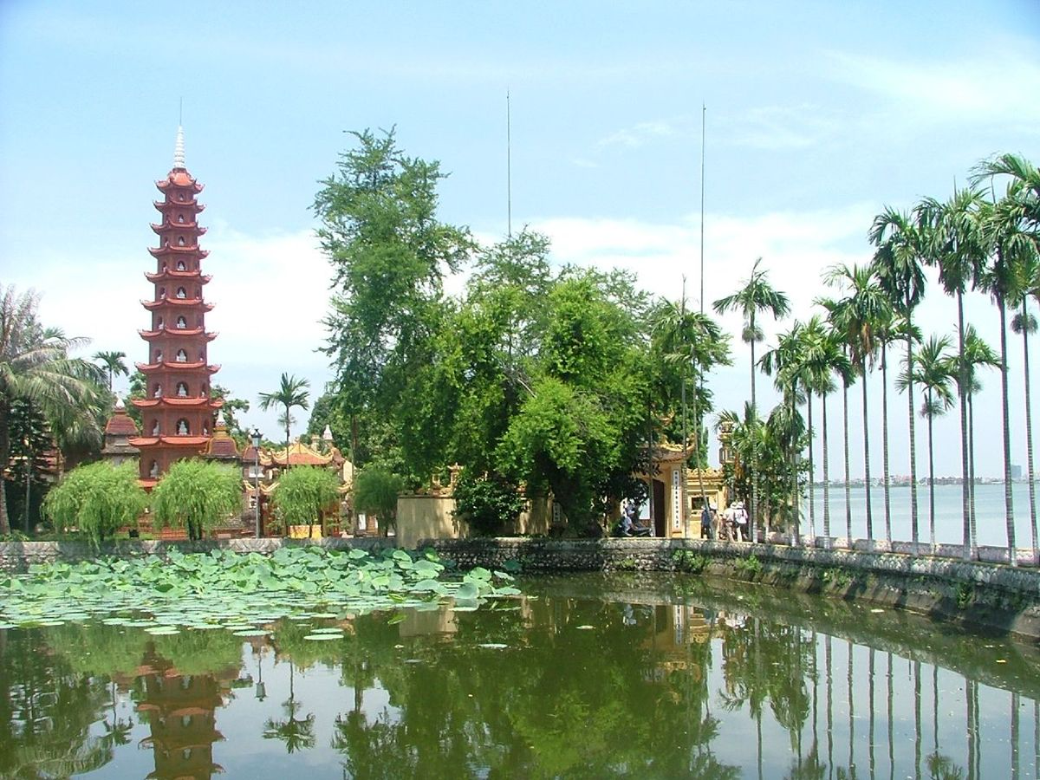
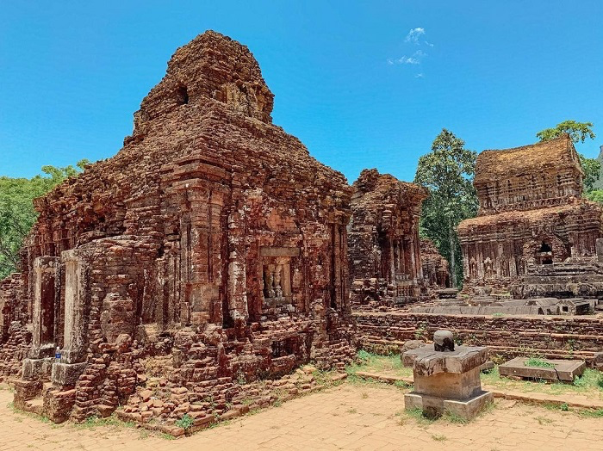
Interviewing a tourism officer to write about a tourist attraction

Slide 15
Task a
You're interviewing a tourism officer to write about a tourist attraction.
In pairs: Student B, you’re the interviewee.
Student A, you're the interviewer.
Ask about Trấn Quốc Pagoda to complete the notes.

Slide 16
Where/what is it?
What can I see/do there?
How can I get there?
What else should I know?

Slide 17
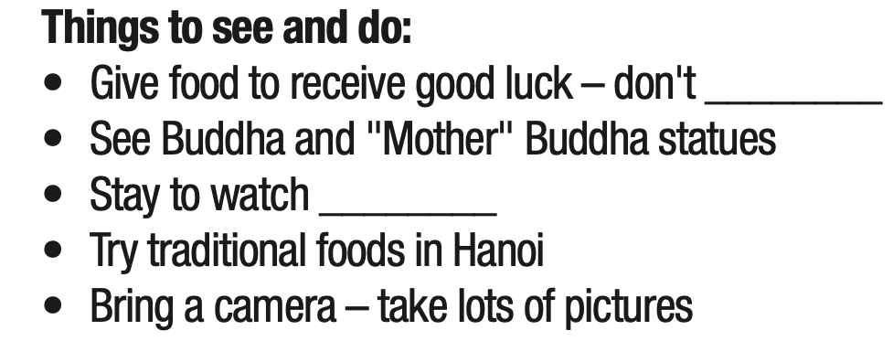

Slide 18
Task b
Swap roles and repeat.
Answer questions about Mỹ Sơn Sanctuary using the notes given.

Slide 20
Task c
Discuss which of the places above you would like to visit and why.

Slide 21
Now, write a description for a tourism board's website about one of the heritage sites you discussed.
Use the Writing Skill box, the reading model, and your speaking notes in to help you.
Write 150–180 words.

Slide 22
Consolidation

Slide 23
Write a description of a heritage site you would like to visit in the future. (about 150-180 words)
Example: Hanoi, the capital city of Vietnam, is fascinating to millions of visitors because of its popularity and friendliness. Located in the north part of the country, Hanoi is one of the most ancient cities in the world due to its age, which is greater than one thousand years old. This place can offer both comfortable temperatures and classic design, as Hanoi has a tropical climate and talented architects. Talking about Hanoi, people definitely think about Hoan Kiem Lake, which is known as the "green lungs" of the capital city. As its name, the lake gives fresh air that is really comfortable for the pedestrian. The next sight that cannot be missed is the Hanoi art gallery, with approximately 700 artworks display carefully. A long time ago, the capital of Vietnam used to be a really poor city, but now it has changed to one that is full of skyscrapers, huge schools, and hospitals.

Slide 24
WRAP-UP

Slide 25
Today’s lesson
Writing:
learn how to write an attractive description, using a past participle clause
write a description of a tourist attraction
Speaking
talk about a heritage site in Vietnam

Slide 27
- Do the exercises in workbook on page 37.
- Prepare the next lesson: Unit 7 - Lesson 1.1 – Vocab. & Listening (pages 68 & 69 SB).
- Play the consolidation games in Tiếng Anh 11 i-Learn Smart World DHA App on www.eduhome.com.vn

Slide 28
Lesson 3
Stay positive and have a nice day!

