Slide 1

Unit 6: World Heritages
Lesson 3.1: Listening & Reading
Page: 66

Slide 2
Lesson Outline
Warm-up
Listening
Reading
Consolidation
Wrap-up

Slide 3

By the end of this lesson,
students will be able to:
Listening
listen for specific information, predict what happens next when the speaker finishes talking
Reading
read for the author’s purposes and specific information

Slide 4



Slide 5

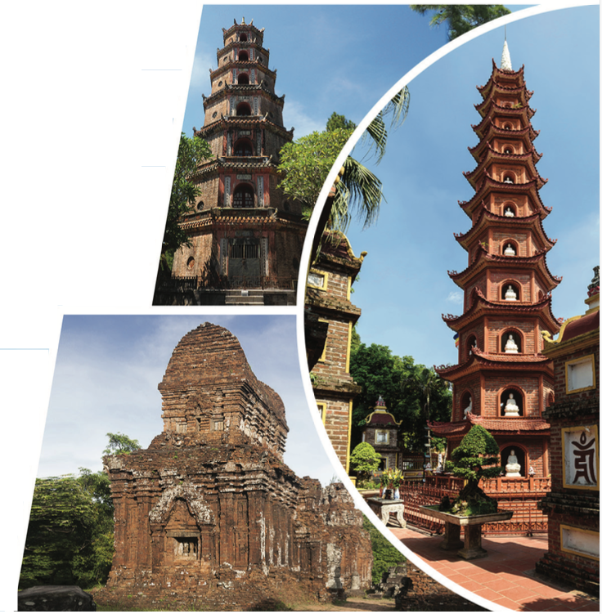
Work in pairs.
What do you know about the places in the pictures?
Which places do most tourists visit when they come to Vietnam? Why?

Slide 6



Slide 7
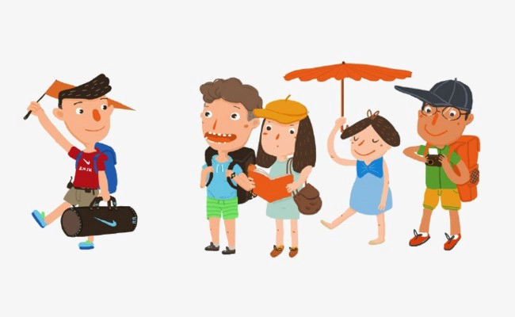
Pre - listening
What is the job of a tour guide?
What do you think tourists will do after a tour guide introduces a tour?

Slide 8

Listen to a tour guide talking about a tour. What will the tourists do when the tour guide's finished speaking?
visit a tomb
look around a temple
take the bus back to the office
While - listening

Slide 9
b. Now, listen and number.
1. The visitors shouldn't speak loudly.
2. The tour guide likes this place the most.
3. The tower was built in 1844.
4. Don't forget to see the statue of the turtle.
5. The pagoda is near the Huong River.
While - listening
5
1
3
4
2

Slide 10
Listening Scripts
Tour guide: OK, thanks everyone for joining today's tour. I hope you enjoyed the dragon boat ride from Minh Mạng's tomb. Please bring all your things when you exit the boat. This is the final stop of the day, but it's my favorite on the tour. This is the Pagoda of the Celestial Lady, or Thiên Mụ as we say. Located close to the Hương River, the pagoda is the symbol of Huế. There's an old story about an old lady who appeared on the hill. She told people that there would be a temple on the hill where they could pray for the country to become richer. After hearing what the old lady had said, Nguyễn Hoàng ordered the construction of a temple. However, the tower came later. Built in 1844, the twenty-one-meter tower was made on the orders of the ruler Thiệu Trị. At the temple, you can walk around the gardens or go inside and see some treasures. Be sure to check out the giant bell. It can be heard from over ten kilometers away! And remember to see the turtle statue which is a symbol of long life. One more thing before you go. Many people live and work at the temple. Please respect them by speaking quietly. We'll meet back here in forty-five minutes to take the bus back to our office.

Slide 11

Post - listening
Work in pairs.
What are some of the advantages and disadvantages of group tours?
Example:
The advantage is you don’t have to think about where to go during the trip.
The disadvantage is you have to follow the plan strictly.

Slide 12



Slide 13
Task a
Read and underline the key words in the questions.
Read the description of the old capital of Hue. What is the purpose of the text?
Pre - reading

Slide 14
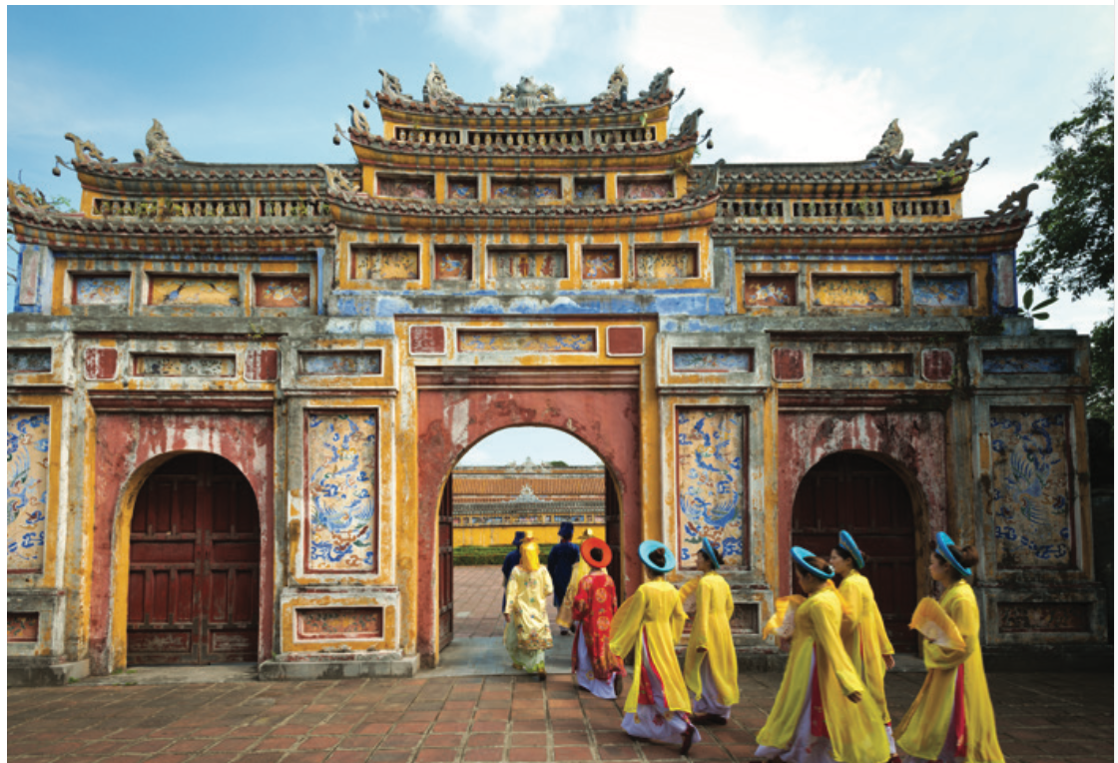
Read the description of the old capital of Hue. What is the purpose of the text?
to say what the writer likes about Hue
to encourage people to visit Hue
While - reading

Slide 15
Located beside the Hương River, the old capital of Huế was the home of the Nguyễn emperors. Built in the early 19th century, the walled city was a symbol of the emperor's power. The city was made with brick and stone. If you like history, you'll really like Huế.
When you first arrive, you should pass through Ngọ Môn, where the emperor would watch parades. The central gate was for the emperor only. Next, enter the Imperial City. Inside is the Ngũ Phụng Pavilion, which was originally only open to members of the Royal Family. After that, you should check out the Thái Hoà Palace. It was used for important celebrations such as the Royal Family’s birthdays. Finally, visit the Duyệt Thị Đường Royal Theater. It's the oldest theater in Vietnam! When you're finished exploring the old capital, you should take a boat trip to visit the tombs of the emperors. Remember to bring an umbrella because it often rains in Huế.
You can fly to Huế from Ho Chi Minh City or Hanoi. If you want to see more of the country, we recommend taking an overnight train. After you arrive in Huế, you can take a taxi, bike, or walk around the city. Remember to give yourself lots of time to try the specialty foods of Huế.

Slide 16
The purpose of the text is…
to say what the writer likes about Hue
to encourage people to visit Hue
While - reading

Slide 17
Task b
Read and underline the key words in the questions.
1. When was the old capital of Hue built?
2. What kind of person does the writer think would enjoy visiting Hue?
3. Where does the writer suggest you visit after seeing the old capital?
4. What kind of transportation is suggested to see more of Vietnam?
While - reading

Slide 18
1. When was the old capital of Hue built?
2. What kind of person does the writer think would enjoy visiting Hue?
in the early 19th century
Built in the early 19th century, the walled city was a symbol of the emperor's power.
a person who likes history
If you like history, you'll really like Huế.
While - reading

Slide 19
3. Where does the writer suggest you visit after seeing the old capital?
4. What kind of transportation is suggested to see more of Vietnam?
tombs of the emperors
When you're finished exploring the old capital, you should take a boat trip to visit the tombs of the emperors.
an overnight train
If you want to see more of the country, we recommend taking an overnight train.
While - reading

Slide 20
c. Listen and read.
Located beside the Hương River, the old capital of Huế was the home of the Nguyễn emperors. Built in the early 19th century, the walled city was a symbol of the emperor's power. The city was made with brick and stone. If you like history, you'll really like Huế.
While - reading

Slide 21
c. Listen and read.
When you first arrive, you should pass through Ngọ Môn, where the emperor would watch parades. The central gate was for the emperor only. Next, enter the Imperial City. Inside is the Ngũ Phụng Pavilion, which was originally only open to members of the Royal Family. After that, you should check out the Thái Hoà Palace. It was used for important celebrations such as the Royal Family’s birthdays. Finally, visit the Duyệt Thị Đường Royal Theater. It's the oldest theater in Vietnam! When you're finished exploring the old capital, you should take a boat trip to visit the tombs of the emperors. Remember to bring an umbrella because it often rains in Huế.
While - reading

Slide 22
c. Listen and read.
You can fly to Huế from Ho Chi Minh City or Hanoi. If you want to see more of the country, we recommend taking an overnight train. After you arrive in Huế, you can take a taxi, bike, or walk around the city. Remember to give yourself lots of time to try the specialty foods of Huế.
While - reading

Slide 23
Post - reading
Work in pairs.
Would you like to visit the old capital of Hue?
Do you like to visit historical places? Why (not)?
Example: Yes, I really love to visit the old capital of Hue because I am very interested in history. I can see a lot of historical sites which makes me feel like I am living in the Nguyen Dynasty.

Slide 24

Consolidation

Slide 25
Write 5 sentences to describe different places in Vietnam tourists often visit.
Example:
Sapa Town is famous both for its fine, rugged scenery and for its rich cultural diversity.

Slide 26

WRAP-UP

Slide 27
Today’s lesson
Listening
listen for specific information, predict what happens next when the speaker finishes talking
Reading
read for the author’s purposes and specific information

Slide 28


Slide 29
- Do the exercises in workbook on page 36.
- Prepare the next lesson: Lesson 3.2 – Speaking & Writing (page 67 SB).
- Play the consolidation games in Tiếng Anh 11 i-Learn Smart World DHA App on www.eduhome.com.vn

Slide 30

Lesson 3
Stay positive and have a nice day!

