Slide 1

Unit 6: World Heritages
Lesson 2.3: Pronun. & Speaking
Pages: 64 & 65

Slide 2
Lesson Outline
Warm-up
Pronunciation
Speaking
Consolidation
Wrap-up

Slide 3

By the end of this lesson,
students will be able to:
Pronunciation
practice intonation for choice options
Speaking
talk about ways to preserve world heritages

Slide 4



Slide 5

Work in pairs.
Choose the word whose main stress is placed
differently from the others.
A. unused B. clever C. amazed D. unique
2. A. responsible B. intelligent C. historical D. fashionable
3. A. carry B. surround C. expand D. declare
/ˈklevər/
/əˈmeɪzd/
/ju:ˈniːk /
/ʌnˈjuːzd /
/rɪˈspɑːnsəbl/
/ɪnˈtelɪdʒənt/
/ˈfæʃənəbəl/
/hɪˈstɔːrɪkl/
/ˈkæri/
/səˈraʊnd/
/ɪkˈspænd/
/dɪˈkler/

Slide 6
Work in pairs.
Choose the word whose underlined part is
pronounced differently from that of the other words.
A. protein B. column C. shoulder D. photo
2. A. sunset B. curfew C. jungle D. study
3. A. invest B. pretend C. impress D. preserve
/ˈkɑːləm/
/ˈʃoʊldə/
/ˈfoʊtoʊ/
/ˈproʊtiːn /
/ˈsʌnset /
/ˈkɜːrfjuː/
/ˈstʌdi/
/ˈdʒʌŋɡl/
/ɪnˈvest /
/prɪˈtend/
/ ɪmˈpres/
/prɪˈzɜːrv/

Slide 7



Slide 8
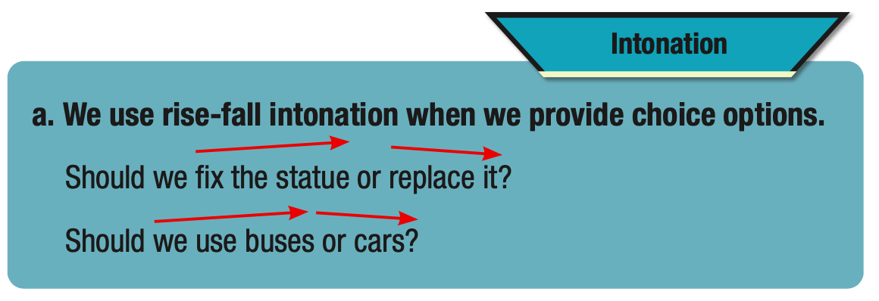

Slide 9

Listen to the sentence and focus on how the intonation rises then falls.
Should we put up signs or hire security?

Slide 10
Listen and cross out the sentence with the wrong intonation.
Should we preserve the old buildings or knock them down?
Should we prevent people from cutting down trees or put up signs saying "Don't leave trash"?
Read the sentences with the correct intonation to a partner.

Slide 11

Task a
Ask questions about the problems.
Give your opinion (using the possible solutions or your own ideas), and then ask for your partner's opinion.
Pronunciation

Slide 12
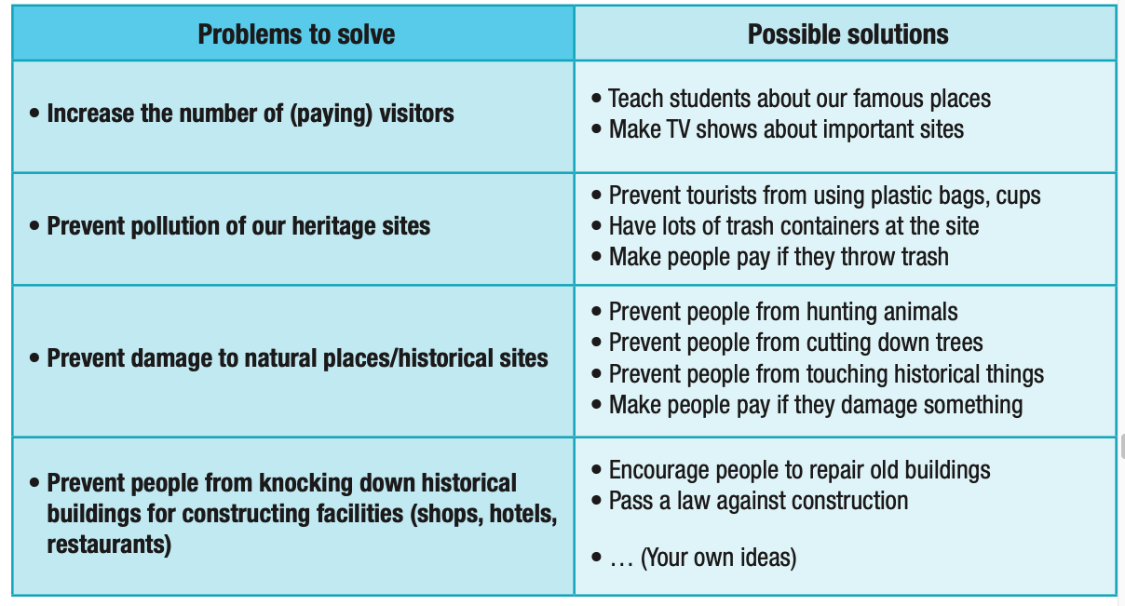

Slide 13
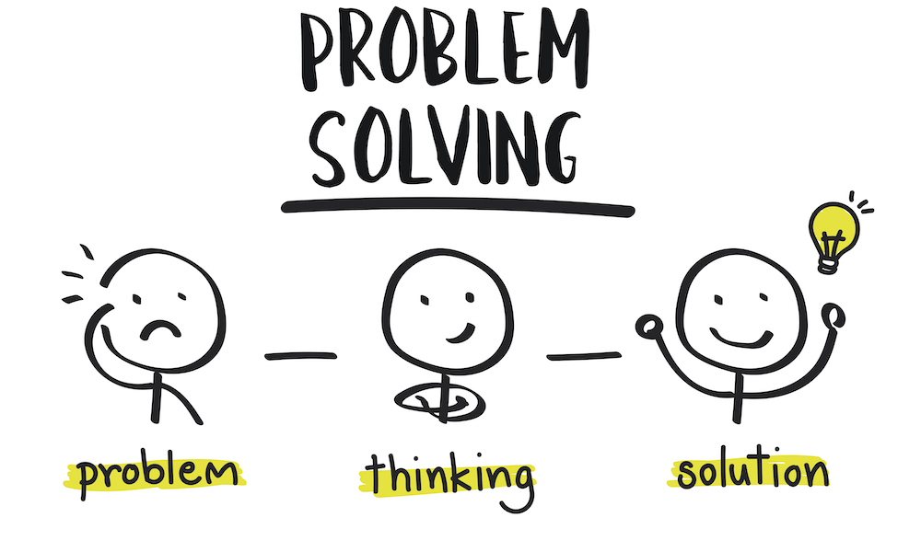
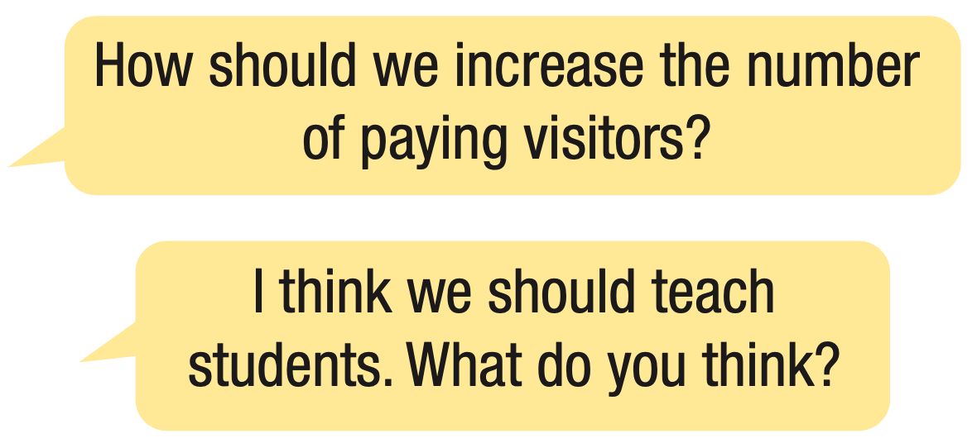
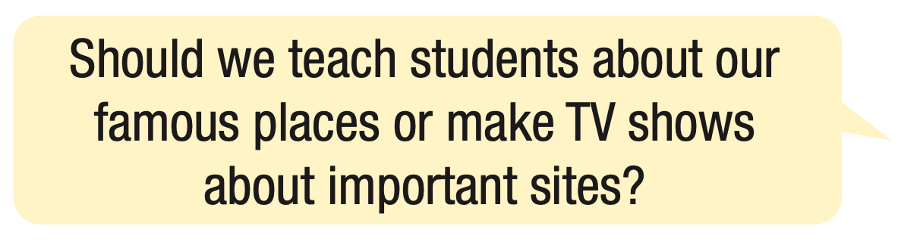

Slide 14
Task b
Practice with your own ideas.

Slide 15



PRESERVING OUR HERITAGE

Slide 16

Task a
Choose a world heritage site from below or another site you know.
List the possible problems the site may have, e.g. not being famous, pollution, damage, etc.
Discuss the best ways of dealing with those problems to best preserve the site.

Slide 17

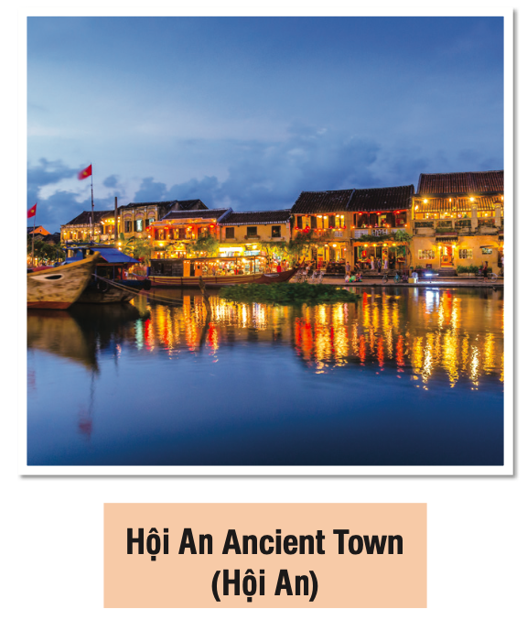
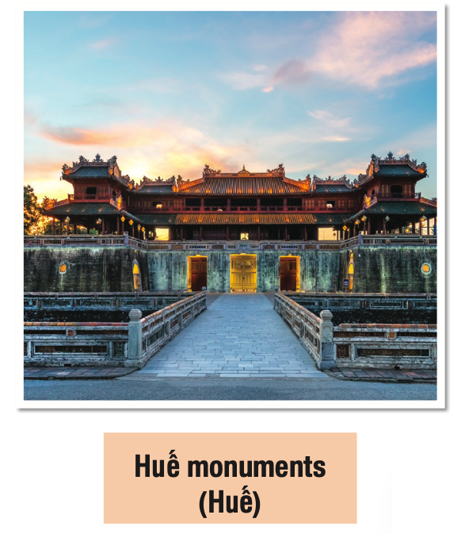

Slide 18

Task b
Join another pair and tell them the site you chose.
Share the problems you think it may have, and your solutions.

Slide 19

Consolidation

Slide 20
Write 5 sentences about ways to preserve heritage sites.
For example:
Schools should teach students the cultural and historical values of heritage sites so that they are willing to preserve them.

Slide 21

WRAP-UP

Slide 22
Today’s lesson
Pronunciation
practice intonation for choice options
Speaking
talk about ways to preserve world heritages

Slide 23


Slide 24
- Practice intonation for choice options.
- Do the exercises in workbook on page 35.
- Prepare the next lesson: Lesson 3.1 –Listening & Reading (page 66 SB).
- Play the consolidation games in Tiếng Anh 11 i-Learn Smart World DHA App on www.eduhome.com.vn

Slide 25

Lesson 3
Stay positive and have a nice day!

