Slide 1

Unit 6: World Heritages
Lesson 2.1: Vocab & Listening
Pages: 62 & 63

Slide 2
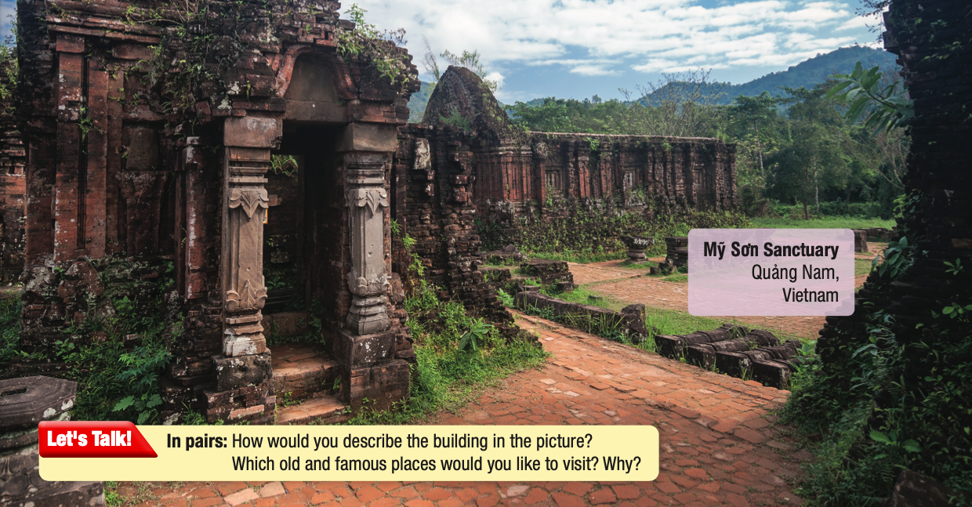
Lesson Outline
Warm-up
Vocabulary
Listening
Consolidation
Wrap-up

Slide 3
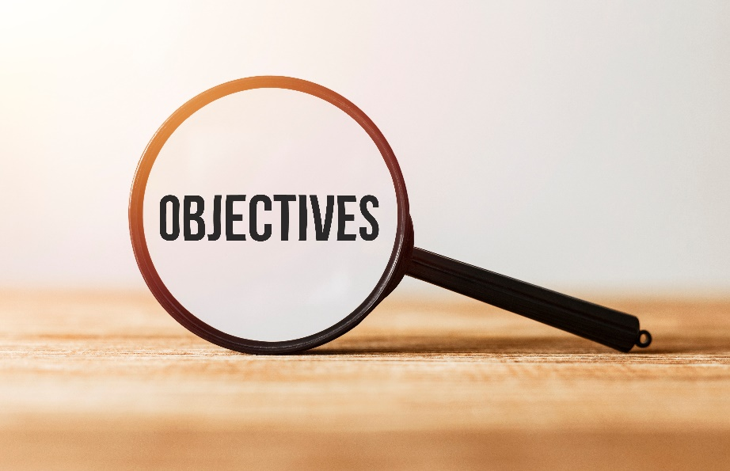
By the end of this lesson,
students will be able to:
practice and learn vocab. related to World heritages
practice listening for specific information
practice functional English (Asking for opinions)

Slide 4
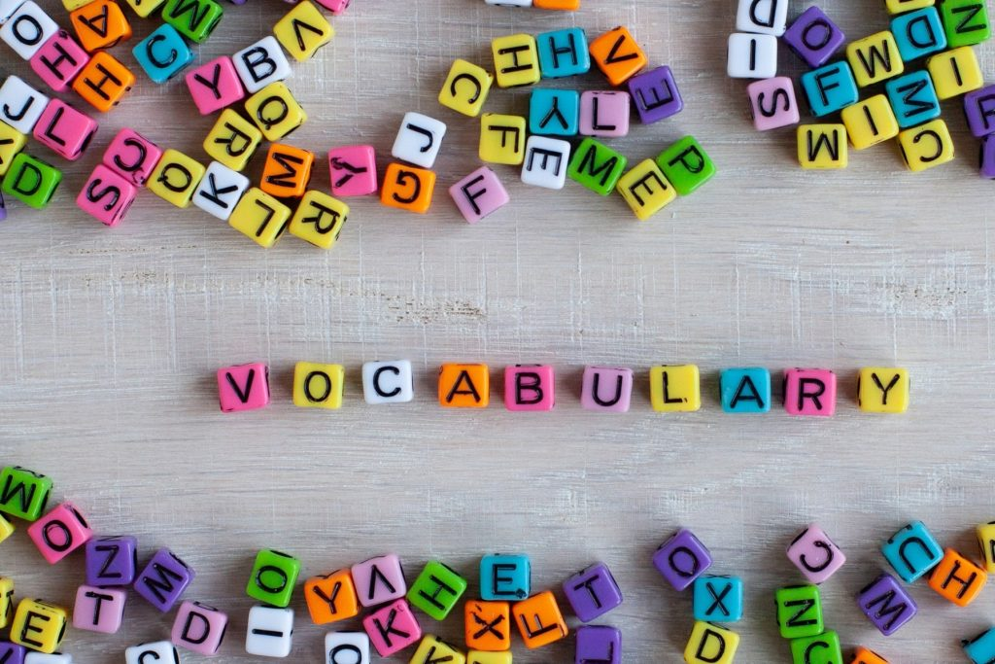
New words
preserve
historical
knock down
prevent
pass a law
statue

Slide 5



Slide 6

Work in pairs.
How would you describe the building in the picture?
Are there any old and famous places that would you like to visit? Why?

Slide 7
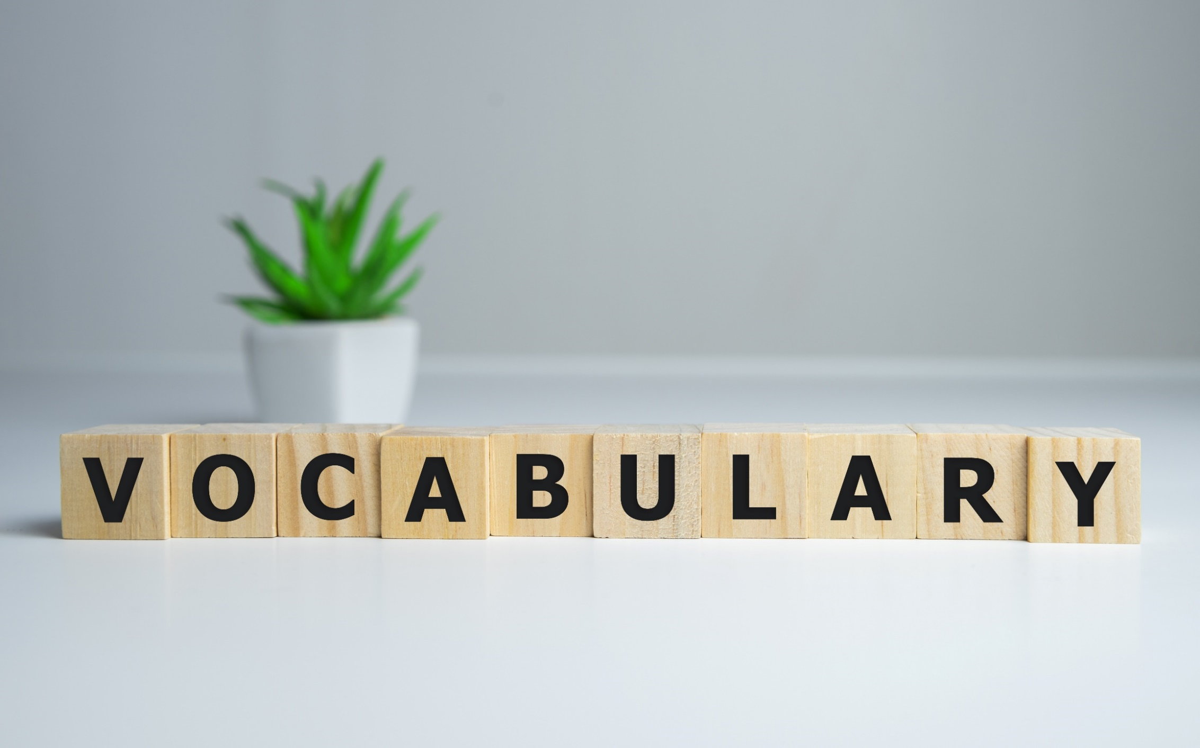


Slide 8
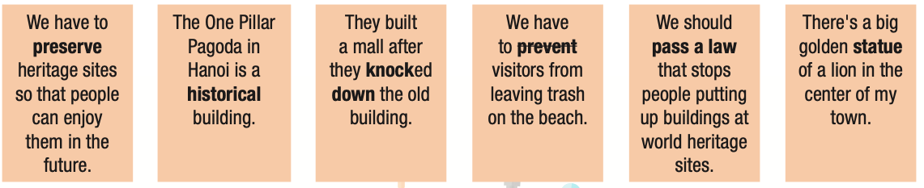
Read the sentences, then write the bold words in the conversation.

Slide 9
preserve historical knock down prevent pass a law statue
A: Let's discuss what we can do to prevent our important cultural sites from disappearing.
B: Well, firstly, we should do our best to (2) _________ the places that currently exist.
A: I agree. There are many (3) ________sites that are thousands of years old, so we cannot lose them now.
B: Yes, we shouldn't (4) ____________any old buildings. They're all part of our country's history.
A: And not only buildings – we should also look after other impressive cultural pieces, like (5) _____ s.
B: I think we should (6) __________ to stop people knocking down historical buildings.
A: Good idea!
preserve
historical
knock down
statue
pass a law

Slide 10

Listen and repeat. Click on each phrase to hear the sound.
Practice saying them with a partner.
preserve (n) /prɪˈzɜːrv/ bảo tồn
historical (n) /ˈhɪˈstɔːrɪkl / thuộc về lịch sử
knock down(n. phr) /'nɑːk daʊn / đập bỏ (công trình cũ)
prevent (n) /prɪˈvent / ngăn chặn
pass a law(n) /pæs eɪ lɑː / ban hành luật
statue (adj) /ˈstætʃuː/ bức tượng
Notes:
GV click vào từng cụm nghe âm thanh

Slide 11

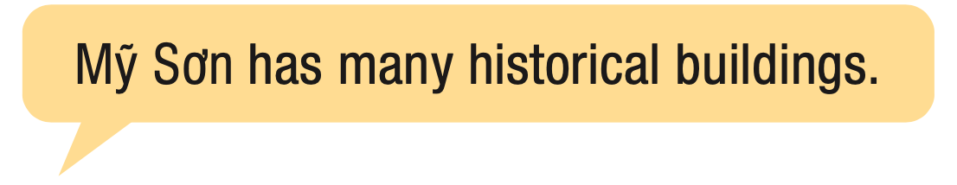
In pairs:
Do you know any historical buildings or heritages? What are they?

Slide 12
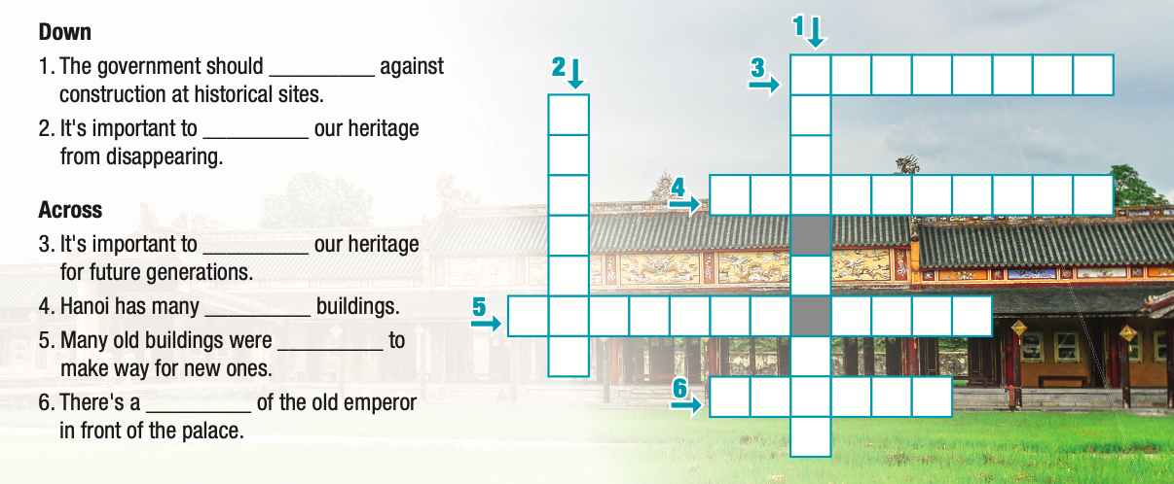
Extra Practice
WB, page 34
A. Complete the words.
P
A
S
S
A
L
A
W
R E S E R V E
P
R
E
V
E
N
T
H I T O R I C A L
K O C K E D D O W N
S T T U E

Slide 13



Slide 14
Pre - listening
Read the instruction quickly. Underline the key words. What are we going to do?
Listen to city officials discussing a preservation project. Do they agree on the plan?

Slide 15

Listen to city officials discussing a preservation project.
Do they agree on the plan?
yes
no
While - listening

Slide 16
b. Now, listen and fill in the blanks
1. Quân and Jennifer still have a few more weeks before they have to ________ their plan.
2. Jennifer thinks they should look at the ___________ to preserve the old statues and buildings.
3. A company wants to knock down the old buildings and build expensive ____________.
4. Jennifer thinks they should ____________ the company from knocking down the buildings.
5. Quân wants to turn the unused apartments into a ____________ or clothes stores.
present
cost
apartments
prevent
museum
While - listening

Slide 17
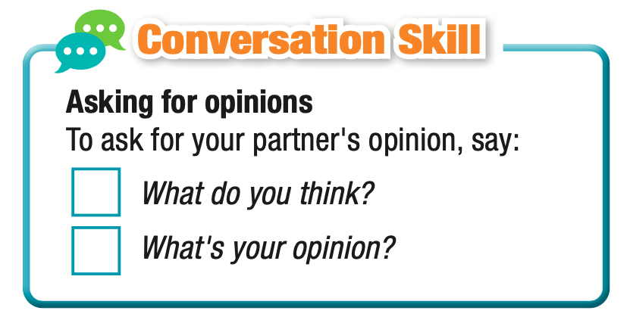
c. Read the Conversation Skill box. Then, listen and repeat.

Slide 18
d. Now, listen to the conversation again and number the phrases in the order you hear them.
1
2

Slide 19

Post - listening
Work in pairs.
Do you think it's better to preserve old buildings or knock them down to build new ones? Why?
For ex:
I think we should knock old buildings down to build new ones. What do you think?
I don’t agree with you. I think we should preserve them for people in the future to enjoy.

Slide 20

Consolidation

Slide 21
Write 5 sentences to describe some buildings in Vietnam, using the words you learned today.
For ex:
The government has tried to preserve Hue Imperial Citadel because it has a lot of historical values.

Slide 22

WRAP-UP

Slide 23
Today’s lesson
Vocabularies
preserve
historical
knock down
prevent
pass a law
statue

Slide 24
Today’s lesson
practice and learn vocab. related to World heritages
practice listening for specific information
practice functional English (Asking for opinions)

Slide 25


Slide 26
- Do the exercises in workbook on pages 34 & 35.
- Prepare the next lesson: Lesson 2.2 – Grammar (pages 63 & 64 SB).
- Play the consolidation games in Tiếng Anh 11 i-Learn Smart World DHA App on www.eduhome.com.vn

Slide 27

Lesson 3
Stay positive and have a nice day!

