Slide 1
Unit 6: World Heritages
Lesson 1.1: Vocab & Reading
Pages: 58 & 59

Slide 2
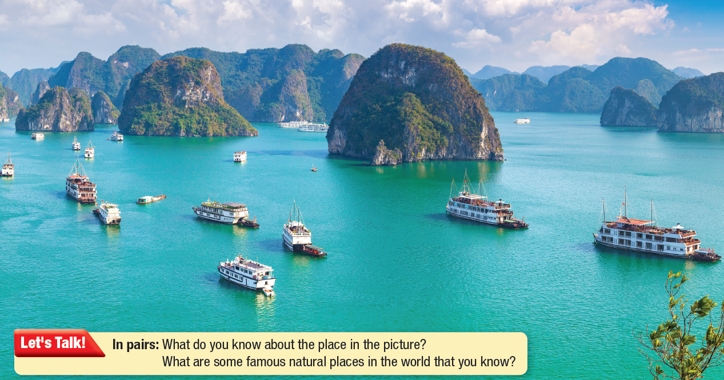
Lesson Outline
Warm-up
Vocabulary
Reading
Consolidation
Wrap-up

Slide 3
By the end of this lesson,
students will be able to:
- practice and learn vocabulary related to World Heritages.
- practice reading for specific information.

Slide 4
New words
jungle
landscape
endangered species
karst
limestone
impressive
rare
unique

Slide 6
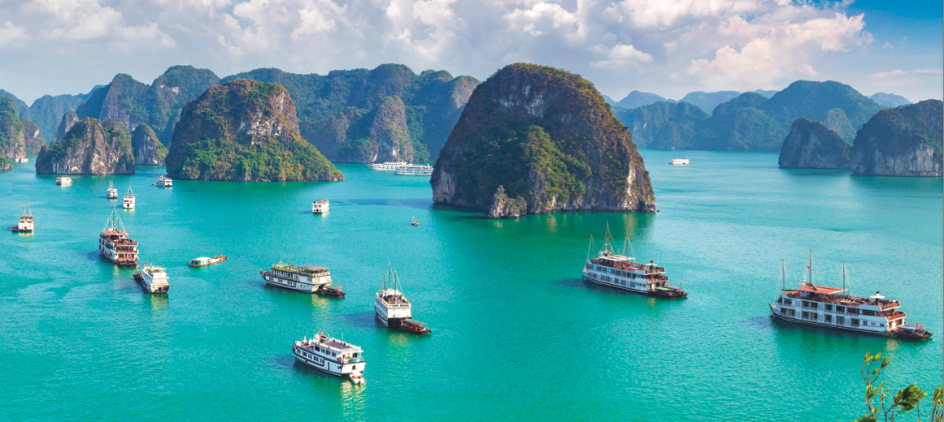
Work in pairs.
What do you know about the place in the picture? What are some famous natural places in the world that you know?

Slide 8
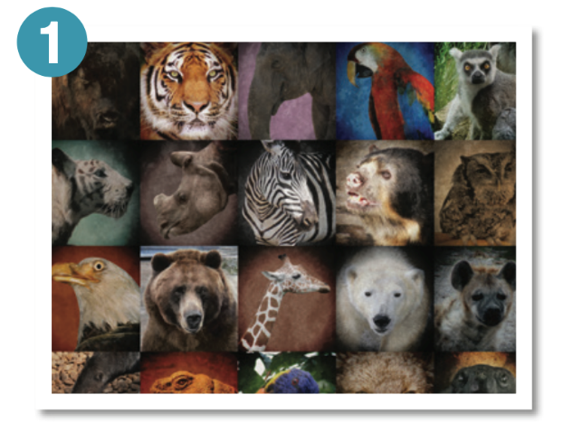
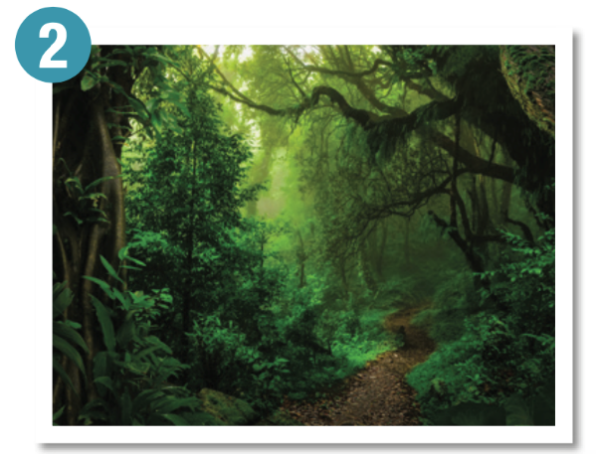
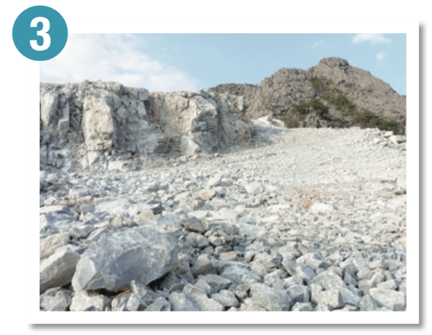
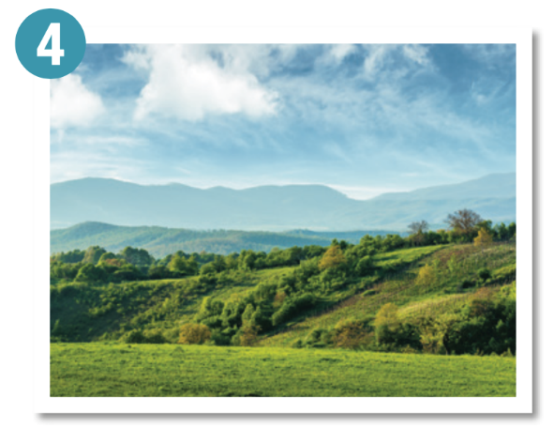
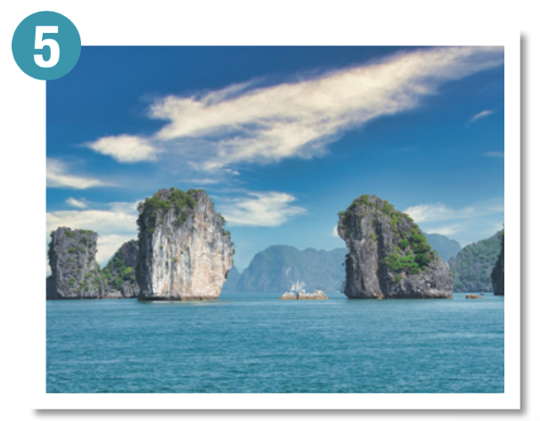
Work in pairs. Read the words and definitions and label the pictures.
endangered species
jungle
limestone
landscape
karst

Slide 9
Listen and repeat. Click each phrase to hear the sound.
jungle (n) /ˈdʒʌŋɡl/ rừng rậm
landscape (n) /ˈlændskeɪp/ phong cảnh
endangered species (n. phr) /ɪnˈdeɪndʒərd ˈspiʃiz/ những loài có nguy cơ tuyệt chủng
karst (n) /kɑːrst/ vùng đá vôi bị xói mòn
limestone(n) /ˈlaɪmstoʊn/ đá vôi
Notes:
GV click vào từng cụm nghe âm thanh

Slide 10
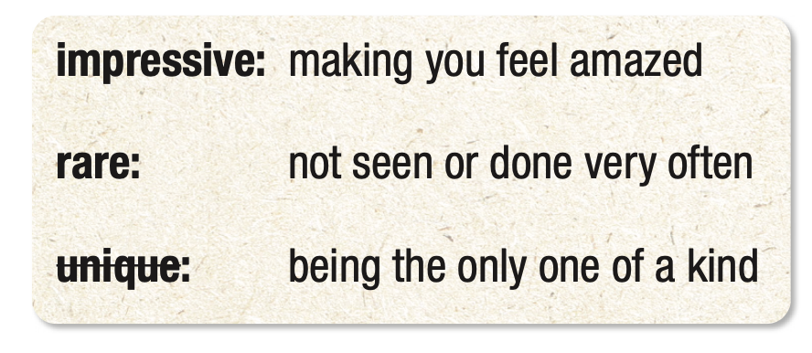
Work in pairs. Read the words and definitions and fill in the blanks.
There’s no place in the world like Sơn Đoòng cave. That makes it _________ .
I couldn’t believe the view! It was so _________ .
Seeing a tiger in the wild is _________ these days.
unique
impressive
rare

Slide 11
Listen and repeat. Click each phrase to hear the sound.
impressive (adj) /ɪmˈpresɪv/ gây ấn tượng
rare (adj) /rer/ hiếm
unique (adj) /ju:ˈniːk/ độc nhất vô nhị
Notes:
GV click vào từng cụm nghe âm thanh

Slide 12
Practice saying these words with a partner.
jungle (n) /ˈdʒʌŋɡl/ rừng rậm
landscape (n) /ˈlændskeɪp/ phong cảnh
endangered species(n. phr) /ɪnˈdeɪndʒərd ˈspiʃiz/ những loài có nguy cơ tuyệt chủng
karst (n) /kɑːrst/ vùng đá vôi bị xói mòn
limestone(n) /ˈlaɪmstoʊn/ đá vôi
impressive (adj) /ɪmˈpresɪv/ gây ấn tượng
rare (adj) /rer/ hiếm
unique (adj) /ju:ˈniːk/ độc nhất vô nhị
Notes:
GV click vào từng cụm nghe âm thanh

Slide 13
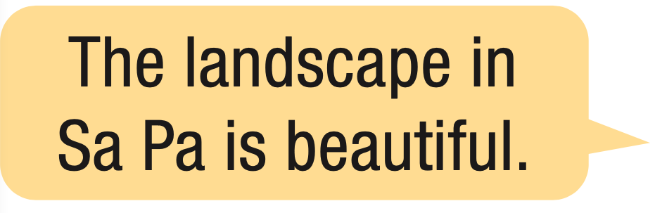
In pairs: Talk about impressive natural places in Vietnam using the new words.

Slide 14
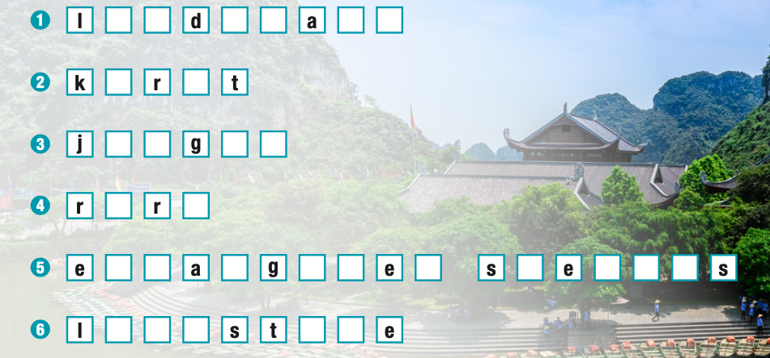
Extra Practice
WB, page 32
A. Complete the words.
a n s c p e
a s
u n l e
a e
n d n e r d p c i e
i m e o n

Slide 15
Extra Practice
WB, page 32
B. Fill in the blanks with the words from Task A.
landscape
karst
rare
limestone
jungle
endangered species

Slide 17
Pre - reading
Read the instruction quickly. Underline the key words. What are we going to do?
Read the blog post very quickly. Which year was Son Đoòng first explored?

Slide 18
Scan the text to find the answer.
Training
Before I could lead a tour, I had to train. The company taught us a lot about the endangered species here and safety in the jungle. We even practiced rock climbing. That was fun and exciting, but it was the photography training that I liked most. We learned how to take cool photos of the park's most incredible places like Son Đoòng cave. It's the biggest cave in the world! It was only in 2009 that Son Đoòng was first explored. Can you believe it?
While - reading

Slide 19
Pre - reading
Read and underline the key words in the questions.
What is Hùng's new job?
What four things did Hùng learn about?
What was Hùng's favorite part of the training?
What made the caves and towers?
The word here in paragraph 4 refers to ______.

Slide 20
Read and answer the questions.
1. What is Hùng's new job?
He is a tour guide
I'm a tour guide with a company in Phong Nha-Ke Bàng in Central Vietnam.
While - reading

Slide 21
Read and answer the questions.
While - reading
2. What four things did Hùng learn about?
endangered species, safety, rock climbing, photography training
The company taught us a lot about the endangered species here and safety in the jungle. We even practiced rock climbing. That was fun and exciting, but it was the photography training that I liked most. We learned how to take cool photos of the park's most incredible places like Son Đoòng cave.

Slide 22
Read and answer the questions.
3. What was Hùng's favorite part of the training?
photography training
… but it was the photography training that I liked most.
While - reading

Slide 23
Read and answer the questions.
4. What made the caves and towers?
Water washed away some of the limestone (over millions of years)
People travel here because of the rare karst landscapes. Over millions of years, water washed away some of the limestone and created unique towers and caves. Vietnam has some of the biggest karst areas in the world.
While - reading

Slide 24
Read and answer the questions.
5. The word here in paragraph 4 refers to ______.
a. Hạ Long Bay
b. Sơn Đoòng
c. Phong Nha-Kẻ Bàng
Working here for the last few months has been great. It's also been a nice break from busy city life. I'm learning a lot,
meeting great people, and loving being around nature. I definitely recommend it!
While - reading

Slide 25
Listen and Read.
What's new
Hey, everyone! It's Hùng here. I can't wait to tell you all what I've been up to. If you read my last blog, then you know I had a big problem. I needed to save money before going to university abroad. I hated being a waiter, and I wasn't good at my teaching assistant job, but I finally found something. I'm a tour guide with a company in Phong Nha-Ke Bàng in Central Vietnam.

Slide 26
Listen and Read.
Training
Before I could lead a tour, I had to train. The company taught us a lot about the endangered species here and safety in
the jungle. We even practiced rock climbing. That was fun and exciting, but it was the photography training that I liked most. We learned how to take cool photos of the park's most incredible places like Son Đoòng cave. It's the biggest cave in the world! It was only in 2009 that Son Đoòng was first explored. Can you believe it?

Slide 27
Listen and Read.
Phong Nha
Phong Nha-Ke Bàng is an impressive place. It's one of Vietnam's UNESCO natural world heritages.
People travel here because of the rare karst landscapes. Over millions of years, water washed away some of the limestone and created unique towers and caves. Vietnam has some of the biggest karst areas in the world. It's their amazing karst landscapes that make Phong Nha and Ha Long Bay UNESCO Heritage Sites.

Slide 28
Listen and Read.
Final thoughts
Working here for the last few months has been great. It's also been a nice break from busy city life. I'm learning a lot,
meeting great people, and loving being around nature. I definitely recommend it!

Slide 29
Post - reading
Work in pairs.
Would you like to work at Phong Nha-Kẻ Bàng? Why (not)?
For ex:
I love to work at Phong Nha – Ke Bang because I can see the beautiful and unique landscape there.
I don’t like to work at Phong Nha - Ke Bang because I prefer the busy life in the city.

Slide 30
Consolidation

Slide 31
Write 5 sentences to describe places in Vietnam, using the words you learned today.
Example:
The landscape in Sapa is very impressive.
Elephants in Tay Nguyen now are very rare.

Slide 32
WRAP-UP

Slide 33
Today’s lesson
Vocabularies
jungle
landscape
endangered species
karst
limestone
impressive
rare
unique

Slide 34
Today’s lesson
Vocabulary:
- practice and learn vocabulary related to World Heritages.
Reading:
- practice reading for specific information.

Slide 36
- Do the exercises in workbook on page 32.
- Prepare the next lesson: Lesson 1.2 – Grammar (pages 59 & 60 SB).
- Play the consolidation games in Tiếng Anh 11 i-Learn Smart World DHA App on www.eduhome.com.vn

Slide 37
Lesson 3
Stay positive and have a nice day!

