Slide 1
Unit 5: Vietnam & ASEAN
Lesson 3.2: Speaking & Writing
Page 55

Slide 2
Lesson Outline
Warm-up
Writing
Speaking
Consolidation
Wrap-up

Slide 3
By the end of this lesson, students will be able to…
practice expanding on important information.
write an email to inform events and information.
talk about plans for ASEAN students visiting their hometowns.

Slide 4
WARM UP

Slide 5
… because this place is so cool and poetic.
… to know more about Vietnam’s history.
… because it is one of the cultural symbols of Vietnam.
- Which places are these? Where are they?
- Why should people visit these places?

Slide 7
a. Read about expanding on important information. Then, read Sengphet's email again and underline the extra information which answers who and where.

Slide 8
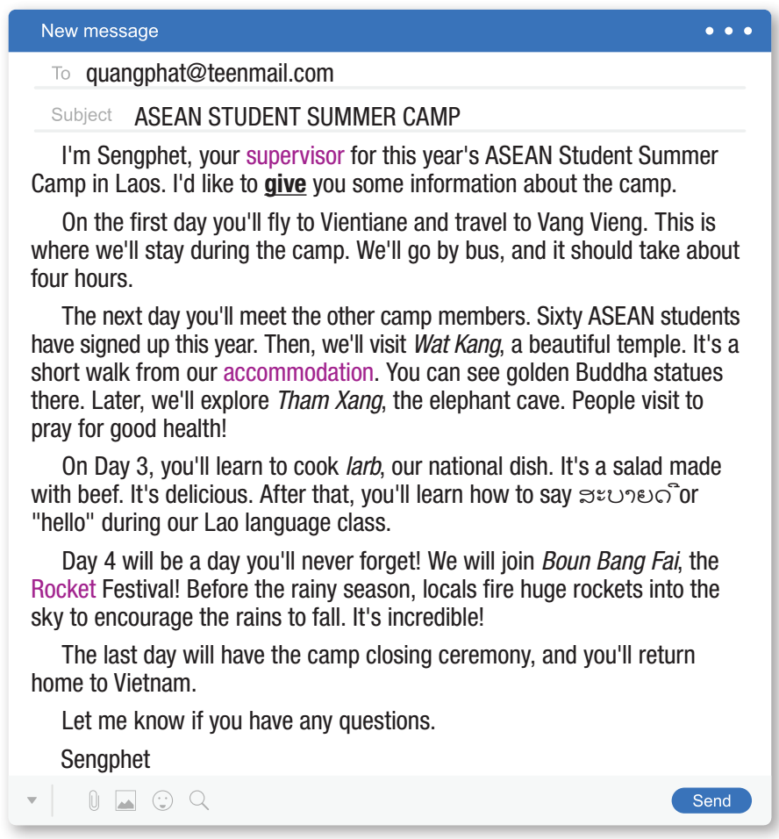
a. Read about expanding on important information. Then, read Sengphet's email again and underline the extra information which answers who and where.

Slide 9
a. Read about expanding on important information. Then, read Sengphet's email again and underline the extra information which answers who and where.
On the first day you'll fly to Vientiane and travel to Vang Vieng. This is where we'll stay during the camp. We'll go by bus, and it should take about four hours.
The next day you'll meet the other camp members. Sixty ASEAN students have signed up this year. Then, we'll visit Wat Kang, a beautiful temple. It’s a short walk from our accommodation. You can see golden Buddha statues there.
Day 4 will be a day you'll never forget! We will join Boun Bang Fai, the Rocket Festival! Before the rainy season, locals fire huge rockets into the sky to encourage the rains to fall. It's incredible!

Slide 10
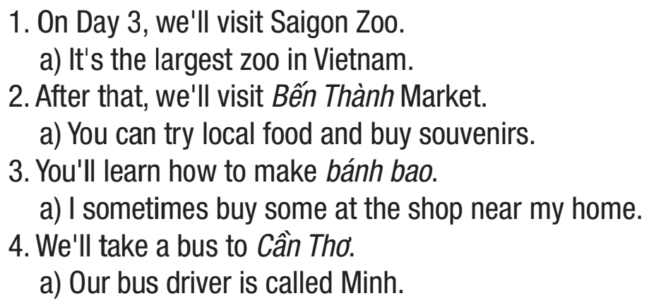
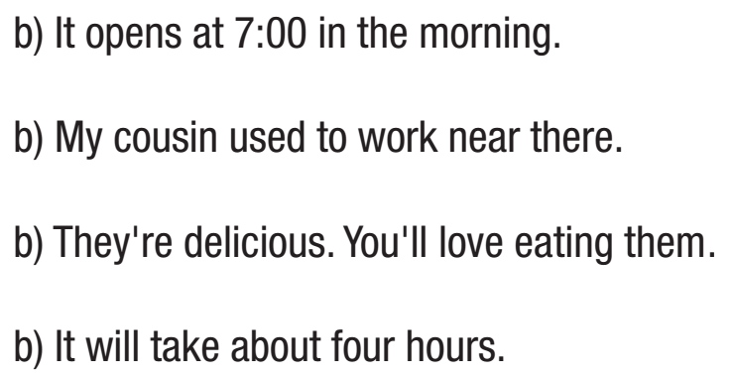

Slide 12
What are we going to do?

Slide 13
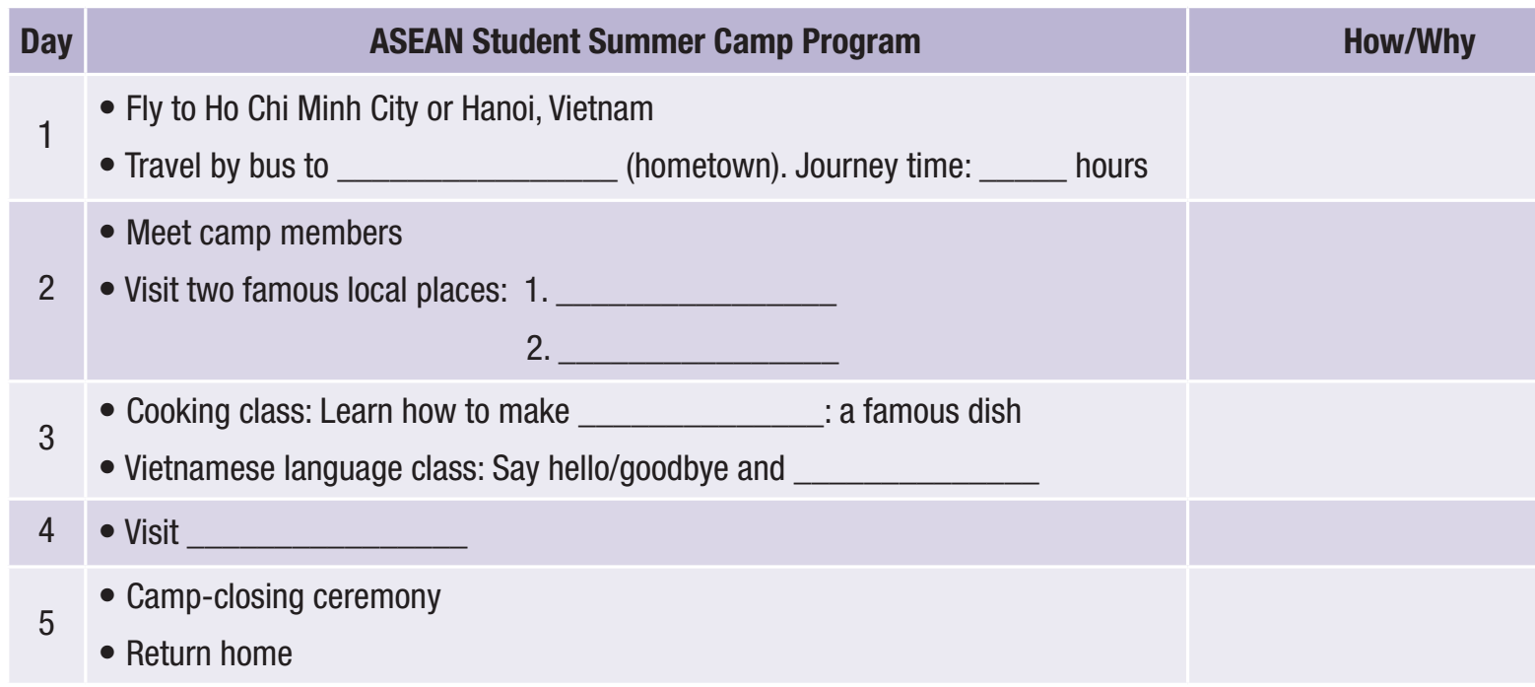

Slide 14
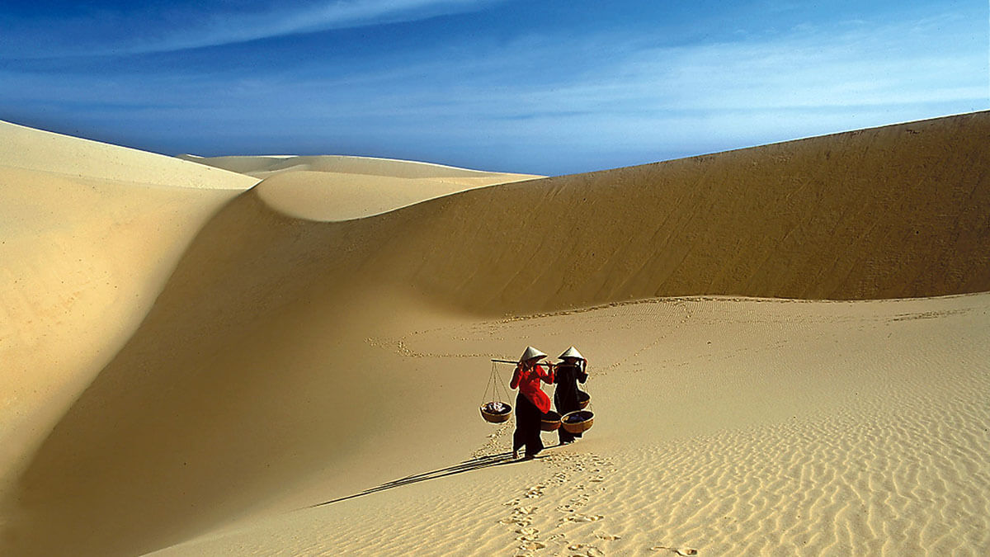
Which places are these? Where are they ?
Phan Thiết – Bình Thuận
Mũi Né sandunes
Tà Cú Mountain

Slide 15
different landscapes
Phan Thiết
5
Tà Cú mountain
Mũi Né sandunes

Slide 17
Now, write an email to Akara, a Cambodian student taking part in the summer camp, to inform her about the program. Say what will happen each day and expand on important information. Use the Writing Skill box, the reading model, and your speaking notes to help you. Write 150–180 words.

Slide 18
Now, write an email to Akara, a Cambodian student taking part in the summer camp, to inform her about the program. Say what will happen each day and expand on important information. Use the Writing Skill box, the reading model, and your speaking notes to help you. Write 150–180 words.

Slide 19
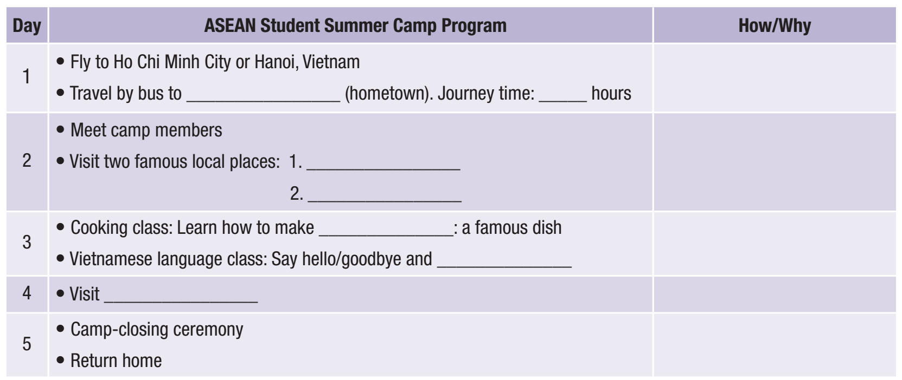
Now, write an email to Akara, a Cambodian student taking part in the summer camp, to inform her about the program. Say what will happen each day and expand on important information. Use the Writing Skill box, the reading model, and your speaking notes to help you. Write 150–180 words.

Slide 20
Now, write an email to Akara, a Cambodian student taking part in the summer camp, to inform her about the program. Say what will happen each day and expand on important information. Use the Writing Skill box, the reading model, and your speaking notes to help you. Write 150–180 words.

Slide 21
Post– Writing

Slide 22
Post– Writing
Swap the writing with a partner. Read, and give feedback.

Slide 23
CONSOLIDATION

Slide 24
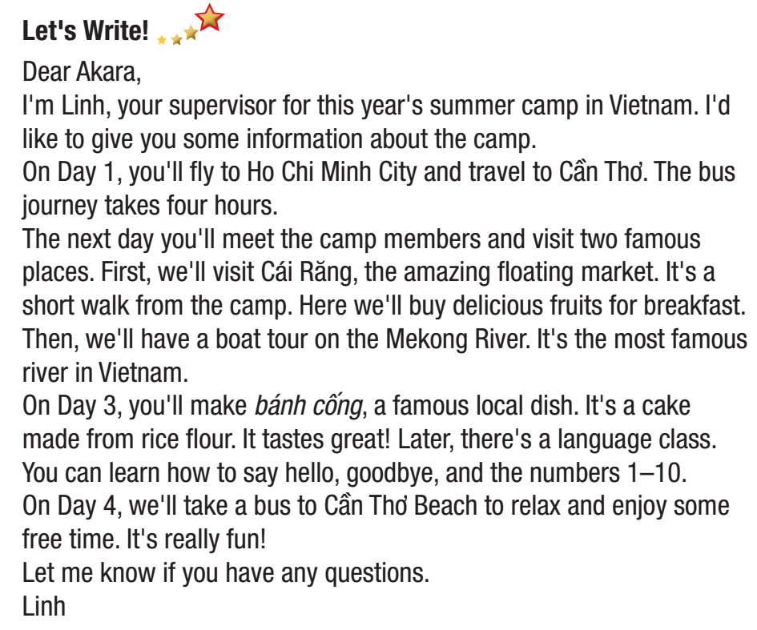
Post– Writing
Read a sample

Slide 25
WRAP-UP

Slide 26
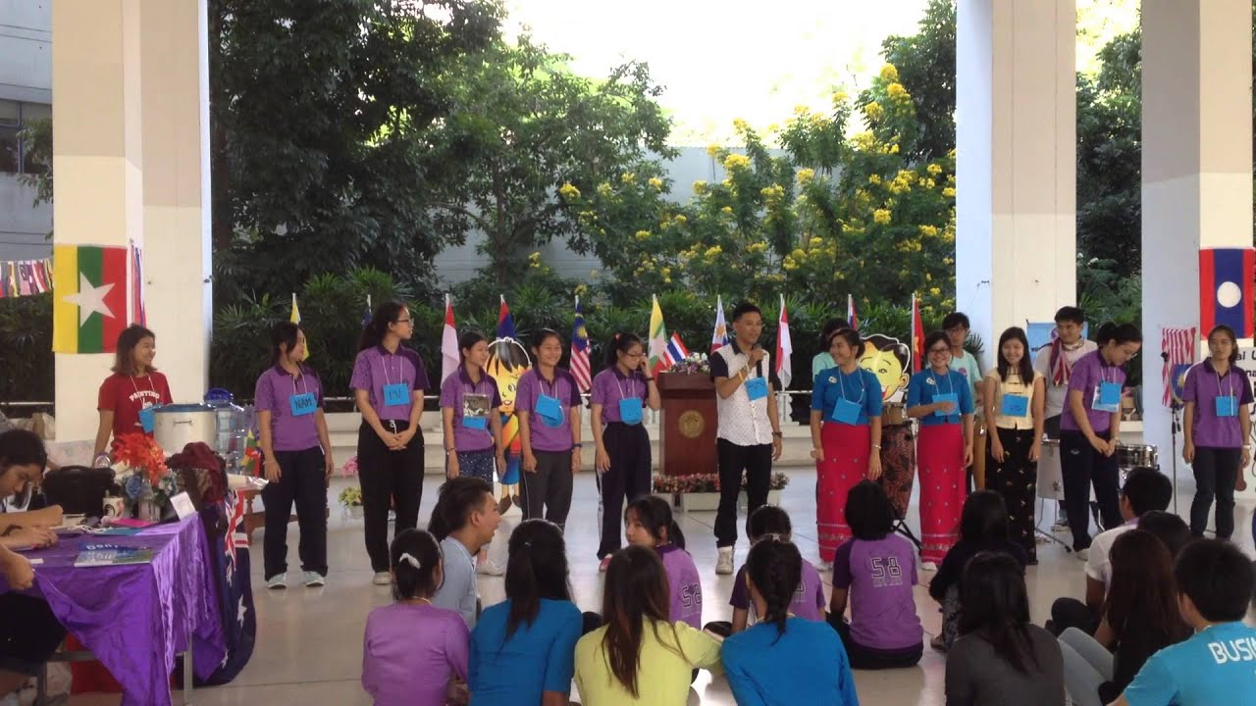
Today’s lesson
Designing a program and writing an email to inform an ASEAN student about that program.
Speaking
Writing

Slide 28
Homework
Do the exercises on page 31 WB.
Prepare the next lesson Review 2 (page 56 – SB).
Play the consolidation games on www.eduhome.com.vn.

Slide 29
Lesson 3
Stay positive and have a nice day!

