Slide 1

Unit 5: Vietnam & ASEAN
Lesson 3.1: Listening & Reading
Page 54

Slide 2
Lesson Outline
Warm-up
Listening
Reading
Consolidation
Wrap-up

Slide 3

By the end of this lesson, students will be able to…
practice listening and reading for specific information.

Slide 4

WARM UP

Slide 5






Slide 6



Slide 7
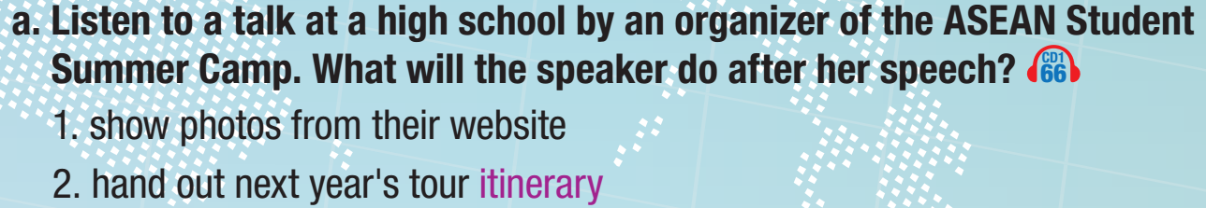
Pre – Listening
Read the instructions for a and b quickly. Underline the key words. What are we going to do?
Listen and decide what the speaker will do after her speech.

Slide 8
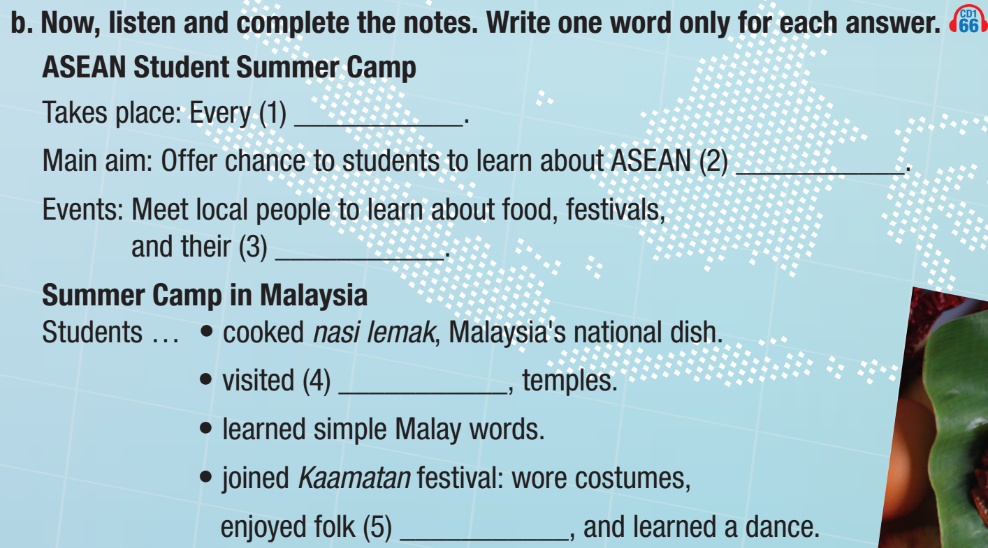
Pre – Listening
What are we going to do?
Listen and complete the notes.
Write one word only for each answer.

Slide 9
Pre – Listening
Skim the questions and underline the key words.

Slide 10

While– Listening

Slide 11
While– Listening
summer
cultures
language
museums
songs

Slide 12
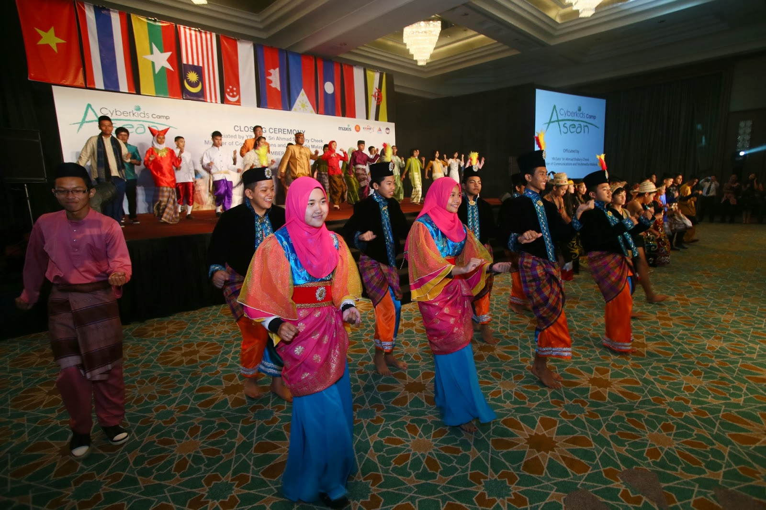
Post – Listening

Slide 13



Slide 14

Pre – Reading
Do you often send or receive emails?
If yes, what are the emails about?

Slide 15
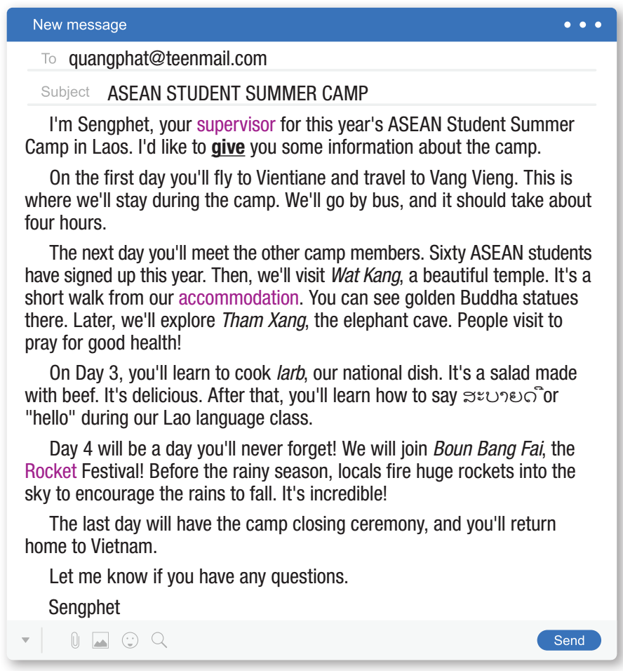
Pre – Reading
Who wrote this email?
Who received this email?

Slide 16

While – Reading

Slide 17
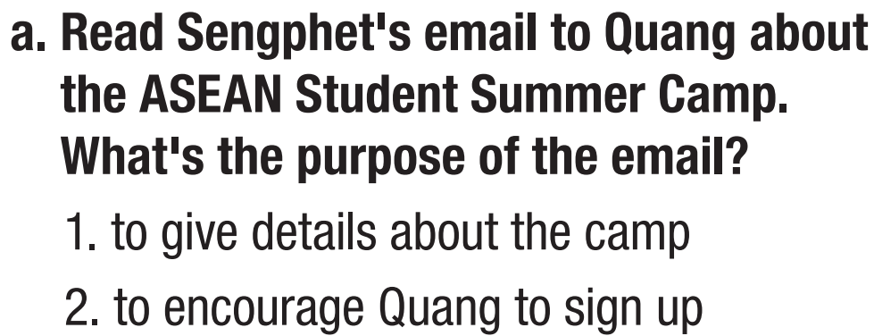
While – Reading
Read the instruction of task a quickly. Underline the key words.
What are we going to do?
Read and decide what the purpose of the email is.

Slide 18
While – Reading

Slide 19
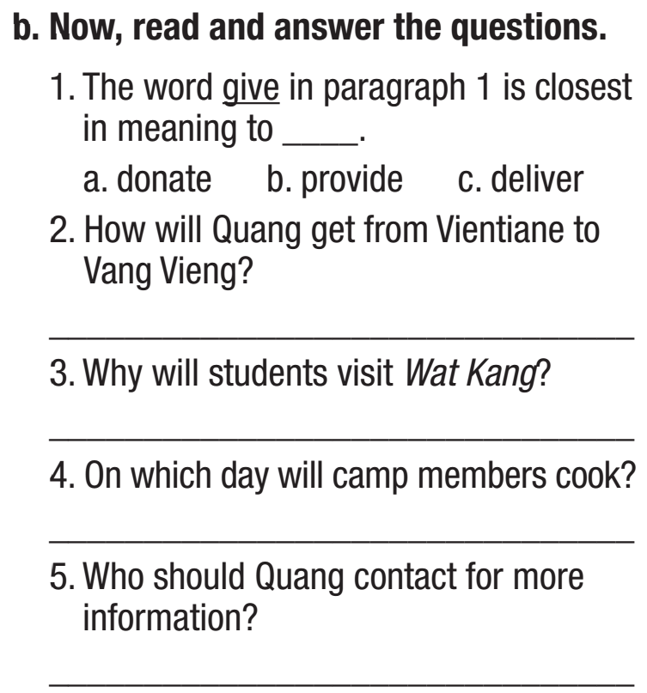
While – Reading
Read the instruction of task b quickly. Underline the key words.
What are we going to do?
Read and answer the questions.
Read and underline the key word of the questions.

Slide 20
While – Reading
by bus
to see golden Buddha statues
Day 3
Sengphet

Slide 21

Post – Reading

Slide 22

Post – Reading

Slide 23
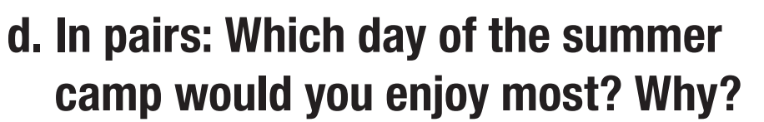
Post – Reading

Slide 24

CONSOLIDATION

Slide 25
Review the key words/ phrases in the listening and reading.

Slide 26

WRAP-UP

Slide 27
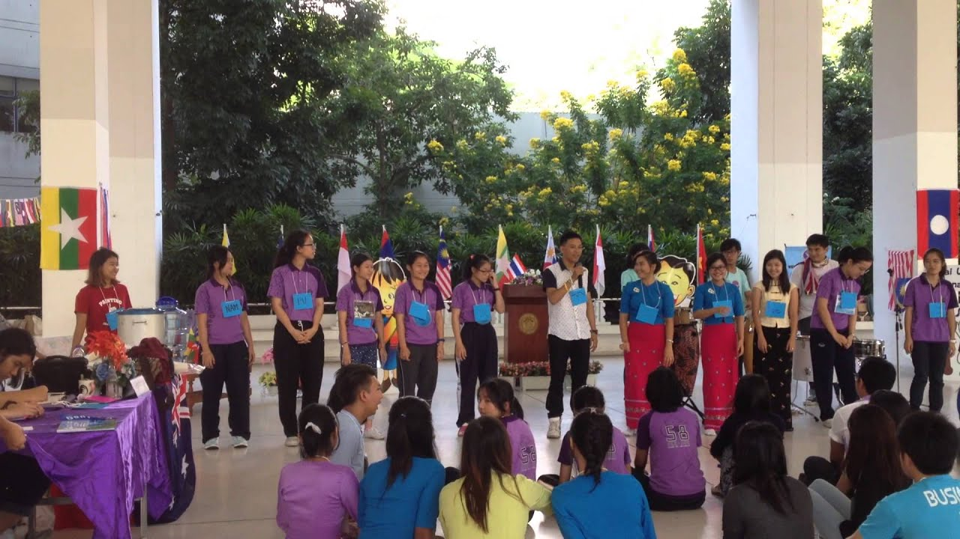
Today’s lesson
ASEAN STUDENT SUMMER CAMP
Listening
Reading

Slide 28


Slide 29
Homework
Do the exercises on page 30 WB.
Prepare the next lesson (Speaking & Writing – page 55 SB).
Play the consolidation games on www.eduhome.com.vn.

Slide 30

Lesson 3
Stay positive and have a nice day!

