Slide 1

Unit 5: Vietnam & ASEAN
Lesson 2.3: Pronun. & Speaking
Pages: 52 & 53

Slide 2
Lesson Outline
Warm-up
Pronunciation
Speaking
Consolidation
Wrap-up

Slide 3

By the end of this lesson, students will be able to…
practice sentence stress.
talk about studying abroad in ASEAN countries.

Slide 4

WARM UP

Slide 5

Work in pairs.
Choose the word whose main stress is placed
differently from the others.
1. A. several B.expensive C. practical D. suitable
2. A.vitamin B. privacy C. permission D. influence
3. A. allow B. afford C. ignore D. focus
/ ˈsevərl/
/ ɪkˈspensɪv/
/ˈpræktɪkl/
/ˈsuːtəbl/
/ ˈvaɪtəmɪn /
/ ˈpraɪvəsi/
/ pərˈmɪʃn/
/ ˈɪnfluəns/
/əˈlaʊ/
/əˈfɔːrd/
/ɪgˈnɔːr/
/ˈfoʊkəs/

Slide 6
Work in pairs.
Choose the word whose underlined part is
pronounced differently from that of the other words.
A. prohibit B. imagine C. emphasize D. influence
2. A. obesity B. approximate C. carbohydrate D. biofuel
3. A. declaration B. unemployment C. emergency D. expectancy
/prəˈhɪbɪt/
/ ɪˈmædʒɪn/
/ ˈemfəsaɪz/
/ ˈɪnfluəns /
/oʊˈbiːsəti /
/əˈprɑːksɪmət/
/ ˌkɑːrboʊˈhaɪdreɪt/
/ˈbaɪoʊfjuːəl/
/ˌdekləˈreɪʃn/
/ˌʌnɪmˈplɔɪmənt/
/ɪˈmɜːrdʒənsi/
/ɪkˈspektənsi /

Slide 7

Work in pairs Unscramble the sentences and read out loud.
so/ People/are/ in HCM/ friendly/ city.
People in HCM city are so friendly.
was/to/Why/place/ such/ it/ good/ a/ study?
Why was it such a good place to study?

Slide 8

Presentation

Slide 9
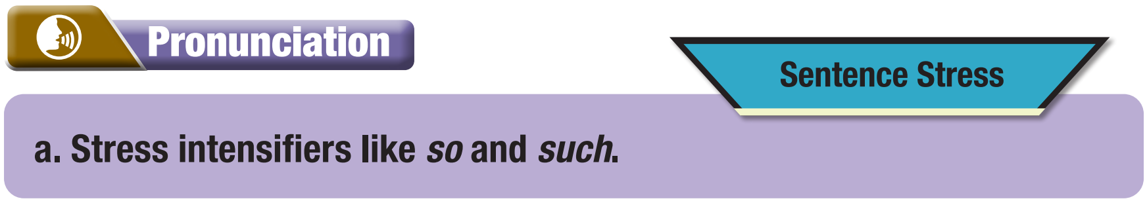
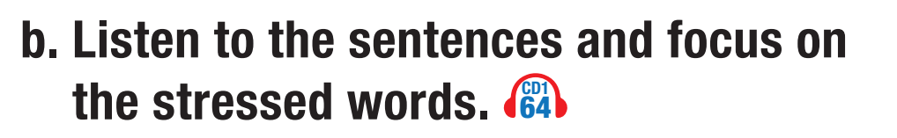

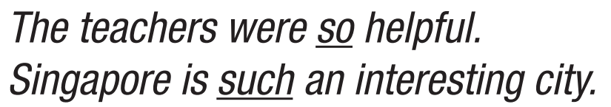
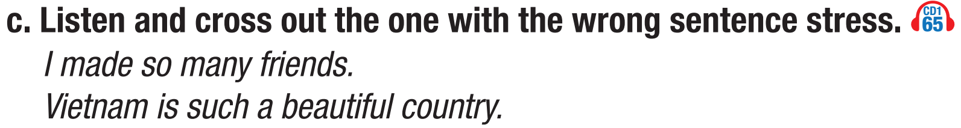
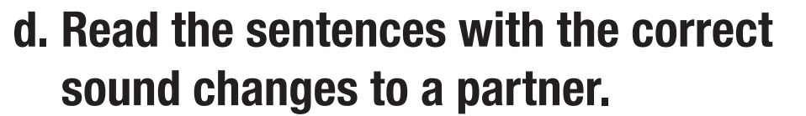
❌

Slide 10
Practice

Slide 11

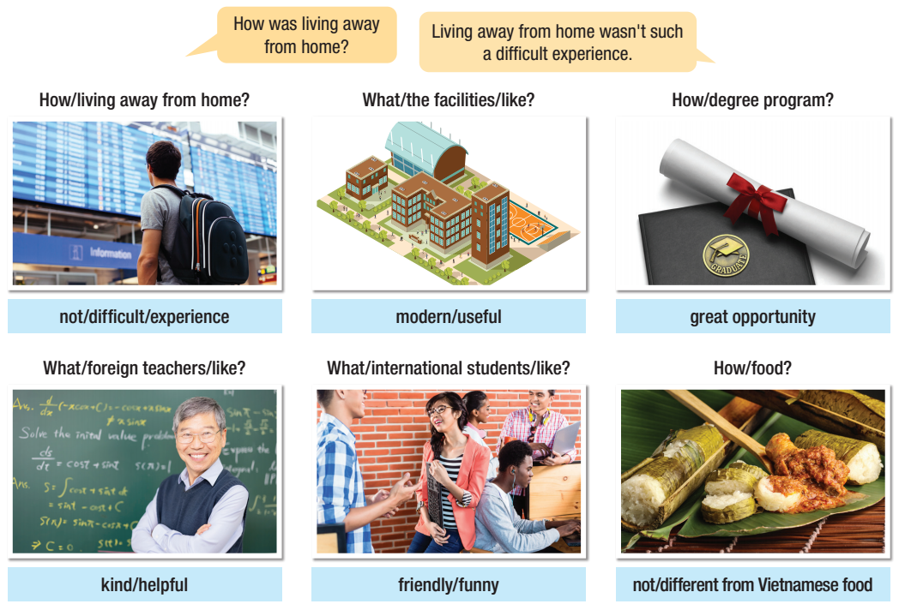
a- Take turns talking about the topics using the vocabulary in the boxes.
What were the facilities like?
The facilities/ They were so modern and useful.

Slide 12
b- Practice with your own ideas.
How was living away from home?
It was such an interesting experience.
What were the facilities like?
They were so new and easy to use.
What were foreign teachers like?
….
What were international students like?
….
How was the food?
….

Slide 13
Production

Slide 14


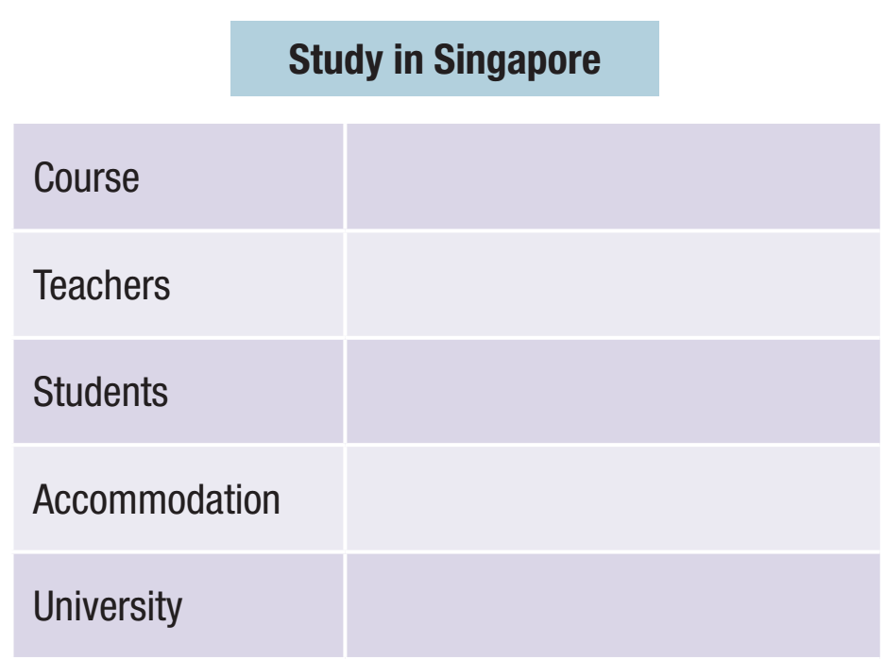
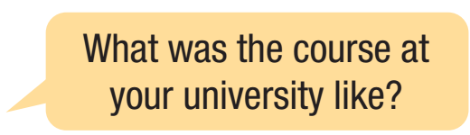
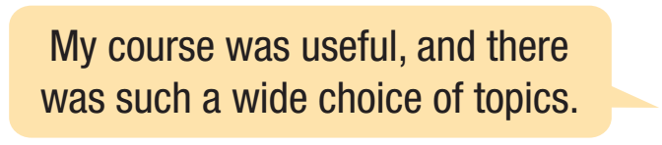
Task a. You're a high school student at an education fair.
In pairs: Student B,
Student A, you're preparing to go to university. Ask about studying in Singapore and complete the table.

Slide 15
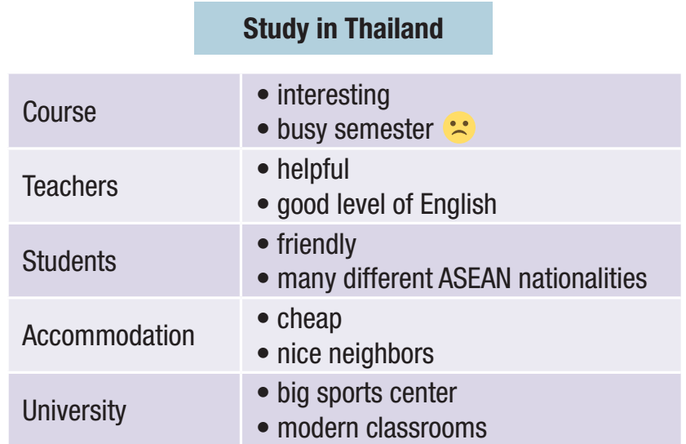
Task b. Swap roles and repeat.
Student A, you studied in Thailand. Draw a happy face or sad face next to four things you want to emphasize. Then, answer Student B's questions about studying in Thailand. Emphasize what you did or didn't like.

Slide 16



Task c. Would you rather study in Thailand or Singapore? Why?
I prefer studying in Thailand because education in Thai is so … Moreover, ….
I’d rather study in Singapore because this country has such … Besides, ….

Slide 17

CONSOLIDATION

Slide 18
Complete the sentences and share it in pairs.
1. The facilities in our school are so …
2. We have such …. friends and …. teachers.

Slide 19

WRAP-UP

Slide 20
Today’s lesson
Pronunciation
Speaking

Slide 21


Slide 22
Homework
- Do the writing exercise on page 29 WB.
- Prepare the next lesson (Listening & Reading – page 54 SB). - Play the consolidation games on www.eduhome.com.vn.

Slide 23

Lesson 3
Stay positive and have a nice day!

