Slide 1

Unit 5: Vietnam & ASEAN
Lesson 2.2: Grammar
Pages: 51 & 52

Slide 2
Lesson Outline
Warm-up
Grammar
Consolidation
Wrap-up

Slide 3

By the end of this lesson, students will be able to…
learn and use intensifiers so and such correctly.

Slide 4

WARM UP

Slide 5
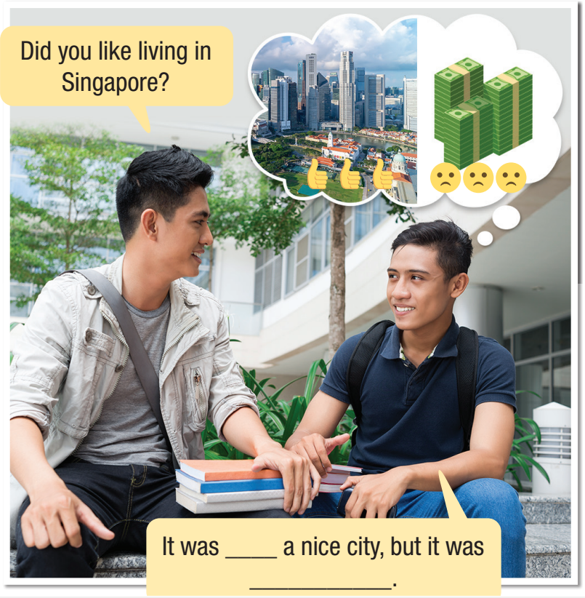


- Look at the picture. What do you think the boy is saying?
such
so expensive

Slide 6

Presentation

Slide 7


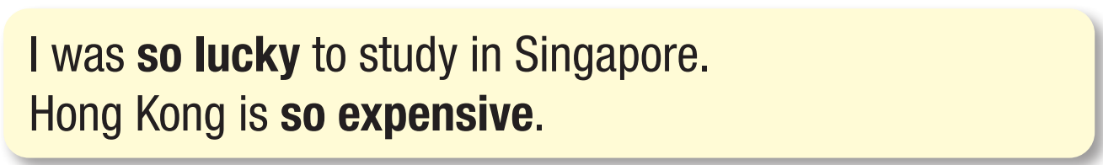
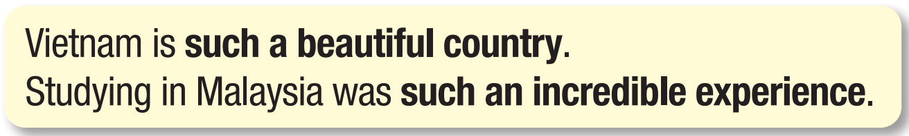
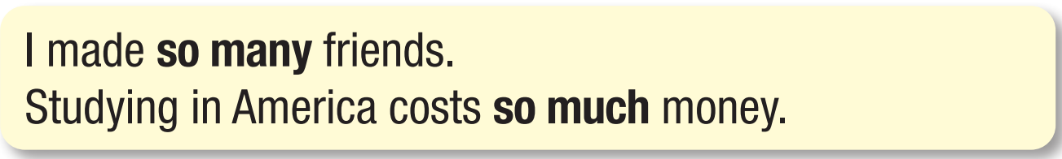
to emphasize our feelings about the subject or event
to emphasize the description of the subject or event.
to show there is a lot of something.

Slide 8
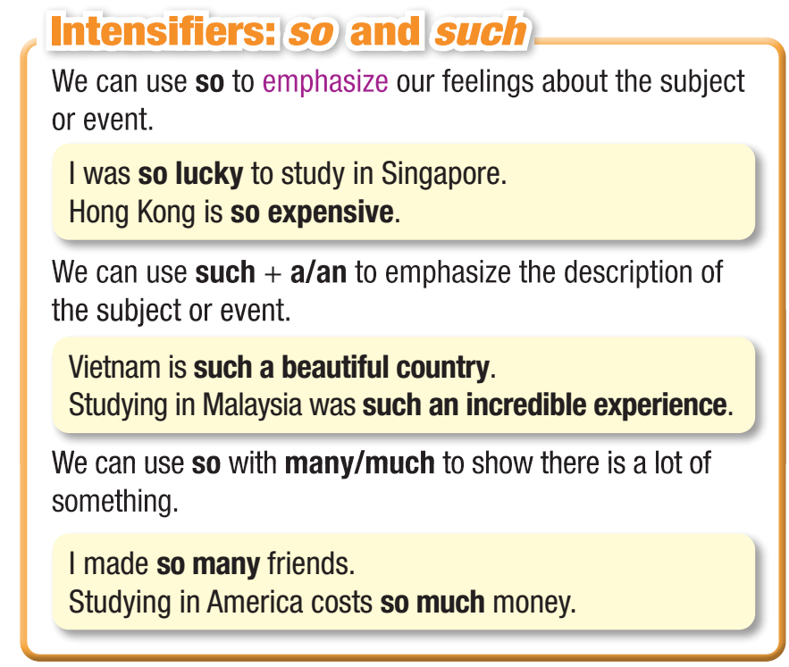


Slide 9

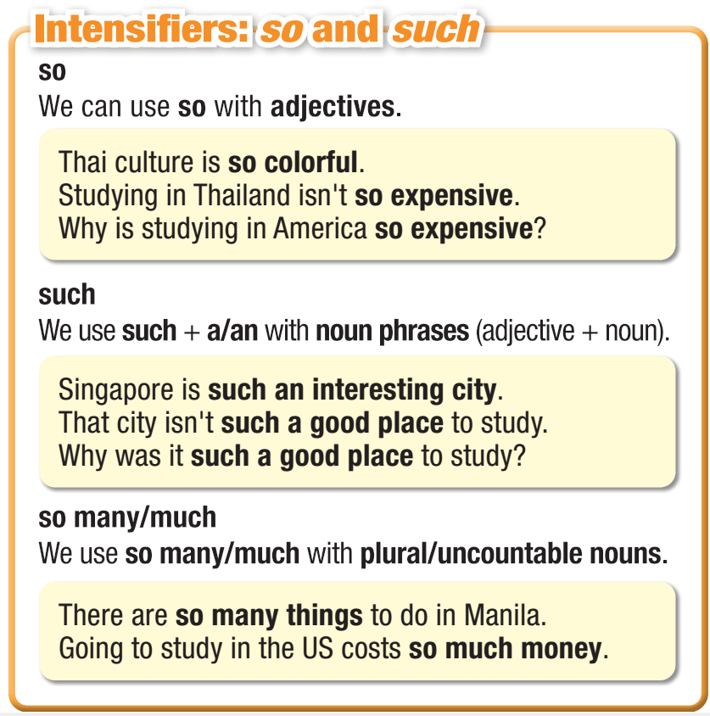
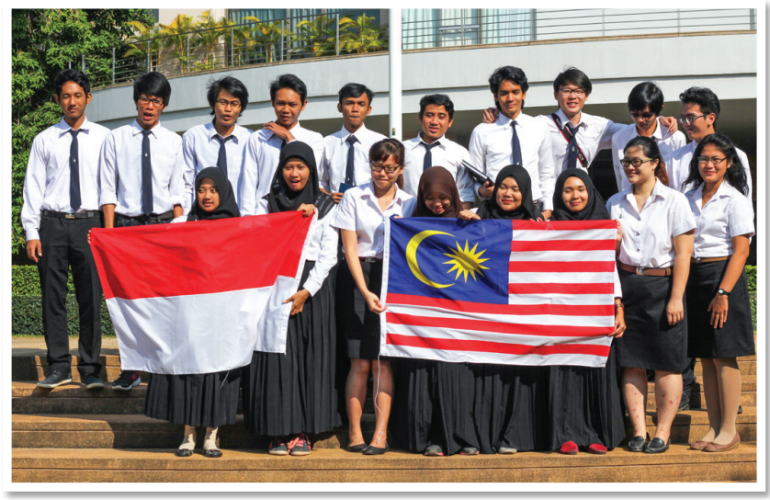

Slide 10
Practice

Slide 11

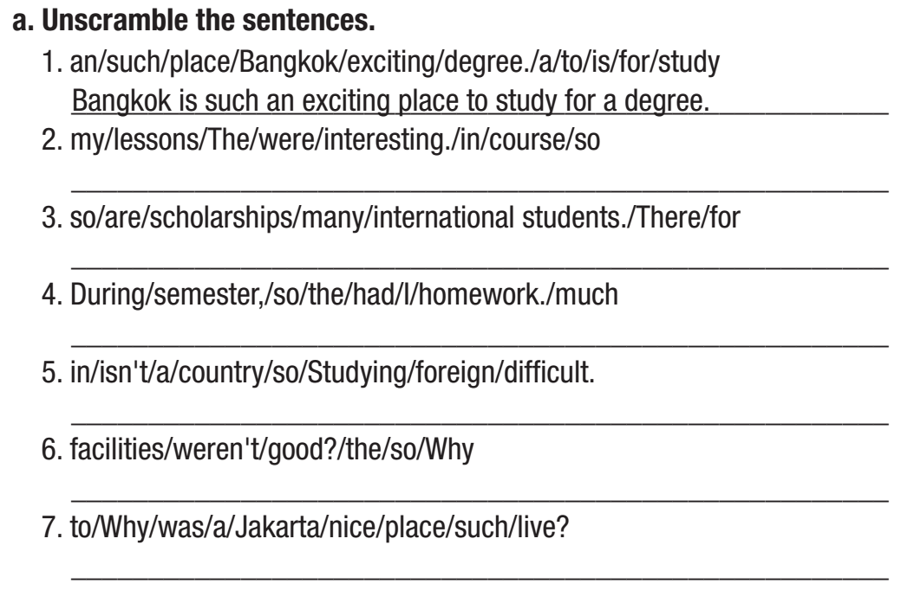
Do this task and work in pairs to check the answers.
The lessons in my course were so boring.
There are so many scholarships for international students.
During the semester, I had so much homework.
Studying in a foreign country isn’t so difficult.
Why weren’t the facilities so good?
Why was Jakarta such a nice place to live?

Slide 12
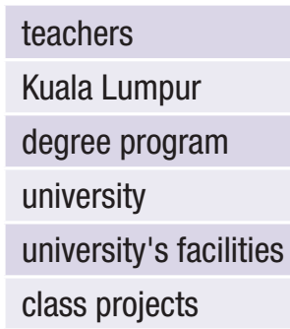
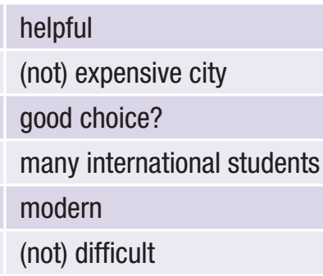
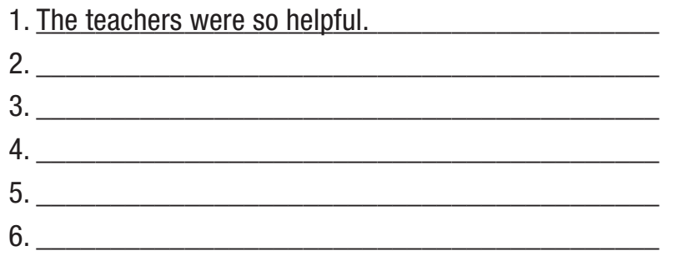
Do this task and work in pairs to check the answers.
Kula Lumpur wasn’t such an expensive city.
Why was your degree program such a good choice?
The university had so many international students.
The university’s facilities were so modern.
The class projects weren’t so difficult.

Slide 13
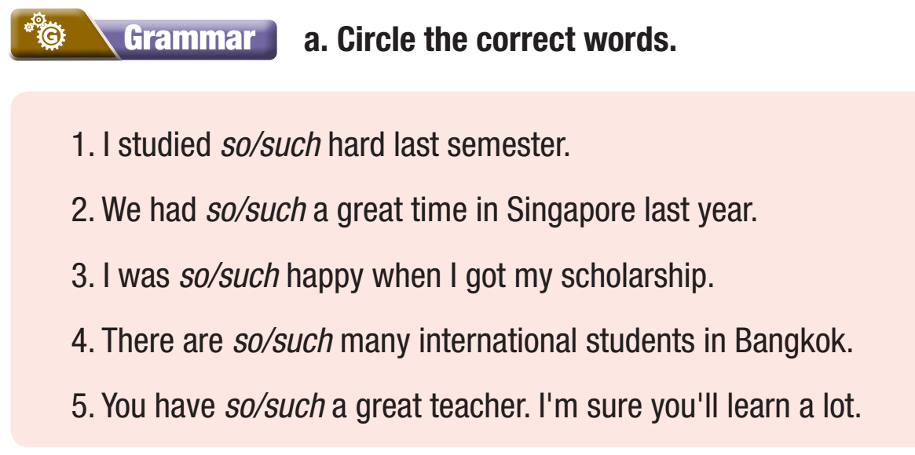
WB p. 29

Slide 14
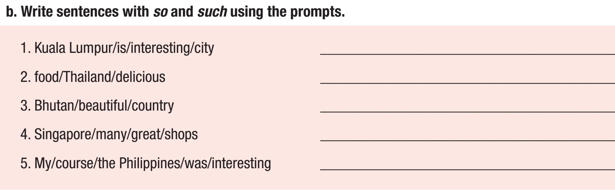
WB p. 29
Kuala Lumpur is such an interesting city.
The food in Thailand is so delicious.
Bhutan is such a beautiful country.
Singapore has so many great shops.
My course in the Philippines was so interesting

Slide 15
Production

Slide 16
Work in pairs
Task c . Talk about living and studying in Vietnam using so or such.
Our teachers are so helpful.
There are so many interesting activities in a lesson.
Each school has such a good library.

Slide 17

CONSOLIDATION

Slide 18
Fill in the blanks with so, such, so many, so much. Use each word or phrase once.
There are ______________ places to visit in Phnom Penh.
You are __________ lucky to have _________ amazing friends.
There isn’t ___________ homework for us to do this evening.
so many
so
such
so much

Slide 19

WRAP-UP

Slide 20
Today’s lesson

Slide 21
Homework
Do the exercises a & b (Grammar) on page 29 WB.
Prepare the next lesson (Pronunciation & Speaking pages 52 & 53 SB).
Play the consolidation games on www.eduhome.com.vn.

Slide 22

Lesson 3
Stay positive and have a nice day!

