Slide 1

Unit 5: Vietnam & ASEAN
Lesson 2.1: Vocab. & Reading
Pages: 50 & 51

Slide 2
Lesson Outline
Warm-up
Vocabulary
Reading
Consolidation
Wrap-up

Slide 3

By the end of this lesson, students will be able to…
practice and learn vocabulary related to studying abroad.
practice reading for main ideas and specific information.

Slide 4

New words
scholarship
facilities
graduate
program
degree
semester

Slide 5

WARM UP

Slide 6


Slide 7


Work in pairs
1 What are they celebrating in the picture?
2 Would you like to study in a foreign country? Why (not)?

Slide 8

Pre-Reading

Slide 9



Slide 10
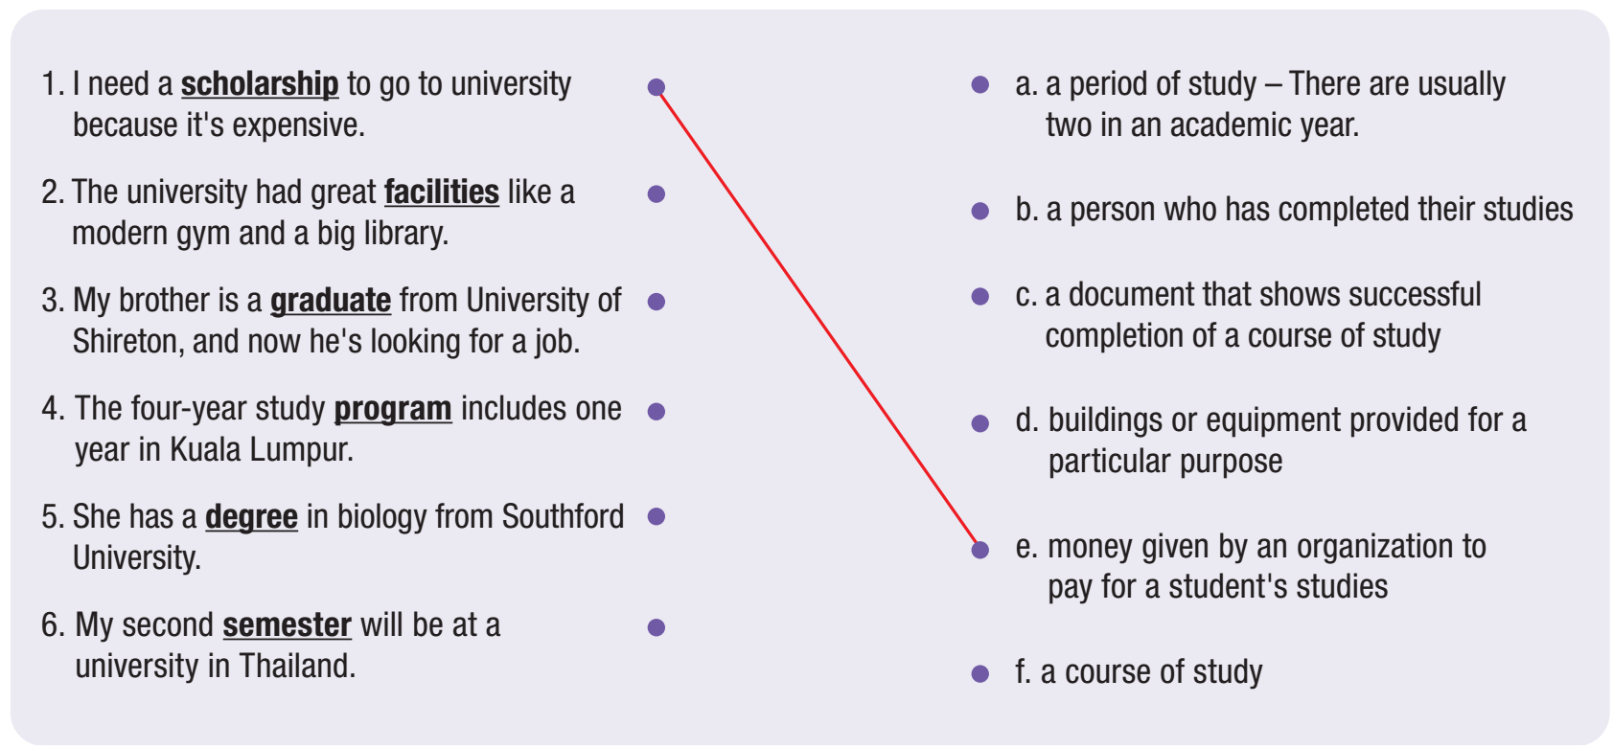

Slide 11


Slide 12
Listen and repeat. Click on each word to hear the sound.
scholarship (n) /ˈskɑːlərʃɪp/ học bổng
facilities (n) /fəˈsɪlətiz/ cơ sở vật chất
graduate (n) /ˈɡrædʒuət/ người đã tốt nghiệp
program (n) /ˈproʊɡræm/ chương trình
degree (n) /dɪˈɡriː/ bằng cấp
semester (n) /səˈmestər/ học kì
Notes:
GV click vào từng cụm nghe âm thanh

Slide 13
Practice saying these words with a partner.
scholarship (n) /ˈskɑːlərʃɪp/ học bổng
facilities (n) /fəˈsɪlətiz/ cơ sở vật chất
graduate (n) /ˈɡrædʒuət/ người đã tốt nghiệp
program (n) /ˈproʊɡræm/ chương trình
degree (n) /dɪˈɡriː/ bằng cấp
semester (n) /səˈmestər/ học kì
Notes:
GV click vào từng cụm nghe âm thanh

Slide 14
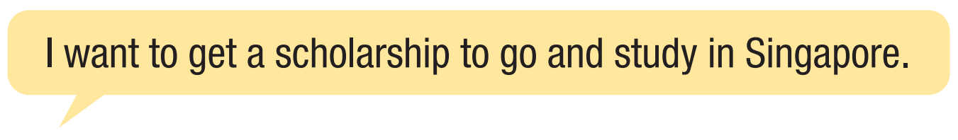

Work in pairs
b. Talk about your future study plans using the new words.

Slide 15



Slide 16
Pre - reading
Read the instruction quickly. Underline the key words.
What are we going to do?
Read and choose Yes or No.

Slide 17
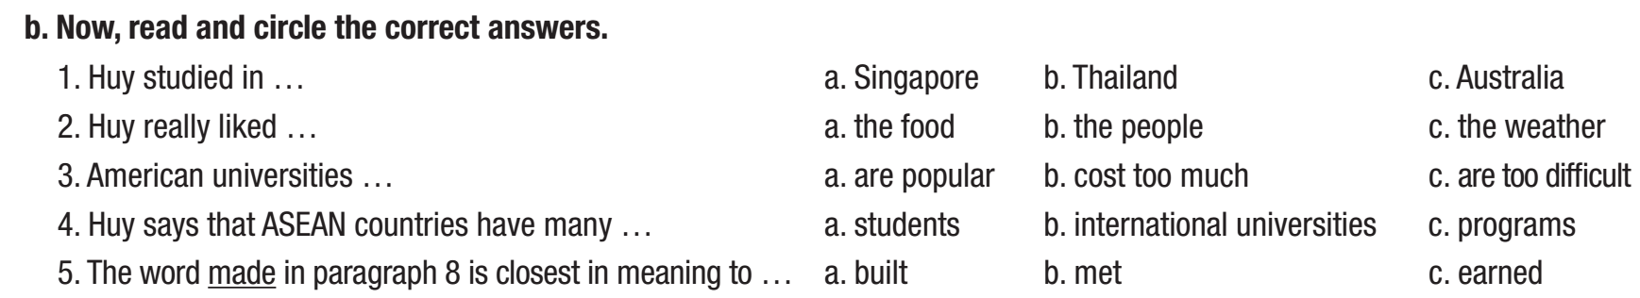
Pre - reading
Read the instruction quickly. Underline the key words.
What are we going to do?
Read and circle the correct answers.

Slide 18
While - Reading

Slide 19
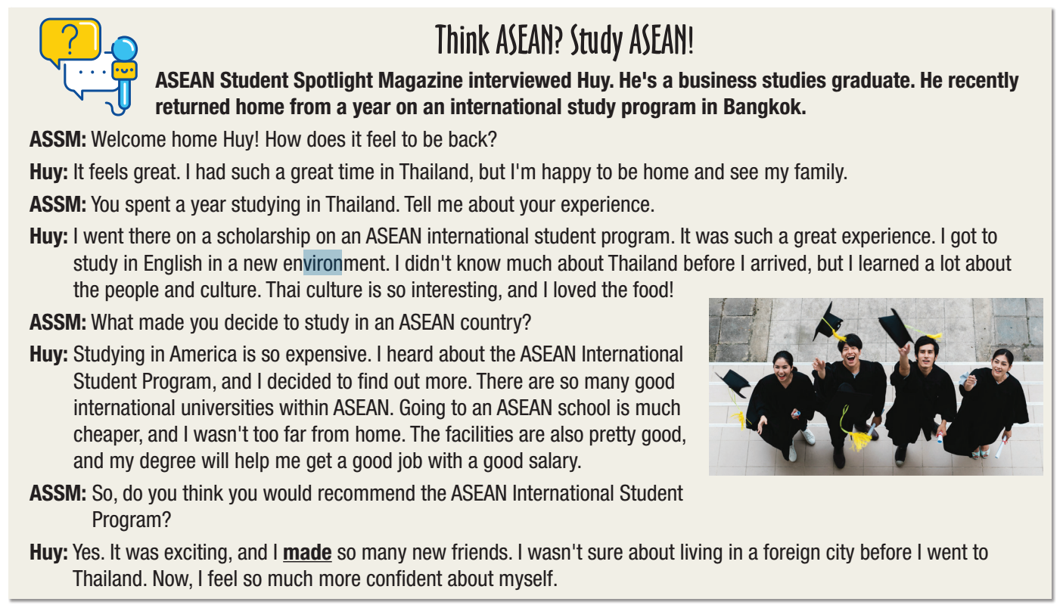
While - reading
Read the magazine interview. Did Huy enjoy living and studying in a foreign country? 1. yes 2. no

Slide 20
While - reading
Read the questions. Highlight the key words.
1. Huy studied in …
Singapore b. Thailand c. Australia
2. Huy really liked …
the food b. the people c. the weather
3. American universities …
are popular b. cost too much c. are too difficult
4. Huy says that ASEAN countries have many …
students b. international universities c. program
5. The word made in paragraph 8 is closest in meaning to …
a. built b. met c. earned

Slide 21
While - reading
Read the questions. Highlight the key words.
1. Huy studied in …
Singapore b. Thailand c. Australia
2. Huy really liked …
the food b. the people c. the weather
3. American universities …
are popular b. cost too much c. are too difficult
4. Huy says that ASEAN countries have many …
students b. international universities c. program
5. The word made in paragraph 8 is closest in meaning to …
a. built b. met c. earned

Slide 22
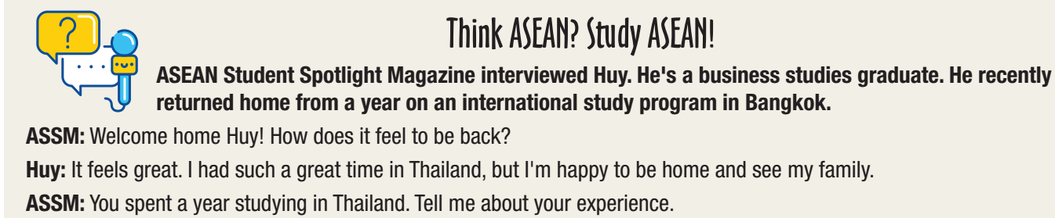
While - reading
Scan the text. Circle the answer.
1. Huy studied in …
Singapore b. Thailand c. Australia

Slide 23
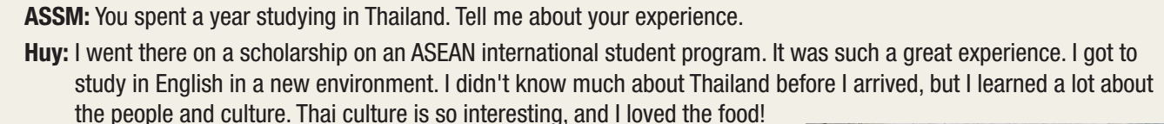
While - reading
Scan the text. Circle the answer.
2. Huy really liked …
the food b. the people c. the weather

Slide 24
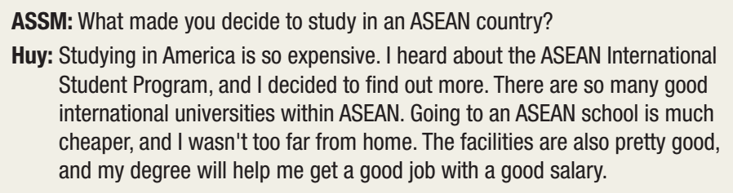
While - reading
Scan the text. Circle the answer.
3. American universities …
are popular b. cost too much c. are too difficult
4. Huy says that ASEAN countries have many …
students b. international universities c. program

Slide 25
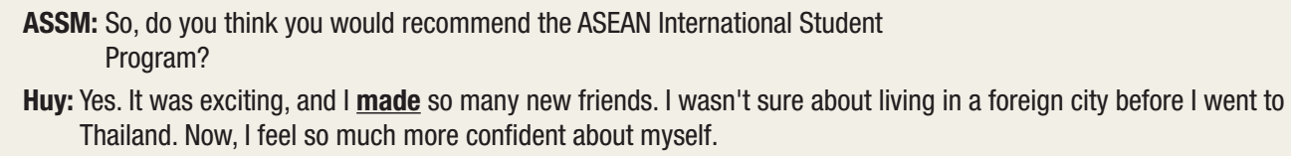
While - reading
Scan the text. Circle the answer.
5. The word made in paragraph 8 is closest in meaning to …
a. built b. met c. earned

Slide 26

While - reading

Slide 27
Post - Reading

Slide 28


Post - reading
c. Work in pairs
What would you like most about living and studying in a
foreign country? Why?

Slide 29

CONSOLIDATION

Slide 30

Name 3 advantages and 3 disadvantages of studying abroad.

Slide 31
Name 3 advantages and 3 disadvantages of studying abroad.
... we may feel lonely
... helps us to be independent.
... costs a lot of money
... gives us new experience.

Slide 32

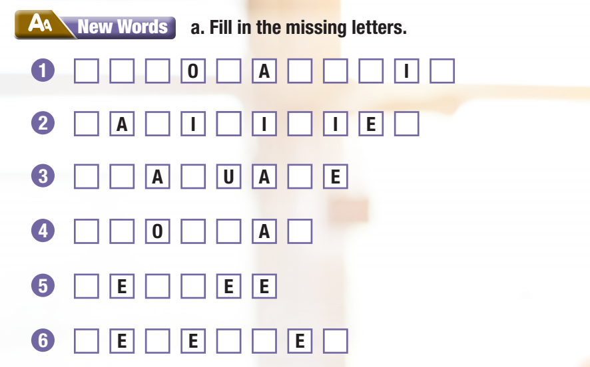
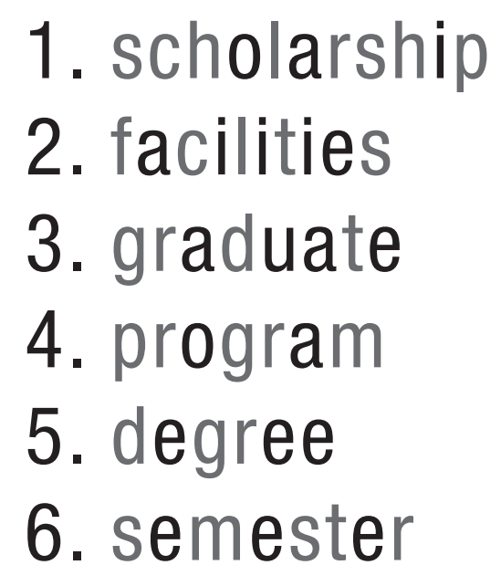
WB – p. 28

Slide 33
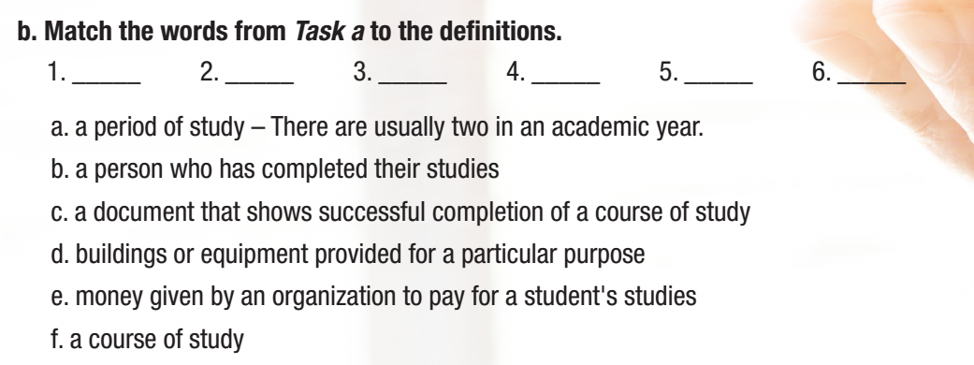
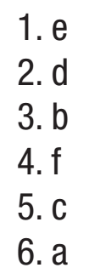
WB – p. 28

Slide 34

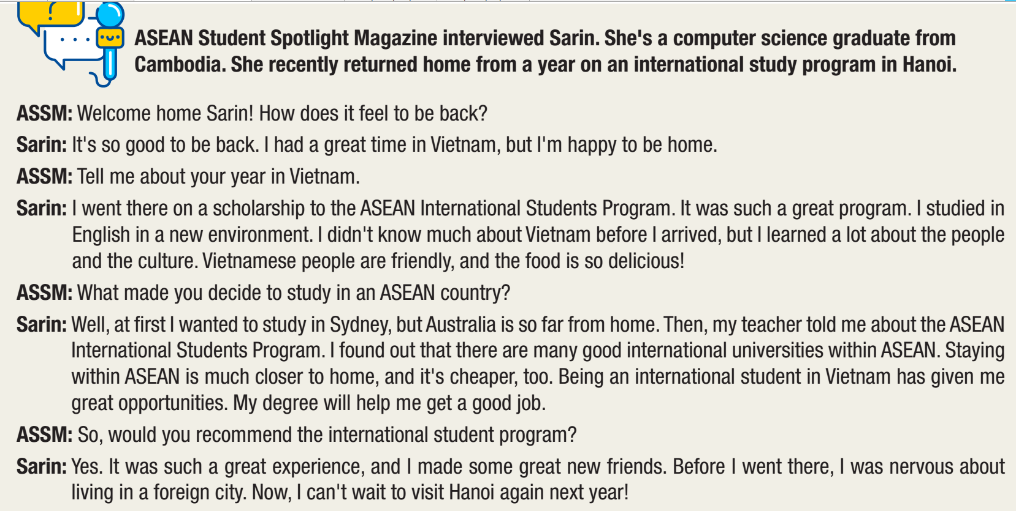
WB – p. 28

Slide 35
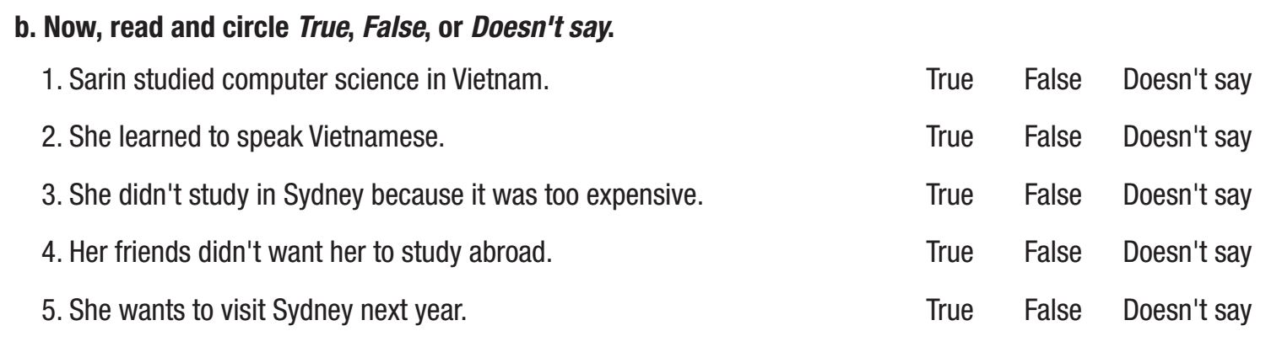
WB – p. 29

Slide 36
WB – p. 28

Slide 37
WB – p. 29

Slide 38

WRAP-UP

Slide 39
Today’s lesson
New words
scholarship
facilities
graduate
program
degree
semester

Slide 40
Today’s lesson
Reading:
- Understanding instructions.
Skimming and scanning for general and specific information.
Speaking:
- Talking about the advantages of living and studying abroad.

Slide 41
Homework
Learn by hearts vocabularies and make sentences using them.
Do the exercises on pages 28 & 29 WB.
Prepare the next lesson (Grammar - pages 51 & 52 SB)
Play the consolidation games on www.eduhome.com.vn

Slide 42

Lesson 3
Stay positive and have a nice day!

