Slide 1

Unit 5: Vietnam & ASEAN
Lesson 1.3: Pronun. & Speaking
Pages: 48 & 49

Slide 2
Lesson Outline
Warm-up
Pronunciation
Speaking
Consolidation
Wrap-up

Slide 3

By the end of this lesson, students will be able to…
practice intonation for WH- questions.
ask and answer questions about ASEAN.
Notes:
To practice and learn vocab. related to a country and its relationship
To practice listening for specific information
To practice functional English (Holding your turn)

Slide 4

WARM UP

Slide 5

Work in pairs.
Choose the word whose main stress is placed
differently from the others.
1. A. agreement B. addiction C. official D. scholarship
2. A. degree B. summit C. network D. founder
3. A. bully B. discuss C. promote D. consume
/əˈɡriːmənt/
/əˈdɪkʃn/
/əˈfɪʃl/
/ˈskɑːlərʃɪp/
/dɪˈɡriː/
/ˈsʌmɪt/
/ˈnetwɜːrk/
/ˈfaʊndər/
/dɪˈskʌs/
/prəˈmoʊt/
/kənˈsuːm/
/ˈbʊli/

Slide 6
Work in pairs.
Choose the word whose underlined part is
pronounced differently from that of the other words.
1. A. impact B. restate C. expand D. practice
2. A. global B. program C. fossil D. protein
3. A. outfit B. license C. lifestyle D. website
/ ɪmˈpækt /
/ˌriːˈsteɪt/
/ɪkˈspænd/
/ˈpræktɪs/
/ˈɡloʊbl/
/ˈproʊɡræm/
/ˈfɑːsl/
/ˈproʊtiːn/
/ˈaʊtfɪt/
/ˈlaɪsns/
/ˈlaɪfstaɪl/
/ˈwebsaɪt/

Slide 7

Work in pairs Take turns asking and answering these questions in 2 minutes.
Did you do anything for fun last night?
What time did you go to bed?

Slide 8
Pay attention to the intonation of each question.
Yes-No question:
Did you do anything for fun last night?
WH- question:
What time did you go to bed?

Slide 9

Presentation

Slide 10
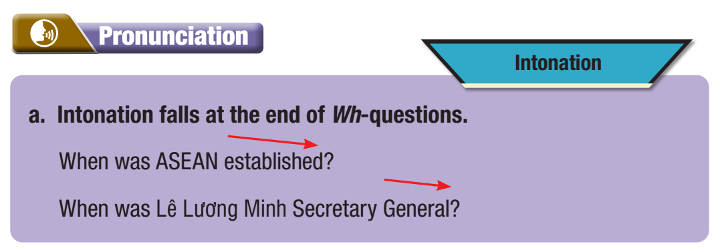
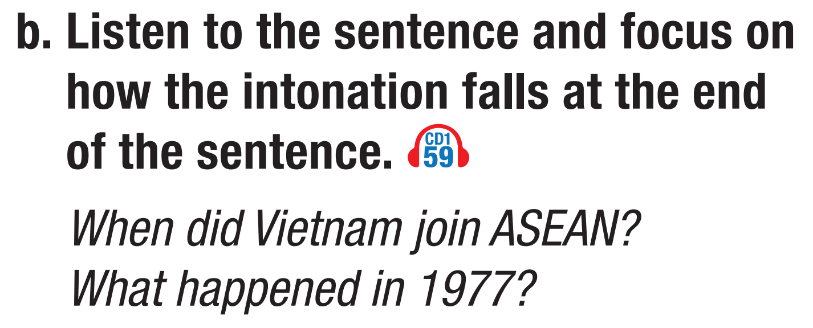


Slide 11
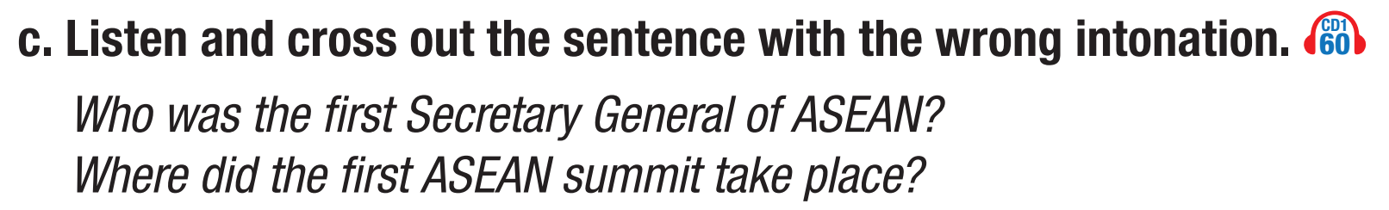


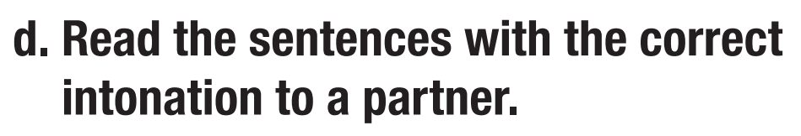

Slide 12
Practice

Slide 13

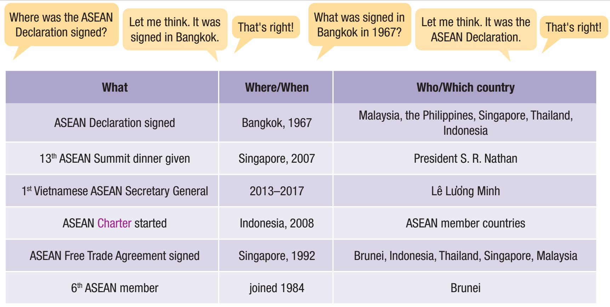
Practice asking and answering questions using the information in the table. Hold your turn if you need time to think.

Slide 14
Which phrases can be used to hold a turn?
A
B
A
B
A
B
Let me think.
Let me see.
Let’s see.
Interesting questions.

Slide 15

Practice asking and answering questions using the information in the table. Hold your turn if you need time to think.

Slide 16
Production

Slide 17

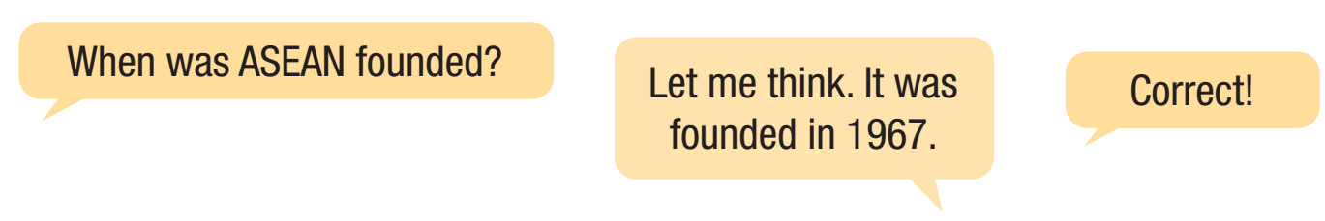

Task a. You're reviewing for an ASEAN Quiz.
In pairs: Use ideas from the lesson or your own knowledge to write five questions about Vietnam and ASEAN.
Then, join another pair. Close your books and take turns asking the questions you wrote.

Slide 18

Task b. In pairs: What's one thing you learned about ASEAN that surprises you?

Slide 19

CONSOLIDATION

Slide 20
In pairs, answer these questions in 1 minute.
Which country joined ASEAN in 1984?
Who gave the 13th ASEAN summit dinner?
Where was ASEAN Charter started?
Brunei.
President S.R. Nathan.
In Indonesia.
In pairs, ask and answer the questions above, focusing on intonation.

Slide 21

WRAP-UP

Slide 22
Today’s lesson
Pronunciation
Speaking

Slide 23


Slide 24
Homework
Do the writing exercise on page 27 WB.
Prepare the next lesson (Vocabulary & Reading pages 50 & 51 SB).
Play the consolidation games on www.eduhome.com.vn.

Slide 25

Lesson 3
Stay positive and have a nice day!

