Slide 1

Unit 5: Vietnam & ASEAN
Lesson 1.2: Grammar
Pages: 47 & 48

Slide 2
Lesson Outline
Warm-up
Grammar
Consolidation
Wrap-up

Slide 3

By the end of this lesson, students will be able to…
learn and use Past tense – WH questions correctly.

Slide 4

WARM UP

Slide 5




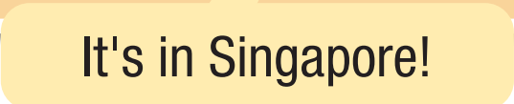
- Look at the picture. What do you think they are saying?
Where did
take place

Slide 6

Presentation

Slide 7



Slide 9

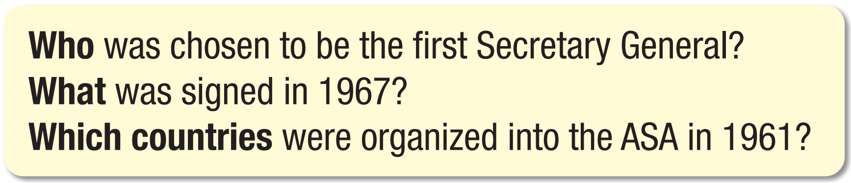
- Are these sentences in the active or passive voice?
- What are the roles of the bolded words in these sentences?
Active:
Subject
Passive:
Subject

Slide 10
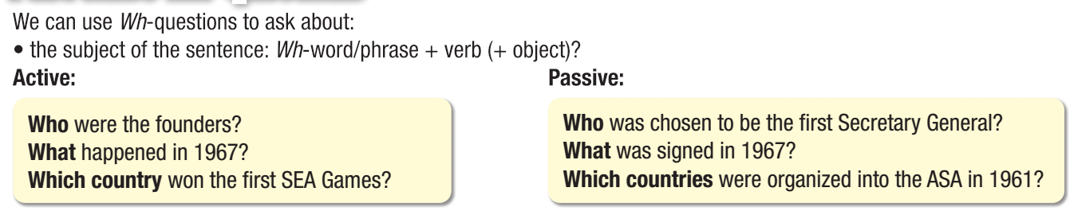

Slide 11


- Are these sentences in the active or passive voice?
- What are the roles of the bolded words in these sentences?
Active:
Adverb
Passive:
Adverb

Slide 12
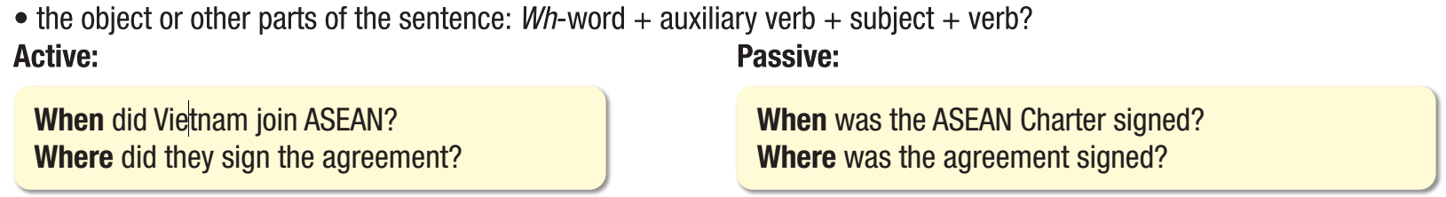

Slide 13

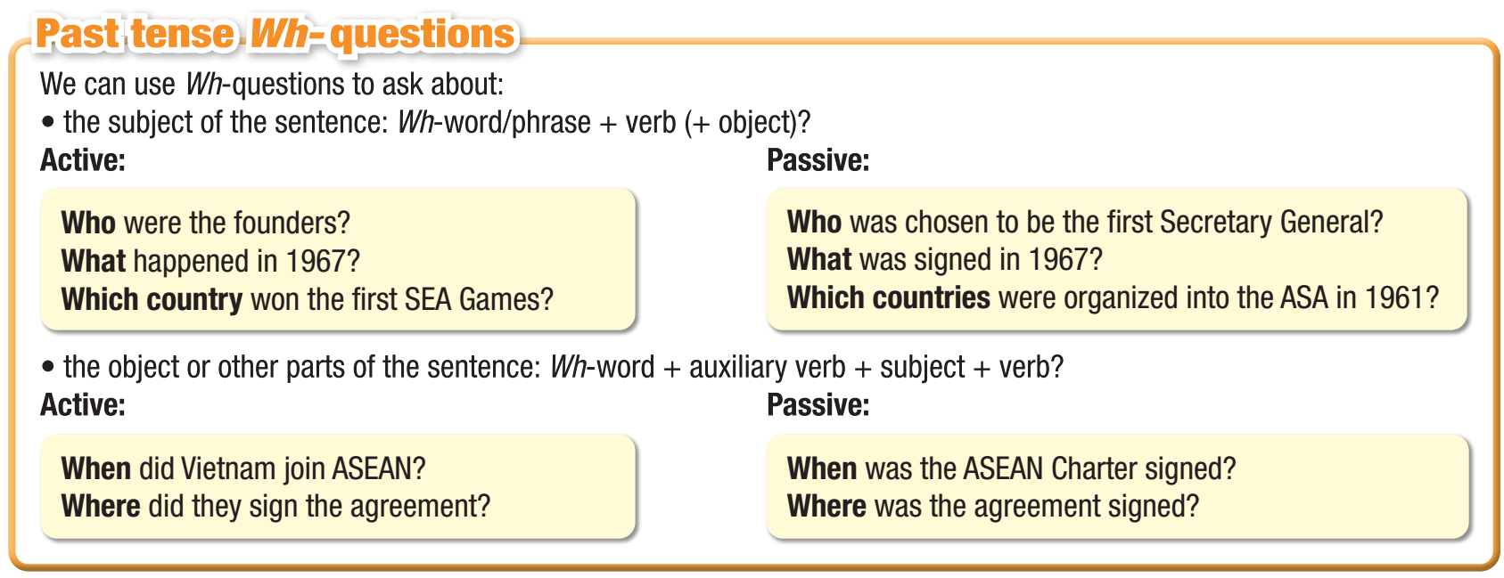

Slide 14
Practice

Slide 15

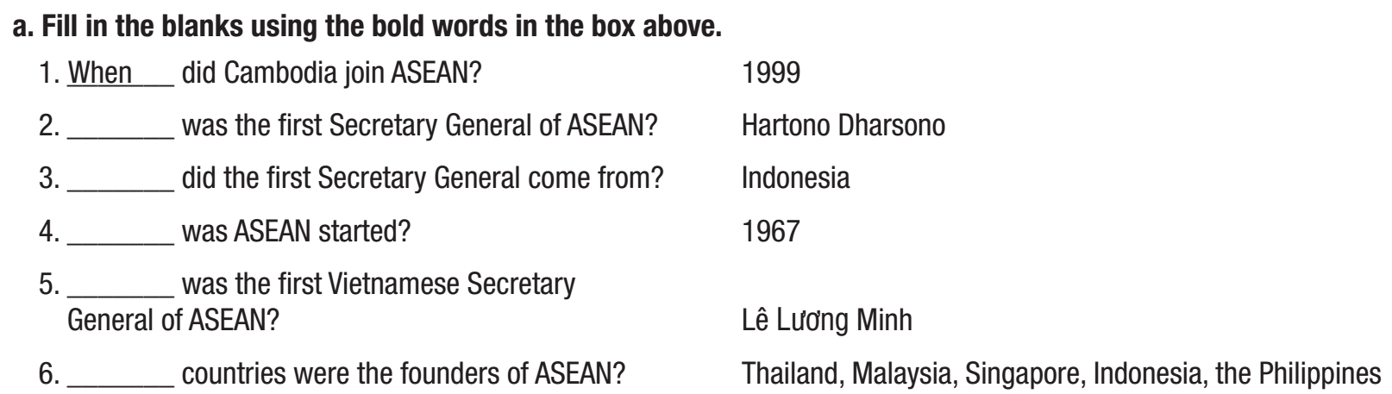
Do this task and work in pairs to check the answers.
Who
Where
When
Who
Which

Slide 16
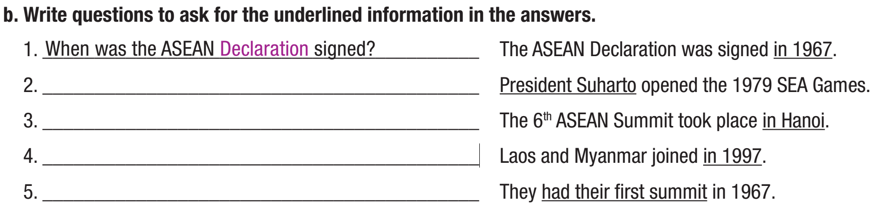
Do this task and work in pairs to check the answers.
Who opened the 1979 SEA Games?
Where did the 6th ASEAN summit take place?
When did Laos and Myanmar join?
What did they have in 1967?

Slide 17
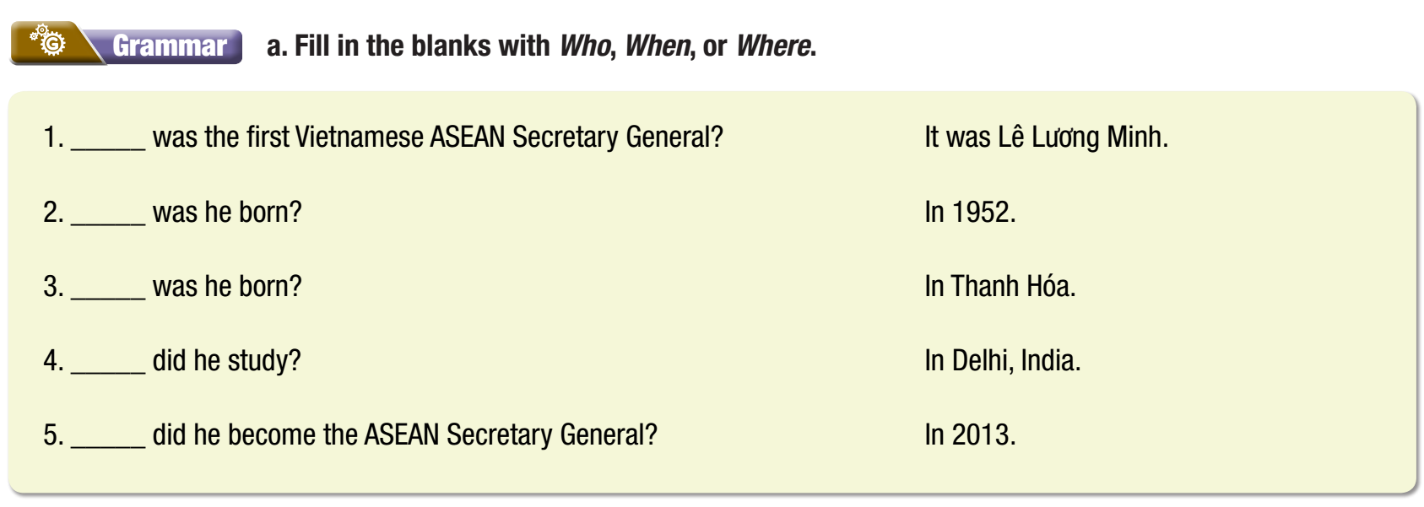
WB p. 27
Who
When
Where
Where
When

Slide 18
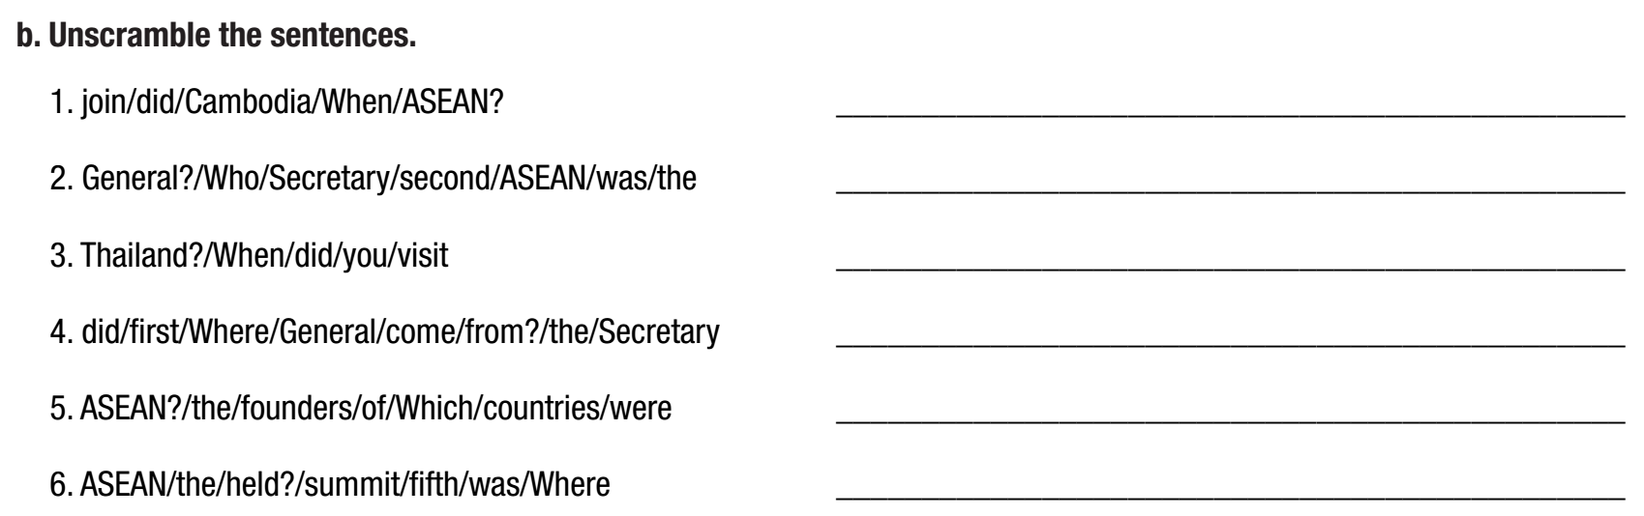
WB p. 27
When did Cambodia join ASEAN?
Who was the second ASEAN Secretary General?
When did you visit Thailand?
Where did the first Secretary General come from?
Which countries were the founders of ASEAN?
Where was the fifth ASEAN summit held?

Slide 19
Production

Slide 20

Work in pairs
Task C . Take turns asking and answering questions about your partner's life.

Slide 21

CONSOLIDATION

Slide 22
Fill in the blanks with the correct words.
______ _____ you born? – In HCMC.
______ _____ you meet last Sunday? – My grandparents.
______ _____ you do your homework? – Last night.
______ _____ given to you on your last birthday? - A teddy bear and a bike.
Where were
Who did
When did
What was/were

Slide 23

WRAP-UP

Slide 24
Today’s lesson

Slide 25
Today’s lesson

Slide 26
Homework
Do the exercises a & b (Grammar) on page 27 WB.
Prepare the next lesson (Pronunciation & Speaking pages 48 & 49 SB).
Play the consolidation games on www.eduhome.com.vn.

Slide 27

Lesson 3
Stay positive and have a nice day!

