Slide 1
Unit 5: Vietnam & ASEAN
Lesson 1.1: Vocab & Listening
Pages: 46 & 47

Slide 2
Lesson Outline
Warm-up
Vocabulary
Listening
Consolidation
Wrap-up

Slide 3
By the end of this lesson, students will be able to…
practice and learn vocabularies related to a country and its relationship.
practice listening for specific information.
practice functional English.

Slide 4
New words
founder
summit
agreement
Secretary General
promote
trade

Slide 5
WARM UP

Slide 7
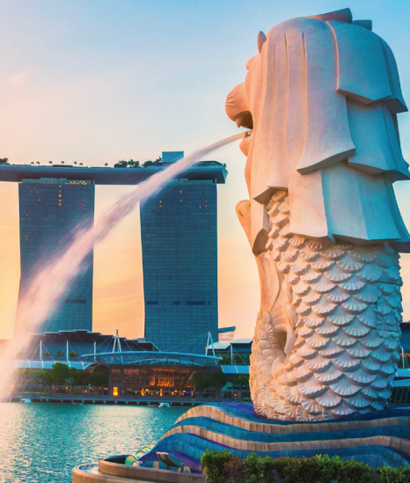
Work in pairs
1. Can you name the different ASEAN (Association of Southeast Asian Nations) countries shown in the picture?
2. Which ASEAN country would you like to visit? Why?

Slide 8
Pre-Listening

Slide 10
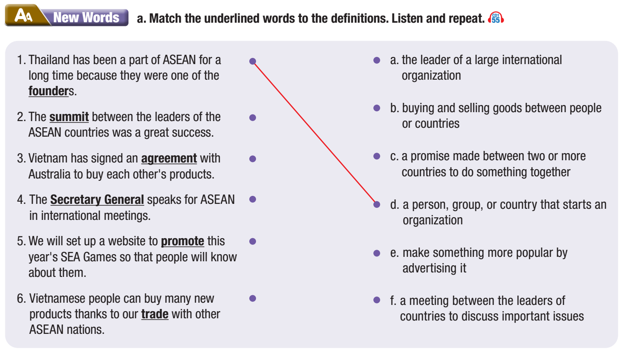

Slide 12
Listen and repeat. Click on each word to hear the sound.
founder (n) /ˈfaʊndər/ người sáng lập
summit (n) /ˈsʌmɪt/ hội nghị cấp cao, hội nghị thượng đỉnh
agreement (n) /əˈɡriːmənt/ sự thỏa thuận, hiệp định
Secretary General (n) /ˌsekrəteri ˈdʒenərəl/ Tổng thư kí
promote (v) /prəˈmoʊt/ quảng bá
trade (n) /treid/ thương mại, mậu dịch
Notes:
GV click vào từng cụm nghe âm thanh

Slide 13
Practice saying these words with a partner.
founder (n) /ˈfaʊndər/ người sáng lập
summit (n) /ˈsʌmɪt/ hội nghị cấp cao, hội nghị thượng đỉnh
agreement (n) /əˈɡriːmənt/ sự thỏa thuận, hiệp định
Secretary General (n) /ˌsekrəteri ˈdʒenərəl/ Tổng thư kí
promote (v) /prəˈmoʊt/ quảng bá
trade (n) /treid/ thương mại, mậu dịch
Notes:
GV click vào từng cụm nghe âm thanh

Slide 14
Work in pairs
b. Use the new words to talk about something you’ve learned in history class.

Slide 16
Pre – Listening
Read the instruction quickly. Underline the key words.
What are we going to do?
Listen and decide the speakers.

Slide 17
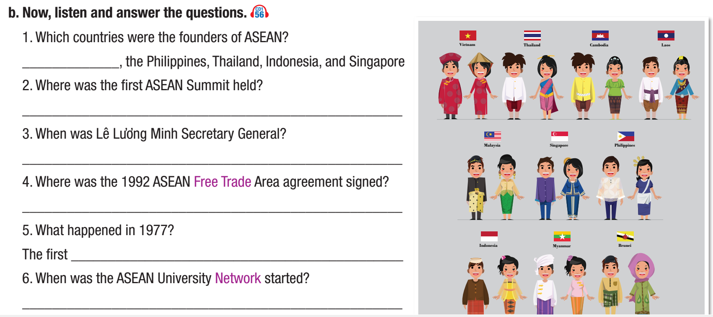
Pre – Listening
Read the instruction quickly. Underline the key words.
What are we going to do?
Listen and answer the questions.

Slide 18
Pre – Listening
Skim the questions and underline the key words.

Slide 19
While-Listening

Slide 20
While– Listening

Slide 21
While– Listening
Malaysia
Indonesia
2013-2017
Singapore
SEA Games
1995

Slide 22
Listen and repeat.
To give yourself time to think of an answer to a question.

Slide 23
Post-Listening

Slide 24
Post - listening
Work in pairs
Who knows more about ASEAN, Lin or Tuấn? Why?

Slide 25
Tuân: So what have you found out about ASEAN for our project, Lin?
Lin: I looked at the history of ASEAN. It was started in 1967.
Tuân: Which countries were the first members?
Lin: Malaysia, the Philippines, Thailand, Indonesia, and Singapore.
Tuân: So they had their first summit in 1967?
Lin: No. That was in 1976.
Tuân: Where was it held?
Lin: In Indonesia.
Tuân: I'm sure our teacher's going to ask if ASEAN has had a Vietnamese Secretary General.
Lin: There was a Vietnamese Secretary General. His name is Lê Lương Minh.
Tuân: Yep. Do you know when he was Secretary General?
Lin: Let me think … Ah, of course, it was from 2013 to 2017. What did you find out?
Listening scripts

Slide 26
Tuân: I looked at what ASEAN does to help its members.
Lin: So, what does ASEAN do?
Tuân: ASEAN helps its members' economies through the ASEAN Free Trade Area agreement. It was signed
in Singapore in 1992. It also organizes sporting events like the SEA Games.
Lin: When were the first SEA Games held?
Tuân: The first SEA Games were held in Malaysia in 1977. ASEAN also does a lot for young people.
Lin: What do they do?
Tuân: ASEAN creates chances for young people to travel and study. And ASEAN exchange students can go to different countries in the region. The ASEAN University Network was started in 1995.
Lin: I think we both have enough here to make a good project about ASEAN, Tuân.
Tuân: Me too, Lin!

Slide 27
CONSOLIDATION

Slide 28
- Name at least 5 countries that are ASEAN members.
- What does ASEAN do to help its members?

Slide 29
WRAP-UP

Slide 30
Today’s lesson
Vocabularies
founder
summit
agreement
Secretary General
promote
trade

Slide 31
Today’s lesson
Vocabulary:
- Practicing vocabularies related to a country and its relationship.
Listening:
- Listening to a discussion about the history of ASEAN.

Slide 32
Homework
Learn by hearts vocabularies and make sentences using them.
Do the exercises on page 26 WB.
Prepare the next lesson (Grammar pages 47 & 48 SB)
Play the consolidation games on www.eduhome.com.vn

Slide 33
Lesson 3
Stay positive and have a nice day!

