Slide 1
Unit 4: Global Warming
Lesson 3.2: Speaking & Writing
Page: 45

Slide 2
Lesson Outline
Warm-up
Speaking
Writing
Consolidation
Wrap-up

Slide 3
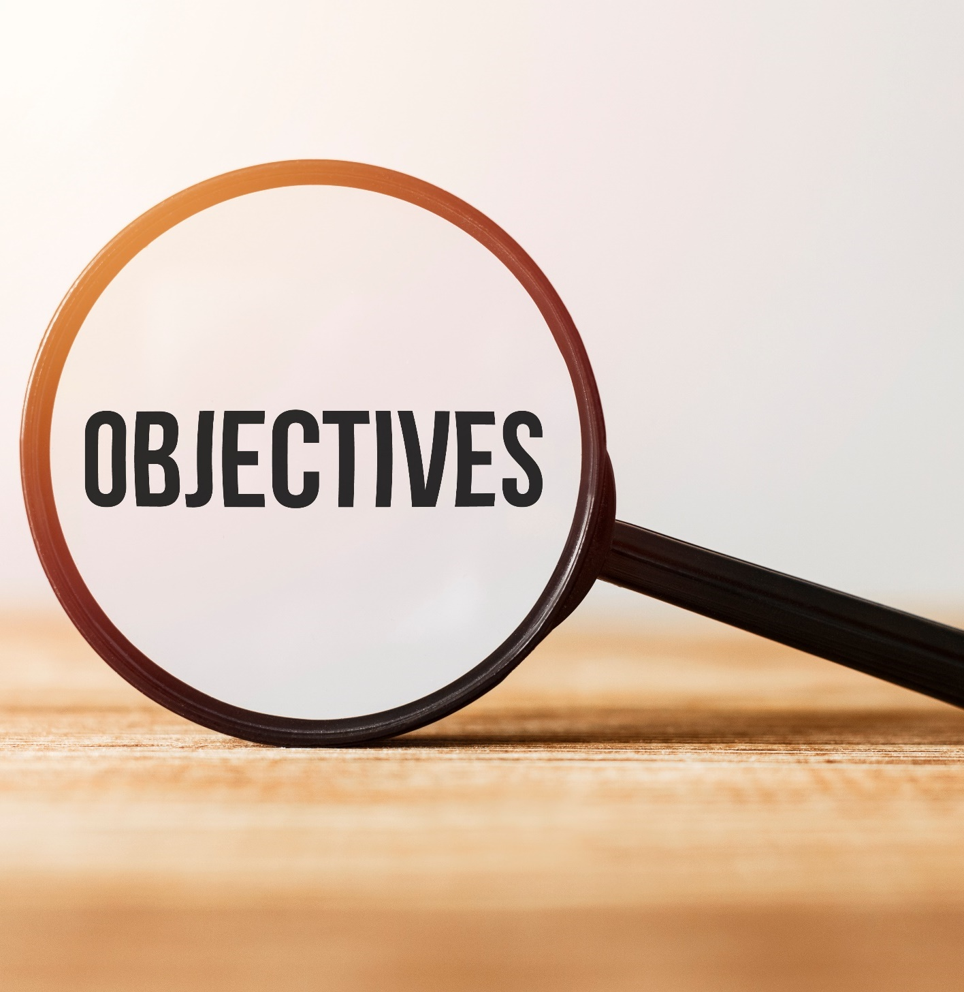
By the end of this lesson, students will be able to…
- practice writing a letter using indirect questions.
- practice speaking about global warming using indirect questions.

Slide 4
WARM UP

Slide 5
Watch the video. Answer the questions.
1. Read this question: “Where is the restroom?”. This is a direct/ indirect question.
2. What is the indirect question of the question in 1?
_____ you tell me _____ the restroom ____?
3. An indirect question has one/two/three parts.
Can
where
is

Slide 6
Watch the video. Answer the questions. https://www.youtube.com/watch?v=2wxVdehE-m0
4. ‘Could you tell me’ is the first/ second part.
5. In indirect questions, the verb in part two is always the _______.
6. An indirect question is more formal/ informal.
end

Slide 7
Writing

Slide 9
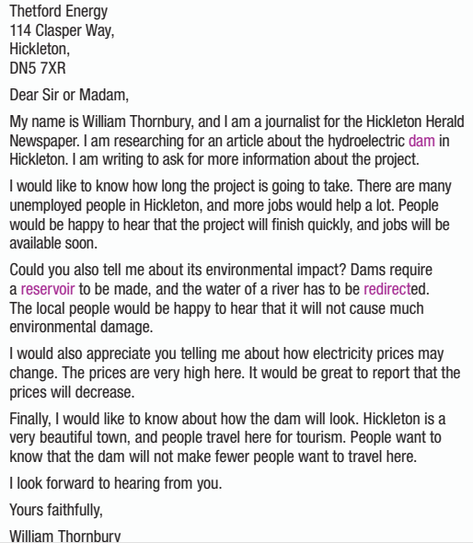

Slide 10
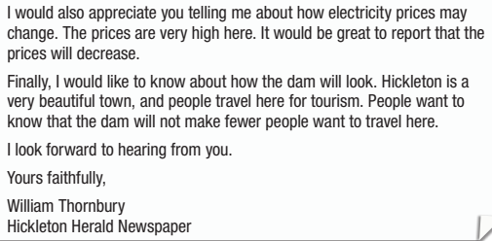

Slide 11
b. Rewrite the questions to be indirect using the prompts.
How long will the project take?
I would be interested in knowing how long the project will take.
2. What will the wind farm look like? Would you mind telling me what the wind farm will look like?
3. Will electricity prices decrease? Could you tell me whether electricity prices will decrease?
4. Will the power plant make a lot of noise? I was wondering whether the power plant will make a lot of noise.
5. How much pollution will it create?
I would like to know how much pollution it will create.

Slide 12
Speaking

Slide 13
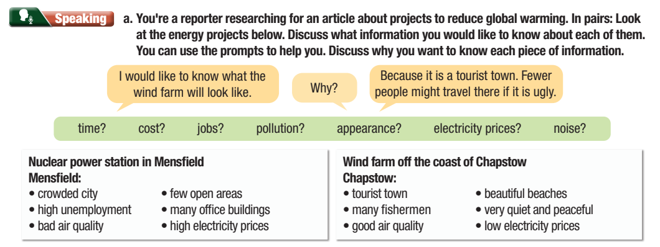

Slide 15
Writing

Slide 16
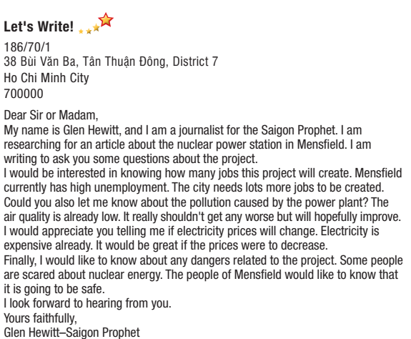
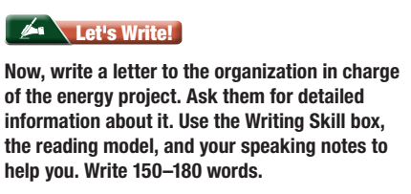

Slide 17
CONSOLIDATION

Slide 18
Workbook - Extra practice Page 25

Slide 19
Workbook- Extra practice Page 25
Will energy prices change?
I would like to know if energy prices will change.
2. Where will the plant be built?
Would you mind telling me where the plant will be built?
3. Is the project going to create a lot of jobs?
Could you tell me if the project is going to create a lot of jobs?

Slide 20
Workbook- Extra practice Page 25
4. Is the project going to create traffic jams in the city?
I was wondering whether the project is going to create traffic jams in the city.
5. What are the dangers of this type of energy?
I would be interested in learning about the dangers of this type of energy.

Slide 21
WRAP-UP

Slide 22
Today’s lesson
Writing:
Writing an email about an energy project using indirect questions.
Speaking:
- Asking and answering about an energy project using indirect questions.

Slide 23
Homework
Do the exercises on page 25 WB.
Prepare the next lesson (Vocabulary & Reading pages 46 & 47 SB)
Play the consolidation games on www.eduhome.com.vn

Slide 24
Lesson 3
Stay positive and have a nice day!

