Slide 1
Unit 4: Global Warming
Lesson 3.1: Reading & Listening
Page: 44

Slide 2
Lesson Outline
Warm-up
Reading
Listening
Consolidation
Wrap-up

Slide 3
By the end of this lesson, students will be able to…
- learn vocabulary words related to global warming.
- practice listening and reading for gist and specific information about the topic of global warming.

Slide 4
WARM UP

Slide 5
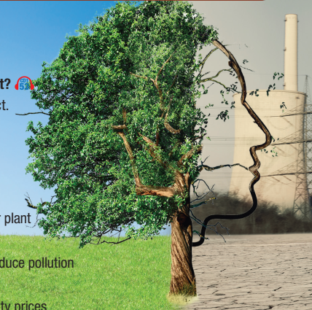
Look at the picture. What can you see in the picture?
What can we do to stop that from happening?

Slide 6
Vocabulary

Slide 7
Match the sustainable energy sources/ projects to the pictures.
1. | 2. | 3. | 4. | 5.
a. | b. | c. | d. | e.
hydroelectric dam | nuclear power plant | Solar panel | coal power plant | wind farm

Slide 8
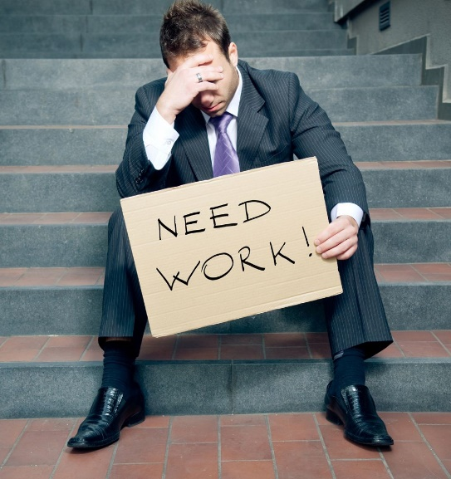
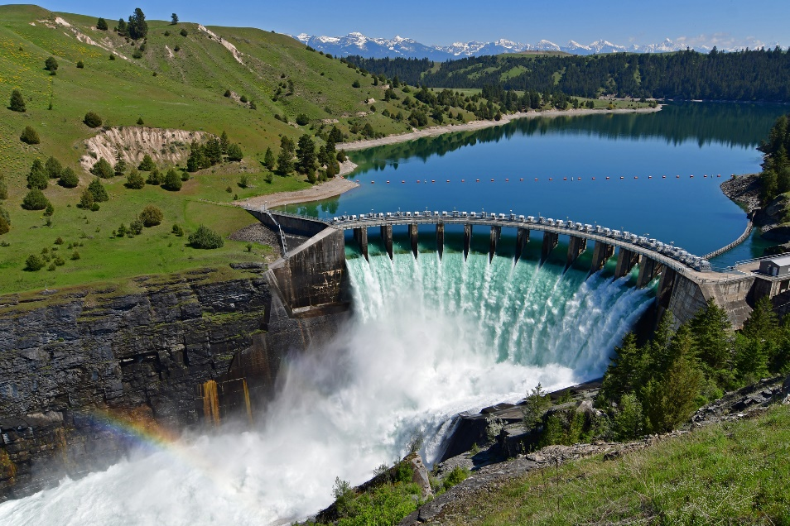
Listen and repeat.
unemployment (n) /ˌʌnɪmˈplɔɪmənt/ sự thất nghiệp
dam (n) /dæm/ đập nước
Notes:
NOTE: Không có file âm thanh của các từ

Slide 9
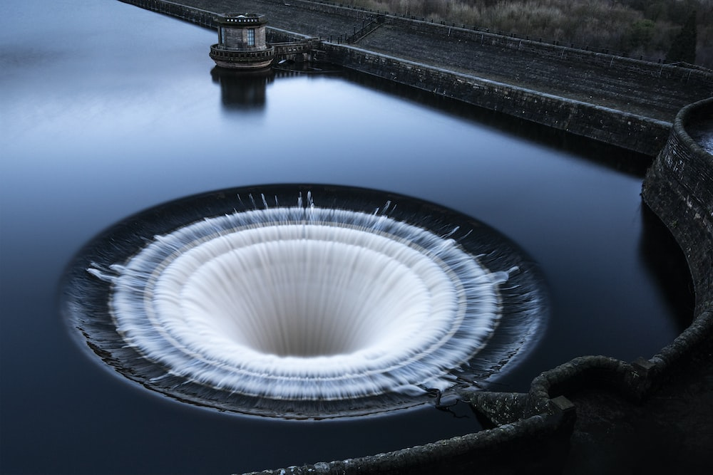
Listen and repeat.
reservoir (n) /ˈrezərvwɑːr/ hồ chứa nước
redirect (n) /ˌriːdaɪˈrekt/ chuyển hướng
Notes:
NOTE: Không có file âm thanh của các từ

Slide 10
Listening

Slide 11
Pre-Listening
Read the questions. What are you going to do?
Listen and identify specific ideas
Listen and identify main idea

Slide 12
Read the questions. Underline the key words.

Slide 13
While listening

Slide 14
M: Welcome back. I'm here talking to Emma Issions about the new nuclear power plant project.
W: Hello.
M: So Emma, most people think the power plant is a great thing. What do you think?
W: I don't think people know enough about it.
M: Oh?
W: We have been told how it will reduce pollution and reduce electricity prices, which is a great thing, but, there is so much more.
M: I see.
W: People need to know how long the project is going to take.
M: OK.
W: It may reduce pollution but when will it start to help? They also need to know how many jobs the project will create. There are lots of unemployed people in this area. Is the project going to create enough jobs for the local people?
M: Hmm, yes, very interesting. What else?
W: They need to think about how the project will affect the roads and transport. A lot of materials will need to be moved around the city. I worry that it will create traffic jams. Will people be late for work? These things are important.
M: Yes, they are.
W: And what about the dangers? We have all heard of nuclear power and know it can be dangerous. Are we safe having this nuclear power station so close to us?
M: Some very good points. That's all we have time for. Thanks for joining us, Emma.
W: Thank you.

Slide 15
Post-listening
c. In pairs: How would you feel if this type of energy source was being built in your country? Why?

Slide 16
Reading

Slide 17
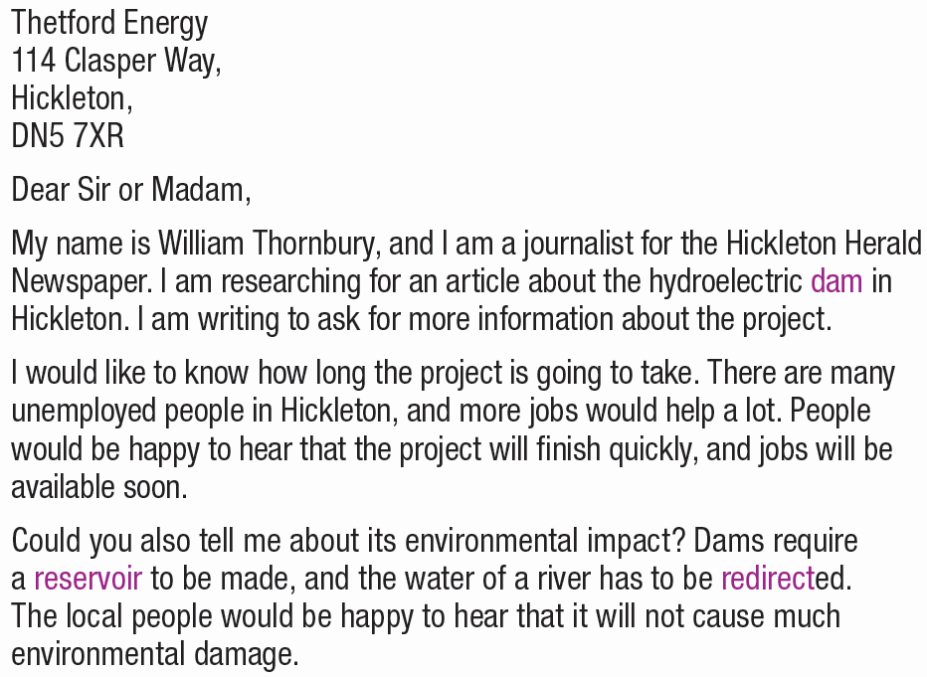
Pre-Reading
Read William’s letter and underline his questions.

Slide 18
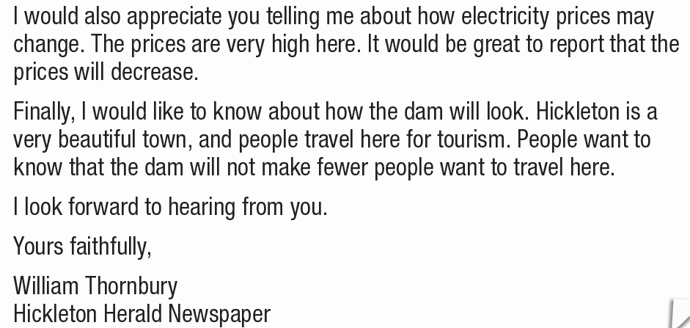

Slide 19
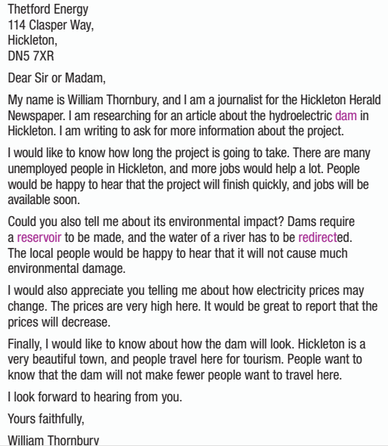
While-Reading
a. Read William’s letter. Who is the letter to?
a newspaper
an organization building a dam
an environmental charity

Slide 20
b. Read and answer the questions.
1. What is William writing an article about?
The hydroelectric dam in Hickleton.
2. Why do local people want the project to be completed quickly?
Because more jobs will be available.

Slide 21
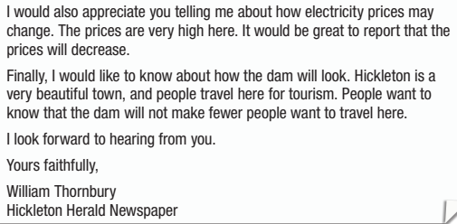
b. Read and answer the questions.
3. What needs to be made above the dam?
A reservoir
4. What are energy prices like in Hickleton?
Very high

Slide 22
b. Read and answer the questions.
5. Why do people want the dam to look nice?
Because people still want to travel to Hickleton.
6. According to William's letter, what
conclusion can be drawn about Hickleton?
a. Most people there are rich.
b. The town's people have many questions about the new dam.
c. Not many tourists come to visit Hickleton.
d. There are plenty of jobs available there

Slide 23
Post-Reading

Slide 25
WRAP-UP

Slide 26
Today’s lesson
Vocabularies
unemployment
dam
reservoir
redirect.

Slide 27
Today’s lesson
Reading:
- Understanding instructions.
Reading for main idea and specific information.
Listening:
- Listening for main idea and specific information.

Slide 28
Homework
Learn by hearts vocabularies and make sentences using them.
Do the exercises on page 24 WB.
Prepare the next lesson (Writing & Speaking page 45 SB)
Play the consolidation games on www.eduhome.com.vn

Slide 29
Lesson 3
Stay positive and have a nice day!

