Slide 1

Unit 4: Global Warming
Lesson: 2.3. Pronun. & Speaking
Pages: 42 & 43

Slide 2
Lesson Outline
Warm-up
Pronunciation
Speaking
Consolidation
Wrap-up

Slide 3

By the end of this lesson, students will be able to…
- practice the /lz/ sound.
- practice pronouncing vocabulary in the conversation.
- practice speaking about global warming solutions.

Slide 4

WARM UP

Slide 5
Unscramble the sentences
should/ turn off/ We/ lights. / the/
We should turn off the lights.
2. prohibit/ Governments/ cars. / should/
Governments should prohibit cars.
3. more/ Factories/ energy. / sustainable/ consume/ should/
Factories should consume more sustainable energy.
Presentation
4. plant/ trees/ Farmers/ should/ more. /
Farmers should plant more trees.

Slide 6

Pronunciation

Slide 7

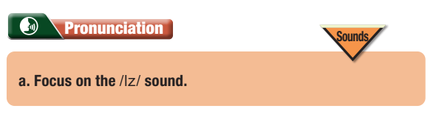
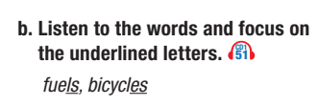

Slide 8
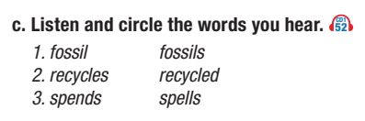


Slide 9

Speaking

Slide 10
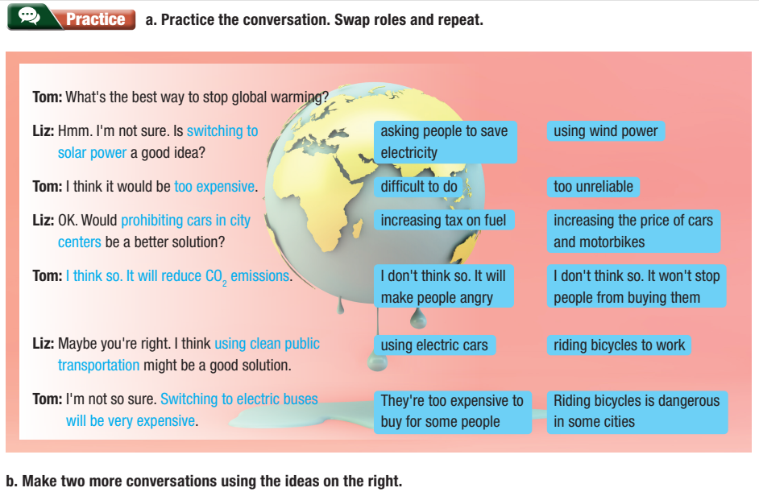

Slide 11
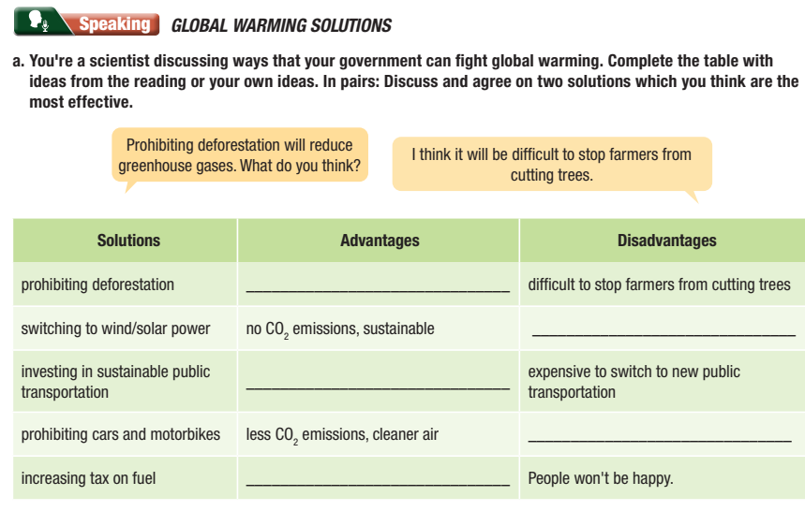
Prohibiting deforestation will reduce greenhouse gases. What do you think?
I think t will be difficult to stop farmers from cutting trees.

Slide 12
b. Join another pair and compare your choices. Did you choose the same
solutions? Why (not)?

Slide 13
Further Practice

Slide 14

Work in pairs.
Choose the word whose underlined part is
pronounced differently from that of the other words.
1. A. outfits B. biofuels C. outskirts D. jackets
2. A. avoids B. affords C. invests D. ignores
3. A. raised B. played C. scared D. cooked
/ˈaʊtfɪts/
/ˈbaɪoʊˌfjuːəlz/
/ˈaʊtskɜːrts/
/ˈdʒækɪts/
/əˈvɔɪdz/
/əˈfɔːrdz/
/ɪnˈvests/
/ɪɡˈnɔːrz/
/reɪzd/
/pleɪd/
/skerd/
/kʊkt/

Slide 15
Work in pairs.
Choose the word whose underlined part is
pronounced differently from that of the other words.
1. A. hosts B. risks C. spears D. lacks
2. A. allows B. limits C. respects D. restates
3. A. bullied B. removed C. switched D. consumed
/hoʊsts/
/rɪsks/
/spɪrz/
/læks/
/əˈlaʊz/
/ˈlɪmɪts/
/rɪˈspekts/
/riˈsteɪts/
/ˈbʊlid/
/riˈmuvd/
/swɪʧt/
/kənˈsuːmd/

Slide 16
Work in pairs.
Choose the word whose main stress is placed
differently from the others.
A. manage B. focus C. consume D. happen
A. lifestyle B. protein C. fitness D. dessert
3. A. influence B. survival C. skyscraper D. reservoir
/ˈmænɪdʒ/
/ˈfoʊkəs/
/kənˈsuːm/
/ˈhæpən/
/ˈlaɪfstaɪl/
/ˈproʊtiːn/
/ˈfɪtnəs/
/dɪˈzɜːrt/
/ˈɪnfluəns/
/sərˈvaɪvəl/
/ˈskaɪskreɪpər/
/ˈrezərvwɑːr/

Slide 17

WRAP-UP

Slide 18
Lesson 3
Today’s lesson
- The pronunciation of the /lz/ sound.
- Talking about what we can do to stop global warming.

Slide 19
Lesson 3
Homework
Practice the pronunciation of the /lz/ sound.
Prepare the next lesson 3.1. Reading & Listening (page 44 SB)
Play the consolidation games on www.eduhome.com.vn

Slide 20

Lesson 3
Stay positive and have a nice day!

