Slide 1

Unit 4: Global warming
Lesson 2.1: Vocab. & Reading
Pages: 40 & 41

Slide 2
Lesson Outline
Warm-up
Vocabulary
Reading
Consolidation
Wrap-up

Slide 3

By the end of this lesson, students will be able to…
learn and use the vocabulary words that related to Global warming.
practice reading and understanding general and specific information about global warming.

Slide 4

New words
biofuel, consume, law, natural, prohibit, remove, sustainable, switch, tax

Slide 5

WARM UP

Slide 6


Slide 7

Pre-Reading Vocabulary

Slide 8
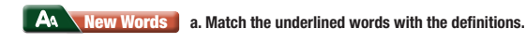
1. Governments should prohibit farmers from destroying forests to step deforestation. | a. Use something, usually in large amounts
2. We can switch from oil to solar power. | b. Energy made from living things
3. Governments should increase the tax on gas to make it more expensive. | c. Part of the money that we earn or spend, which goes to the government
4. Biofuels are much cleaner than fossil fuels. | d. Stop something by using a rule or law
5. If we continue consume fossil fuels, global warming will get worse. | e. Change to something different
6. Wind and solar energy are more sustainable than fossil fuels. | f. Using natural products and energy that doesn’t damage the environment

Slide 9

Listen and repeat. Click each word to hear the sound.
Practice saying these words with a partner.
biofuel (n) /ˈbaɪoʊˌfjuːəl/ nhiên liệu sinh học
consume(v) /kənˈsuːm/ tiêu thụ
prohibit (v) /prəˈhɪbɪt/ (prəʊˈhɪbɪt) cấm
sustainable (adj) /səˈsteɪnəbl/ bền vững
switch (v) /swɪtʃ/ chuyển, thay đổi
tax (n) /tæks/ thuế
Notes:
GV click vào từng cụm nghe âm thanh

Slide 10
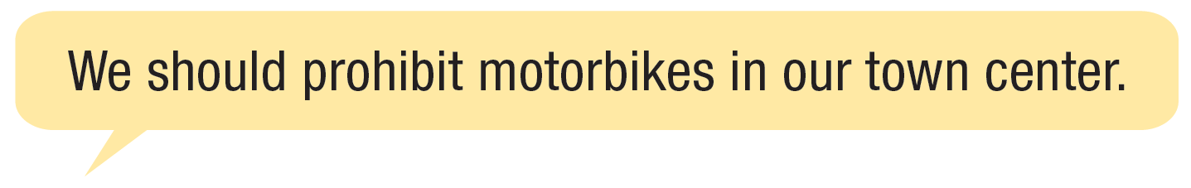

b. In pairs: talk about things that can be done to help the environment where you live.

Slide 11

Reading

Slide 12
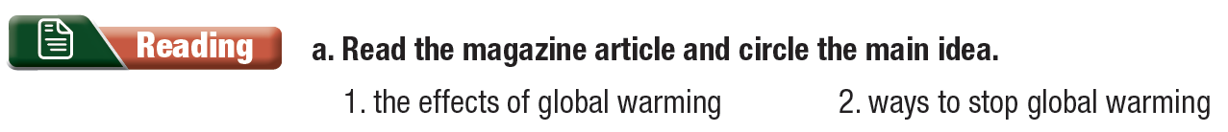
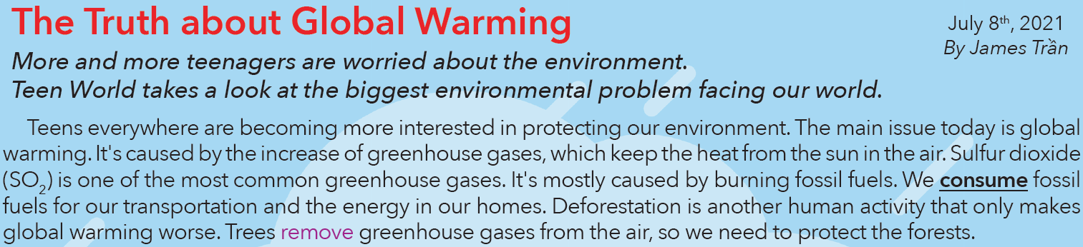
Read & underline the key words.
Pre-reading

Slide 13
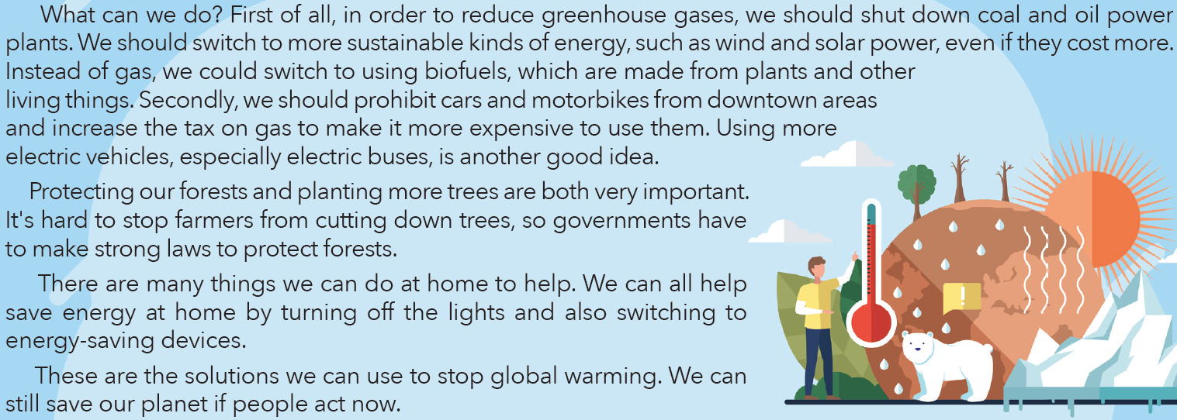

Slide 14

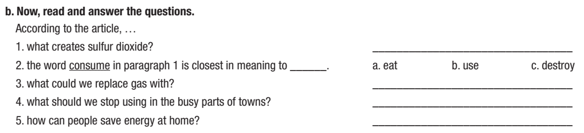
While-reading
Read & answer the questions
Burning fossil fuels
biofuels
cars and motorbikes
by turning off the lights

Slide 15

Post-reading
c. Listen and read
d. In pairs: do you remember to switch off the lights? How else do you save electricity?

Slide 16

CONSOLIDATION

Slide 17
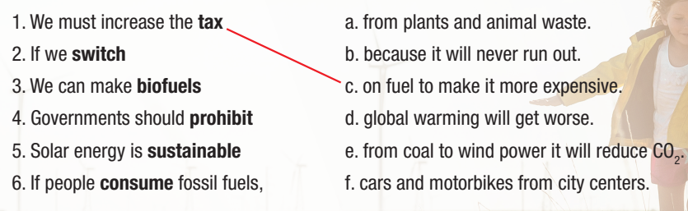
Workbook page 22: a. Read and match to make sentences.

Slide 18

WRAP-UP

Slide 19
Today’s lesson
Vocabularies
biofuel, consume, law, natural, prohibit, remove, sustainable, switch, tax

Slide 20
Today’s lesson
Reading:
- Understanding instructions.
Skimming and scanning for general and specific information.
Speaking:
- Talking about ways to stop global warming.

Slide 21
Homework
Learn by hearts vocabularies and make sentences using them.
Do the exercises on page 22 WB.
Prepare the next lesson (pages 41 & 42 SB)
Play the consolidation games on www.eduhome.com.vn

Slide 22

Lesson 3
Stay positive and have a nice day!

