Slide 1

Unit 4: Global Warming
Lesson 1.3. Pronun. & Speaking
Pages: 38 & 39

Slide 2
Lesson Outline
Warm-up
Pronunciation
Speaking
Consolidation
Wrap-up

Slide 3

By the end of this lesson, students will be able to…
- practice word stress for two-syllable words.
- practice pronouncing vocabulary in the conversation.
- practice speaking about global warming.

Slide 4

WARM UP

Slide 5

Work in pairs.
Choose the word whose underlined part is
pronounced differently from that of the other words.
1. A. fossil B. sugar C. seaside D. summer
2. A. emission B. email C. easy D. eastern
3. A. order B. month C. tonne D. done
/ˈfɑːsl/
/ˈʃʊɡər/
/ˈsiːsaɪd/
/ˈsʌmər/
/ˈiːmeɪl/
/ˈiːzi/
/ˈiːstərn/
/ɪˈmɪʃn/
/ˈɔːrdər/
/mʌnθ/
/tʌn/
/dʌn/

Slide 6
Work in pairs.
Choose the word whose main stress is placed
differently from the others.
1. A. agreement B. addiction C. official D. scholarship
2. A. degree B. summit C. network D. founder
3. A. bully B. discuss C. promote D. consume
/əˈɡriːmənt/
/əˈdɪkʃn/
/əˈfɪʃl/
/ˈskɑːlərʃɪp/
/dɪˈɡriː/
/ˈsʌmɪt/
/ˈnetwɜːrk/
/ˈfaʊndər/
/ˈbʊli/
/dɪˈskʌs/
/prəˈmoʊt/
/kənˈsuːm/

Slide 7
Work in pairs.
Choose the word whose underlined part is
pronounced differently from that of the other words.
1. A. impact B. restate C. expand D. practice
2. A. global B. program C. fossil D. protein
3. A. outfit B. license C. lifestyle D. website
/ ɪmˈpækt /
/ˌriːˈsteɪt/
/ɪkˈspænd/
/ˈpræktɪs/
/ˈɡloʊbl/
/ˈproʊɡræm/
/ˈfɑːsl/
/ˈproʊtiːn/
/ˈaʊtfɪt/
/ˈlaɪsns/
/ˈlaɪfstaɪl/
/ˈwebsaɪt/

Slide 8
Fill in the blanks with the correct prepositions: from, to or by.
From
to
1. _______2000 _________ 2015, CO2 emissions increased by one hundred thousand tonnes.
by
2. The area of deforestation in Vietnam decreased ________ two million hectares.
from
to
3. There were _______ five million _______ six million people living in Hanoi.
Presentation
by
4. The amount of waste has decreased _________ approximately three billion tonnes.

Slide 9

Pronunciation

Slide 10
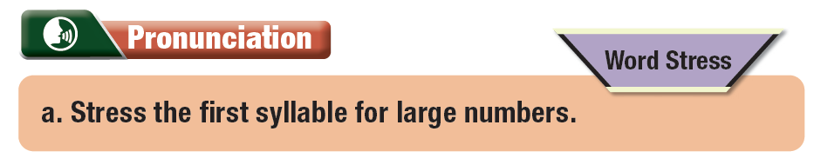

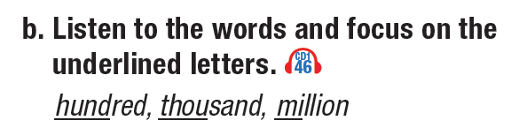
Notes:
GV click vào từng cụm nghe âm thanh

Slide 11
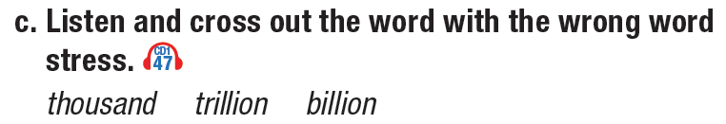
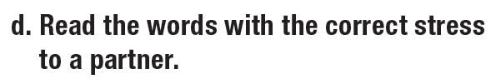

Slide 12

Speaking

Slide 13
Yes. It rose by approximately one hundred thousand hectares.
Did CO2 emissions increase from 2016 to 2017?
Did deforestation increase from 2019 to 2020?
Did CO2 emissions increase from 2016 to 2017?
 | 2016 | 2017 | 2018 | 2019 | 2020
CO2 emissions (tonnes) | 200,000 | 300,000 +100,000 | 350,000 +50,000 | 380,000 +30,000 | 500,000 +120,000
Deforestation (hectares) | 550,000 | 500,000 -50,000 | 620,000 +120,00 | 590,000 -30,000 | 700,000 +110,000

Slide 14
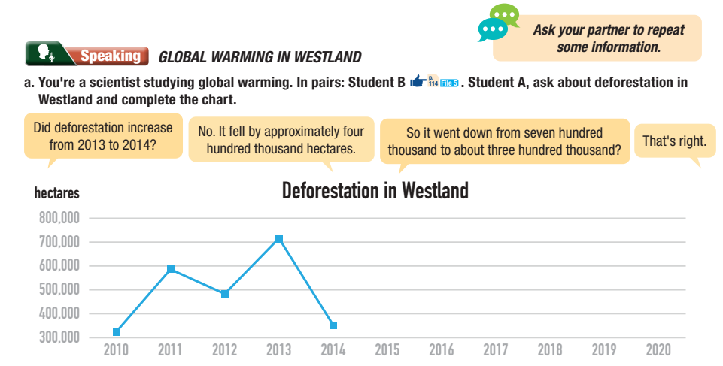
Did deforestation increase from 2013 to 2014?
No. I felt by approximately four hundred thousand hectares.
So it went down from seven hundred thousand to about three hundred thousand?
That’s right.

Slide 15
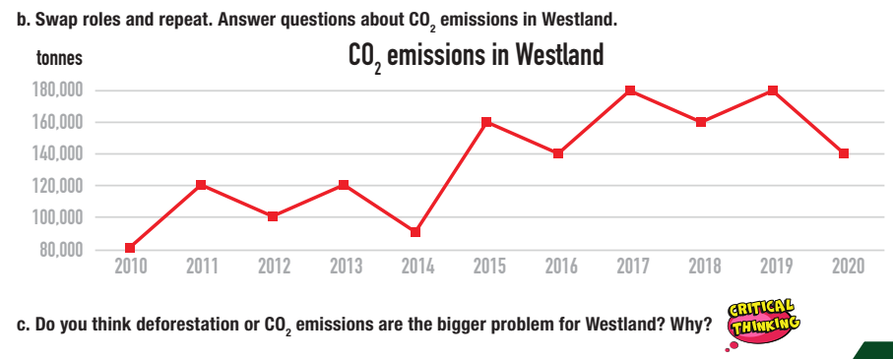

Slide 16
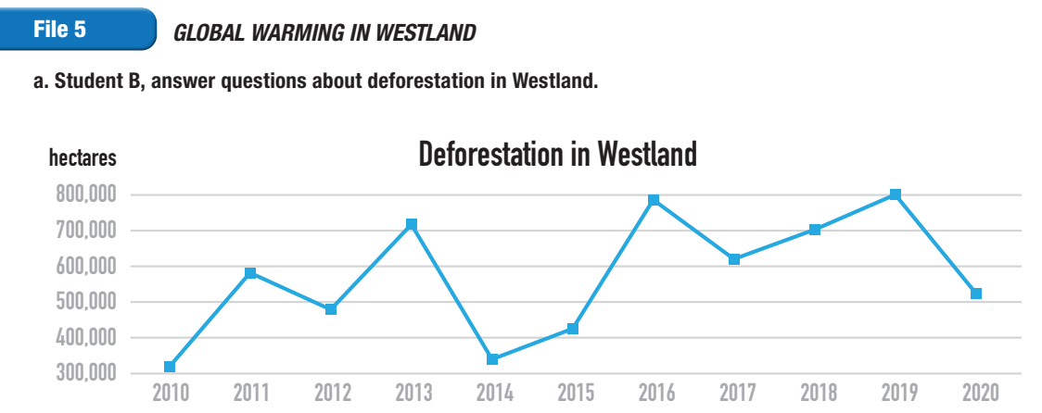
Activity File

Slide 17
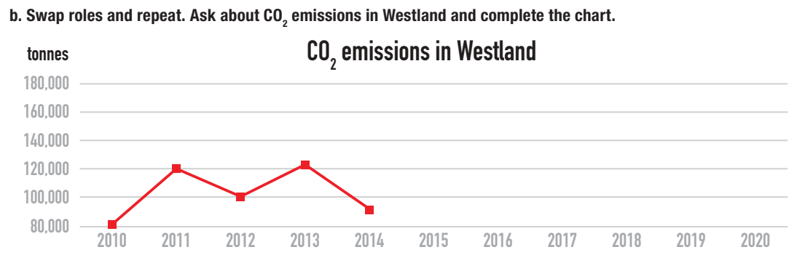

Slide 18

c. Do you think deforestation or CO2 emissions are the bigger problem for Westland? Why?

Slide 19

CONSOLIDATION

Slide 20
Look and say these numbers.
2,000
650,000
230,000
3,000,000
45,000,000
15,000,000,000
16,500,200,000

Slide 21

WRAP-UP

Slide 22
Lesson 3
Today’s lesson
- The stress of two-syllable words.
- Talking about global warming using a table.

Slide 23
Homework
Practice the pronunciation of two-syllable words.
Do the exercises on page 21 WB.
Prepare the next lesson 2.1. Vocabulary & Reading (pages 40 & 41 SB)
Play the consolidation games on www.eduhome.com.vn

Slide 24

Lesson 3
Stay positive and have a nice day!

