Slide 1

Unit 4: Global Warming
Lesson 1.2: Grammar
Pages: 37 & 38

Slide 2
Lesson Outline
Warm-up
Grammar
Consolidation
Wrap-up

Slide 3

By the end of this lesson, students will be able to…
- practice the use of prepositions of time/ duration/ amount: from … to … and by ….
- write sentences about global warming.
- talk about global warming.

Slide 4

WARM UP

Slide 5
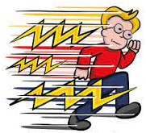
Game: Lightning fast
Play in 2 teams.
Look at the picture and say the word.
The faster group has 1 point.

Slide 6
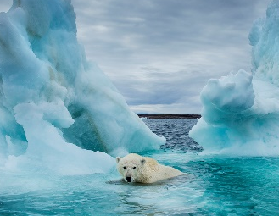
global warming

Slide 7
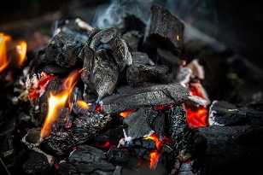
fossil fuels

Slide 8
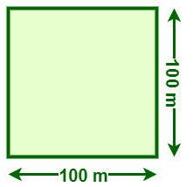
Hectare(s)

Slide 9
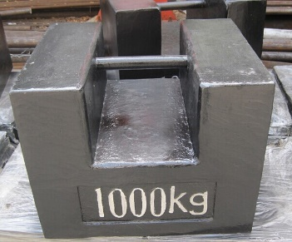
tonne

Slide 10
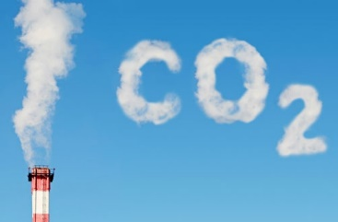
Carbon dioxide

Slide 11
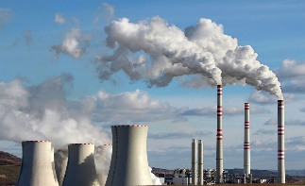
emission(s)

Slide 12

approximately

Slide 13



Slide 14

Presentation

Slide 15
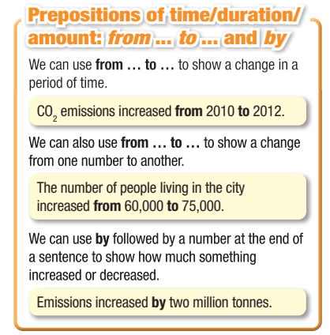

Slide 16
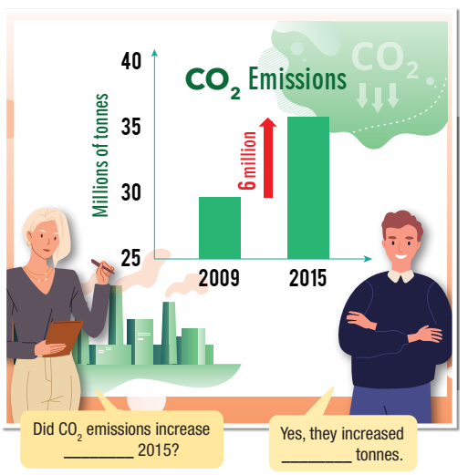
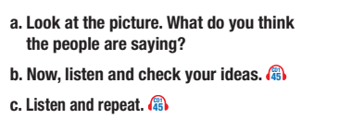

from 2009 to
by six million

Slide 17
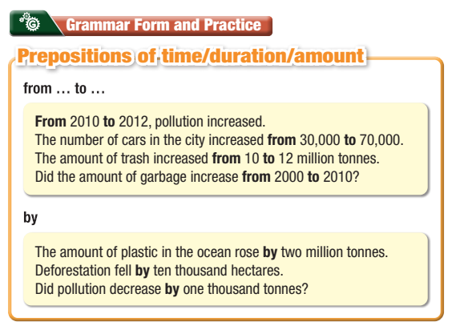

Slide 18
Practice

Slide 19
Fill in the blanks using from … to … or by…
1. _______ 1995 _______ 1997, one hundred thousand trees were cut down.
From
to
by
2. Traffic emissions in Jakarta increased _______ 10%.
3. Did emissions rise _______ 2010 _______ 2020?
from
to
by
4. Deforestation increased _______ one hundred thousand hectares from 2008 to 2010.
5. The number of cars on our streets increased _______ five million _______ six million in 1998.
from
to

Slide 20
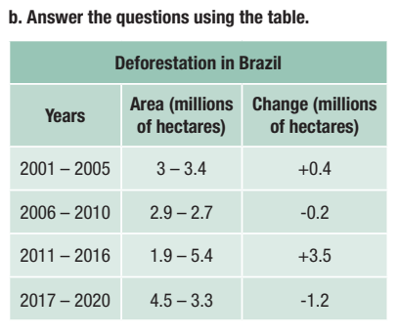

2. How much did deforestation decrease from 2006 to 2010?
It decreased by 0.2 million hectares.
3. How did the area of deforestation change from 2011 to 2016?
It increased from 1.9 to 5.4 million hectares.

Slide 21
4. How did the area of deforestation change from 2017 to 2020?
It decreased from 4.5 to 3.3 million hectares.
5. How much did deforestation decrease from 2017 to 2020?
It decreased by 1.2 million hectares.

Slide 22
Production

Slide 23

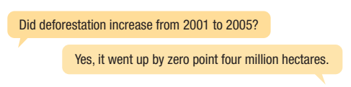


Slide 24

CONSOLIDATION

Slide 25
Workbook page 21
Grammar a. Fill in the blanks using from … to … or by.
by
1. Motorbike sales in Bigton increased ______ 20,000 in 2020.
2. Coal consumption in Bigton increased ______ 2018 ______ 2020.
from
to
3. Deforestation in Madison County decreased ______ 300 hectares in 2021.
by
4. Emissions rose ______ 100 million tonnes last year.
by
5. The number of cars increased ______ 1 million ______ 2 million in 2010.
from
to

Slide 26

WRAP-UP

Slide 27
Today’s lesson
Grammar:
Prepositions of time/duration/amount.
Practice talking about global warming.
Practice writing skills.

Slide 28
Homework
Learn the grammar points and make sentences using prepositions of time/duration/amount.
Do the exercises on page 21 WB.
Prepare the next lesson (Pronunciation & Speaking page 39 SB)
Play the consolidation games on www.eduhome.com.vn

Slide 29

Lesson 3
Stay positive and have a nice day!

